Slide 1
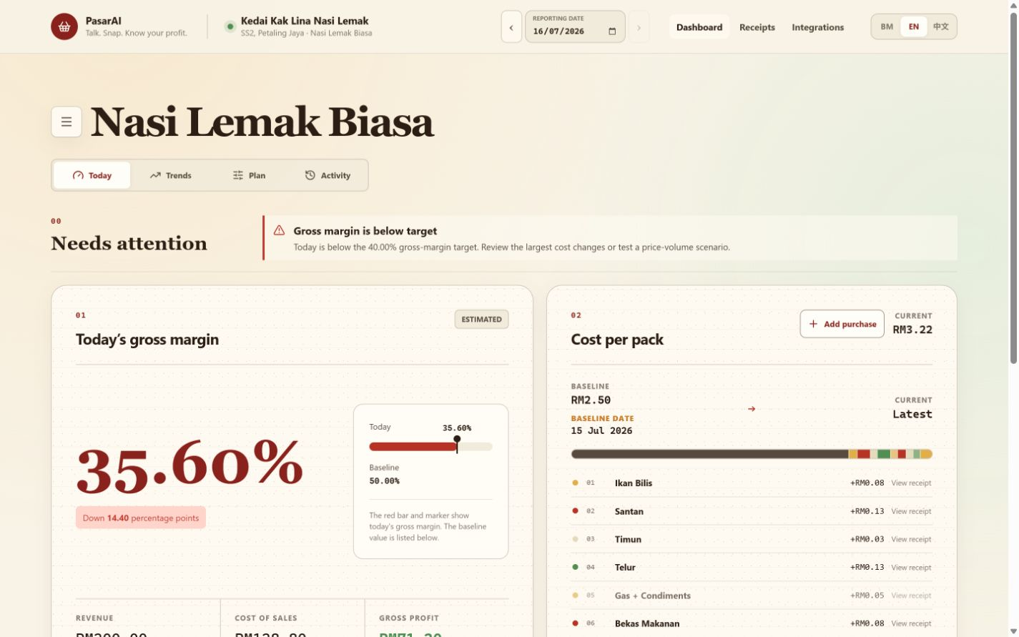
P
PASARAI
WORKING PRODUCT
MALAYSIA FIRST
PasarAI
The Zero-UI financial copilot for Malaysia's micro-vendors.
Starting with product-based traders.
PASAR MALAM
FOOD STALLS
TAILORS
HOME BAKERS
Hackathon demo deck
Notes:
Opening:
PasarAI is a zero-UI financial copilot for Malaysian micro-vendors.
Merchants speak or send receipts in the channels they already use, then get verified daily margin clarity.
The dashboard on this slide is the working product, not a design mockup.

Slide 2
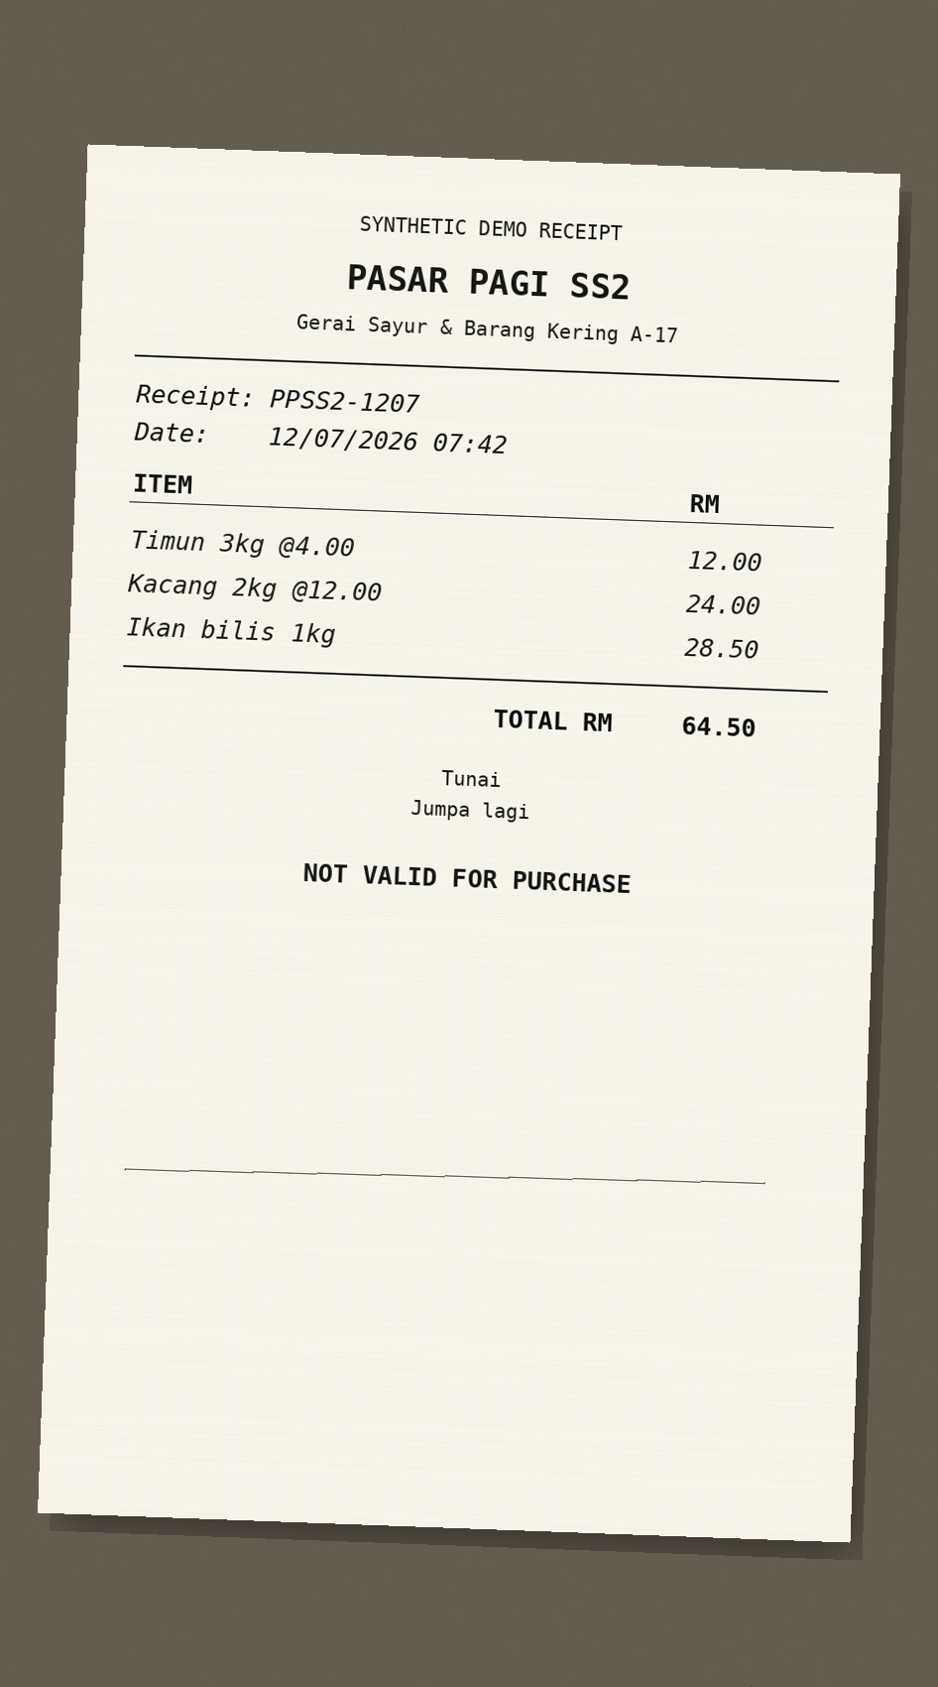
PROBLEM
Revenue is visible. Real margin isn't.
01
Cash + QR sales
What merchants know
?
RM200
02
Receipt photos
sales today
03
Voice notes
TODAY'S REAL
MARGIN
What they cannot see
04
Changing input prices
RM ?
gross profit after today's costs
ONE RECEIPT. MANY COST CHANGES.
Most micro-vendors know what they sold, not what they actually made.
PasarAI
02
Notes:
Problem framing:
Micro-vendors often have the sales number but not the daily cost-of-sales picture.
Inputs arrive as cash, QR transactions, photos, voice notes, and changing supplier prices.
The result is delayed or guessed pricing decisions, especially when ingredient or material costs move.

Slide 3
SOLUTION
Turning Voice Notes into Real-Time Margins.
PasarAI turns everyday merchant inputs into verified margin decisions.
MARGIN CONTROL
BOARD
VOICE NOTE
NEEDS CONFIRMATION
"Eggs up RM2 per tray today."
Tray size: 30 eggs?
CONFIRMED
01
CAPTURE
Natural input
RECEIPT EVIDENCE
VERIFIED
4 ingredients detected
35.60%
COST DRIVERS
02
VERIFY
Eggs
+RM0.18 / pack
Visible evidence
EGGS
FLOUR
OIL
SUGAR
PACKAGING
TODAY'S GROSS MARGIN
Oil
+RM0.06 / pack
03
DECIDE
Evidence #08 · 14:32
RM71.20 gross profit · RM200 sales
Packaging
unchanged
Margin action
RECOMMENDED NEXT MOVE
14:34 MYT · 8 evidence items · 94% confidence
Evidence-linked
and merchant-approved
Hold price
Reduce oil waste
Test RM0.50 increase
Simulate volume
Deterministic calculation v1.3
No forms. No spreadsheet setup. One verified daily answer.
PasarAI
03
Notes:
Solution framing:
This is a deck-native view of the operating experience, not a webpage screenshot.
Natural merchant inputs remain connected to receipt evidence, visible confirmation, and deterministic arithmetic.
The verified 35.60% margin is the central daily decision, with cost drivers and recommended actions around it.
The merchant gets one answer without forms or spreadsheet setup.

Slide 4
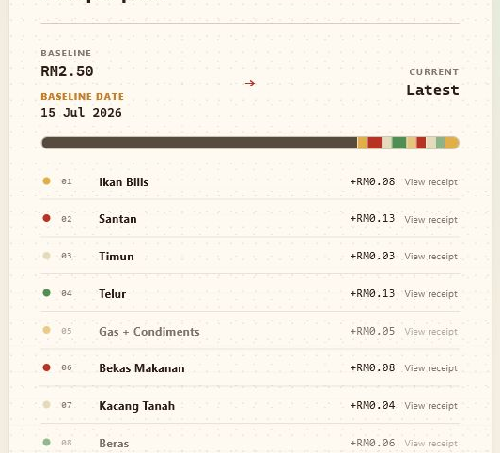
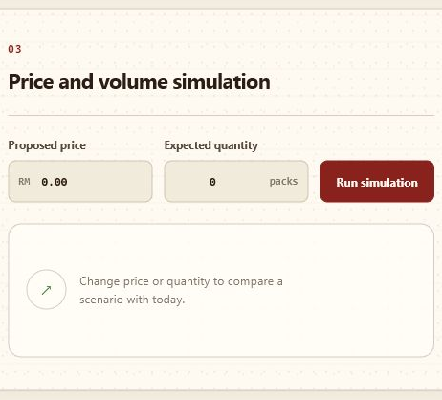

HOW IT WORKS
Five visible handoffs from input to action.
1
2
3
4
5
CAPTURE
STRUCTURE
CONFIRM
CALCULATE
ACT
EXTRACTED PURCHASE
NEEDS CONFIRMATION
Item
Eggs
What does one tray mean?
Quantity
1 tray
Unit
30 eggs
Choose the unit before margin is updated.
Price
RM15.00
30 eggs
Other
72% confidence
Voice, receipt, or purchase enters naturally.
Items, units, and prices become visible facts.
Ambiguity waits for merchant approval.
Deterministic math updates unit economics.
Scenarios turn margin into a next move.
TRUST RAIL
Natural input
→
visible ambiguity
→
merchant approval
→
deterministic math
→
explainable action
PasarAI
04
Notes:
Workflow narration:
Each stage uses a distinct crop from the working PasarAI product.
Capture accepts natural merchant input; Structure exposes extracted facts; Confirm keeps uncertainty visible.
Calculate applies deterministic business logic, and Act lets the merchant test an explainable next move.
The trust rail is the product contract: natural input, visible ambiguity, approval, math, then action.

Slide 5
ARCHITECTURE
CHANNELS
CONFIGURED
Next.js
Dashboard + BFF
Telegram bot
ElevenLabs
Live Advisor
Google Sheets
AI ADAPTERS
RUNTIME CORE
OPERATIONAL STATE
NODE.JS API
IMMUTABLE
EVIDENCE FILES
ElevenLabs
Scribe v2
Qwen /
DashScope
Deterministic business service
voice only
interpretation
Validation · margin math · scenarios · output routing
LAKEBASE
Operational Postgres
TRIGGERED ANALYTICS LOOP
LAKEBASE
JDBC SNAPSHOT
DELTA / LAKEFLOW
FORECAST NOTEBOOK
BACK TO
LAKEBASE
Outputs return through Node API
Databricks
BRONZE
SILVER
GOLD
publish forecasts
BUILD WORKFLOW — NON-RUNTIME
SOURCE
TESTS
DEPLOYMENT
No live data path
Codex
05
Notes:
Architecture narration:
Node.js is the single runtime hub and owns deterministic business logic plus every output path.
Next.js and Google Sheets connect directly; voice input alone uses Scribe, while Qwen supports interpretation.
Immutable evidence files and Lakebase operational Postgres remain separate responsibilities.
Databricks runs only when triggered: JDBC snapshot, Delta and Lakeflow Bronze-Silver-Gold, forecast notebook, then forecasts return to Lakebase.
Codex belongs only to the build workflow and has no live data path.

Slide 6
MARKET
A focused Malaysian market, with room to scale.
TAM / SAM / SOM
PREDICTED SME SOFTWARE GROWTH
8.2%
MALAYSIA
767K
CAGR through 2030
TAM
Market index (2025 = 100)
3 STATES
148
3-YEAR
~377K
137
SAM
126
3.8K
117
SOM
108
100
SAM is a planning estimate using establishment concentration as a proxy.
2025
2026
2027
2028
2029
2030
Sources: DOSM Economic Census 2023; APEC / SME Corp Malaysia MSME composition; ResearchAndMarkets SEA SME Software Forecast to 2030.
PasarAI
06
Notes:
Market narration:
We are not claiming every microenterprise on day one.
The beachhead is product-based micro-vendors in the three densest commercial markets.
SAM is explicitly a planning estimate and should be refined with sector-level DOSM counts.
The SOM target is 3,800 active merchants in three years, approximately one percent of the planning-estimate SAM.

Slide 7
GO-TO-MARKET
Start with a concentrated merchant wedge, prove weekly habit, then scale through trusted partners.
01
02
03
BEACHHEAD
DISTRIBUTION
EXPANSION
Ideal first customer: a product-based merchant in a dense Klang Valley cluster.
Turn a weekly margin habit into cohorts delivered by institutions merchants already trust.
Reuse the operating habit across sectors, markets, and sponsored partner programmes.
Pasar malam + stalls
Organisers + councils
Sector templates
Guided setup
Associations + wholesalers
Merchant referrals
First verified margin
14-DAY MARGIN
CHALLENGE
Banks + referrals
Partner cohorts
setup → first margin → weekly habit
OPERATING LOOP
REFERRALS
PARTNER COHORTS
20 MERCHANTS
WEEKLY HABIT
1 MARKET
TARGETS
ACTIVATION RATE
WEEKLY RETAINED
VERIFIED ENTRIES
REFERRAL RATE
setup → first verified margin
merchants returning each week
per merchant per week
new merchants from trust loops
PasarAI
07
Notes:
GTM narration:
The first wedge is a product-based merchant in a dense Klang Valley cluster, with guided setup and a first verified margin.
The 14-Day Margin Challenge bridges beachhead proof into weekly habit and partner-ready evidence.
Distribution comes through organisers, councils, associations, wholesalers, banks, and merchant referrals.
The operating loop is one market, twenty merchants, weekly habit, referrals, then repeatable partner cohorts.
The KPI rail is explicitly a target set, not current traction.

Slide 8
OPTIONAL SLIDE
A simple model merchants can understand.
FREE
PRO
PARTNER
RM0
RM29
CUSTOM
/ month
1
Manual capture
1
Voice + photo capture
1
Sponsored cohorts
2
Daily gross margin
2
Scenarios + trends
2
Programme reporting
3
7-day history
3
Forecasts + exports
3
Co-branded onboarding
NO TRANSACTION FEE
NO SALE OF MERCHANT DATA
Later: opt-in supplier, financing, and insurance referrals.
Pricing benchmark: Bukku Seed RM35/month; StoreHub Starter from RM122/month.
PasarAI
08
Notes:
Business-model narration:
This slide is optional because pricing still needs direct pilot validation.
RM29 per month is intentionally below entry accounting and POS benchmarks.
Partner-sponsored cohorts can fund distribution while keeping the merchant entry price low.
PasarAI should not take a transaction fee or sell merchant data.

Slide 9
APPENDIX Q&A
How is this different from Touch 'n Go or financial calculators?
They track transactions. PasarAI explains margin.
PAYMENT / FINANCE APPS
PASARAI
"What came in?"
"What did I actually make?"
01
Transaction history
01
Cash + digital + voice + receipts
02
Spend summaries
02
Evidence-backed cost of sales
03
Static calculators
03
Verified margin and scenarios
04
Usually tied to app or payment data
04
Payment-agnostic operating layer
NOT ANOTHER WALLET
A daily operating decision layer that can sit above any payment method.
PasarAI | Appendix
09
Notes:
Recommended answer:
Touch 'n Go and similar apps are valuable for payments, transaction visibility, and merchant tools.
PasarAI is payment-agnostic and focuses on a different question: after today's changing input costs, what did the merchant actually make?
It combines cash and digital activity with voice notes and receipts, then produces an evidence-backed gross-margin decision.

Slide 10
APPENDIX Q&A
The judge questions we are ready for.
Q1
How accurate is the AI?
Q2
Is gross margin the same as profit?
AI interprets. A deterministic engine calculates. Ambiguity requires confirmation.
No. PasarAI labels gross margin clearly; overheads stay excluded unless configured.
Q3
Can merchants trust the forecast?
Q4
Can this scale beyond Telegram?
Forecasts appear only when data sufficiency and accuracy gates pass.
Yes. Channel adapters share the same contracts, evidence, and finance engine.
MOAT
Localized merchant ontology + evidence-linked history + multilingual confirmation data + partner distribution.
PasarAI | Appendix
10
Notes:
Additional answers:
Privacy: use merchant-scoped authentication, encrypted integration tokens, append-only audit history, and production PDPA controls.
Outage handling: evidence is retained and uncertain interpretations stay in review rather than silently writing financial facts.
Non-food use: the architecture is reusable for any product or component-based micro-business; the current demo is strongest for food vendors.
Moat: the compound dataset is not generic chat. It is localized, evidence-linked merchant operations data with confirmations and outcomes.

