Slide 1
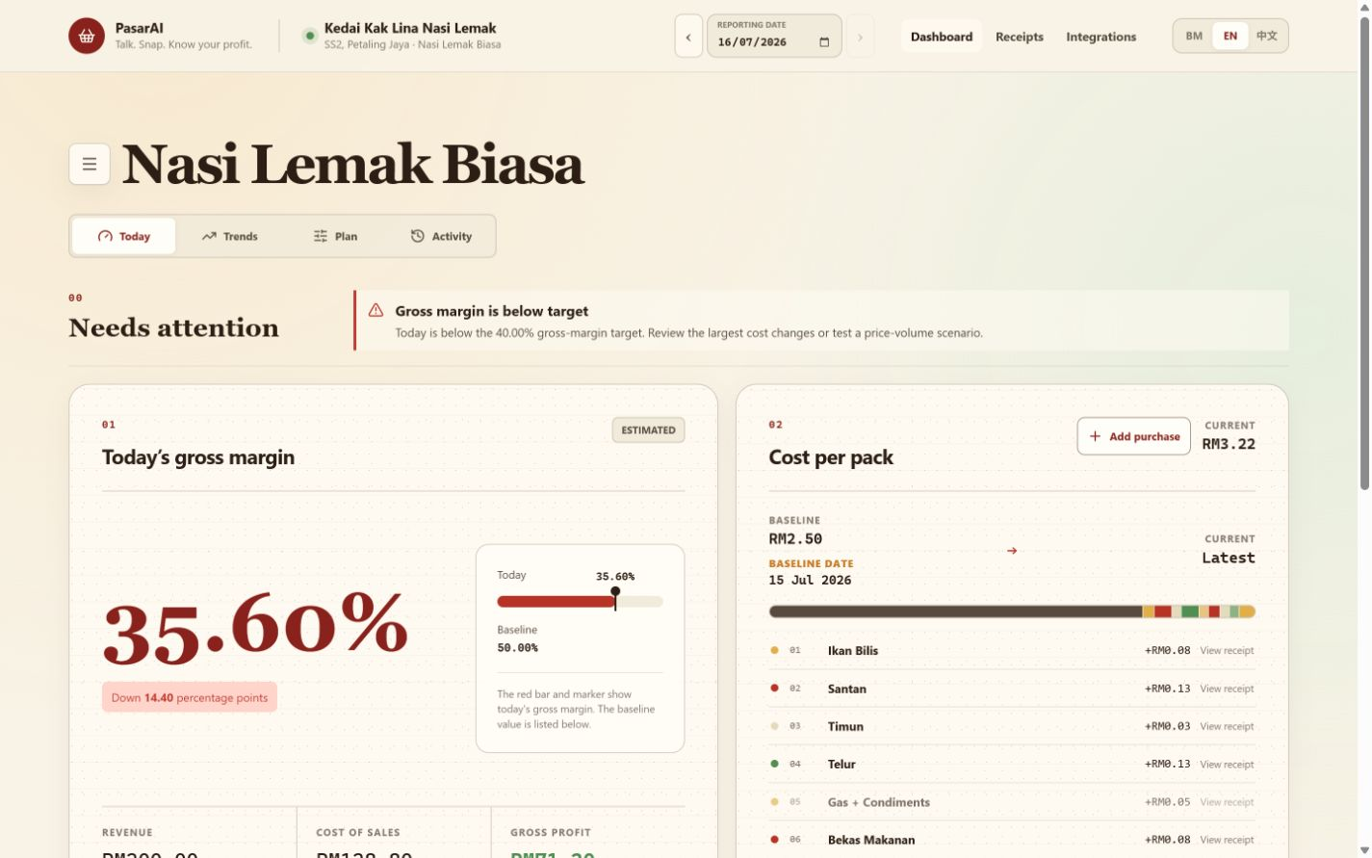
P
PASARAI
WORKING PRODUCT
MALAYSIA FIRST
PasarAI
The Zero-UI financial copilot for Malaysia's micro-vendors.
Starting with product-based traders.
PASAR MALAM
FOOD STALLS
TAILORS
HOME BAKERS
Hackathon demo deck
Notes:
Opening:
PasarAI is a zero-UI financial copilot for Malaysian micro-vendors.
Merchants speak or send receipts in the channels they already use, then get verified daily margin clarity.
The dashboard on this slide is the working product, not a design mockup.

Slide 2
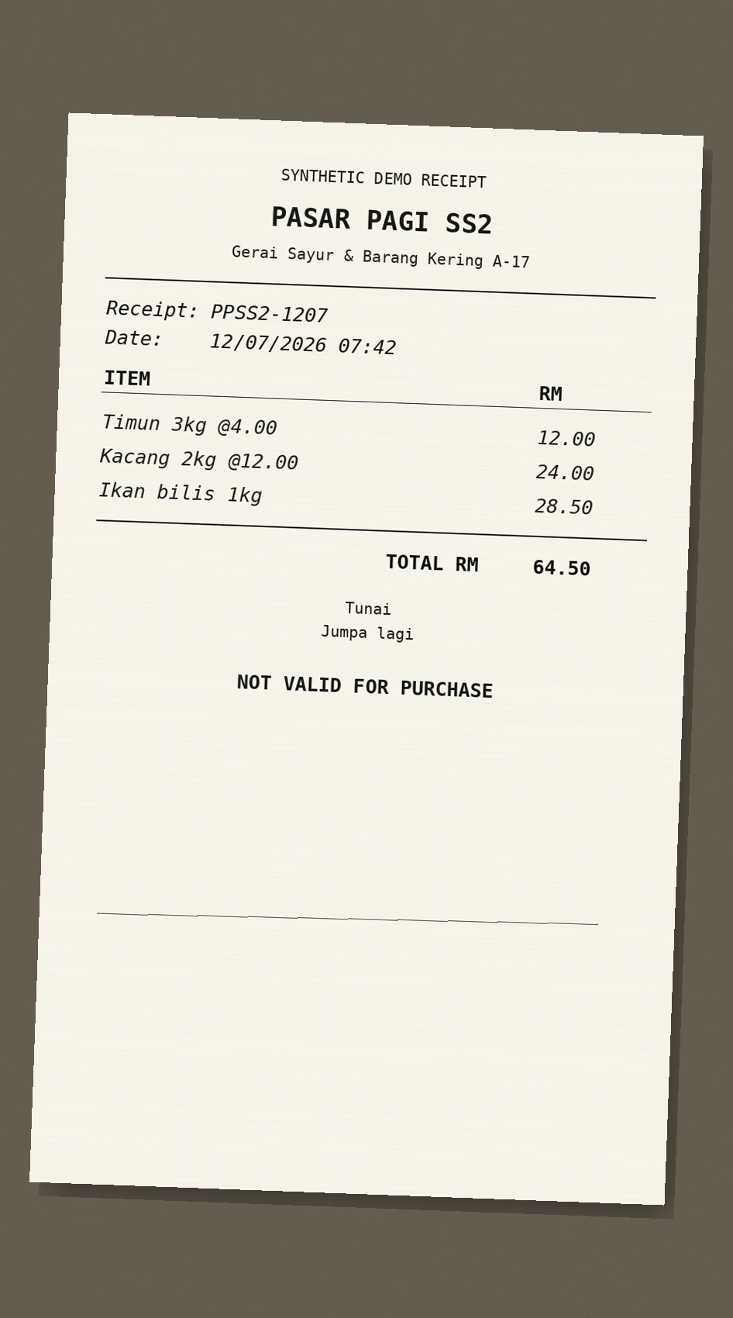
PROBLEM
Revenue is visible. Real margin isn't.
01
Cash + QR sales
What merchants know
?
RM200
02
Receipt photos
sales today
03
Voice notes
TODAY'S REAL
MARGIN
What they cannot see
04
Changing input prices
RM ?
gross profit after today's costs
ONE RECEIPT. MANY COST CHANGES.
Most micro-vendors know what they sold, not what they actually made.
PasarAI
02
Notes:
Problem framing:
Micro-vendors often have the sales number but not the daily cost-of-sales picture.
Inputs arrive as cash, QR transactions, photos, voice notes, and changing supplier prices.
The result is delayed or guessed pricing decisions, especially when ingredient or material costs move.

Slide 3
SOLUTION
Turning Voice Notes into Real-Time Margins.
01
CAPTURE
VOICE NOTE
RECEIPT
CONFIRMED
Voice, Telegram, receipts, and cash purchases.
02
VERIFY
AI structures the input and asks for confirmation.
03
DECIDE
See margin, cost drivers, scenarios, and forecasts.
35.60% GROSS MARGIN
Zero new forms. Zero spreadsheet setup. One verified daily answer.
PasarAI
03
Notes:
Solution framing:
The user does not need to learn accounting software or maintain a new spreadsheet.
PasarAI captures natural inputs, verifies ambiguity, then calculates using deterministic finance logic.
The key distinction from a calculator is the evidence-linked workflow and the continuous daily operating view.

Slide 4
HOW IT WORKS
From voice note to decision in five steps.
1
2
3
4
5
SPEAK / SNAP / LOG
AI STRUCTURES
MERCHANT CONFIRMS
MARGIN ENGINE
RECOMMEND
Natural merchant input
Item, quantity, unit, price
Ambiguity stays visible
Deterministic calculation
Act on price, cost, volume
REAL EXAMPLE
"Egg price increased RM2 per tray."
CONFIRM
RECALCULATE
UPDATE
SUGGEST
tray size
cost per pack
gross margin
price / volume
PasarAI
04
Notes:
Demo narration:
A merchant sends a voice note or receipt.
The AI extracts structured facts, but it does not silently guess ambiguous units.
After confirmation, the deterministic engine recalculates cost per pack and gross margin.
The merchant receives a recommendation in the same channel and can inspect the evidence on the dashboard.

Slide 5
ARCHITECTURE
CHANNELS
INGRESS + AI
CORE
ANALYTICS + OUTPUT
WEB DASHBOARD
NEXT.JS BFF
PUBLIC NODE API
LAKEBASE SNAPSHOT
TELEGRAM
WEBHOOKS + SYNC
DETERMINISTIC FINANCE ENGINE
BRONZE
SILVER
GOLD
ELEVENLABS AGENT
SCRIBE TRANSCRIPTION
IMMUTABLE EVIDENCE STORE
GOOGLE SHEETS
QWEN INTERPRETER
FORECAST PUBLISHER
LAKEBASE APPEND-ONLY LEDGER
VALIDATION + CONFIRMATION
DASHBOARD + SCENARIOS
TELEGRAM REPLIES
SHEETS SYNC
EVIDENCE + AUDIT
BUILT WITH
NEXT.JS
NODE.JS
TELEGRAM
ELEVENLABS
QWEN
GOOGLE SHEETS
DATABRICKS
LAKEBASE
CODEX
05
Notes:
Architecture narration:
Channels stay thin; the shared contracts and deterministic engine sit behind them.
AI interprets and validates inputs, while the finance engine owns arithmetic.
Evidence and ledger writes are append-only for traceability.
Databricks publishes trusted analytics and forecasts back into the operational layer.
Codex was part of the build workflow, not a runtime dependency.

Slide 6
MARKET
A focused Malaysian market, with room to scale.
TAM / SAM / SOM
PREDICTED SME SOFTWARE GROWTH
8.2%
MALAYSIA
767K
CAGR through 2030
TAM
Market index (2025 = 100)
3 STATES
148
3-YEAR
~377K
137
SAM
126
3.8K
117
SOM
108
100
SAM is a planning estimate using establishment concentration as a proxy.
2025
2026
2027
2028
2029
2030
Sources: DOSM Economic Census 2023; APEC / SME Corp Malaysia MSME composition; ResearchAndMarkets SEA SME Software Forecast to 2030.
PasarAI
06
Notes:
Market narration:
We are not claiming every microenterprise on day one.
The beachhead is product-based micro-vendors in the three densest commercial markets.
SAM is explicitly a planning estimate and should be refined with sector-level DOSM counts.
The SOM target is 3,800 active merchants in three years, approximately one percent of the planning-estimate SAM.

Slide 7
GO-TO-MARKET
Win market by market.
01
02
03
BEACHHEAD
DISTRIBUTION
EXPANSION
Food and product-based micro-vendors in Klang Valley.
Market organisers, councils, associations, wholesalers, banks.
Sector templates for bakers, retailers, tailors, and home businesses.
14-DAY MARGIN CHALLENGE
1 MARKET
20 MERCHANTS
WEEKLY USE
REFERRALS
PARTNER COHORTS
local proof
guided onboarding
measured habit
merchant-led trust
repeatable scale
PasarAI
07
Notes:
GTM narration:
Trust is local, so the rollout begins in dense merchant communities rather than broad paid acquisition.
The 14-Day Margin Challenge creates a repeatable onboarding and proof loop.
Partners reduce customer acquisition cost and can sponsor cohorts as a merchant-enablement programme.
Expansion comes through reusable sector templates, not a different product for every trade.

Slide 8
OPTIONAL SLIDE
A simple model merchants can understand.
FREE
PRO
PARTNER
RM0
RM29
CUSTOM
/ month
1
Manual capture
1
Voice + photo capture
1
Sponsored cohorts
2
Daily gross margin
2
Scenarios + trends
2
Programme reporting
3
7-day history
3
Forecasts + exports
3
Co-branded onboarding
NO TRANSACTION FEE
NO SALE OF MERCHANT DATA
Later: opt-in supplier, financing, and insurance referrals.
Pricing benchmark: Bukku Seed RM35/month; StoreHub Starter from RM122/month.
PasarAI
08
Notes:
Business-model narration:
This slide is optional because pricing still needs direct pilot validation.
RM29 per month is intentionally below entry accounting and POS benchmarks.
Partner-sponsored cohorts can fund distribution while keeping the merchant entry price low.
PasarAI should not take a transaction fee or sell merchant data.

Slide 9
APPENDIX Q&A
How is this different from Touch 'n Go or financial calculators?
They track transactions. PasarAI explains margin.
PAYMENT / FINANCE APPS
PASARAI
"What came in?"
"What did I actually make?"
01
Transaction history
01
Cash + digital + voice + receipts
02
Spend summaries
02
Evidence-backed cost of sales
03
Static calculators
03
Verified margin and scenarios
04
Usually tied to app or payment data
04
Payment-agnostic operating layer
NOT ANOTHER WALLET
A daily operating decision layer that can sit above any payment method.
PasarAI | Appendix
09
Notes:
Recommended answer:
Touch 'n Go and similar apps are valuable for payments, transaction visibility, and merchant tools.
PasarAI is payment-agnostic and focuses on a different question: after today's changing input costs, what did the merchant actually make?
It combines cash and digital activity with voice notes and receipts, then produces an evidence-backed gross-margin decision.

Slide 10
APPENDIX Q&A
The judge questions we are ready for.
Q1
How accurate is the AI?
Q2
Is gross margin the same as profit?
AI interprets. A deterministic engine calculates. Ambiguity requires confirmation.
No. PasarAI labels gross margin clearly; overheads stay excluded unless configured.
Q3
Can merchants trust the forecast?
Q4
Can this scale beyond Telegram?
Forecasts appear only when data sufficiency and accuracy gates pass.
Yes. Channel adapters share the same contracts, evidence, and finance engine.
MOAT
Localized merchant ontology + evidence-linked history + multilingual confirmation data + partner distribution.
PasarAI | Appendix
10
Notes:
Additional answers:
Privacy: use merchant-scoped authentication, encrypted integration tokens, append-only audit history, and production PDPA controls.
Outage handling: evidence is retained and uncertain interpretations stay in review rather than silently writing financial facts.
Non-food use: the architecture is reusable for any product or component-based micro-business; the current demo is strongest for food vendors.
Moat: the compound dataset is not generic chat. It is localized, evidence-linked merchant operations data with confirmations and outcomes.

