Slide 1
Java SE 7
Module 3
Inner Classes & Exception Handling
Paweł Beder

Slide 2
Materials
https://github.com/kinder112/java7m3
Smart Bridgit: http://ptc-bridgit.luxoft.com/

Slide 3
Contents
Inner class
Static inner class
Anonymous and local inner classes
Exception handling

Slide 4
9 - 12 Inner classes (break at 10:30)
12 - 13 Launch
13 - 14 Exercise 1&2 (break at end)
15 - 16 Exceptions
16 - 17 Excersise 3

Slide 5
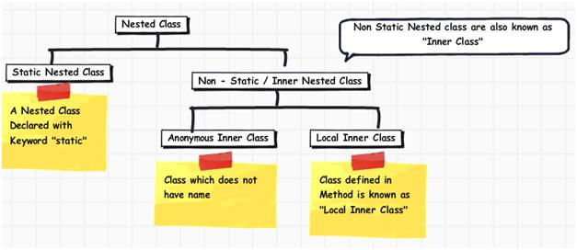
http://www.jitendrazaa.com

Slide 6
Inner class
You can declare a class in any block including blocks that are part of a method.

Slide 7

Inner class
public class Dog { private boolean isAngry; public void bark() { if (isAngry) { class SecretPartOfTheBrain { private String theThoughts = "No, barking is not enough this time..."; public void action() { // ... } } new SecretPartOfTheBrain().action(); } } }
Notes:
This slide used to demonstrate idea that you can put new class declaration anywhere in the code.

Slide 8
Inner class
After compilation, a separate file created with the name generated according to the next template:
OuterClassName$InnerClassName.class
The full name of the inner class will look like this:
packageName.OuterClassName.InnerClassName

Slide 9


Inner class
Inner classes can only be instantiated through an outer class instance.
public class Outer { public class Inner {} public static void main(String[] args) { Inner instance = new Outer().new Inner(); } }
Can be public, private, protected or with default access.

Slide 10
Inner class
Inner classes instance has access to all the data of enclosing type including private.
public class Outer { private int data; class Inner { public int calculate() { return (data + data) * 2; } } }

Slide 11
Inner class
Why do we need a class like that?

Slide 12
private inner class
Sometimes we need data structures that are very important inside the class but meaningless outside it.
Notes:
Here we are using simple LIST implementation idea to demonstrate how to use every type of inner classes.
This example contains private inner class without enclosing type access. (It is basically wrong choice!!! private static will be the right choice and we will demonstrate it later.)

Slide 13
public inner class
Sometimes we need a data structure that provides controllable access to the instance private data.
Notes:
Here we add public class Iterator and it is a perfect choice for public inner class.
—
Here we are using simple LIST implementation idea to demonstrate how to use every type of inner classes.
—

Slide 14
static inner class
Sometimes we need independent internal data structure that can be accessed from the outer world.
Notes:
Here we update Node class to public static that converts it right choise (i0private wrong one). (This technique is used for HashMap.EntrySet and allows us to iterate over entries, it works very well when we need to iterate over all map).
—
Here we are using simple LIST implementation idea to demonstrate how to use every type of inner classes.
—

Slide 15
static inner class
Inner class can be declared as static.
A static nested class cannot use the this keyword to access outer object attributes.
Yet, it can request static variables and static outer class methods.

Slide 16
Local inner class
Also, there is an option, that maybe nobody will find the place where to implement.
Notes:
This type of syntax gives us an ability to create anonymous classes.
I believe we should tell people never use this syntax, at least until they become senior to make own decisions.
I can’t imagine where we can use this type of class, Oracle docs also provide pretty stupid and wrong idea just for syntax demo.

Slide 17
Local inner class
Anything declared within a method is not a class member.
Local objects cannot have access modifiers and cannot be declared as static.

Slide 18
Anonymous inner class
Sometimes we need an instance of the interface…
Notes:
Classic example with Comparator.

Slide 19
Anonymous inner class
You can declare an inner class within the body of a method without naming it.
Can be declared as extension to another class or as an interface implementation.
A constructor cannot be defined for an anonymous class.
The superclass constructor can be called.

Slide 20
Anonymous inner class
Practical when you do not want to use trivial names for classes.
The class code contains several lines.
When compiling an anonymous class, a separate class named EnclosingClassName$n is created, where n is an anonymous class order number in the outer class.

Slide 21
Anonymous inner class
For local and anonymous classes you can only access outer variables if they are declared as final.
public static void print(String data, int times) { final String fData = data; for (int i = 0; i < times; i++) { new Thread(new Runnable() { @Override public void run() { System.out.println(fData); } }).start(); } }
Notes:
Since we create new class (new Runnable…) and instantiate it java should have an ability to read the data from outer variable fData. Only one available option now is copy that variable and put it to created class. Also it is required that both variables contains same data or point to the same object in memory and that is why java force us to make it final.
Since version 8, java smart enough to detect the updates of outer variable and allow not final variables if it’s the value will newer change. This variable calles effectively final.

Slide 22
Inner classes
public interface Pet { String getName(); void beFriendly(); }
public class Cat implements Pet { private String name; public Cat(String name) { this.name = name; } public String getName()
{
return name;
} public void beFriendly() { System.out.println(name + ": I'm friendly!"); } }
List<Pet> pets = new ArrayList<>();
// create anonymous class inherited from Cat pets.add(new Cat("Tiger") { public String getName() { return ""; } public void beFriendly() { System.out.println("I'm Tiger, not friendly!"); } }); // adding Pet interface implementation pets.add(new Pet() { public String getName() { return "I'm a Pet"; } public void beFriendly() { } });

Slide 23
Inner classes
pets.add(new RoboDog("Robik")); // create inner class pets.add(new SpecialRoboDog()); // create anonymous class inherited from RoboDog pets.add(new RoboDog() { public void beFriendly() { System.out.println(getName() + ": I'm more friendly then everyone else!"); } });
// ask all pets to be friendly for (Pet pet : pets) { pet.beFriendly(); }
public class RoboDog extends Robot
implements Pet { private String name; public RoboDog() { this("Noname Robodog"); } @Override public String getName() { return name; } @Override public void beFriendly() { System.out.println(name
+ ": I'm friendly!"); } }
static class SpecialRoboDog extends RoboDog { public void beFriendly() { System.out.println(getName() + ": I'm very special for you!"); } }

Slide 24
Why Use Nested Classes?
Logical grouping of classes - If a class is useful to only one other class, then it is logical to embed it in that class and keep the two together. Nesting such “helper classes” makes their package more streamlined.
Increased encapsulation - Consider two top-level classes, A and B, where B needs access to members of A that would otherwise be declared private. By hiding class B within class A, A’s members can be declared private and B can access them. In addition, B itself can be hidden from the outside world.
More readable, maintainable code - Nesting small classes within top-level classes places the code closer to where it is used.

Slide 25
Inner classes and Java 8
For local and anonymous classes you can only access outer variables if they are effectively final (not final, but never changed).
public static void print(String data, int times) { for (int i = 0; i < times; i++) { new Thread(new Runnable() { @Override public void run() { System.out.println(data); } }).start(); } }
Notes:
Since we create new class (new Runnable…) and instantiate it java should have an ability to read the data from outer variable fData. Only one available option now is copy that variable and put it to created class. Also it is required that both variables contains same data or point to the same object in memory and that is why java force us to make it final.
Since version 8, java smart enough to detect the updates of outer variable and allow not final variables if it’s the value will newer change. This variable calles effectively final.

Slide 26
Inner classes and Java 8
An anonymous class can be replaced with a lambda expression.
public static void print(String data, int times) { for (int i = 0; i < times; i++) { new Thread(() -> System.out.println(data)).start(); } }
Note: lambda expression is a new dynamic type in Java.
Notes:
Show that lambda expression do not create new .class file like anonymous class do.

Slide 27
Inner Classes
Exercise 1 – Dog
Exercise 2 – Bank Application (Inner Classes)

Slide 28
Contents
Inner class
Static inner class
Anonymous and local inner classes
Exception handling

Slide 29
Unsafe Code
Something may go wrong. We must be ready for that. How to control it?
Option #1 Use error code and if blocks:
Method must return:
1. Result of the execution
2. Success status
FileManager manager = new DefaultFileManager(); boolean opened = manager.openFile(); if (opened) { if (manager.readFile()) { //... if (!manager.closeFile()) { System.out.println("Can't close the file."); } } else { System.out.println("Can't read from file."); } } else { System.out.println("Can't open the file."); }
Application logic is mixed with the exception handling => we get a messy code.

Slide 30
Unsafe Code: use exceptions
Option #2 Let FileManager methods may throw exceptions:
public interface FileManager { boolean openFile() throws FileNotFoundException;
boolean readFile() throws IOException;
boolean closeFile() throws FileCloseException; }

Slide 31
Unsafe Code: use exceptions
Option #2 Let FileManager methods may throw exceptions:
FileManager manager = new DefaultFileManager(); try { manager.openFile(); manager.readFile(); manager.closeFile(); } catch (FileNotFoundException e) { System.out.println("Can't open the file."); } catch (IOException e) { System.out.println("Can't read from file."); } catch (FileCloseException e) { System.out.println("Can't close the file."); }
Safe block
Exception handlers
Advantages:
We can concentrate on code and do not think about exceptions.
Handling of all unsafe situations is placed to the single block.

Slide 32
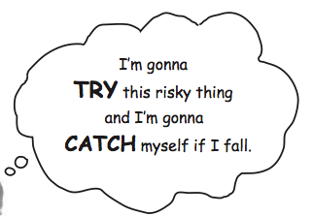
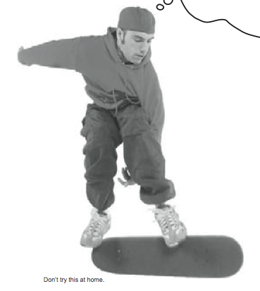
Exception - is an object of type… Exception
try { // do risky thing } catch (Exception e) { // try to recover }
How to recover?
If the server does not respond, you can use catch block to try again or connect to another server.
If file is not found, you can ask user to help to find it.
If you cannot fix it, you should inform user/admin/developer about it.

Slide 33
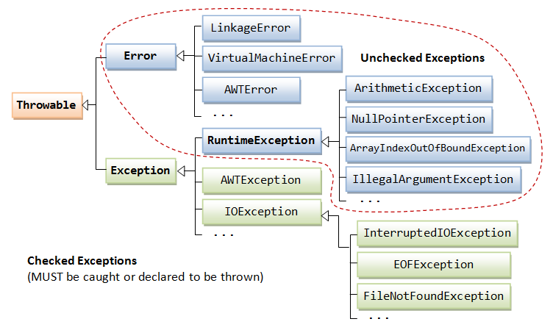
Exception hierarchy
https://www.ntu.edu.sg/home/ehchua/programming/java/J5a_ExceptionAssert.html

Slide 34
Exception is a class
public class PersonNotFoundException extends RuntimeException { }
And we can use it this way:
Person person = personsHolder.find(name); if (person == null) { throw new PersonNotFoundException(); } return person;
Now code to work with person will be like this:
try { Person person = findPerson("John Smith"); person.sendMessage("Hello John"); } catch (PersonNotFoundException e) { System.out.println("Person not found."); }

Slide 35
Exception with parameters
public class PersonNotFoundException extends RuntimeException { private String name; public String getName() { return name; } public void setName(String name) { this.name = name; } }
try { Person person = findPerson("John Smith"); person.sendMessage("Hello John"); } catch (PersonNotFoundException e) { System.out.println("Person " + e.getName() + " not found."); }

Slide 36
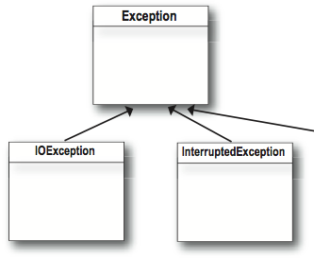
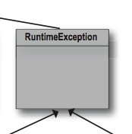
The compiler checks for everything except RuntimeException and Error
Standard unchecked exceptions
ClassCastException
NullPointerException
ArrayIndexOutOfBoundsException
ArithmeticException
RuntimeError
Notes:
Here you can open these classes in IDE and show the exceptions, also you can just write simple demo it would be nice place to change the angle of perception.

Slide 37
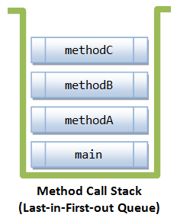
Call stack and the Exceptions
Enter main()
Enter methodA()
Enter methodB()
Enter methodC()
Exit methodC()
Exit methodB()
Exit methodA()
Exit main()
public class MethodCallStackDemo { public static void main(String[] args) { methodA(); } public static void methodA() { methodB(); } public static void methodB() { methodC(); } public static void methodC() { } }

Slide 38
Call stack and the Exceptions
public static void methodC() { System.out.println(1 / 0); // this line triggers an ArithmeticException }
Enter main()
Enter methodA()
Enter methodB()
Enter methodC()
Exception in thread "main" java.lang.ArithmeticException: / by zero
at MethodCallStackDemo.methodC(MethodCallStackDemo.java:22)
at MethodCallStackDemo.methodB(MethodCallStackDemo.java:16)
at MethodCallStackDemo.methodA(MethodCallStackDemo.java:10)
at MethodCallStackDemo.main(MethodCallStackDemo.java:4)
This is a execution stack or call stack.
This is a default behavior of exception.printStackTrace()

Slide 39
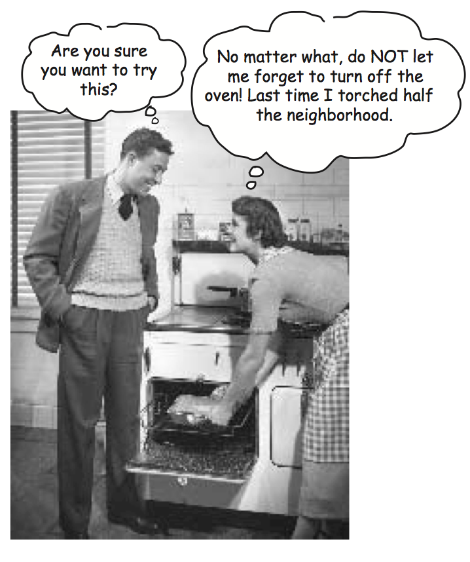
Finally: for the things you want to do no matter what
try { turnOvenOn(); x.bake(); } catch (Exception e) { e.printStackTrace(); }
finally { turnOvenOff(); }
If try block fails
control immediately moves to catch {}
finally {} block runs
try block succeeds (no exception)?
finally {} block runs
try or catch has return?
finally {} block runs anyway!

Slide 40
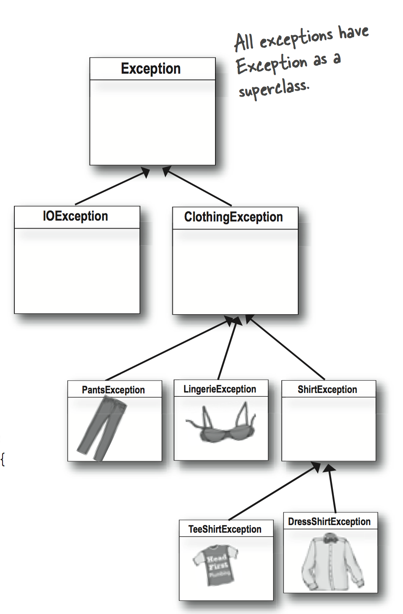
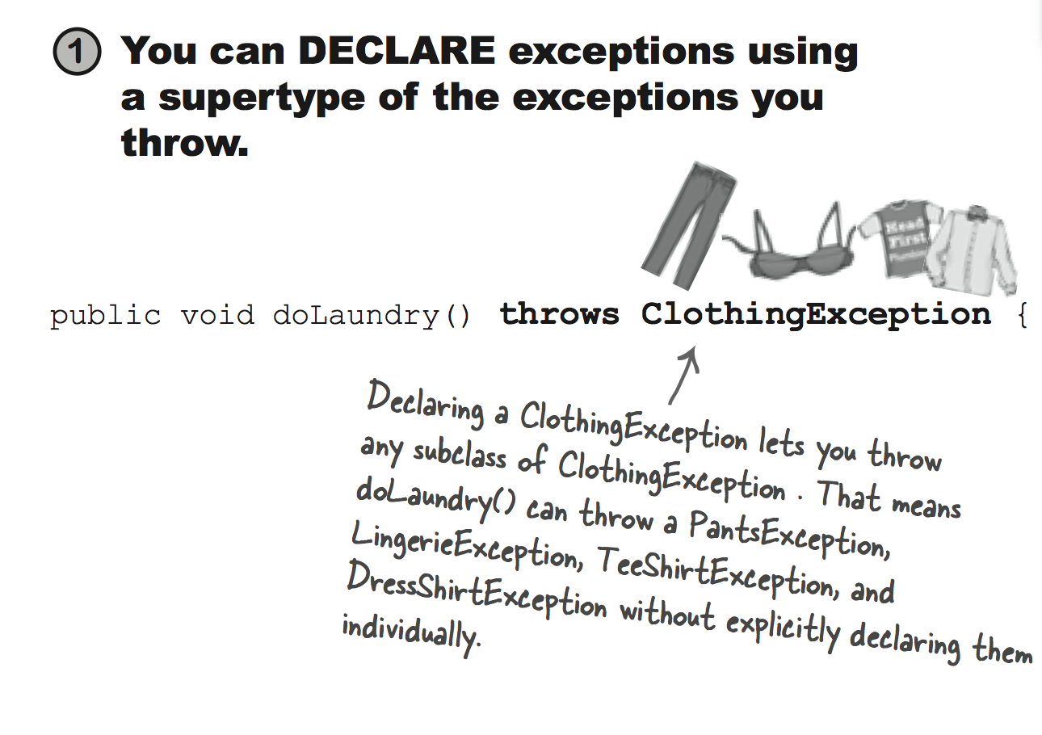
Exceptions are polymorphic

Slide 41
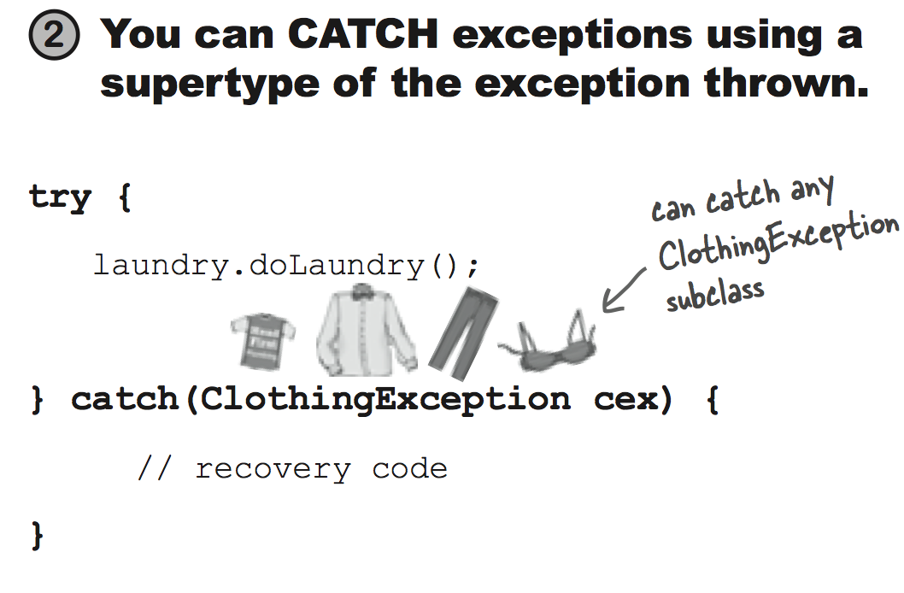
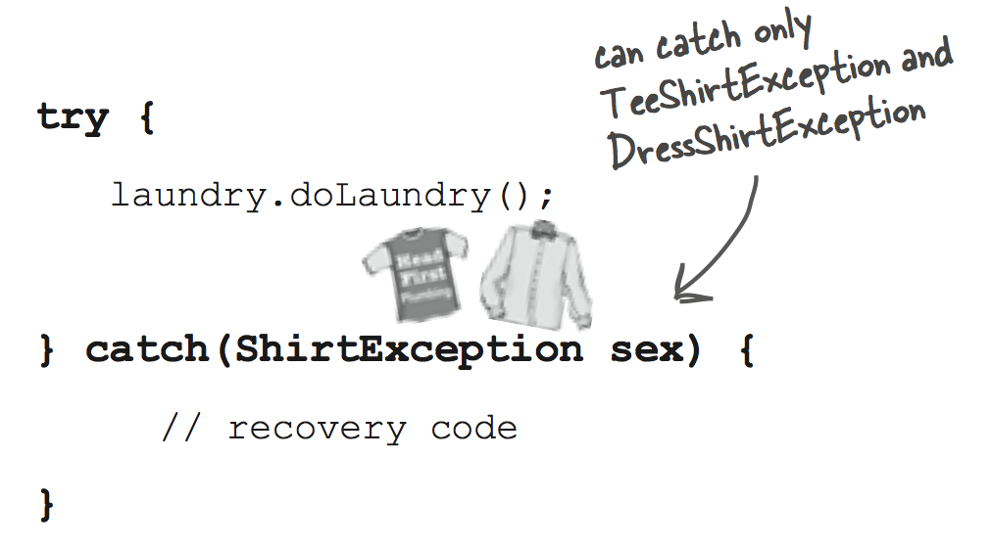

Slide 42
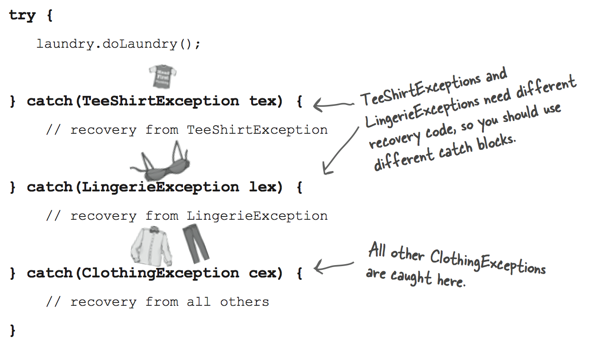

Slide 43
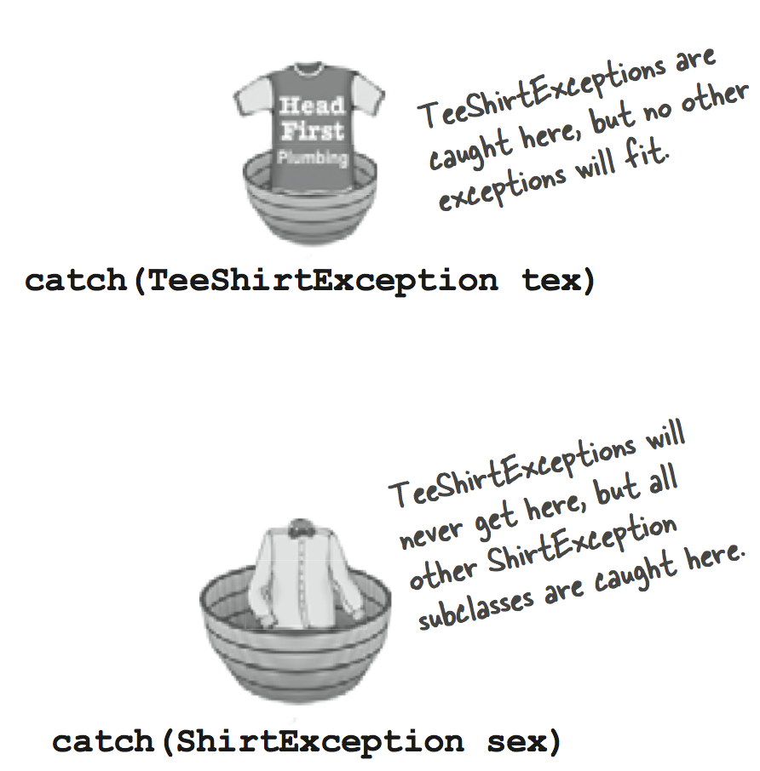
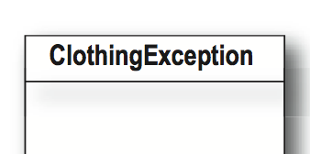
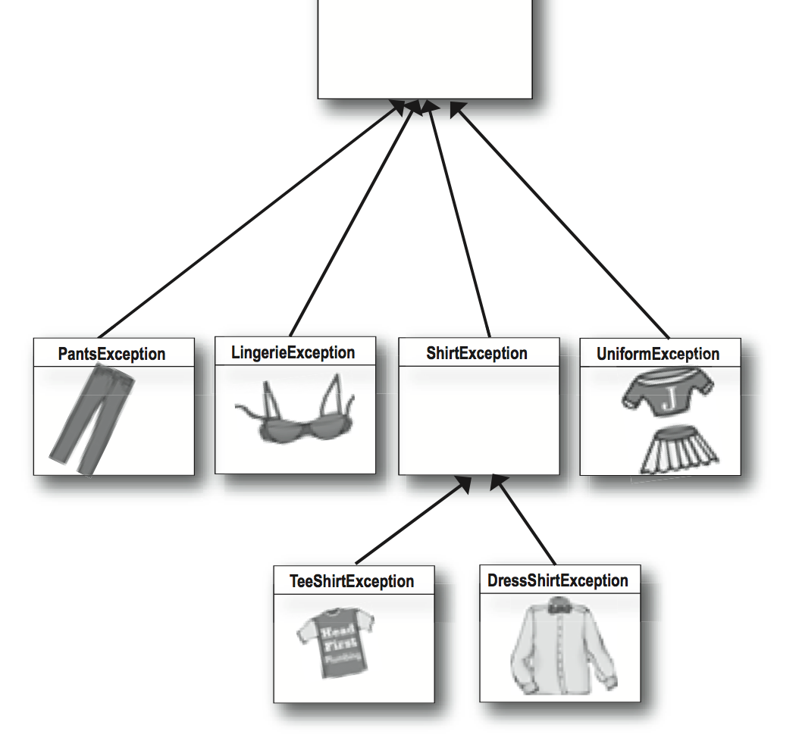
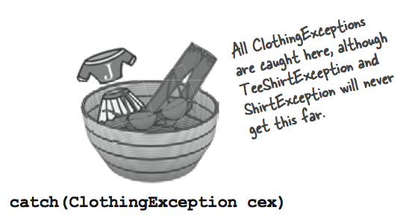
Multiple catch blocks must be ordered according to class hierarchy

Slide 44
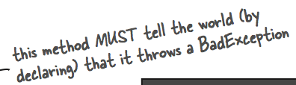
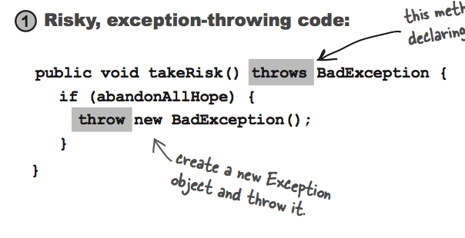
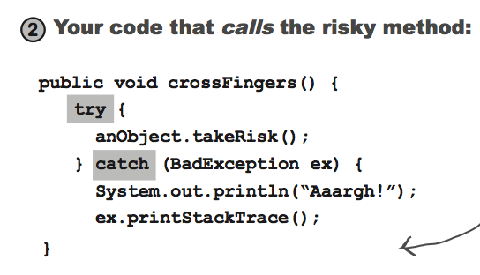
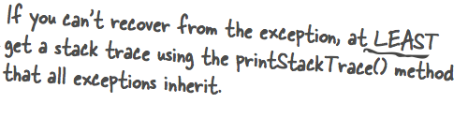
If it’s your code that catches the exception, then whose code throws it?

Slide 45
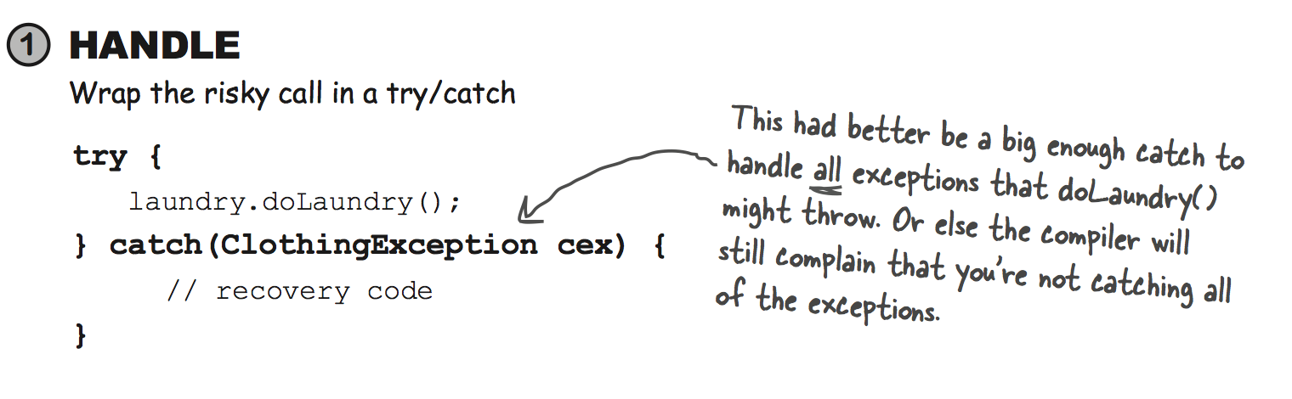
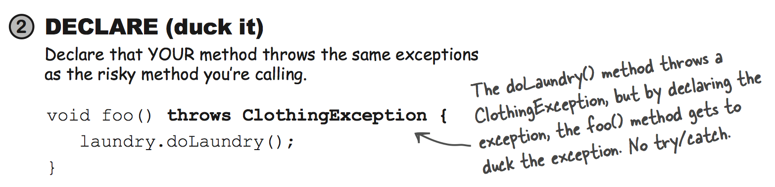
Checked exceptions: Handle || Declare

Slide 46
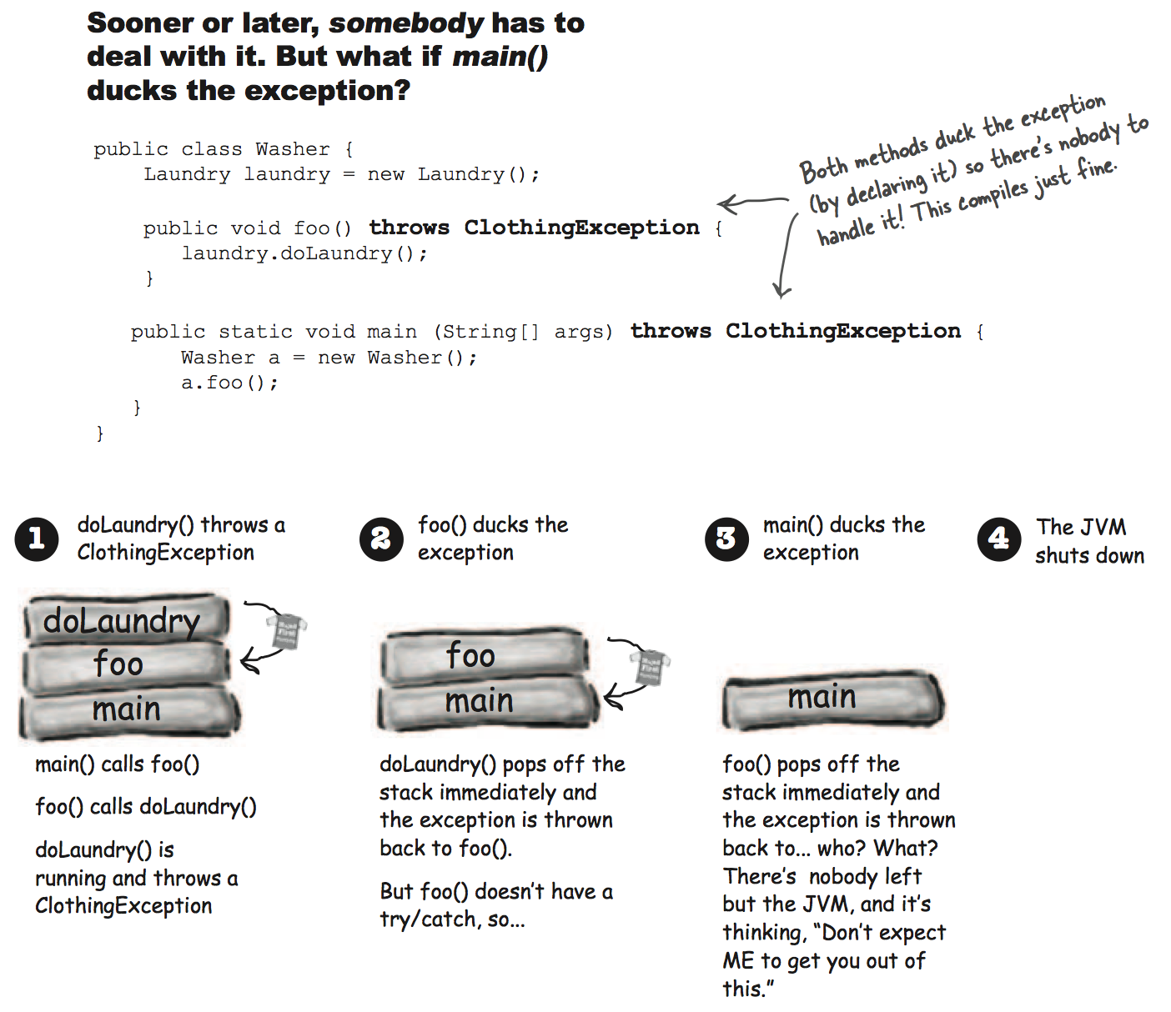

Slide 47
Work with resources: Java 6
InputStream in = null; try { in = new FileInputStream("file.txt"); } catch (IOException e) { // try to recover } finally { try { if (in != null) { in.close(); } } catch (IOException e) { // try to recover } }

Slide 48
Work with resources: Java 7
try (InputStream in = new FileInputStream("file.txt")) { int data = in.read(); // ... } catch (IOException e) { throw new UncheckedIOException(e); }

Slide 49
Work with multiple resources: Java 7
try ( InputStream in = new FileInputStream("file.txt"); BufferedInputStream buffer = new BufferedInputStream(in) ){ int data = buffer.read(); // ... } catch (IOException e) { // try to recover }

Slide 50
Work with resources: AutoClosable
/** * An object that may hold resources (such as file or socket handles) * until it is closed... * * @author Josh Bloch * @since 1.7 */
public interface AutoCloseable
{
void close() throws Exception; }

Slide 51
Catching multiple exceptions: Java 7
try { // ... } catch (SQLException | IOException e) { log(e); }

Slide 52
Exceptions and inheritance
public interface I { void i(); } public class A { public void a() { }; } public class B extends A implements I { public void i() throws Exception {}; // will not compile @Override public void a() throws Exception {}; // will not compile }

Slide 53
Exception Handling
Exercise 3 - Bank Application (Exceptions)

Slide 54


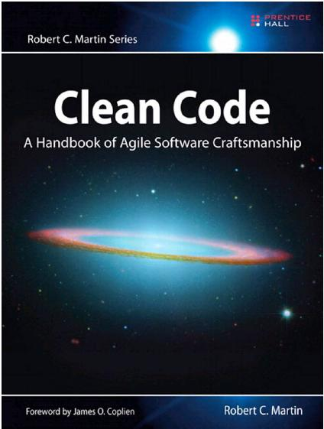

What’s next?
https://codility.com/programmers/lessons/1-iterations/
http://www.dev-books.com/

