Slide 1
Introduction to GIS
through Quantum GIS
Day 3: Data Day
offered by Valley Stewardship Network
taught and prepared by Legion GIS, LLC
March 2016

Slide 2









data
planes/remote sensing
shapefiles
spreadsheets
satellites/GPS
processing
this is technically the “Geographic Information System” part…
publishing
web-map
real map
mobile app

Slide 3
data
planes/remote sensing
shapefiles
spreadsheets
satellites/GPS
processing
this is technically the “Geographic Information System” part…
publishing
web-map
real map
mobile app

Slide 4
Who creates large datasets?
Federal Government, many different agencies
USGS (United States Geological Survey)
USDA (United States Department of Agriculture)
NRCS (Natural Resources Conservation Service)
US Census Bureau
USACE (United States Army Corps of Engineers)
State Governments (agency names vary from state to state)
DNR (Department of Natural Resources)
DOT (Department of Transportation
County-level
Land and Water Conservation Depts
Land Information Office
Universities
Private conservation/land management groups

Slide 5
General Collection Methods
Manual data creation
GPS collection
Digitizing from imagery
Remote Sensing
Aerial Imagery
LiDAR collection
Infrared Imaging
Geoprocessing
Data derived from other data
Hillshades
Contour lines
Sinkhole locations

Slide 6
How to get it?
…the internet!
Spatial data repositories
Public Access FTP sites
They’re not pretty, but they work!
Or… find the right person to ask…
“Do you distribute shapefiles for the flood zones that I see in your maps? If not, do you know where I can get them?”
Here’s our growing list of good sources:
https://docs.google.com/document/d/1MmuemQHztnSK5Xj4DNlbgvtXErR0w_aImZjQWyz3N1Y/pub

Slide 7
Metadata
Data about the data
There are a few standard metadata formats
ISO 19115 and ISO 19139 (international standards)
FGDC (Federal Geographic Data Committee, US standards)
ArcGIS metadata (developed by ESRI)
Comes in many shapes and sizes
Often in .xml files
Sometimes in .txt files
Maybe in an HTML file
Possibly non-existant
Or INSANELY EXISTANT!
http://www.nrcs.usda.gov/wps/portal/nrcs/detail/tx/home/?cid=nrcs142p2_053631

Slide 8
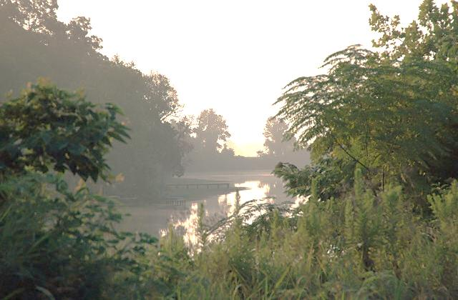
Questions? But not break time yet…

