Slide 1
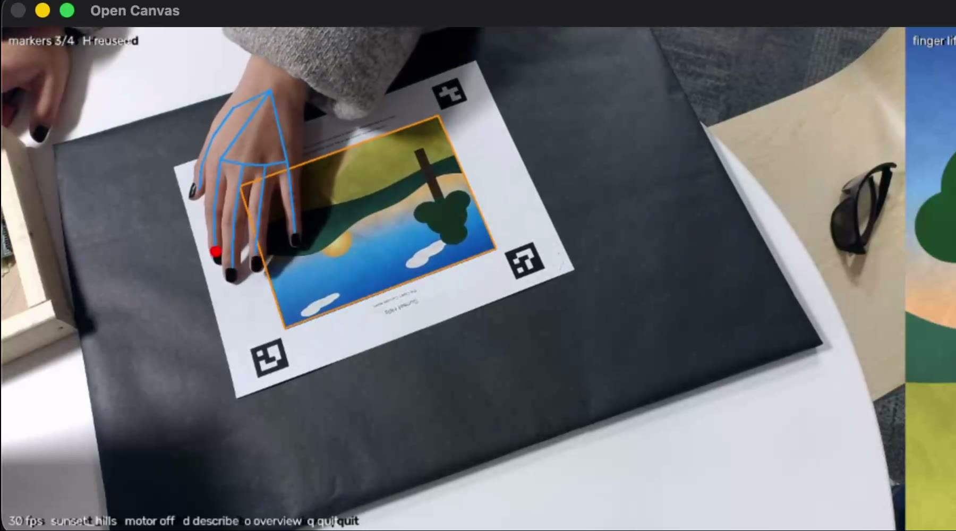
OPEN
CANVAS
DS+X 2026 · ART HACK · BOSTON UNIVERSITY
Explore a painting by touch.
Gerson Avila (CE) · Mauricio Barrientos (EE) · Travis Kanna (BME)
Notes:
Open Canvas lets blind and low-vision people explore a printed painting with their fingertip: color becomes music, objects make sounds, edges buzz, and resting the finger plays a description. The photo is the live camera view: the blue lines are the hand our system tracks, and the black squares are the markers that tell it where the painting is.

Slide 2
Art is made to be seen.
THE PROBLEM
Paintings can’t be touched.
2.2 billion
Museums keep hands off the art, so a painting’s detail stays out of reach.
people live with a near or distance vision impairment.
Audio guides are one-way.
Source: World Health Organization, World report on vision
One voice, one order, one pace. You hear about a painting; you don’t explore it.
Open Canvas · DS+X 2026 Art Hack
02
Notes:
Almost all art is made to be looked at. The WHO estimates at least 2.2 billion people have a near or distance vision impairment. Museums can’t let visitors touch paintings, and the main alternative, the audio guide, is linear: someone else decides what you hear, in what order, at what pace.

Slide 3
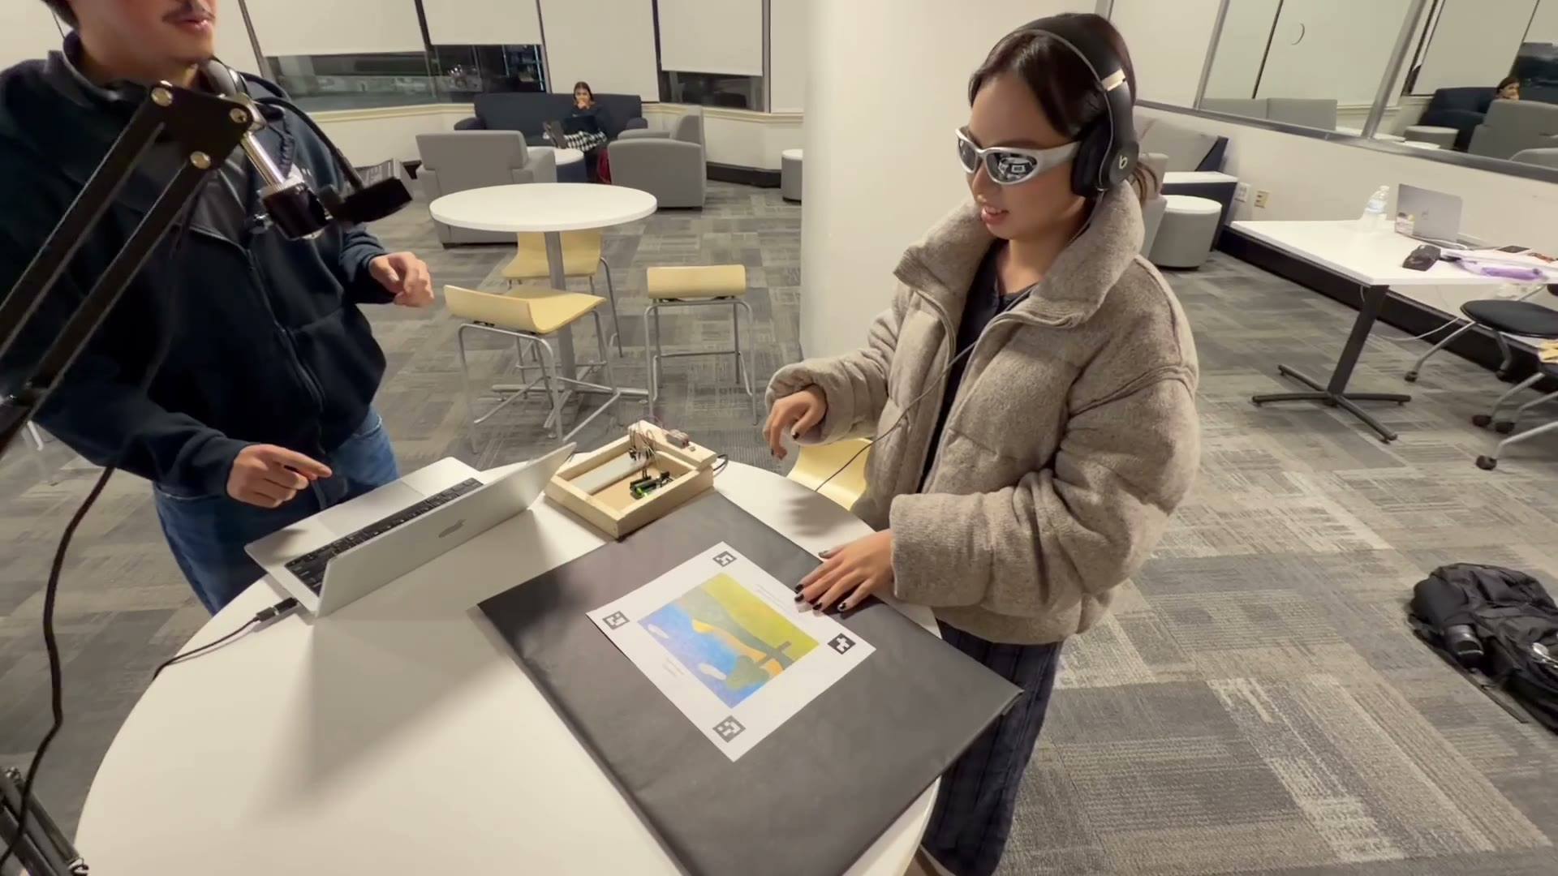
Put a hand on the painting. Hear what’s under your fingertip.
OUR ANSWER
Open Canvas turns a printed painting into something blind and low-vision people can explore on their own: in any order, at their own pace.
No screen, menu or keyboard for the visitor. Swap the printed page and it recognizes the new painting.
Demo: a blindfolded tester explores Sunset Hills.
Open Canvas · DS+X 2026 Art Hack
03
Notes:
The visitor puts a hand on an ordinary printed painting. An overhead camera follows the index fingertip and the part of the painting under it comes alive through headphones and a small motor on the finger. Nothing on screen is needed by the visitor.

Slide 4
Everything happens under one fingertip
FEATURES
Overview first
A voice names the painting and maps out the scene.
Color becomes music
Blue harp, warm strings, green woodwind, pale choir, dark cello. Brighter plays higher.
Objects make sounds
Leaves rustle in the tree, crickets chirp in the field.
Edges are felt
A fingertip motor buzzes when you cross an outline.
Rest to hear more
Hold still for 2.5 seconds and a voice describes that spot.
Swap the page
Four paintings, each recognized by its printed markers.
Open Canvas · DS+X 2026 Art Hack
04
Notes:
Six things the visitor gets. A spoken overview gives a mental map first. Then color plays as instruments: blue harp, warm strings, green woodwind, pale choir, dark cello, brighter spots higher, panned with the finger. Labeled objects add their own sounds. Edges are felt, not heard: research found an audio cue for edges confused people, so a motor on the fingertip buzzes instead. Resting the finger for 2.5 seconds plays a description. Swapping the printed page switches paintings.

Slide 5
From fingertip to sound, every frame
HOW IT WORKS
01
An overhead webcam films the page at 30 fps.
02
Four ArUco markers identify the painting and map camera pixels onto it.
03
MediaPipe finds the index fingertip.
04
We look up color, region and edge in the clean digital painting.
05
Sound goes to headphones; the edge buzz goes to an Arduino and motor.
Live view: a hand hides one marker, so the last good mapping is reused.
Open Canvas · DS+X 2026 Art Hack
05
Notes:
The pipeline runs once per camera frame. Markers at the corners of the print give a homography from camera pixels to painting coordinates, so the camera doesn’t need perfect alignment. MediaPipe gives the fingertip. Colors and regions are read from the clean digital painting, not the webcam image, so room lighting and the hand itself don’t change what is heard. The laptop sends M1 or M0 to the Arduino only when the motor state changes.

Slide 6
Built from off-the-shelf parts
TECH STACK
Vision | OpenCV 5 ArUco markers + homography · MediaPipe hand model
Audio | numpy mixer · sounddevice · ElevenLabs voices and effects
Hardware | Acer webcam · Arduino Uno · transistor driver · coin motor
Launch | Mac app + “Start Open Canvas” Siri Shortcut, no typing
Languages | Python 3.11 with pinned packages · Arduino C++
Kiro: not used
We built with Claude Code instead, working from a shared spec file (CLAUDE.md) that holds the team’s interface contracts.
Open Canvas · DS+X 2026 Art Hack
06
Notes:
Everything is off-the-shelf: OpenCV for the markers and the camera-to-painting mapping, Google’s MediaPipe for hand tracking, a custom numpy audio mixer, and an Arduino Uno driving a coin vibration motor through a transistor with a flyback diode. On Kiro: we did not use it. Our AI-assisted development was done in Claude Code, against one shared spec file, CLAUDE.md, which holds the contracts between team members (coordinates, region map format, serial protocol, audio API), so each of us could build separately and integrate on Saturday.

Slide 7
Our data and where it came from
DATA
Four paintings
Region maps we drew
Hokusai, Van Gogh, Mondrian (public domain, Wikimedia Commons) + our own.
Hand-traced into 6–8 regions each, with a written description and sound.
Live webcam frames
Pretrained hand model
1280×720 at 30 fps. Only the fingertip position is used; nothing is saved.
Google MediaPipe Hand Landmarker (21 keypoints). No training data collected.
How we identified it: only images we may print (public domain or our own); the objects each scene is made of, traced by hand; and design choices grounded in accessibility research (Eyes-Free Art, Rector et al. 2017; EyeMusic) and WHO vision data.
Open Canvas · DS+X 2026 Art Hack
07
Notes:
Four kinds of data. Images: three public-domain masterworks from Wikimedia Commons (The Great Wave, c. 1831; The Starry Night, 1889; Mondrian’s 1930 Composition) and Sunset Hills, which we made. Labels: we traced every painting into labeled regions (7, 7, 6 and 8) and wrote a description for each. Live input: webcam frames, used only to find the fingertip and never stored. Model: MediaPipe’s pretrained hand landmarker; we trained nothing. The layered-audio design comes from Eyes-Free Art (Microsoft Research, 2017), where 11 of 13 blind and low-vision participants preferred layered audio.

Slide 8
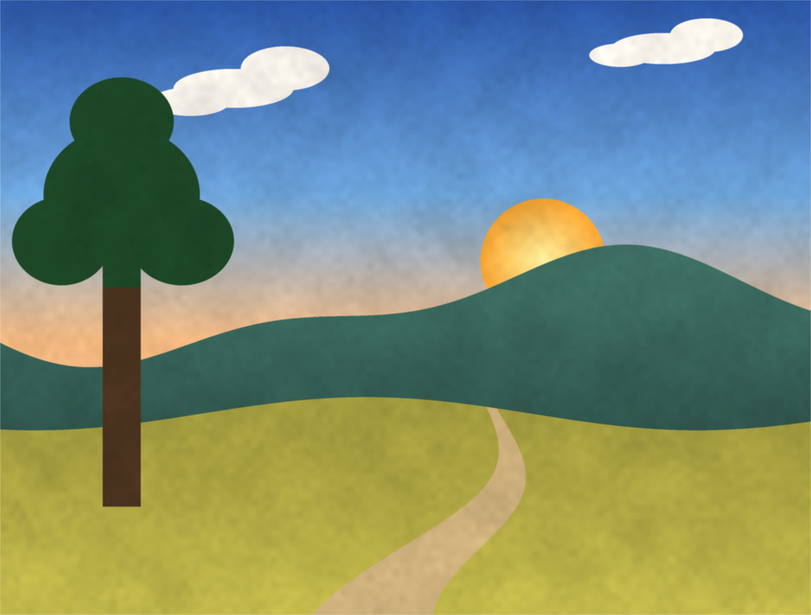
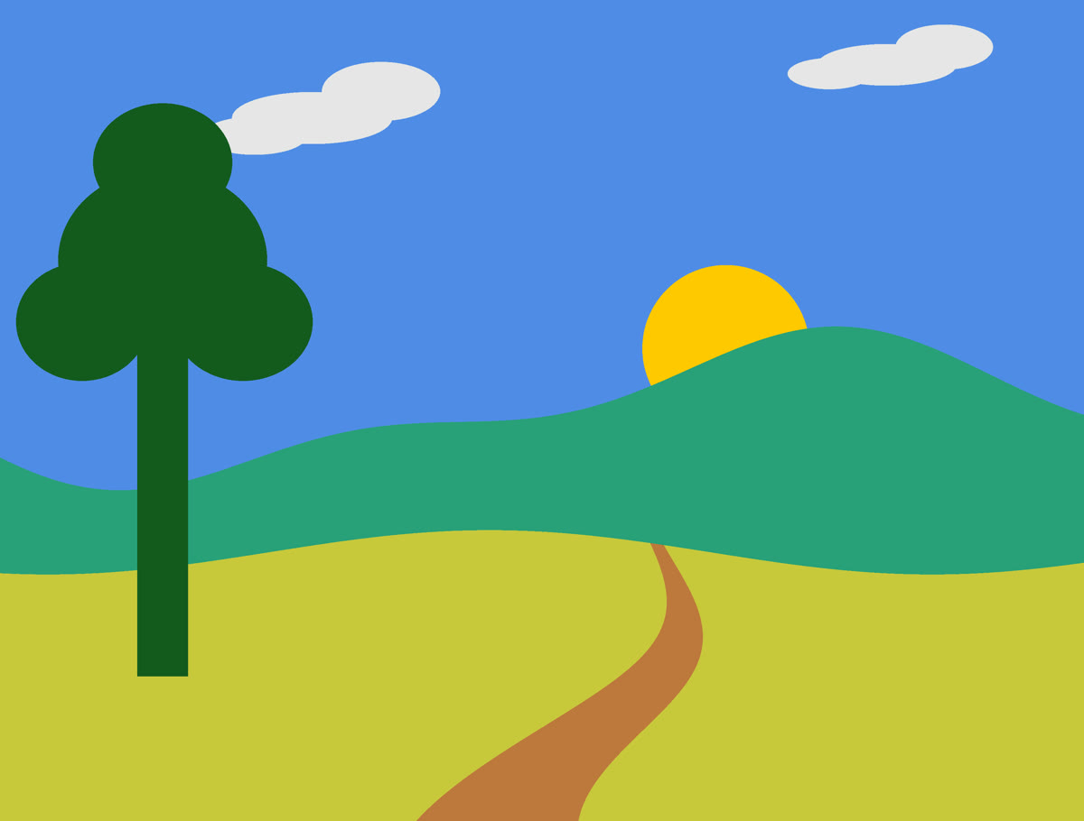
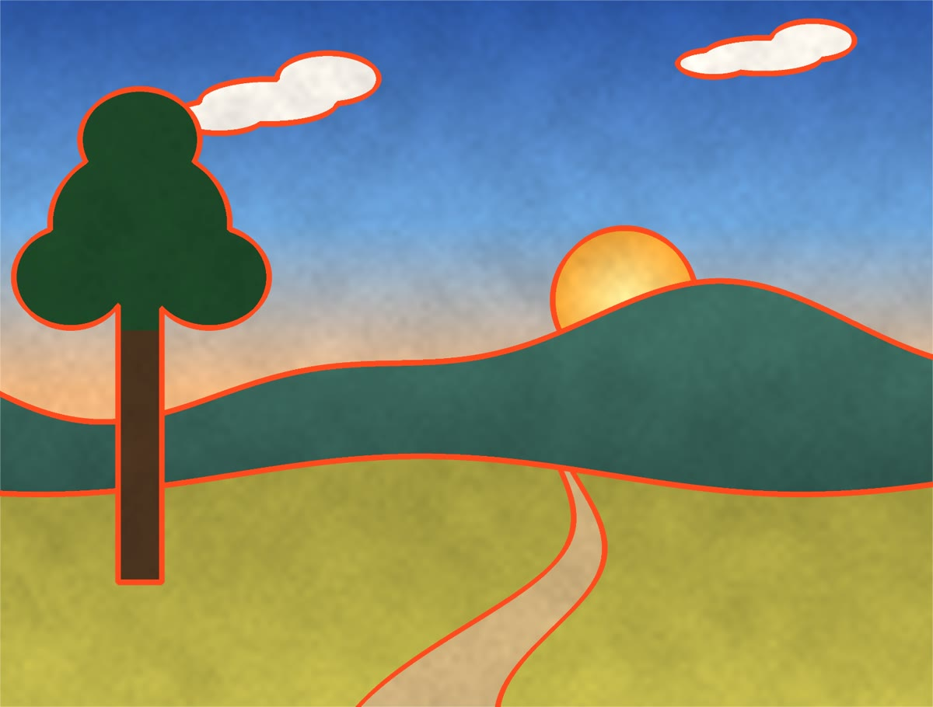
Segmentation and soft classification
DATA SCIENCE · METHOD 1
1 · The painting
2 · Labeled regions
3 · Edge band for the motor
Soft color classes
A data-quality catch
Each color gets weights for five instruments that sum to 1, so sound crossfades at borders instead of flickering.
Luma reads navy as 0.06 (black, so cello). HSL lightness reads 0.25 (blue, so harp). We use lightness.
Open Canvas · DS+X 2026 Art Hack
08
Notes:
Method one is segmentation and classification. We segment each painting into labeled regions: a region map where every pixel holds a region ID. The motor’s edge map is derived from the region boundaries, widened by morphological dilation into a band about 5 mm wide, rather than from edge detection, which would buzz on every brushstroke. Color is classified softly: Gaussian membership on hue and smooth ramps on lightness and saturation give five instrument weights that always sum to one, so the sound crossfades instead of flipping when the finger sits on a border. One data-quality finding: luma under-weights blue, so a navy field read as black; HSL lightness fixed it.

Slide 9
Prediction with anomaly rejection
DATA SCIENCE · METHOD 2
Predict. A pretrained model finds 21 hand keypoints; we keep the fingertip if confidence ≥ 0.5.
Reject outliers. A non-convex marker shape is a bad detection; we keep the last good mapping.
Smooth. An exponential moving average (α = 0.5) steadies the fingertip.
Debounce. The motor switches after 2 agreeing frames; a description needs 2.5 s of stillness.
“markers 3/4 · H reused”: the fallback, live.
Open Canvas · DS+X 2026 Art Hack
09
Notes:
Method two is predictive modeling plus anomaly handling on a live, noisy signal. MediaPipe’s pretrained hand landmarker predicts 21 keypoints per frame; we use keypoint 8, the index fingertip, and require a detection confidence of at least 0.5. The camera-to-painting mapping is solved from the four marker centers; if the detected marker shape is not convex, that frame is an outlier and is rejected, and the last good mapping keeps working, which is what the screenshot shows when a hand covers a marker. The fingertip is smoothed with an exponential moving average, and outputs are debounced: the motor changes state only after two frames agree, an object sound only after 0.12 seconds in a region, and a description only after 2.5 seconds of stillness.

Slide 10
Explore art on your own terms
IMPACT
≈$95
4
0
in parts we bought (webcam, desk arm, motors), plus a laptop and an Arduino.
paintings today. A new one needs an image, a region map and text, not new code.
screens or menus for the visitor. Swap the page; Siri starts the app.
Instead of someone else’s tour, visitors choose where to go, in any order, at their own pace.
So far tested with blindfolded sighted testers. Next: blind and low-vision users.
Open Canvas · DS+X 2026 Art Hack
10
Notes:
The impact is independence. A visitor explores a painting in any order, at their own pace, instead of following a fixed tour. It is cheap: about 95 dollars of parts we bought, plus a laptop and an Arduino. It scales by content, not code: a new painting is an image, a region map and descriptions. And the visitor needs no screen: they swap the printed page, and the app can be started by voice. To be honest about evidence: we have tested with blindfolded sighted people, not yet with blind or low-vision users; that is the next step.

Slide 11
Our statement
ETHICS & RESPONSIBILITY
Open Canvas is for blind and low-vision people, so its mistakes cost them more than us. We print only public-domain paintings or our own, credit ElevenLabs for generated voices and sounds, and use Google’s pretrained hand model without collecting training data. The camera looks down at the table; frames stay in memory, are never saved or uploaded, and only the fingertip position is used. Hand tracking may work less well for some skin tones, lighting or hand differences, which we have not yet measured; our descriptions carry a sighted team’s reading of mostly Western art; and the system assumes hearing, English and a usable fingertip. Because a wrong description misleads someone who can’t check it, every spoken line is written and reviewed by us, not generated live. The overview explains the system before exploring, the README lists sources and limits, and so far only blindfolded sighted people have tested it. Blind and low-vision users must shape what comes next.
Open Canvas · DS+X 2026 Art Hack
11
Notes:
This is our ethics and responsibility statement; the next three slides expand each part: data sourcing and use, privacy, bias and fairness, harms and mitigation, and transparency and accountability.

Slide 12
Sourcing, privacy and fairness
ETHICS · DATA, PRIVACY, FAIRNESS
Responsible sourcing & use
Privacy, bias & fairness
Paintings are public domain (Wikimedia Commons) or our own.
We drew every region map and wrote every description.
ElevenLabs voices and effects, credited as its free plan requires.
Research and the WHO figure are cited by name.
The camera points at the table; frames are never stored or sent.
Hand tracking may vary with skin tone, lighting or limb differences; not yet measured.
Descriptions reflect a sighted team’s view of mostly Western art.
Excludes deafblind users, non-English speakers, and anyone who can’t use a fingertip.
Open Canvas · DS+X 2026 Art Hack
12
Notes:
Sourcing: every image is public domain or ours, so we can print and share it. We traced the regions and wrote the descriptions ourselves, so we know exactly what the system says. Generated voices and sound effects come from ElevenLabs, credited as its free plan requires, and listed in CREDITS.md. Privacy: the camera looks down at the print, frames are processed in memory, and nothing is saved or uploaded. Bias: the hand model was trained by Google on data we did not choose, and may perform differently across skin tones, lighting, nail polish, gloves or limb differences; we have not measured that yet. Our descriptions are a sighted, mostly Western reading of the art. And the design leaves out people who are deafblind, who don’t speak English, or who can’t point with a fingertip.

Slide 13
What could go wrong, and what we did
ETHICS · HARMS & MITIGATION
Possible harm | What we did
A wrong description misleads someone who can’t check it | Every line is written and reviewed by us; no live AI answers in the demo
Sensory overload or being startled | Quiet music bed that ducks under speech; descriptions only after a 2.5 s rest
Motor chatter on the fingertip | Hysteresis; a low-voltage coin motor behind a transistor and flyback diode
Silent failure when tracking is lost | Last good mapping is reused; when the finger is lost, the motor turns off
Open Canvas · DS+X 2026 Art Hack
13
Notes:
The biggest risk is a confident wrong answer to someone who cannot check it, so in the demo build every spoken description is pre-written and reviewed by us; the code can call a live vision model, but we did not turn it on. Audio is designed not to overwhelm: a quiet bed, music ducking to about a third under the voice, and descriptions only after a deliberate 2.5-second rest, never repeated within 20 seconds. The motor uses hysteresis so it doesn’t chatter, and it is driven safely through a transistor with a flyback diode. When tracking fails, the system degrades quietly: a hidden marker reuses the last good mapping, and a lost finger turns the motor off.

Slide 14
Clear about what it is and isn’t
ETHICS · TRANSPARENCY & ACCOUNTABILITY
01
The spoken overview names the painting and explains how to explore before anything else plays.
02
Every description is pre-written by the team, so what users hear can be checked line by line.
03
The README and CREDITS list data sources, licenses, methods and limits; all code is public on GitHub.
04
Limits stated up front: not yet tested with blind or low-vision users, tracking accuracy across hands not measured, four paintings only.
Open Canvas · DS+X 2026 Art Hack
14
Notes:
Users learn what the system is from its first words: the overview names the painting and explains how to explore. Because descriptions are pre-written rather than generated, anyone can audit exactly what a user will hear. Our README and CREDITS file document data sources, licenses, methods and limits, and the code is public. And we state the limits plainly: we have not tested with blind or low-vision users, we have not measured tracking accuracy across different hands, and there are only four paintings so far.

Slide 15
What’s next, and thank you
NEXT STEPS
Test with blind and low-vision users; let their feedback set priorities.
Measure tracking accuracy across skin tones, lighting and hands.
Optional live descriptions for new paintings, with human review.
A wearable fingertip mount, more paintings, more languages.
LINKS
github.com/bee-0207/open-canvas
Watch the 1:42 video
Gerson Avila · Mauricio Barrientos · Travis Kanna
Voices and sound effects by ElevenLabs · Paintings: Wikimedia Commons (public domain) · Research: Eyes-Free Art (Rector et al., Microsoft Research, 2017), EyeMusic
Open Canvas · DS+X 2026 Art Hack
15
Notes:
Next: put it in front of blind and low-vision users and let them set the priorities; measure how well hand tracking works across different hands and lighting; consider live descriptions for new paintings, but only with a human review step; and build a proper wearable fingertip mount, more paintings and more languages. The code and the 1:42 video are on GitHub. Thank you.

