Slide 1

Timetabling problem at FPT University
Students: CongLT, HoaiNV, DucHM, HaNS
Instructors: DungPQ, TrungNT

Slide 2
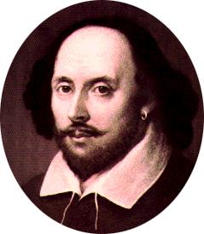
Our Team

Slide 3










SPRING
MySQL
FXML
SPRING DATA
LOG4J
Choco
Tomcat
Hibernate
POI
Open-cbls

Slide 4
Over view
Timetabling problems, challenges, importance
Related works
Our approach
Algorithm details
Result and experiments
Conclusion
Demo

Slide 5
Timetabling problems
The allocation of given resources to objects being placed in space time, satisfy a set of desirable objectives
Course timetabling, examination timetabling, shift timetabling, industry machine scheduling…
Course timetabling, Course scheduling, University timetabling are the same problems

Slide 6
WHY IS IT CHALLENGING?

Slide 7
Why is it challenging?
Part-time teachers
More campuses
Split classes, merge classes
Room constancy
Share teachers
Non-pass students
Condition courses
…

Slide 8
Case of FPT University
Input:
Classes : SE0709, CS0701, IA1001, ..
Courses: MAC101, LAB101, PHY301, ..
Rooms: P201, HB305R, HB301L, ..
Teachers: TrungNT, CauPD, ChiLP
Semester plan
Semester template

Slide 9
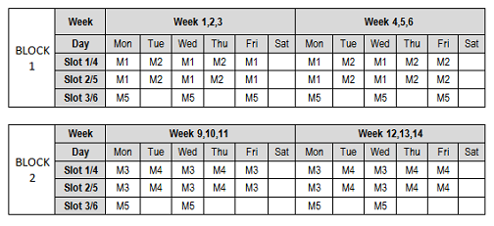
Case of FPT University
Semester template

Slide 10
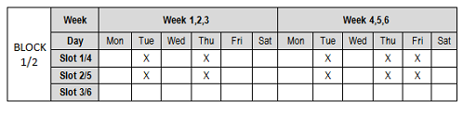
Case of FPT University
Place
Cell

Slide 11
Constraint
Hard constraints :
NO conflict rooms, teachers
Session is constant in each block
Two slots of one class-course are adjacent in a day.
Number of students of each class-course less than or equals to 30, more than or equals to 15.
Soft constraints :
Teachers do not teach in both slot 3 and 4

Slide 12
Objective function
Minimum number of teachers of each course.

Slide 13
Case of FPT University
Manual scheduling process
Parition classes
Schedule
& Assign rooms
Merge classes
Assign teachers
Timetable

Slide 14
Case of FPT University
Manual by Academic Department
Cost much time, power.
Stressful
Cannot avoid mistakes

Slide 15
Related works

Slide 16
Sequential methods
Cluster methods
Timetabling problem
Meta heuristic Methods
Constraint programing

Slide 17
Cluster methods
Split set of course into groups which satisfy all hard constraints
Assign courses to time periods to fulfil the soft constraints
The clusters are formed and fixed at the beginning of the algorithm.
Maybe bad result

Slide 18
Sequential methods
Assign the courses sequentially
Can be represented by a colouring problem:
Courses are represented by vertices
Conflicts are represented by edges
Time slot corresponds to a colour in the graph
No two adjacent vertices are coloured by the same colour

Slide 19
Constraint programing
An exact approach that ensures to find optimal solution if it exists.
Combine of propagation process and branching process.
Propagation process:
Eliminate values in selected variables domain. (by Constraint)
Reduce search space.
Branching process:
Partition the problem into smaller sub-problems.
Split the selected variables domain.
The propagation and branching processes are performed iteratively.

Slide 20
Constraint programing
The search space is completely explored.
Some generic CP solvers :
CHOCO
GECODE
Minizinc

Slide 21
Meta heuristic Methods
Begin with one or more initial solutions and employ search strategies that try to avoid local optimal
High quality solutions in a considerable computational cost.
Some methods:
Tabu search
Simulated annealing
Hill-climbing
Genetic algorithms
Hybrid methods

Slide 22
Local search approaches
They are heuristic methods.
Search space is partially explored.
Cannot ensure to find an optimal solution and prove its optimality.
Can finds high-quality solution in reasonable time.

Slide 23
Local search approaches
Starts from an initial solution generated randomly or by a greedy algorithm
Iteratively moves from a current solution to one of its neighbours.
The neighbour is basically generated by modifying locally the components of the current solution

Slide 24
Hill-climbing algorithm
Selects the best candidate of all neighbours which improve the objective function
If there is no better solution, the search stuck in a local optimum.
restarts the search from another initial candidate
Increase the evaluation value each step by climbing

Slide 25
Min-conflicts algorithm
Selects the random variable that related to some conflict , pick value in its domain which minimize the number of violation
Cannot avoid the local optimal
Random Walk: pick random variable with probability P then apply the min conflict heuristic with probability 1-P

Slide 26
Tabu search
Moving from current solution s to the best solution s’
Avoid iterations that do not improve the solution
tabulist store some properties of solution
Solutions do not have tabulist properties will not be considered in tabulength iterations
Prevent the search from being trapped in local optimal
Improved: Tabu reactive, tabu with 2 tabulists

Slide 27
Genetic algorithm
The idea is based on Natural Selection.
Maintain a populations of candidate solutions.
Candidate solutions have probability to make their child depend on their fitness.
Fitness is evaluated by objective function.
HOW: represent constraint by fitness function.

Slide 28
Hybrid Approaches
performing local search before or after a systematic search.
performing a systematic search improved with local search at some point of the search.
performing an overall local search, and using systematic search either to select a candidate neighbour or to prune the search space
=> These methods have led to good results in large scale problem.

Slide 29
Our approach

Slide 30


Process
Assign rooms
Assign
teachers
Schedule
Partition classes
Assign rooms to class-courses
Automatic or manual
Assign teachers to class-courses
Use score to evaluate
Automatic or manual
Merge classes using Choco
Use a hybrid method to optimize objective function
Automatic or manual
Partition students into classes
Automatic or manual

Slide 31

Partition classes
ALL STUDENT
SE – Semester 1
SE – Semester 2
IA – Semester 2

Slide 32

Partition classes
Groups of 30 students
Classes with 30 students (full)
SE – Semester 1
15 students
Class with 15 students (minimum)
Class with 15 -> 30 students
remaining students

Slide 33
Merge classes
Multi Knapsack problem (bin packing problem)
Input:
Class-courses
Number of students each class-courses
Output:
Merged class-course
Host classes
Guess classes
Constraint: 15 ≤ Number of students each merged class-courses ≤ 30
Use a local search method

Slide 34
Phase 1: Find local timetables
Input:
Classes
Class-courses
Places
Output:
A set of feasible local-timetables for each class
Constraint:
All class-courses of a class have the same session.
All class-courses must be scheduled in different places.
Use Choco solver

Slide 35
Phase 2: Find global timetables
Input:
Set of local-timetable for each class
Output:
Best global-timetable for all classes
Objective function
Minimize number of teacher of each course.
Use Tabu search

Slide 36
Phase 2: Find global timetables

Slide 37
Phase 3: Assign teachers
Input:
Teachers
List of teachers who instruct each course
Global timetables (output phase 2)
Output:
Assigned teachers

Slide 38
Phase 3: Assign teachers
Idea:

Slide 39
Phase 4: Assign rooms
Input:
Rooms
Global timetables from phase 3
List of courses hosted in each room
Output:
Assigned rooms

Slide 40
Results and experiment

Slide 41
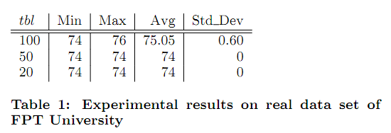

Slide 42
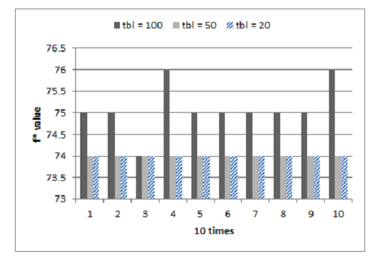

Slide 43
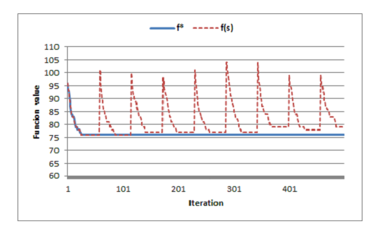

Slide 44
Demo

Slide 45
Conclusion

Slide 46
Thank you!

