Slide 1
Glinski_bee_matrices
Stoten or chemosphere

Slide 2
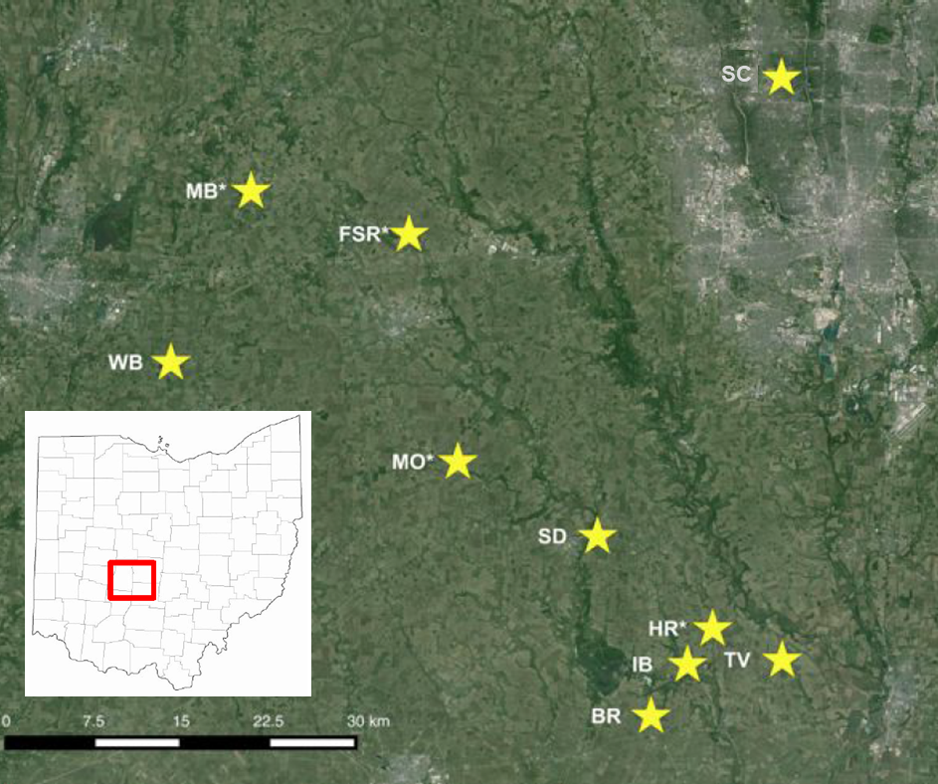
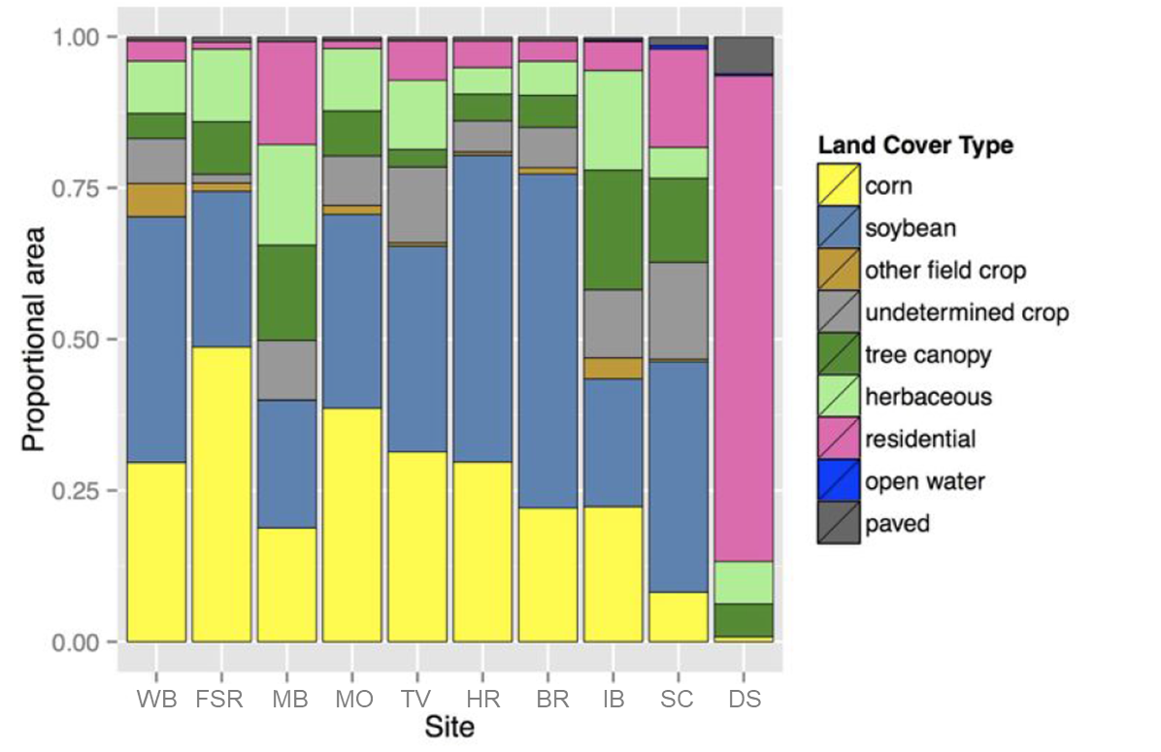
Figure 1. Locations of apiary study sites in central Ohio (1A). A bar chart representing the proportional landscape gradient within a 2 km radius of each apiary (1B). Alternative map for 1A, and figure for 1B.
A
B

Slide 3
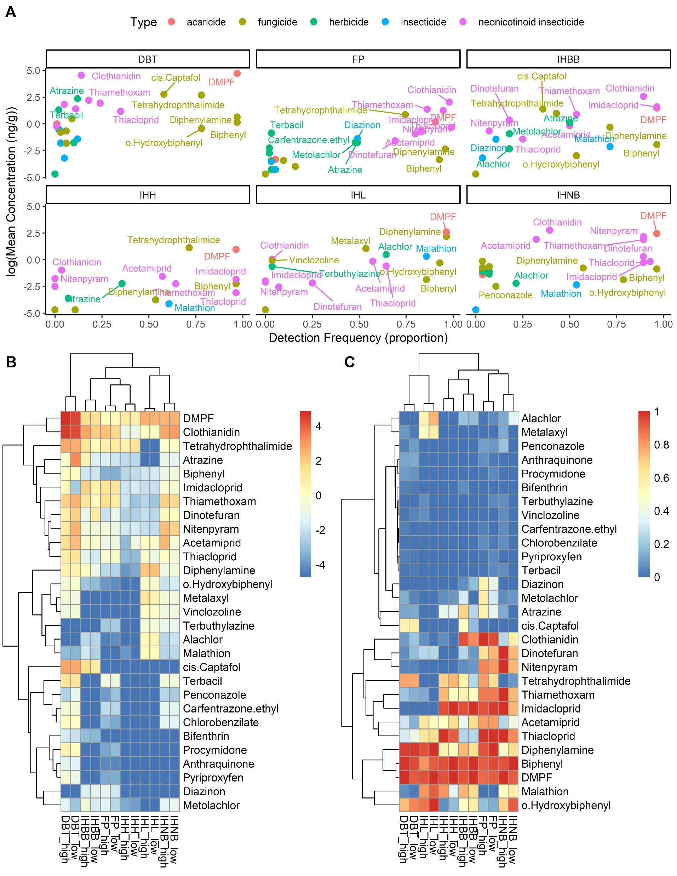
Figure 2. Scatterplot and heatmaps of screened chemical concentrations and detection frequencies across 6 bee matrices (dead bee traps (DBT), field pollen (FP), in-hive bee bread (IHBB), in-hive honey (IHH), in-hive larvae (IHL), and in-hive nurse bees (IHNB). Screening consists of keeping chemicals with greater that 10% detection frequency in 2 or more matrices. Heatmap of mean logged chemical concentrations for the different measured matrices. Screening consists of keeping chemicals with greater that 10% detection frequency in 2 or more matrices, resulting in 29 chemicals for further analysis. Low and high refer to agricultural cover in the vicinity… Matrix type is more influential than agricultural cover for clustering (columns). However, high ag has higher concs more often than not within a media type. The consistently cross-matrix chemical cluster (top 11 rows) are a number of neonics and … (2B and 2C need legend titles, reverse figs 2B and 2C)

Slide 4
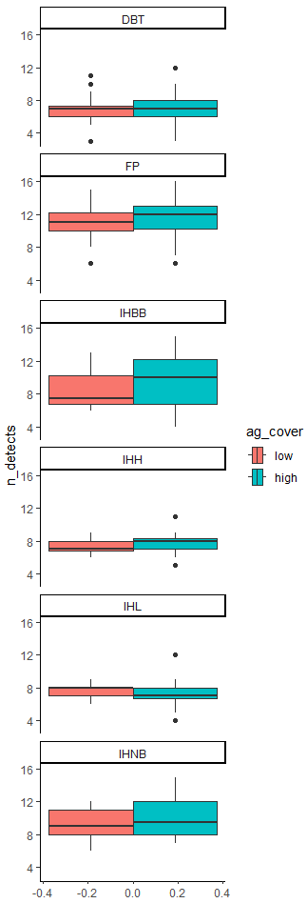
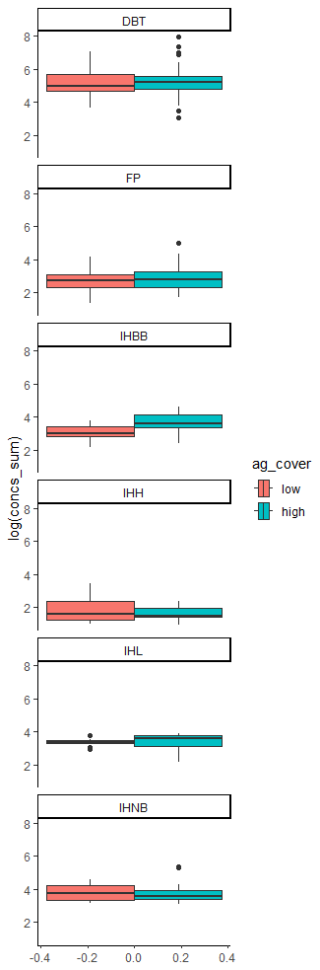
Figure 3. Sample variability over all dates. Paired box plots of number of detects (out of 29) and cumulative concentrations in each sample (location * date) by matrix and ag_cover. Specific sample dates and locations are outliers in dead bee traps and pollen. (drop legend on left and combine into one A/B figure)

Slide 5
Figure 4. Figure that clearly shows chemical class differences across matrices? (Dimensions are chemical, chemical class, matrix, ag_cover, apiary location; outcomes are detection frequency and concentrations) Mean (or boxplot) chemical concentrations by matrix, chemical class, and ag cover? (Paired box plots of chemical concentrations)
Chemical class (5) along the x-axis, paired ag_cover concentration boxplots, and matrix (6) along the y, and pretty colors; it has to be mean since the different chemical classes have different numbers of chemicals

Slide 6
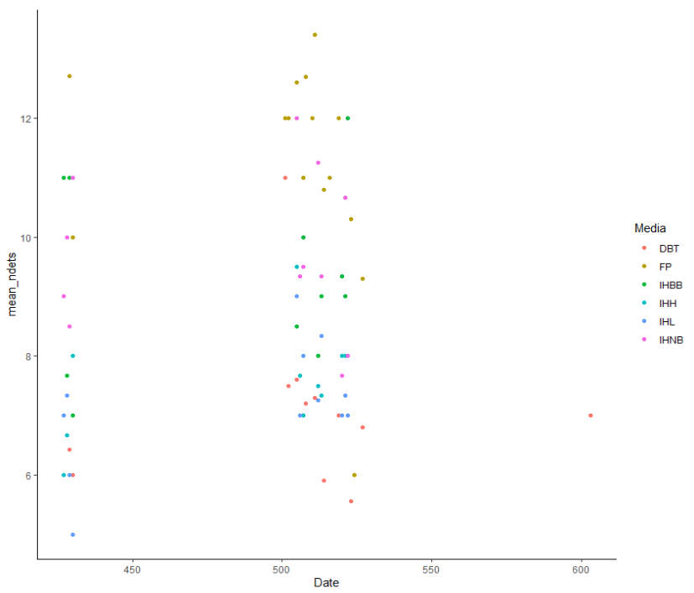
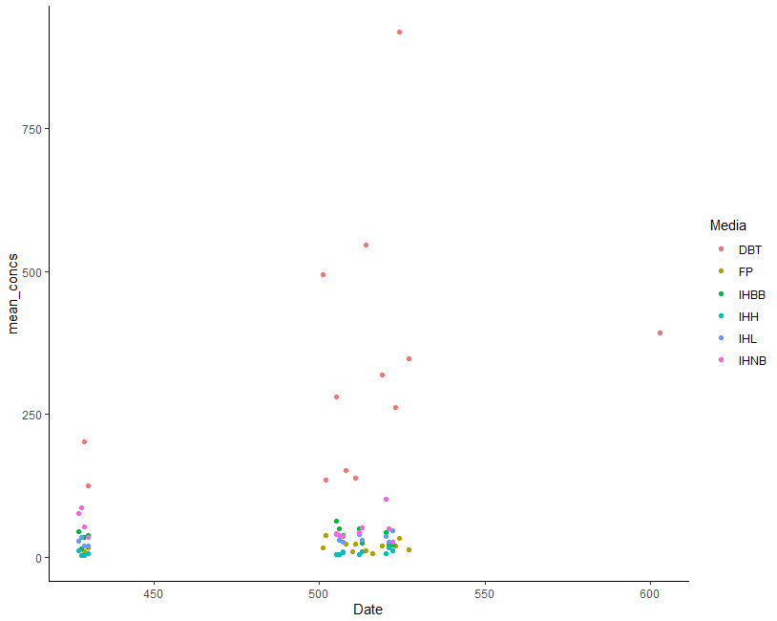
Figure 5. Pollen and dead bee trap concentrations over time. Note that high miticide concentrations may be conflated with Varroa infestation. (Looking to highlight the very high concentration times). We are looking to highlight the outliers from figure 3 here.

Slide 7
Supplemental figures that drill into apiary concentrations.

