Slide 1
Glinski_bee_matrices

Slide 2
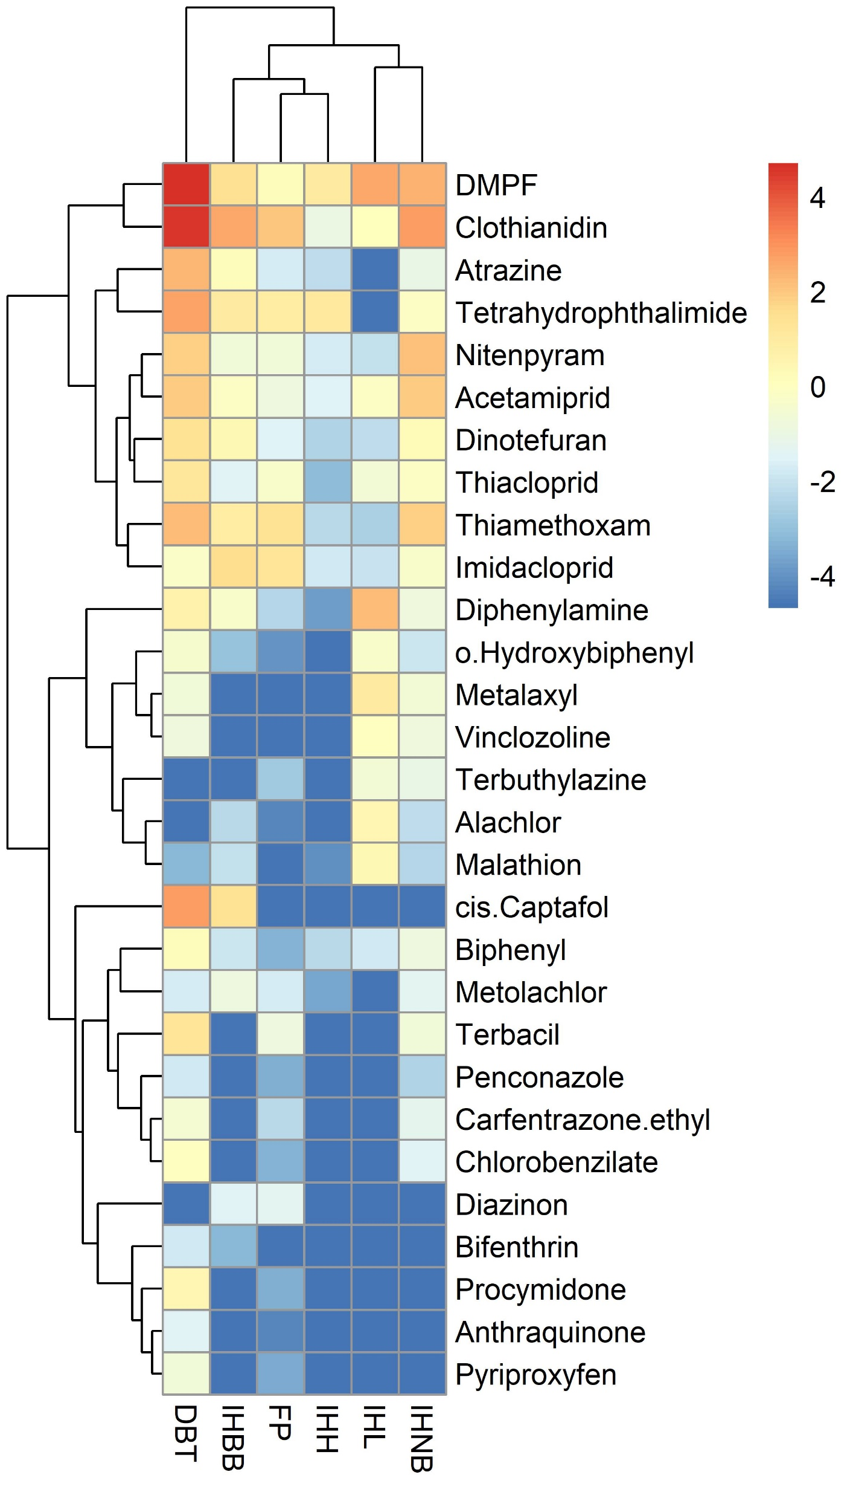
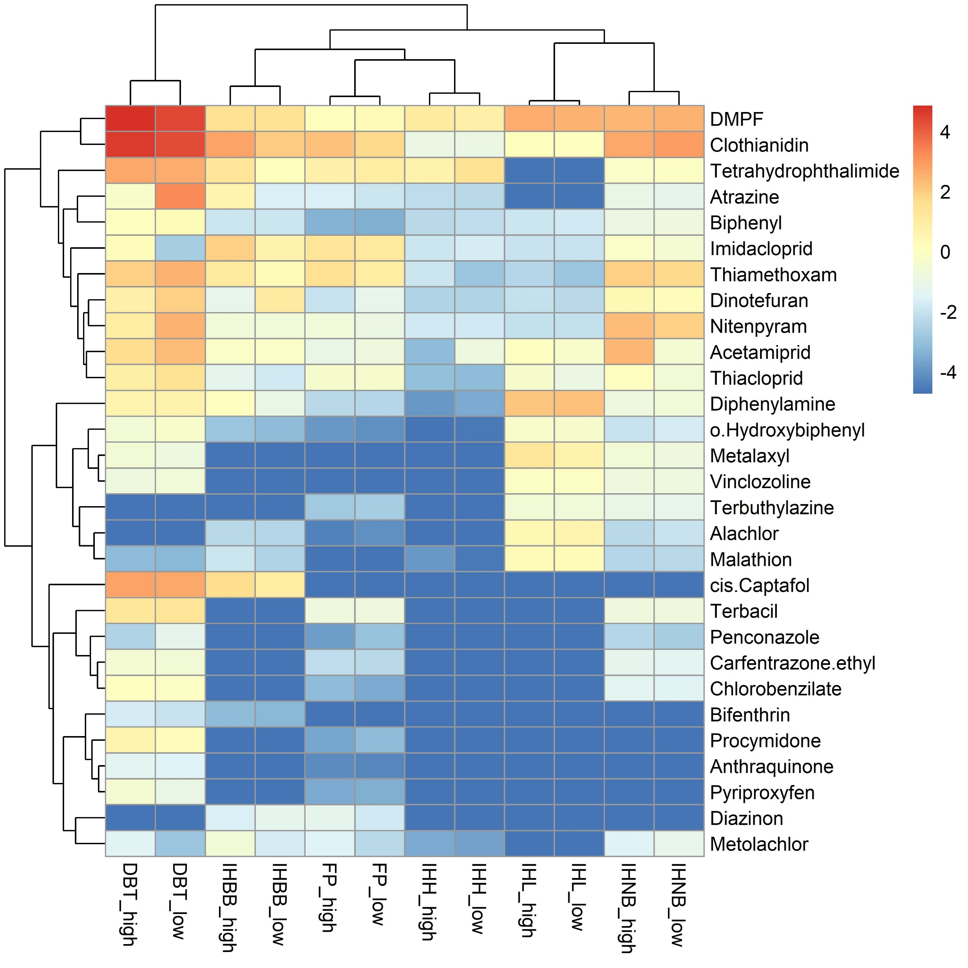

Slide 3
