Slide 1
Glinski_bee_matrices

Slide 2
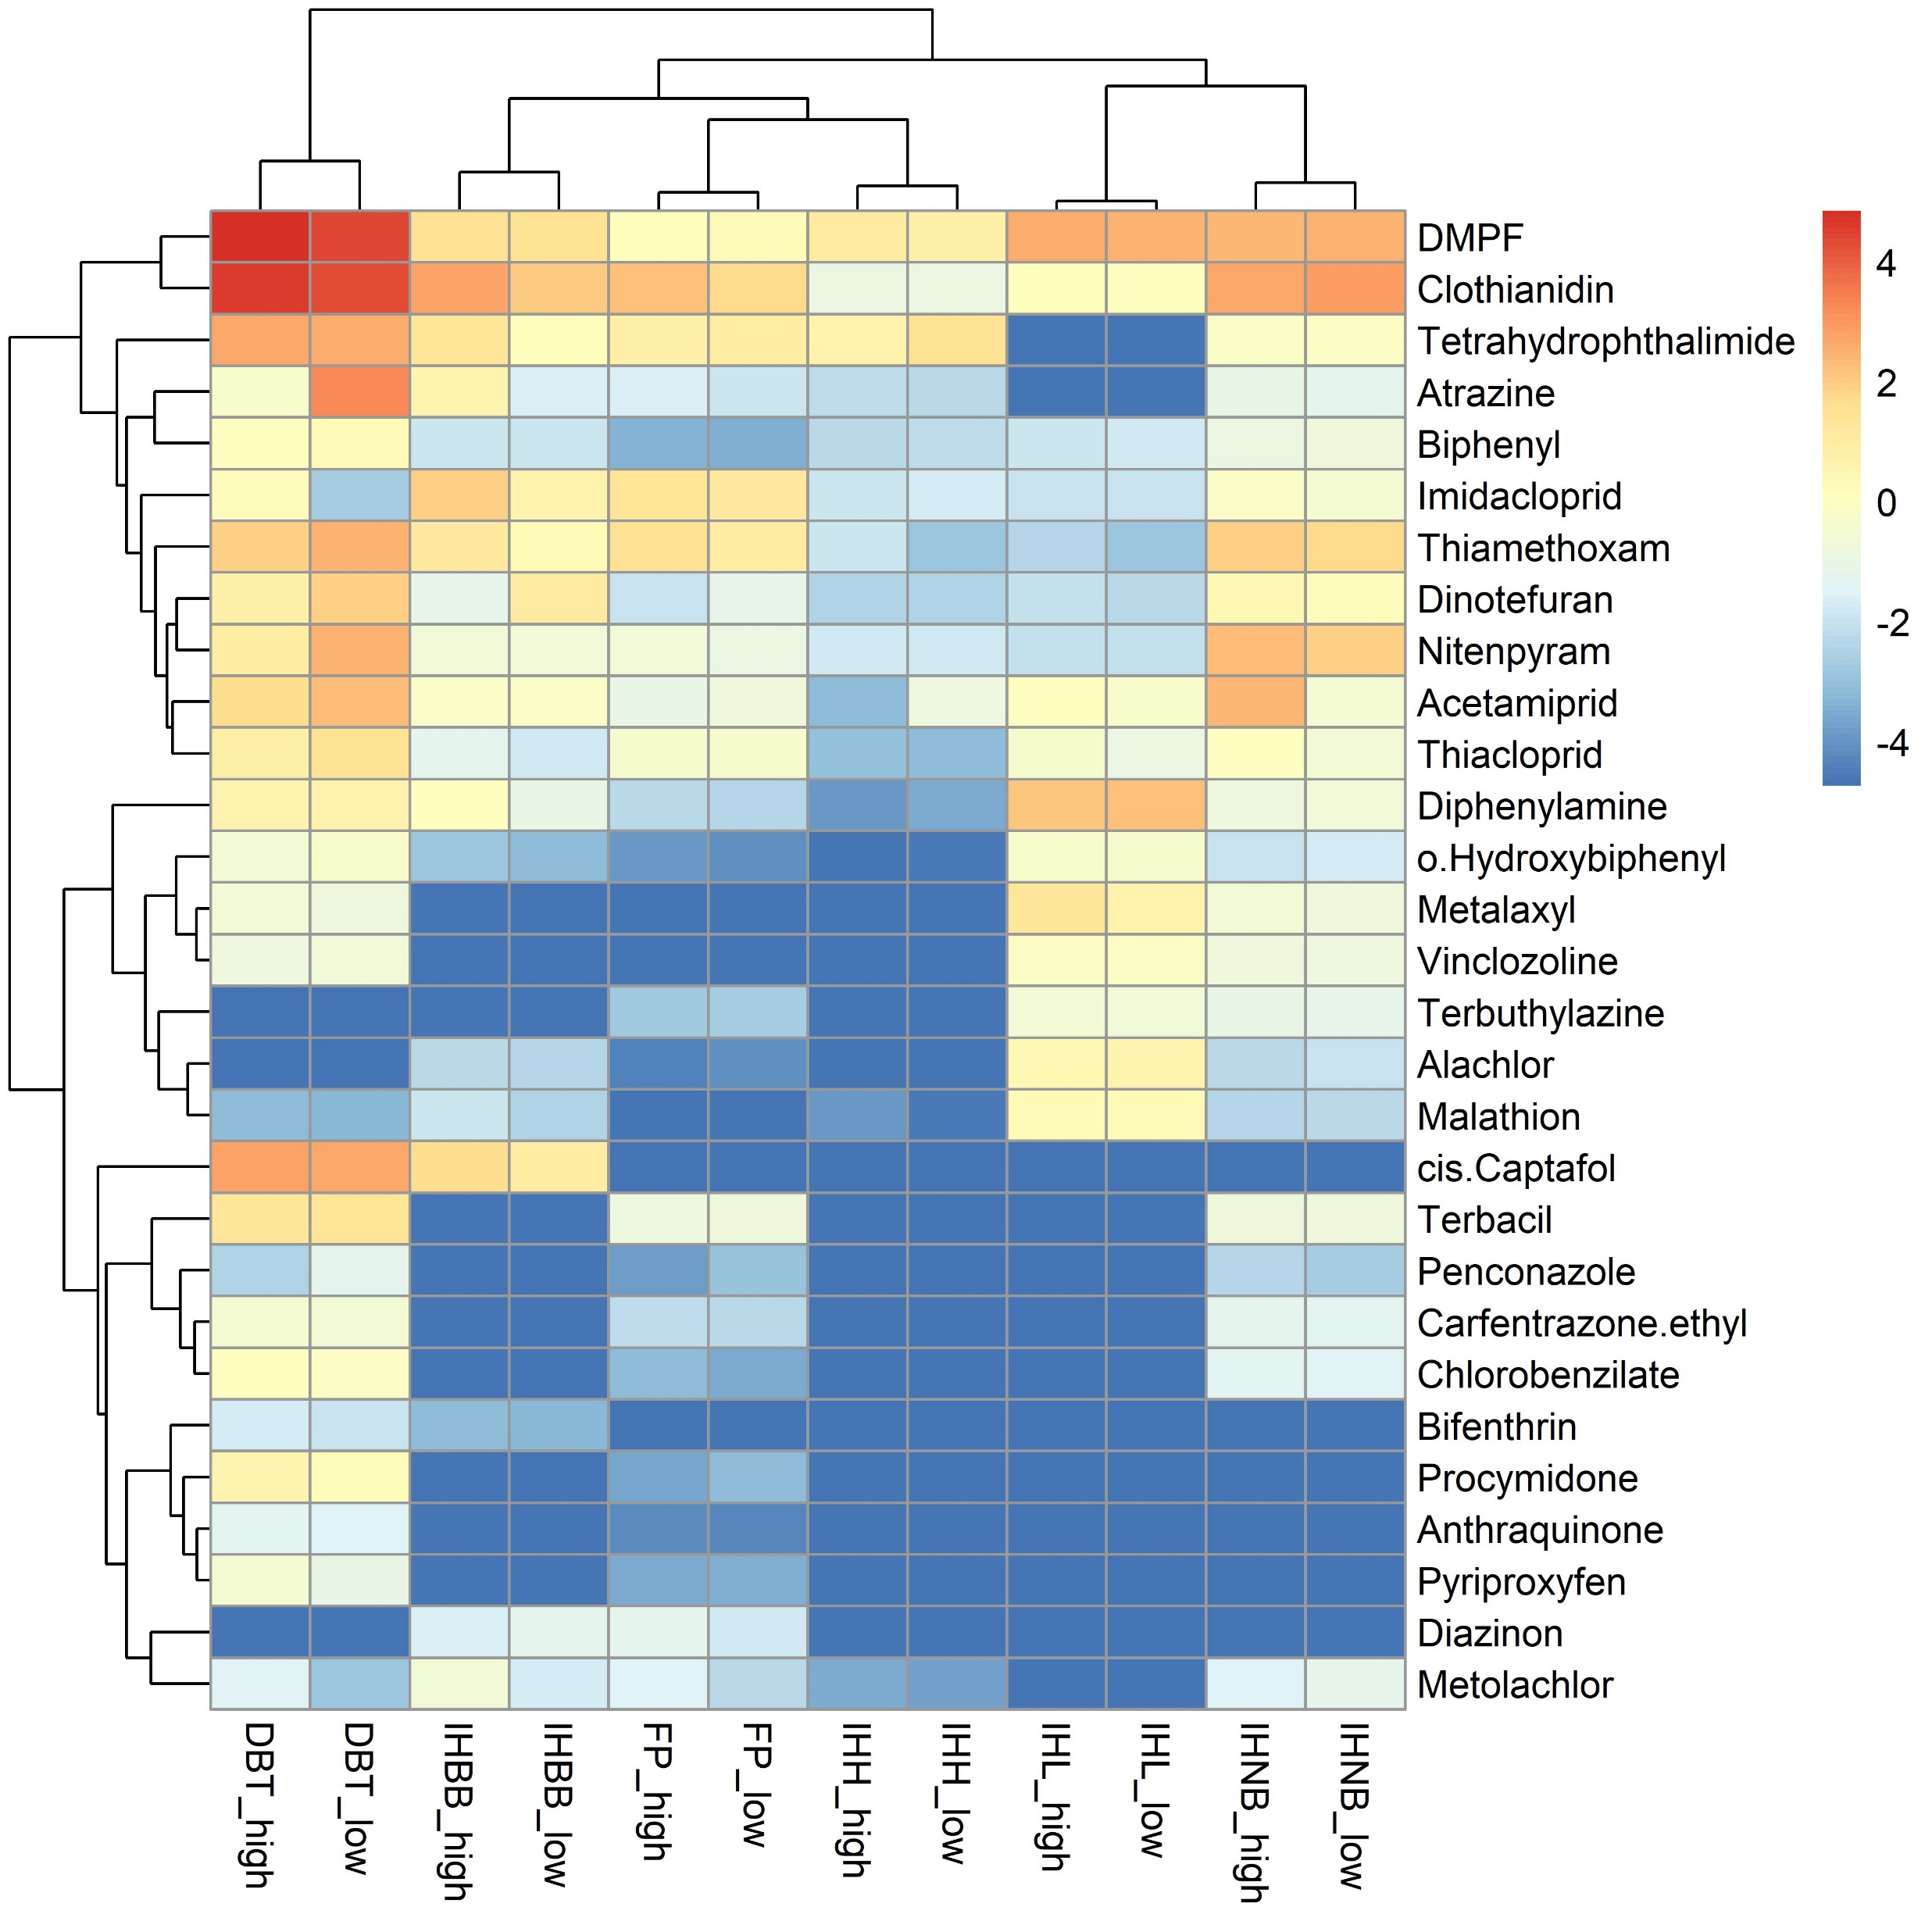
Figure X. Heatmap of mean logged chemical concentrations for the different measured matrices. Screening consists of keeping chemicals with greater that 10% detection frequency in 2 or more matrices. Low and high refer to agricultural cover in the vicinity… Matrix type is more influential than agricultural cover for clustering (columns). However, high ag has higher concs more often than not within a media type. The consistently cross-matrix chemical cluster (top 11 rows) are a number of neonics and …

Slide 3
Figure X. Detection frequency plots

Slide 4
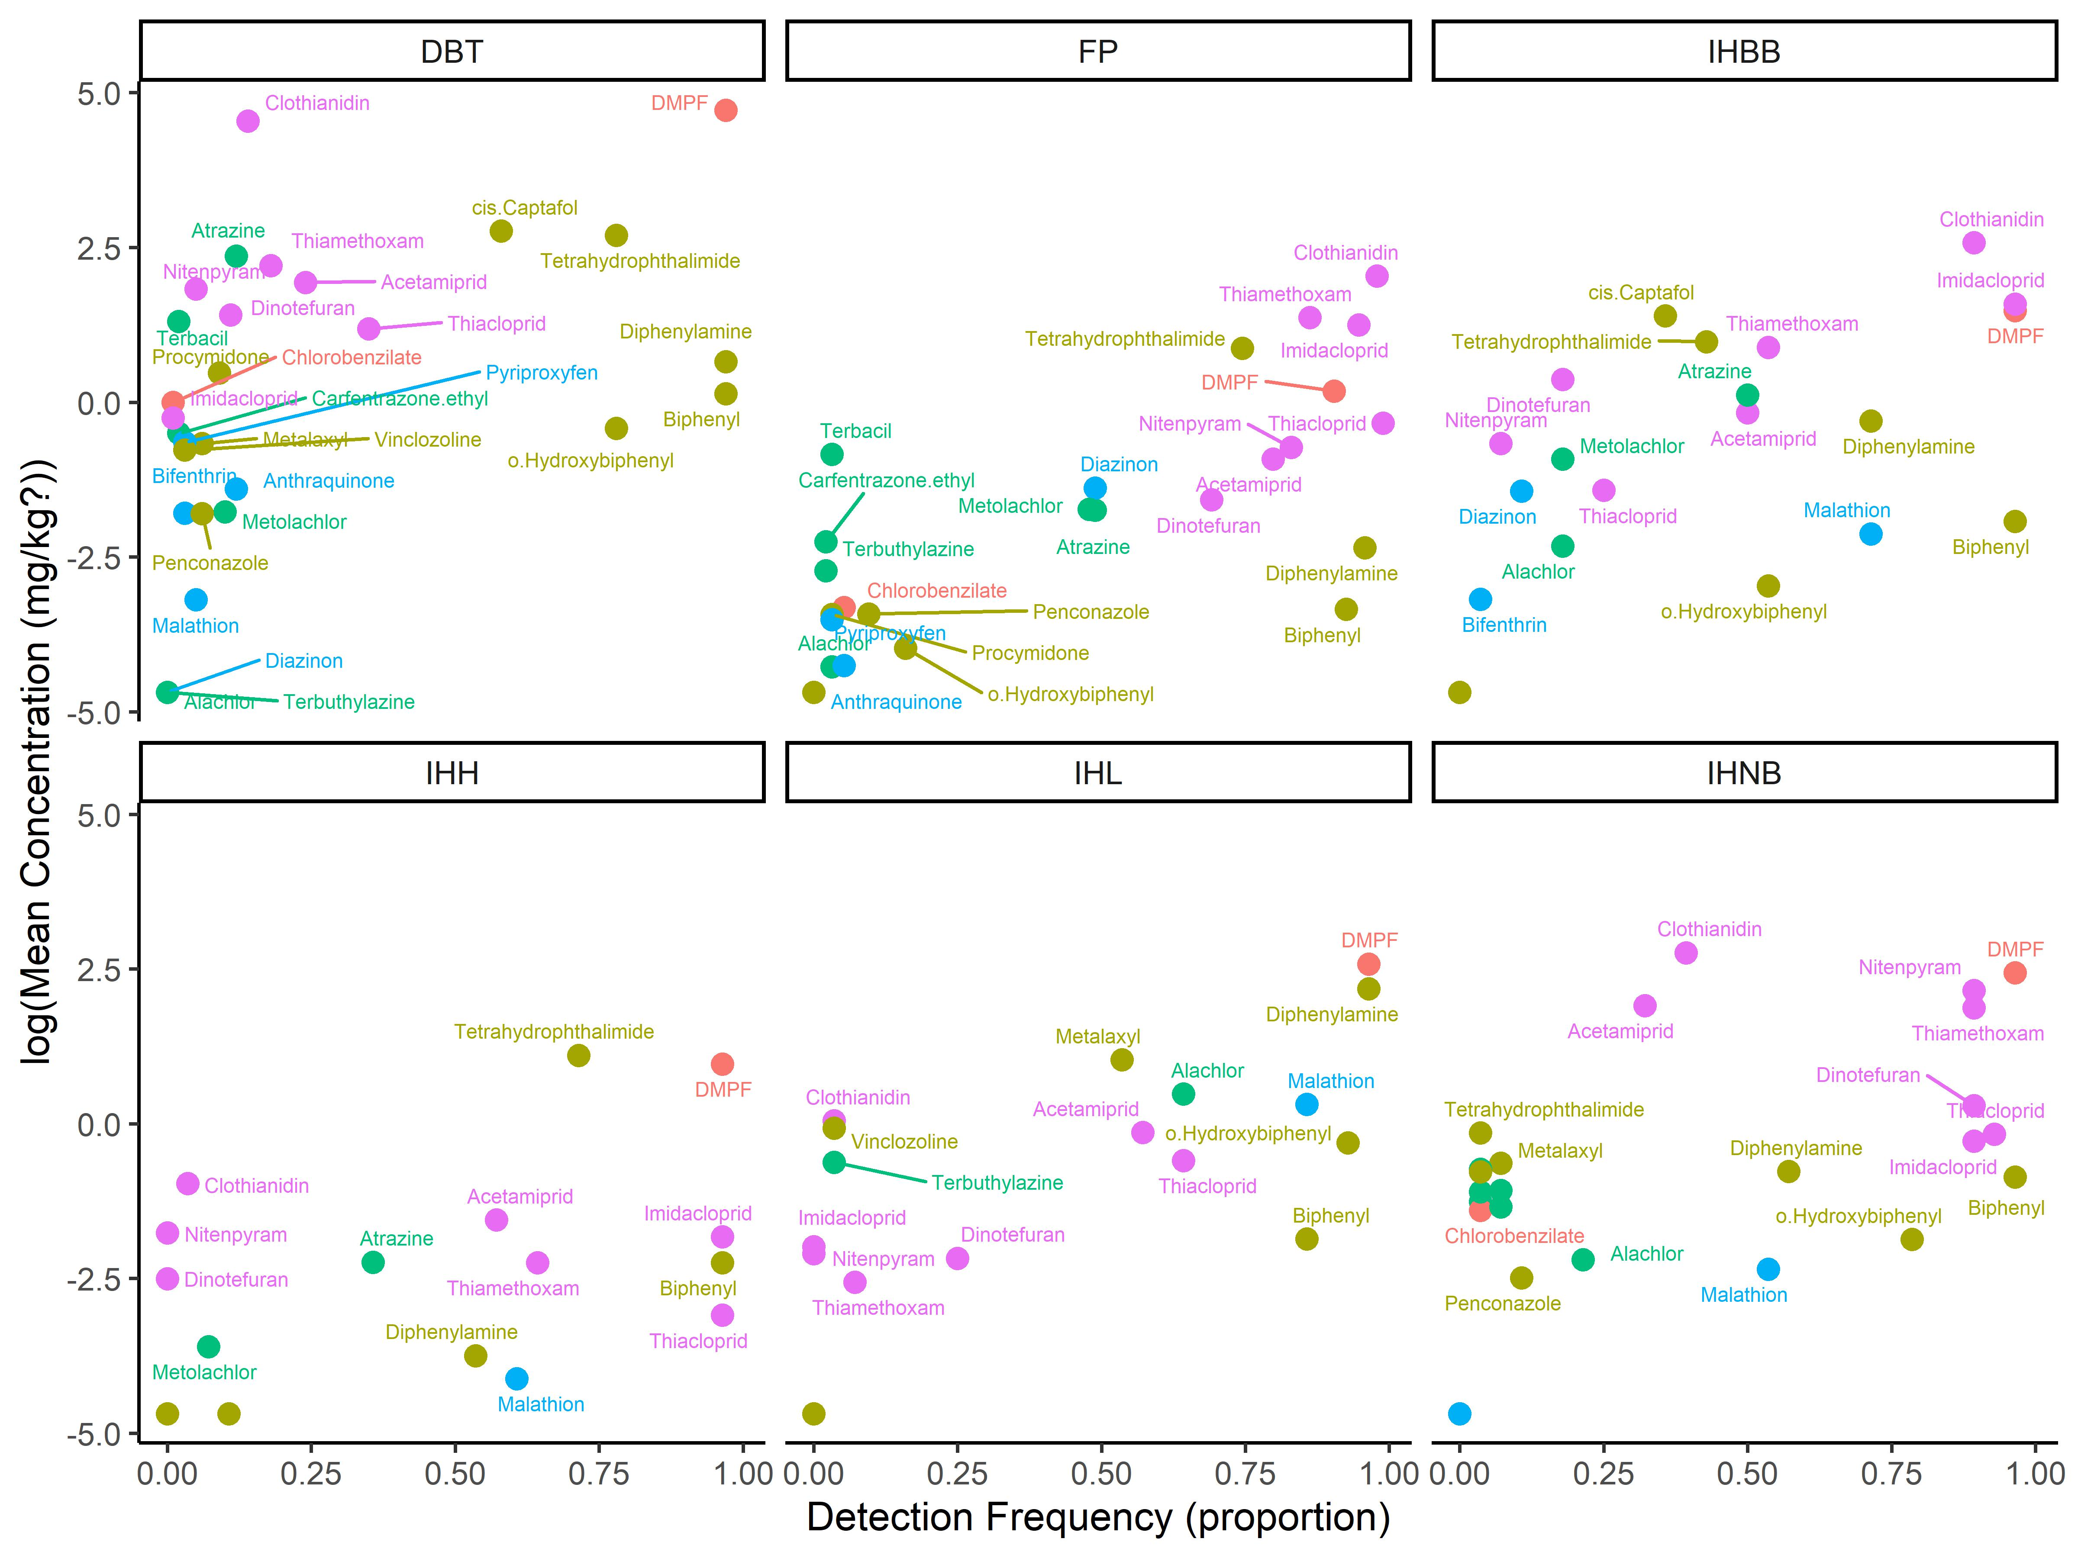
Figure X. Matrix specific plots
Needed edits: confirm units, no labels for log(conc) < -2.5 and det_freq <0.25, situate legend inside figure with chemical types.

Slide 5
Kernel density plots

Slide 6
Kernel density based on ag coverage

