Slide 1
Bee Map tool dataset
>3 million records
After removing records for which no month/year was recorded: >2.5 million records
After removing records prior to 1960: ~ 2 million
Timing:
Oldest record: 1648
Newest record: 2023
Abundance:
Abundance data ranges from 1-1000 for individual counts at location
Uncertainty:
Coordinate uncertainty: NA, 0 - >300,000m
N species:
4202 unique species
Bee Gap includes information on habitat preferences, presence within states, nesting behavior, voltinism, sociality, foraging behavior, tongue length, etc. for individual species

Slide 2
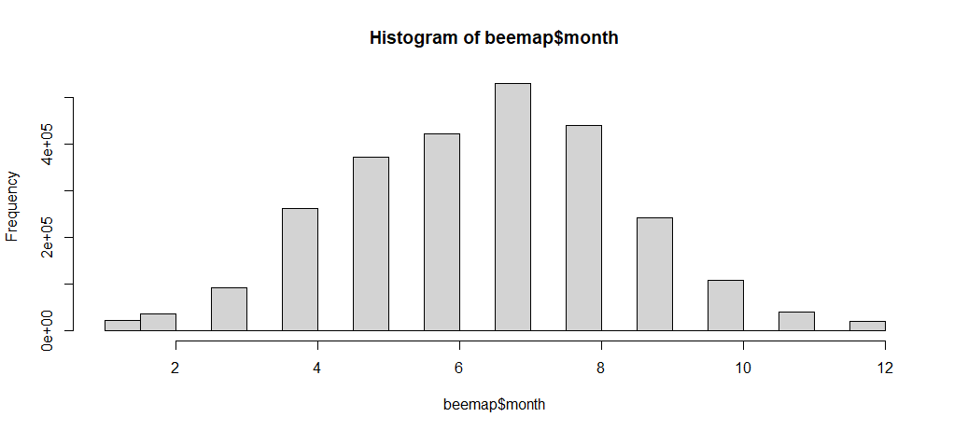

Slide 3
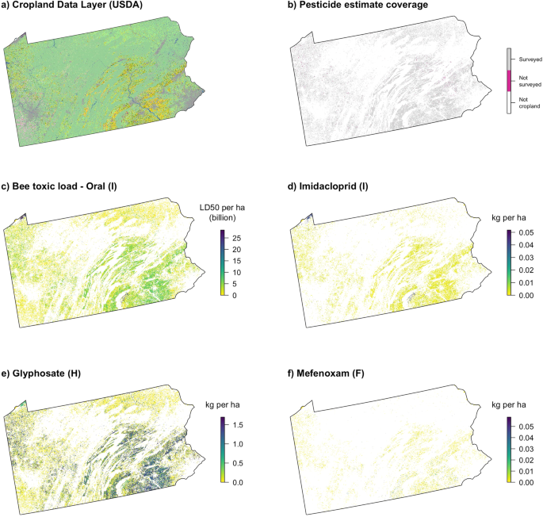
Douglas et al. 2022 loading outputs; would require HPC use but feasible to do for all U.S. where compound info is available
Groups of application type and timing
Groups of compound type?

Slide 4
Applied filters to remove:
All before 1960
Remove any with no information on month of sighting
Removed all iNaturalist
All not classified as: human observation, occurrence, machine observation, or living specimen (i.e., all museum records)
Remove all records with greater than 500m uncertainty
Filter by US location
End result: only 350 records
What percent is absence?
Tour of metadata and columns
Gonna be more advanced to work with than we’d like
Options:
Keep iNaturalist, use county-level diversity metrics

