Slide 1
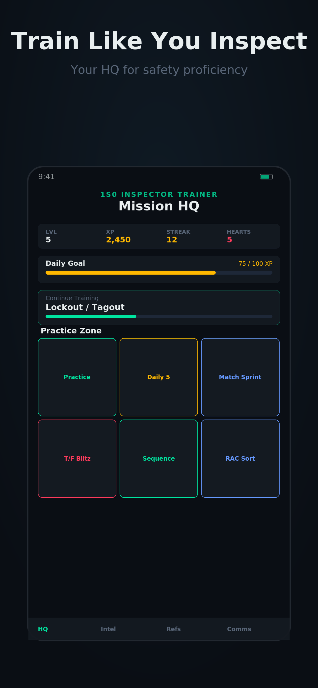

1S0 Inspector Trainer
Train Like You Inspect
Scenario-based safety training for Air Force 1S0 professionals.
OSHA-aligned. Gamified. Built for your phone.
iOS App | Education | Free | No Account Required

Slide 2
The Problem
Skills Fade Fast
Inspectors go weeks or months between real inspections. Without reinforcement, critical knowledge erodes.
Training is Passive
Slide decks and CBTs don't build decision-making skills. Inspectors need scenario practice, not just reading.
No Pocket Tool
There's no quick, mobile way to drill OSHA & AF safety topics on-the-go. Until now.

Slide 3
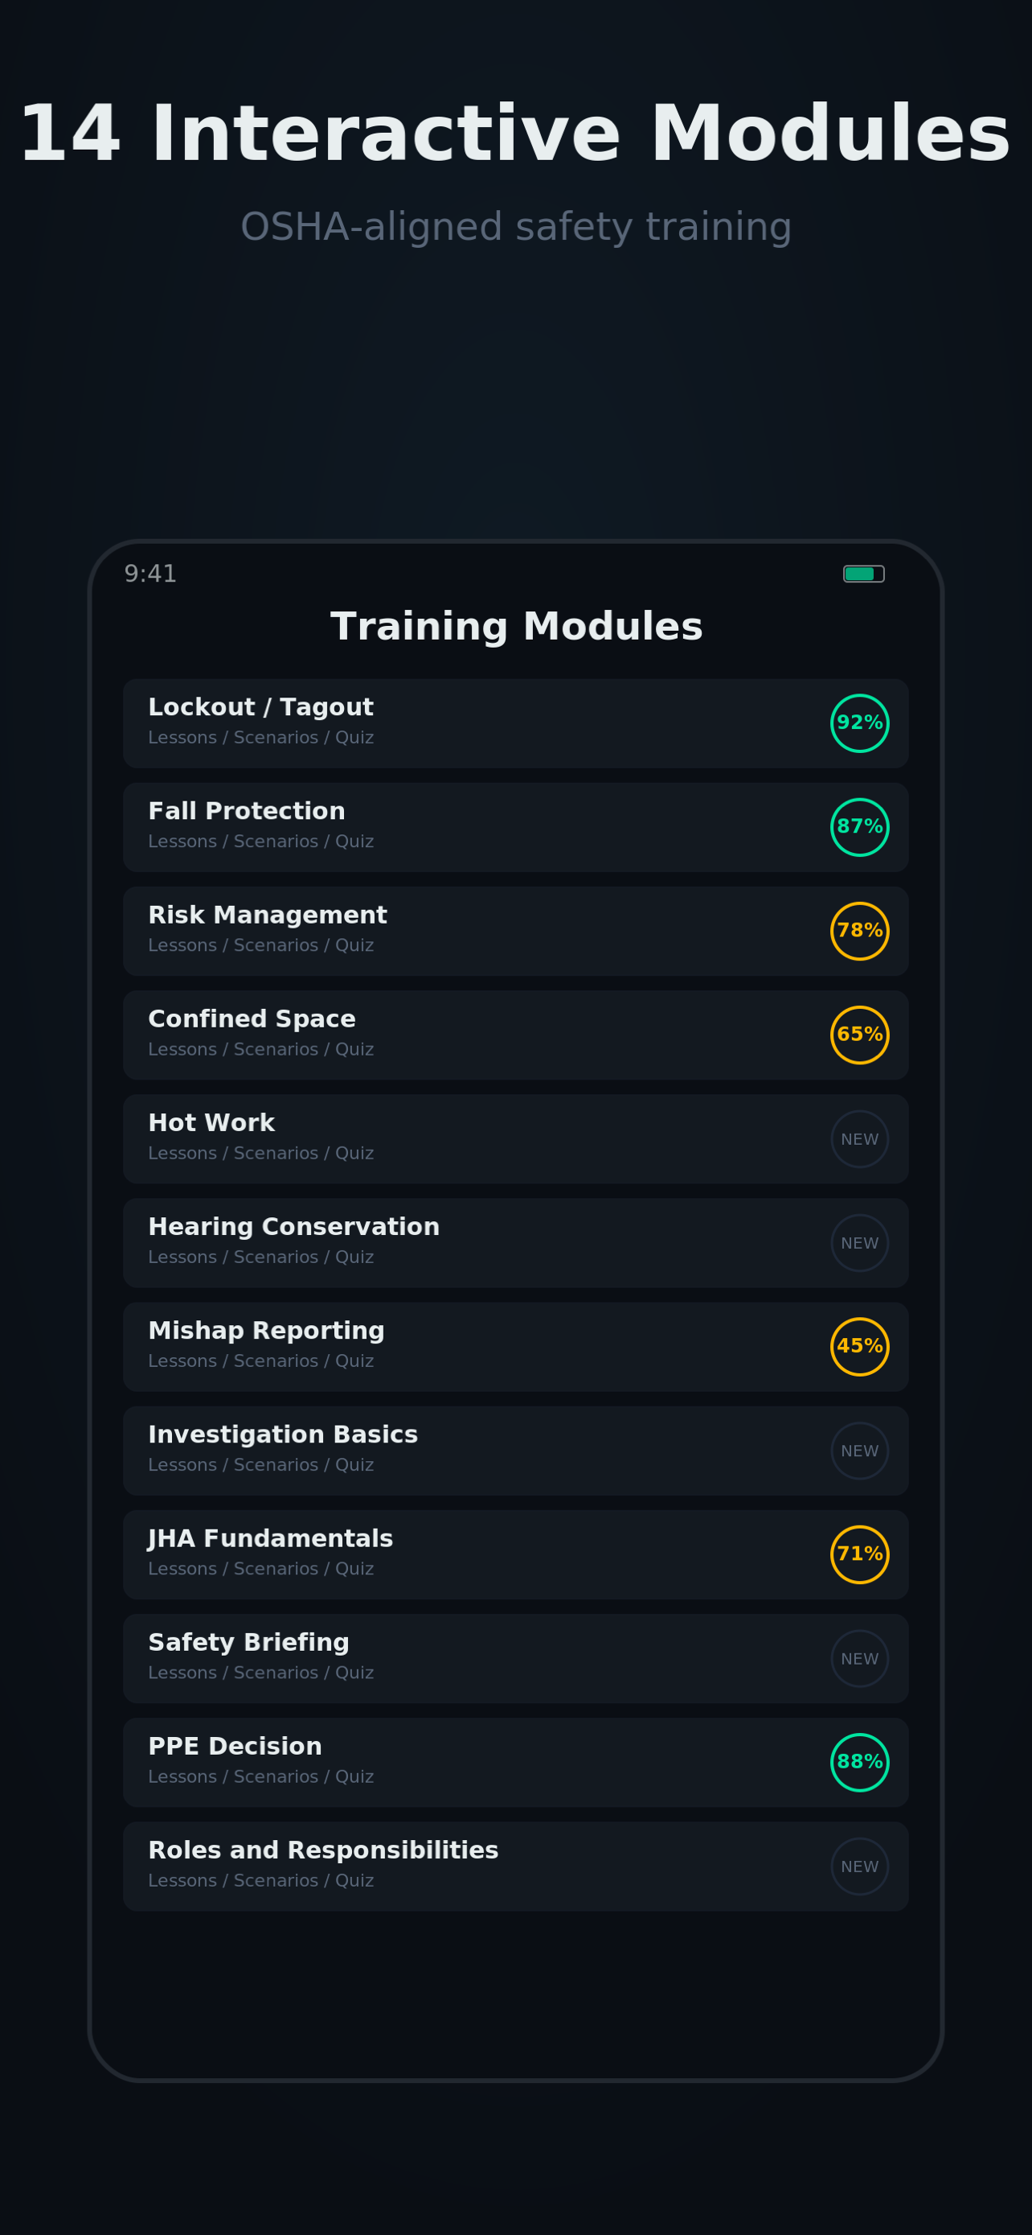
14 Interactive Modules
OSHA-aligned, scenario-driven training
Lockout / Tagout
Investigation Basics
Fall Protection
JHA Fundamentals
Risk Management
Safety Briefing
Confined Space
PPE Decision
Hot Work
Roles & Responsibilities
Hearing Conservation
Hazard Abatement
Mishap Reporting
RAC System
Each module includes:
Lessons + Scenarios + Quiz

Slide 4

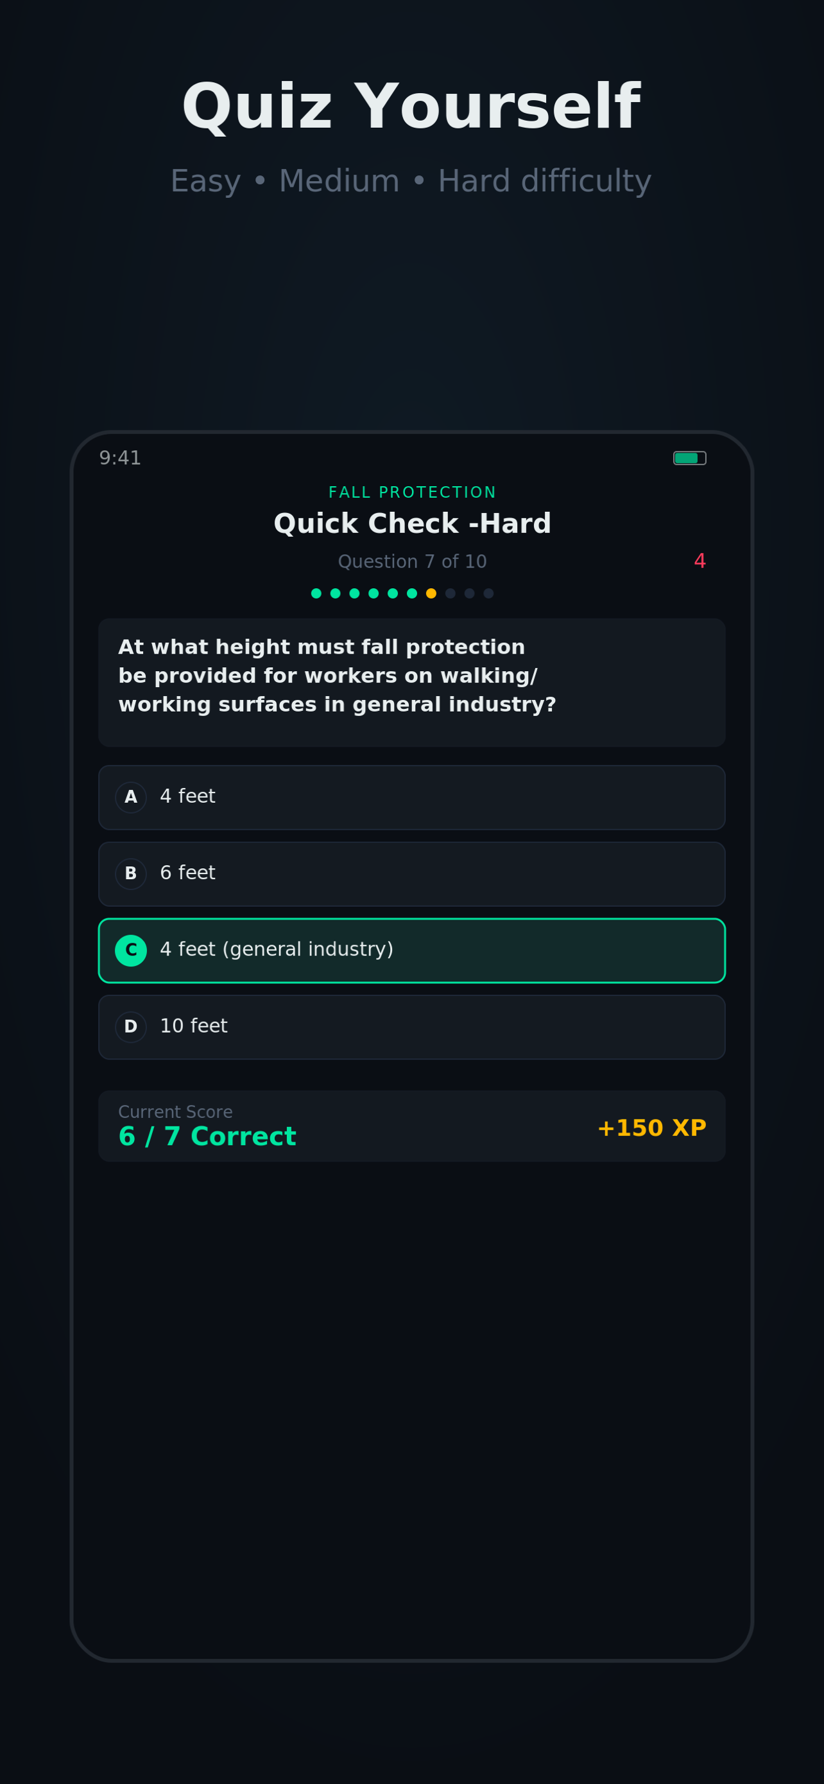
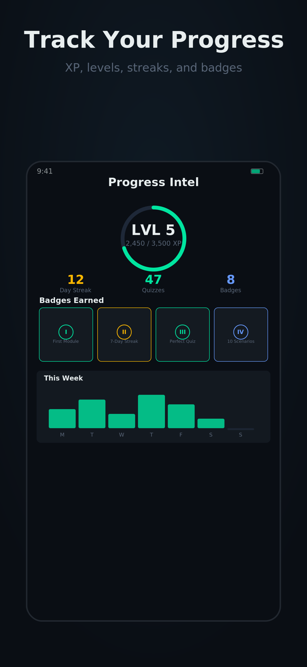
Gamified Progression
XP & Levels
Earn points for every lesson and quiz. Level up as you master content.
Streaks & Hearts
Daily goals keep you consistent. Hearts add stakes to quizzes.
Badges & Stats
Unlock achievements. Track quizzes completed, accuracy, and weekly activity.
Practice Zone
Daily 5, Match Sprint, T/F Blitz, RAC Sort — six drill modes.

Slide 5



Built for Privacy & Simplicity
Zero Data Collection
Always Current
Instant Value
No accounts, no analytics, no ads. Everything stays on your device.
Content aligned to OSHA standards and AF safety guidance. Easy to expand.
Download and start training immediately. No setup, no sign-up friction.

Slide 6
Now
Active this month | High confidence | P0-P1
Content Expansion
Add 4 new modules: Electrical Safety, Fire Protection, Ergonomics, Respiratory Protection. 10 questions each.
Adaptive Difficulty Tuning
Calibrate AdaptiveDifficultyManager thresholds based on user feedback across all 14 existing modules.
App Store Optimization
Update screenshots for iPhone 16/iPad, refine keywords, add App Preview video. Push v1.1 build.
Bug Fixes & Polish
Fix streak reset edge cases, quiz timer on smaller screens, VoiceOver label gaps from feedback reports.
Onboarding Flow Refinement
Polish OnboardingPathView and RoleSelectionView. Reduce steps, clarify role picker for new users.

Slide 7
Next
1-3 months out | Planned and scoped | P1-P2
Spaced Repetition Engine
SM-2 algorithm for quiz review scheduling. Surface missed questions at optimal intervals for long-term retention.
Leaderboard (Local/Unit)
Anonymous leaderboard via unit code. No account required. Data stays on-device via shared UserDefaults or iCloud KVS.
Scenario Branching Expansion
Multi-path decision trees for existing scenarios. 2-3 branching paths with different outcomes and feedback per scenario.
Study Plan / Guided Paths
Training tracks like “New Inspector 30-Day Plan” or “Annual Refresher” that auto-sequence modules and daily goals.

Slide 8
Later
3-6+ months | Directional | Strategic bets
Base-Specific Content Packs
Configurable content layers for specific installations. Units load supplemental procedures on top of the standard 1S0 curriculum.
AI-Powered Question Generation
On-device ML or API-assisted generation of new quiz questions from uploaded AFIs/TOs. Keeps content fresh without manual authoring.
Multi-AFSC Expansion
Extend platform beyond 1S0 to adjacent safety AFSCs (4B0 Bioenvironmental, 4E0 Public Health). Same engine, different content packs.

Slide 9

Ready to Train?
Available on the App Store | Free | iOS
1S0 Inspector Trainer | Train Like You Inspect

