Slide 1

Planning & Budgeting
Barnet Federation of Horticultural & Allotment Societies

Slide 2

What is budgeting?
A budget is a plan expressed in financial terms

Slide 3
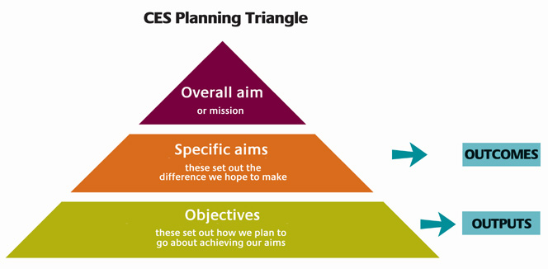
Planning – an overview

Slide 4
Aims - objectives - budget
The organisation has an overall aim or mission
There are specific aims that set out the difference the organisation hopes to make
  These differences are OUTCOMES
Specific objectives set out how the aims are to be achieved
  the objectives require activities that produce OUTPUTS
  The resources needed for each activity can be quantified in a BUDGET

Slide 5
Identify Inputs
What do we need to have in order to make this plan work?
Staff
Materials
Space
Time
Include everything (100% rule)

Slide 6
Make Assumptions
How many staff?
How much space?
How many users?
How long will the project run for?
How many hours per weeK
Etc.

Slide 7
Types of cost
Fixed costs
Variable Costs
Project / direct costs
Overheads / indirect costs
Capital costs
Start up costs
Capital Costs
Revenue Costs

Slide 8
Key Tips
Be reasonable
Be prudent
Be realistic
Be consistent.

