Slide 1
Beebee's Portfolio
(9/2005 – 4/2007, for Microsoft Windows Live)

Slide 2
Project list:
1. Product design
Search Pane
Expo Cargo
Live Portal Mobile Version
2. Simulation demo for usability testing
Search Pane feature demo
Live portal demo
MSN Cartoon demo
Virtual Earth demo
3. Research
Conduct Search Pane Contextual Interview
Local IM Product Research

Slide 3
1. Product
Search Pane - Introduction
Participated in the whole design process:
product definition
usability testing
interaction design
visual design
design specification
product maintenance
Working on this product, I understood the user-centered design flow and knew the importance of the user experience of a product.

Slide 4
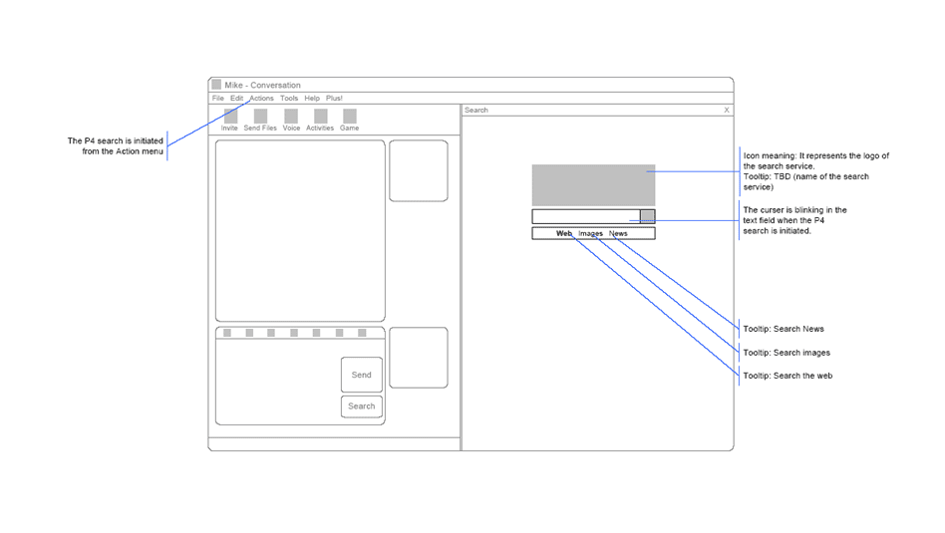
1. Product
Search Pane – Interaction Design Example 1

Slide 5
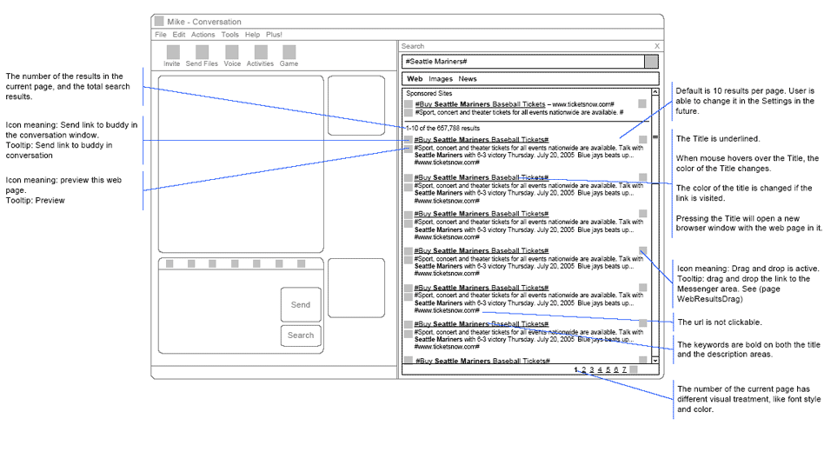
1. Product
Search Pane – Interaction Design Example 2

Slide 6
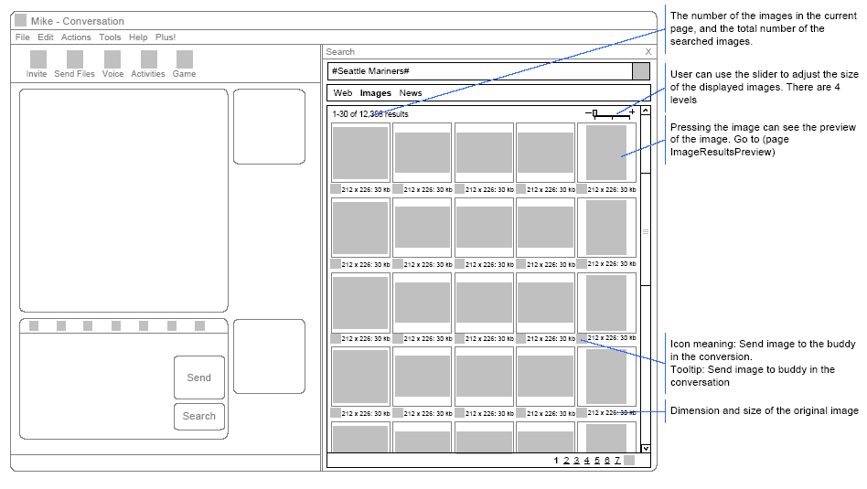
1. Product
Search Pane – Interaction Design Example 3

Slide 7
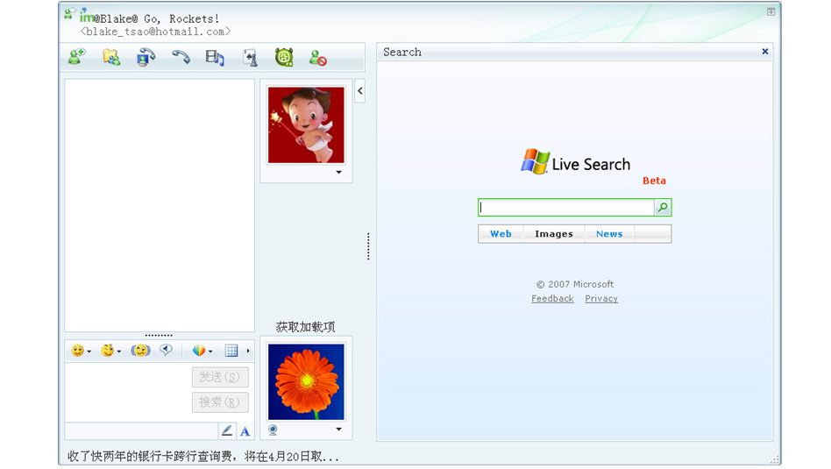
1. Product
Search Pane – Visual Design Example 1

Slide 8
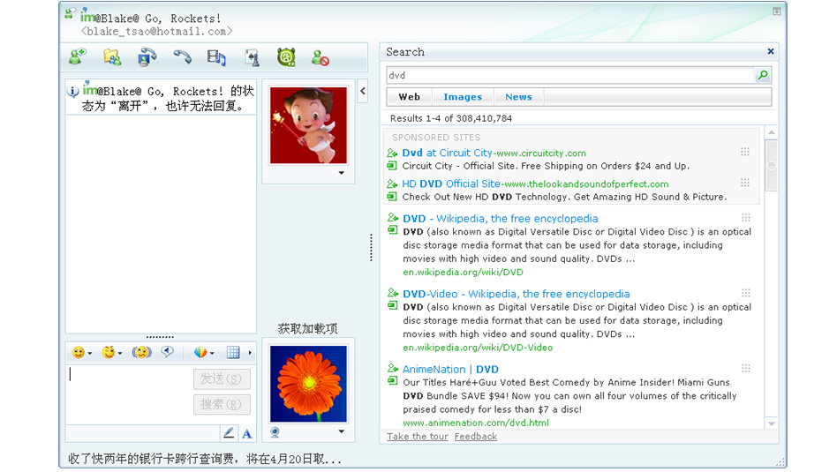
1. Product
Search Pane – Visual Design Example 2

Slide 9
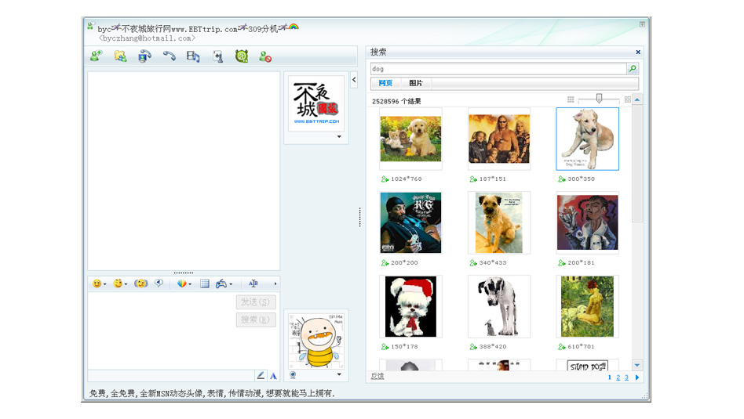
1. Product
Search Pane – Visual Design Example 3

Slide 10
1. Product
Expo Cargo
Expo Cargo is a B2B site, which hasn’t been released yet.
Live Portal Mobile Version
The product is the new mobile version for live.com, which hasn’t been released yet.
Sorry, all of the above are Microsoft confidential.
Examples and images cannot be provided.

Slide 11
2. Simulation demo for usability testing
Search Pane feature demo
Provided different designs for the product features for the usability testing. Selected the proper one after comparing their usability.
Live portal demo
The demo is for the new live.com site (Chinese version). The new site has a new visual design style, which allows users to customize the look and feel of the live portal.
Sorry, all of the above are Microsoft confidential.
Examples and images cannot be provided.

Slide 12
2. Simulation demo for usability testing
MSN Cartoon demo
Msn Cartoon provides a service to convert user’s real photos into pictures in cartoon style. The demo simulates features of the service including: taking photos with camera, zooming in and zooming out, changing clothes for the role etc. The goal of this demo is to test the usability of these features.
Virtual Earth demo
This is a simulation of VirtualEarth.com. Features include drag & drop, zooming in/out for the map.
Sorry, all of the above are Microsoft confidential.
Examples and images cannot be provided.

Slide 13
3. Research
Search Pane Contextual Interview
I conducted a Contextual Interview when the Search Pane beta was just released.
‘Contextual’ means I need to go the user’s real environment and observe how they use the beta version. I visited 8 users for 4 times per person. It took 1 month in total. This is an exciting experience for me to work with the real users. I learned how to design tasks and how to interview users.
The results of the contextual interview directly influenced the following development of the product. For example, the Search Pane’s send icon is grey and small in the beta. It is very difficult to find by users. The product team had made it clearer and bigger in the next version.

Slide 14
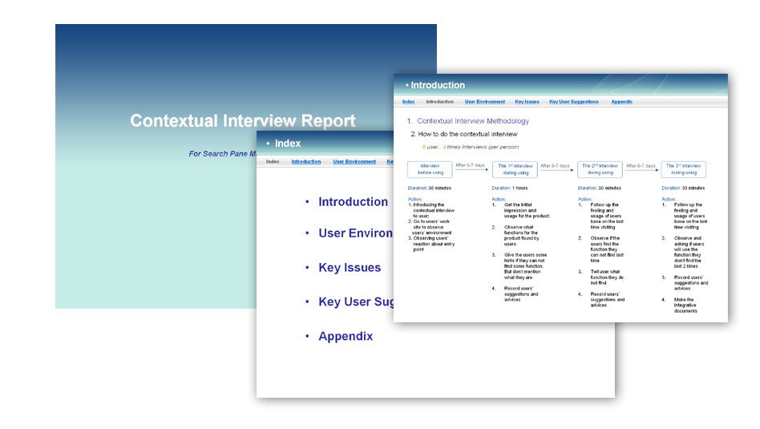
3. Research
Search Pane Contextual Interview - Report Screenshot

Slide 15
3. Research
Local IM Product Research
There is much difference between China market and US market. So when we want to localize the IM product, we need to understand the local IM products.
I did the research in the following areas.
Major use cases
Killer features
Sticky features
How to gain revenue
Opportunities

Slide 16
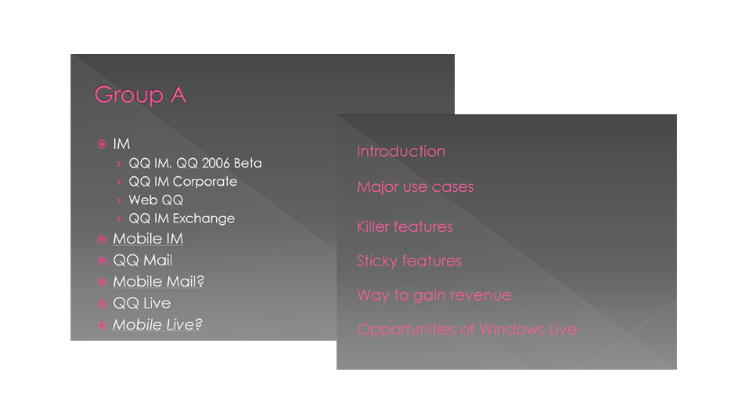
3. Research
Local Product Research - Report Screenshot

Slide 17
Thank you !

