Slide 1
CSCI 126
CSCI 126
A Photo Database
Bee Cha

Slide 2
Domain Description
What kind of data?
  Picture
  Camera
  Lens
Where to get the data?
  From the photographers
  Camera settings

Slide 3
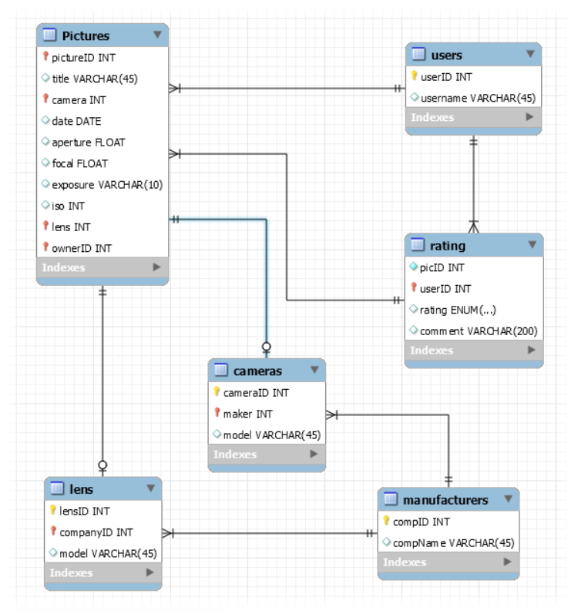
ERD

Slide 4
Schema
pictures (pictureID, title, camera, date,
aperture, focal, exposure, iso,
lens, ownerID)
users (userID, username)
cameras (cameraID, maker, model)
lens (lensID, companyID, model)
manufacturers (compID, compName)
ratings (picID, userID, rating, comment)

Slide 5
Triggers?
When deleting a picture, set rating(s) of
deleted picture to NULL value

Slide 6
Queries
Simple queries
  Average rating
  Number of pictures
  User's collection of lens
More complex queries
  Users with an above average rating with
  a subpar camera with no lens (users who
  don't own a DSLR camera)
  Users with an expensive DSLR camera with
  an expensive lens with poor ratings
  (users who have spent so much money and
  yet achieved poor ratings)

Slide 7
Application use and Data Mining
Popular cameras/lens
  Pictures and cameras with the highest
  ratings
Common camera settings
  Manufacturers can develop new camera
  and lens accordingly
  Popular trends
    Make updated cameras/lens

Slide 8
Future Work
With PHP
  Link actual picture
Social photo album
  Similarity with IMGUR or Instagram
Newer cameras can now pickup location
of where the picture was shot
  Incorporate location attribute

