Slide 1
A Game of Othello
(Reversi)
Bee Cha CSCI 164

Slide 2
Background
Began coding in high school
Interested in AI gaming

Slide 3
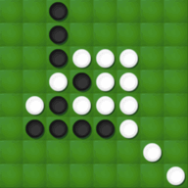
What is Othello?
Two player black and white puzzle game
Dominate the grid space with your
color piece

Slide 4
PEAS
Performance
  Have the most pieces on the game board with maximum score of 64
Environment
  8x8 game board
Actuator
  Placing game pieces upon legal spaces
Sensor
  Game board, and each game piece is similar to the queen in chess

Slide 5
Advesarial Search Approach
Minimax
  Agent will place game piece that will flip the max of opponent's game pieces
Alpha-Beta Pruning
  What depth?
  When to stop evaluating/expanding?
Start Small
  4x4 board

