Slide 1
Another 2D Space Shooter
Bee Cha

Slide 2
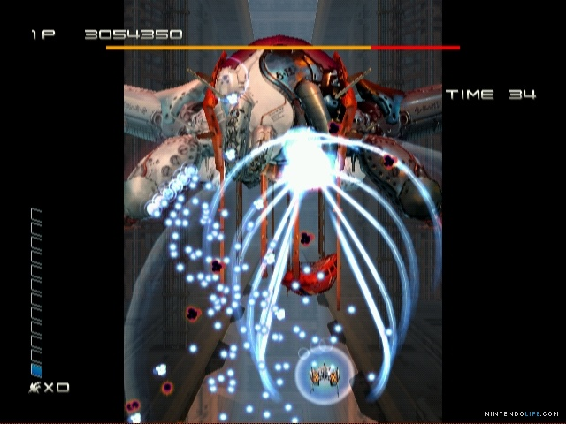
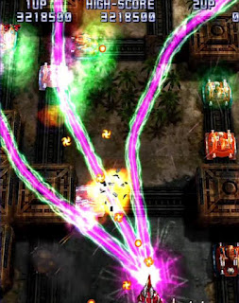
Similar Games
Ikaruga
Raiden

Slide 3
Features
Top down scrolling 2D shooter
Bullet Hell
RPG Elements
  HP
  Experience levels
  Loot (weapon & armor)
  Buffs & debuffs
  Different classes of ships

Slide 4
Unity
Written in C#, a scripted language
Friendly with objects and graphics (especially sprites)
Many resources available

Slide 5
Current progress and demo
Trying to get the skeletal frame of the game first
Looping the background

