Slide 1
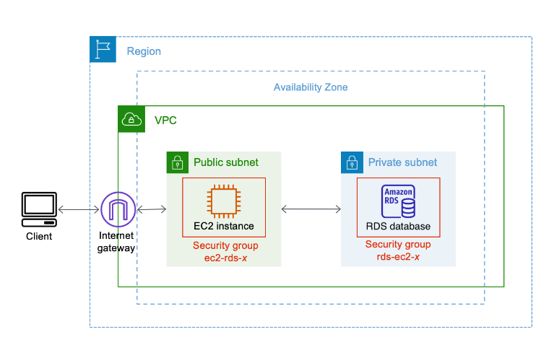
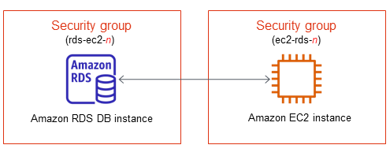
Layout of how the whole picture look like

Slide 2
AWS Web Secure
From: BeiRuiOh
School of IT
DCS

Slide 3
Layout of how it looks like

Slide 4
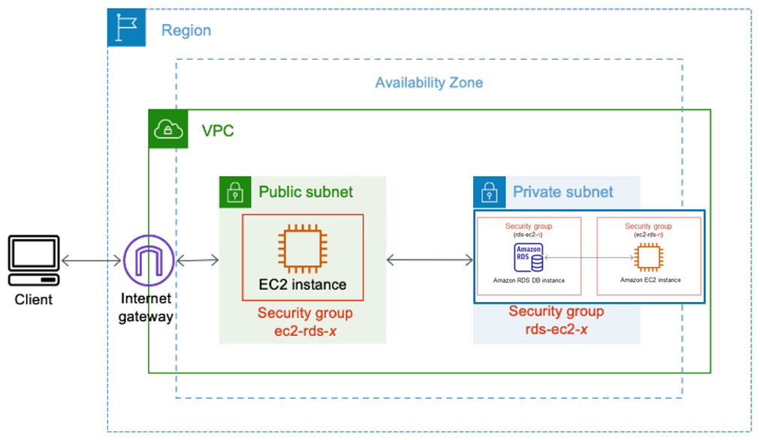
Layout of how the whole picture look like

Slide 5
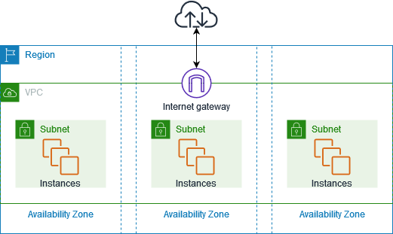
What is Virtual Private Cloud (VPC)
Amazon Virtual Private Cloud (Amazon VPC) enables you to launch AWS resources into a virtual network that you've defined. VPC is a virtual network closely resembles a traditional network that you'd operate in your own data center, with the benefits of using the scalable infrastructure of AWS. After you create a VPC, you can add subnets.
Link:
https://docs.aws.amazon.com/vpc/latest/userguide/what-is-amazon-vpc.html
Notes:
The following diagram shows an example VPC. The VPC has one subnet in each of the Availability Zones in the Region, EC2 instances in each subnet, and an internet gateway.

Slide 6
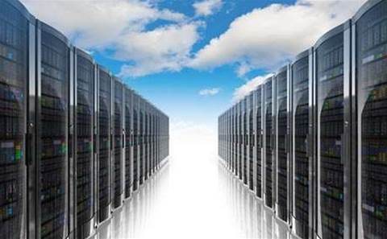
What is Elastic Compute Cloud (EC2)
Amazon Elastic Compute Cloud (Amazon EC2) provides scalable computing capacity in the Amazon Web Services (AWS) Cloud. Using Amazon EC2 eliminates your need to invest in hardware up front, so you can develop and deploy applications faster. You can use Amazon EC2 to launch as many or as few virtual servers as you need, configure security and networking, and manage storage. Amazon EC2 enables you to scale up or down to handle changes in requirements or spikes in popularity, reducing your need to forecast traffic.
Amazon EC2 provides different instance types to enable you to choose the CPU, memory, storage, and networking capacity that you need to run your applications.
Link:
https://docs.aws.amazon.com/AWSEC2/latest/WindowsGuide/concepts.html

Slide 7
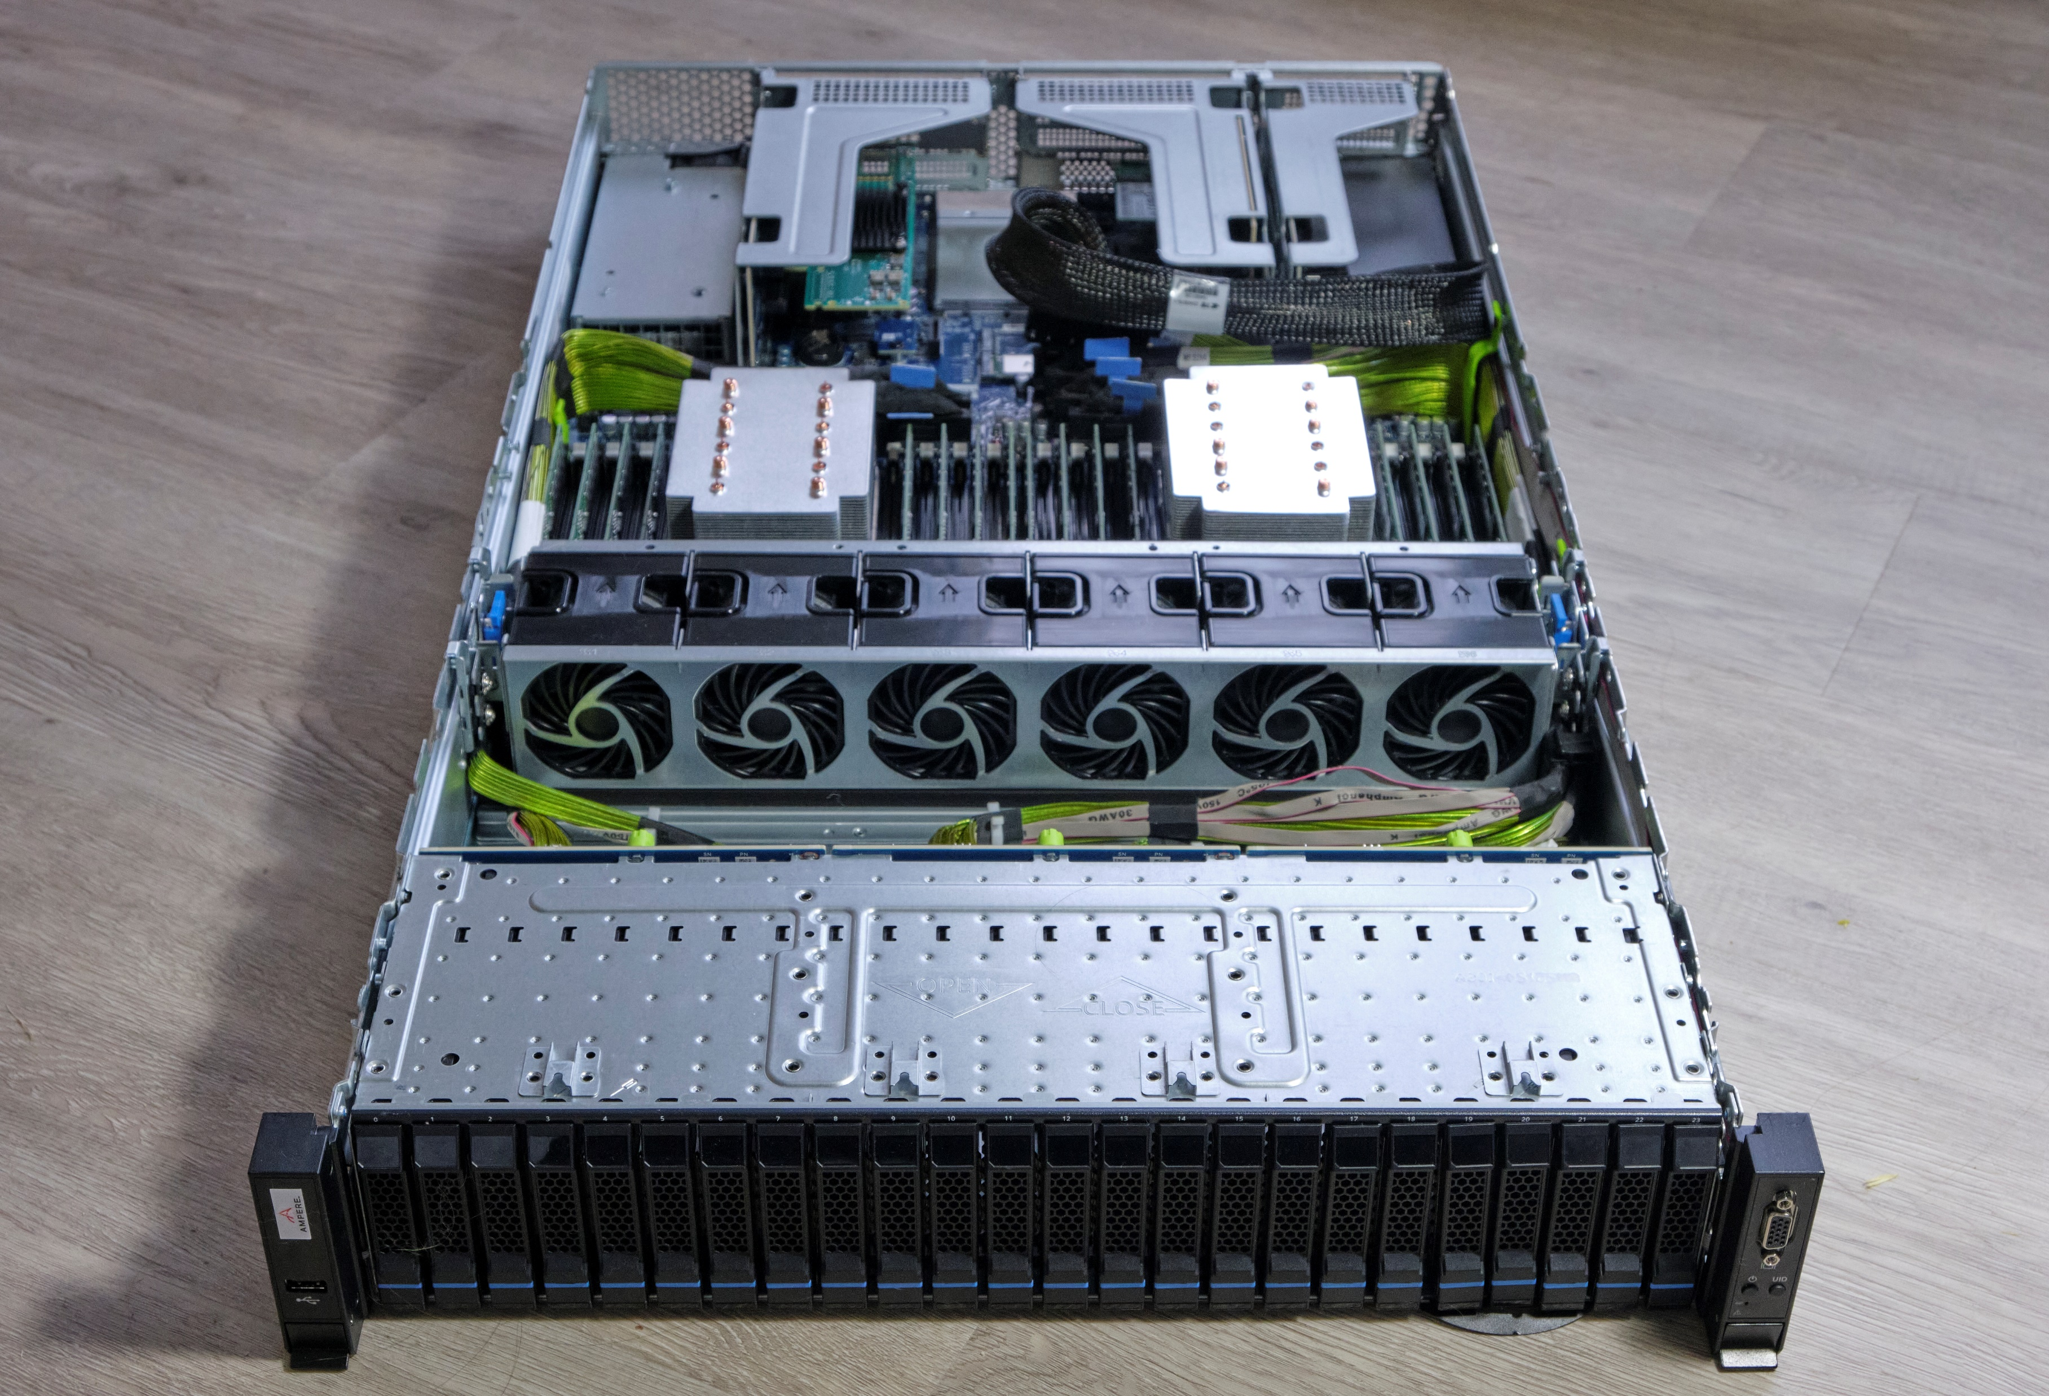
What is Instances
An instance is a virtual server in the cloud.
You can launch different types of instances. An instance type essentially determines the hardware of the host computer used for your instance. Each instance type offers different compute and memory capabilities. Select an instance type based on the amount of memory and computing power that you need for the application or software that you plan to run on the instance.

Slide 8
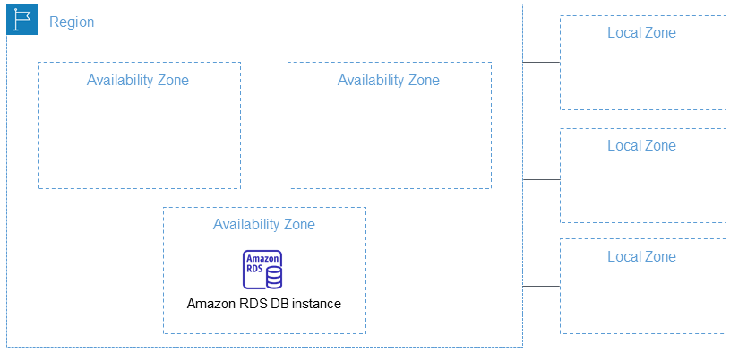
What is Relational Database Service (RDS)
Amazon Relational Database Service (Amazon RDS) is a web service that makes it easier to set up, operate, and scale a relational database in the AWS Cloud. It provides cost-efficient, resizable capacity for an industry-standard relational database and manages common database administration tasks.

Slide 9
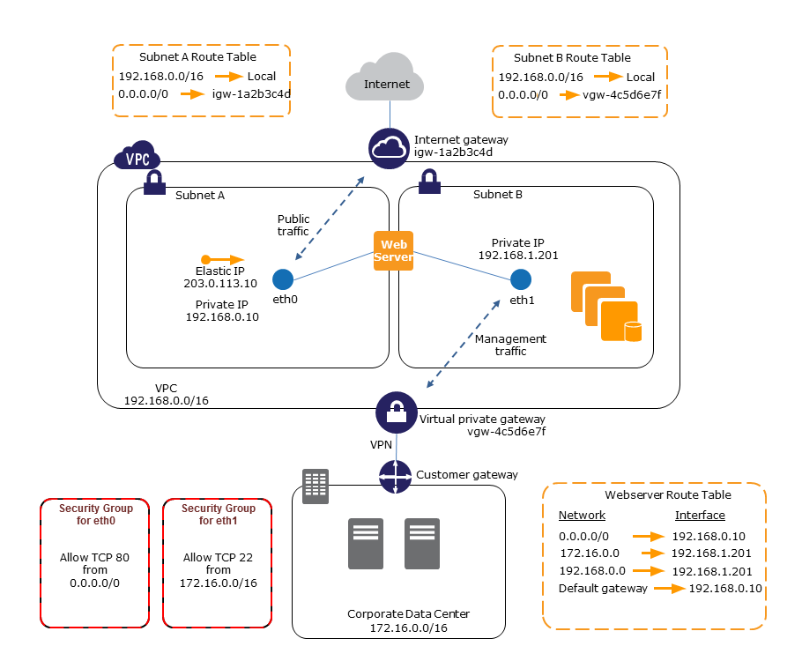

Slide 10
What is Elastic Ip
An Elastic IP address is a static IP address designed for dynamic cloud computing that is associated with your AWS account. It is a public IP address, reachable from the Internet. If your instance doesn’t have a public IP address, you can associate an Elastic IP address with the instance to enable communication with the Internet.

Slide 11
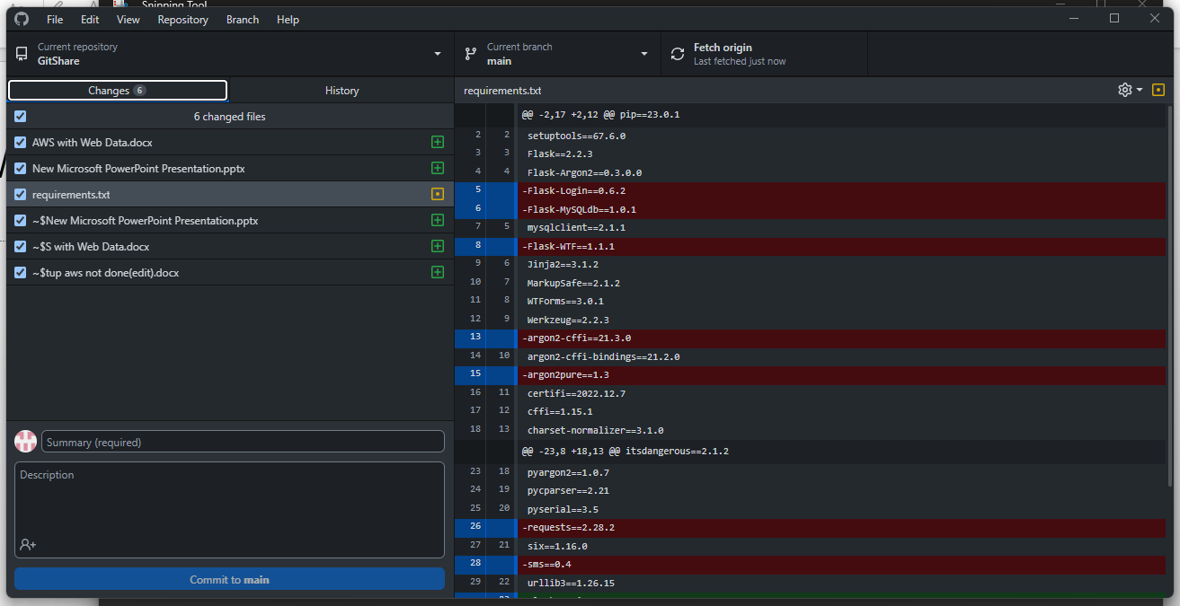
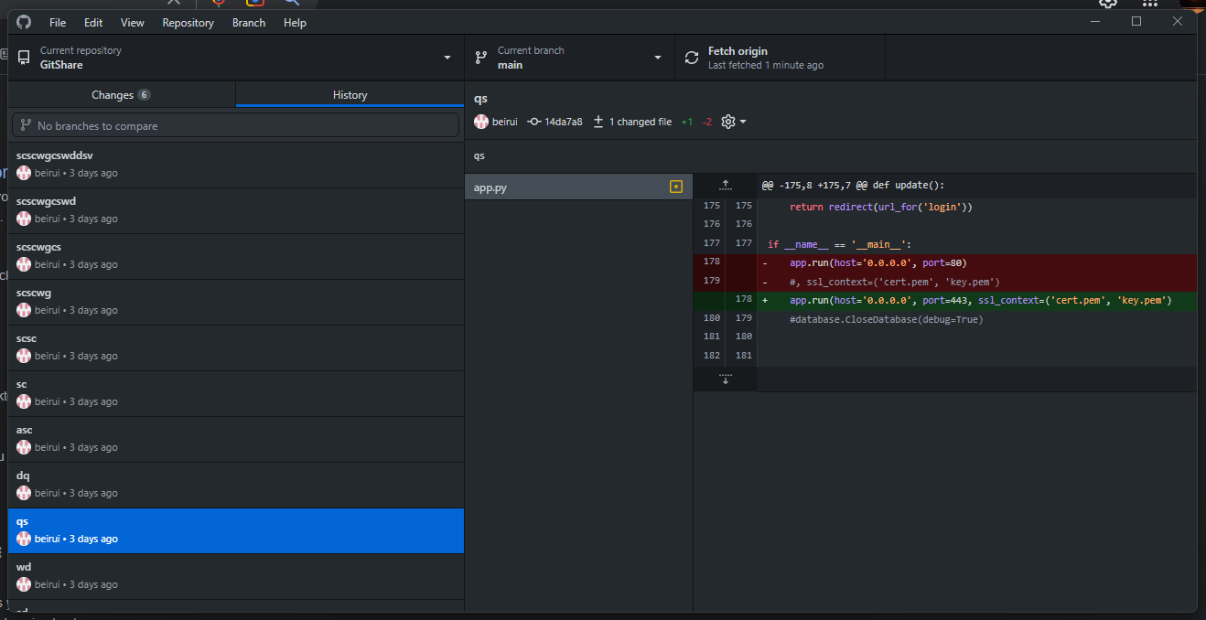
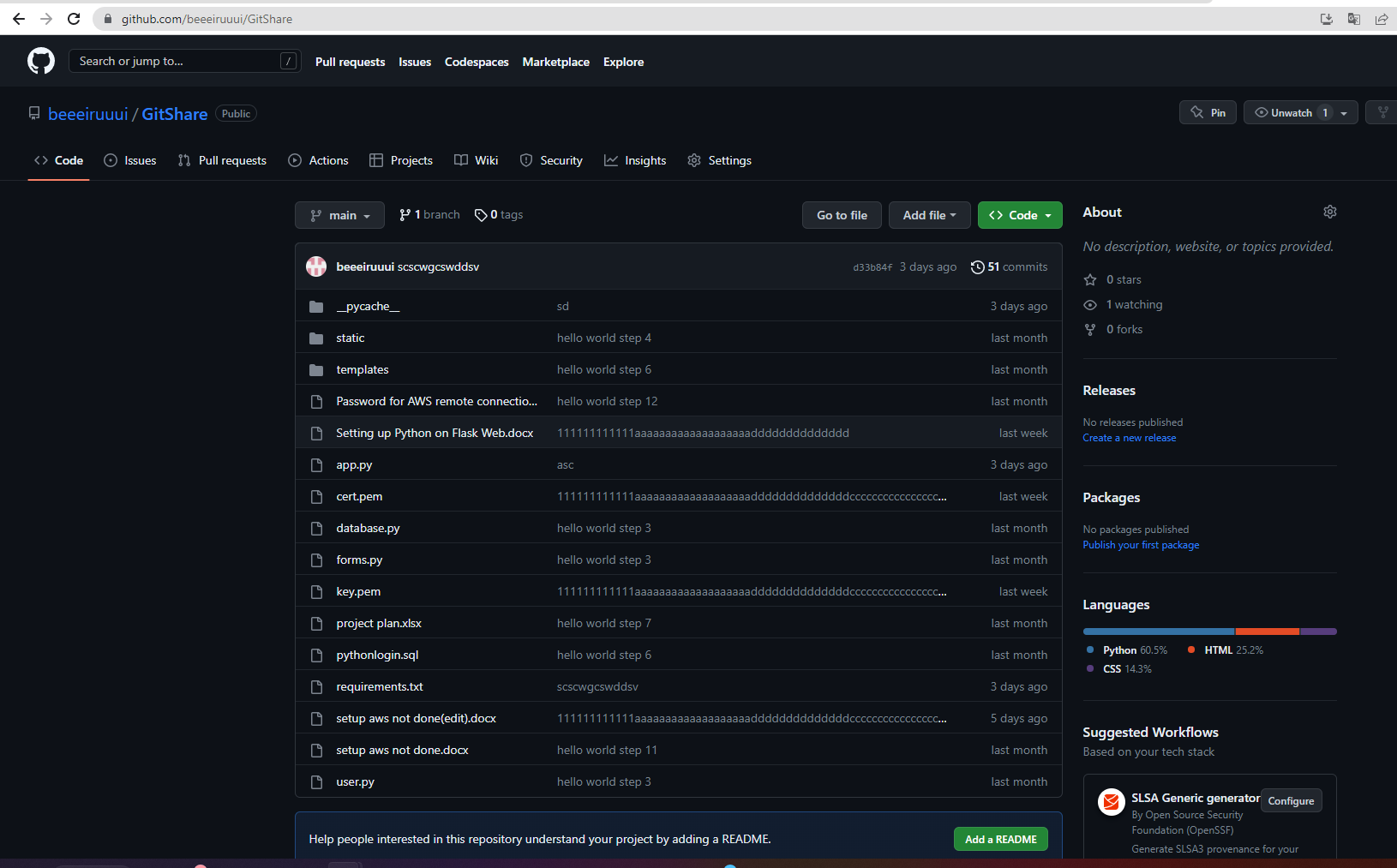
What is GitHub Web and Desktop
GitHub Desktop is an open source tool that enables you to be more productive. GitHub Desktop encourages you and your team to collaborate using best practices with Git and GitHub.
Just a few of the many things you can do with GitHub Desktop are:
Add changes to your commit interactively
Quickly add co-authors to your commit
Checkout branches with pull requests and view CI statuses
Compare changed images

Slide 12
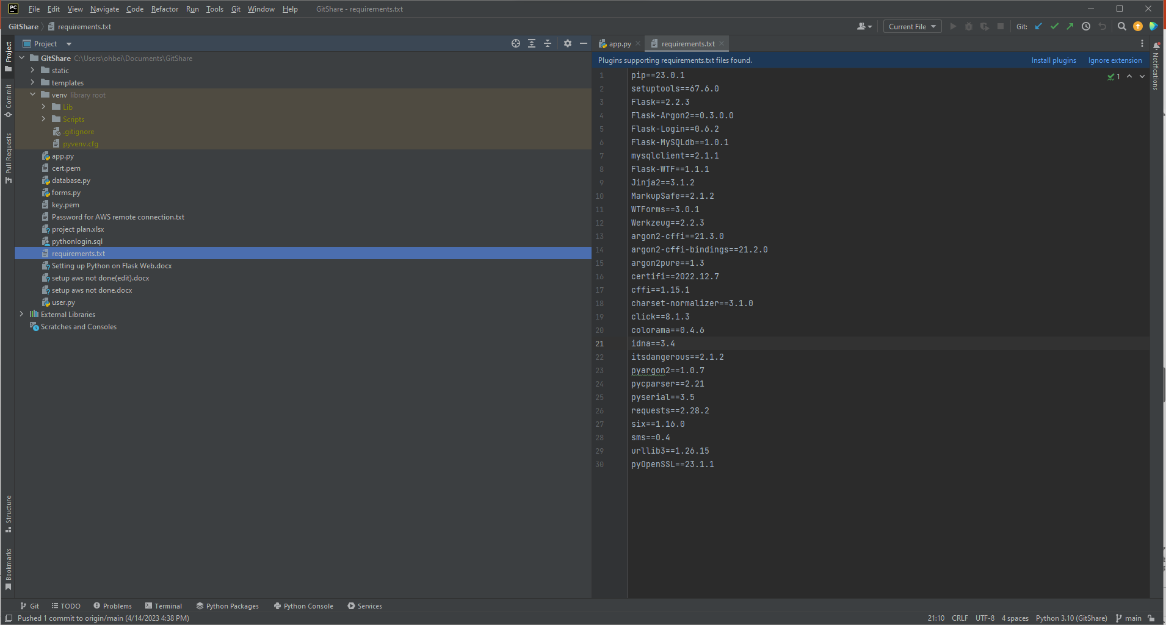
What is PyCharm

Slide 13
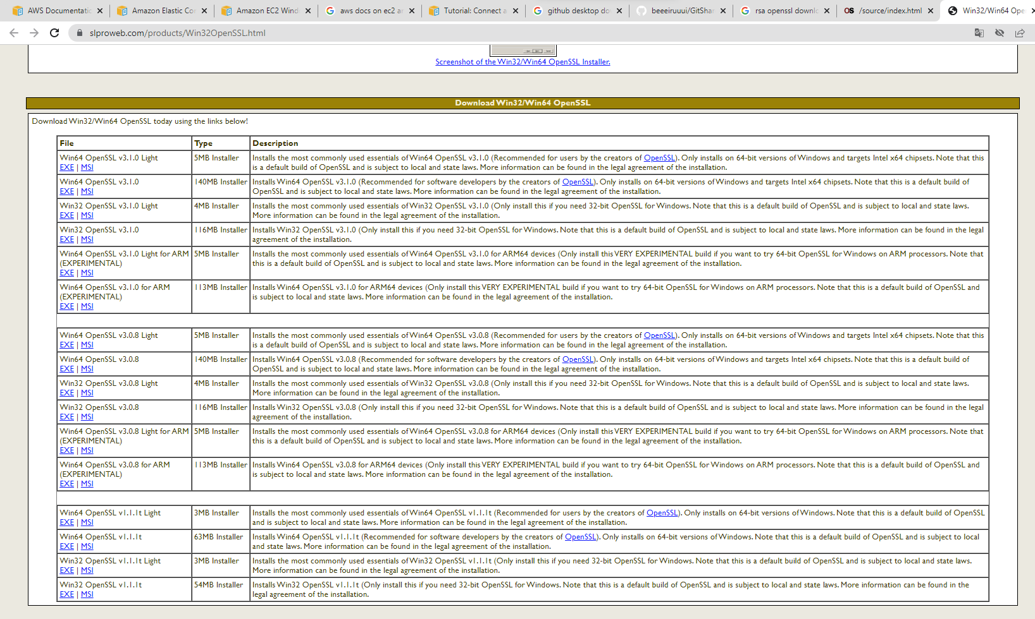
What is SSL

