Slide 1
AWS Web Secure
From: BeiRuiOh
School of IT
DCS
Notes:
Hi Mr Wong and Mr Tan! I am beirui. My FYP topic is to Secure Web Application on AWS Cloud Platform.

Slide 3
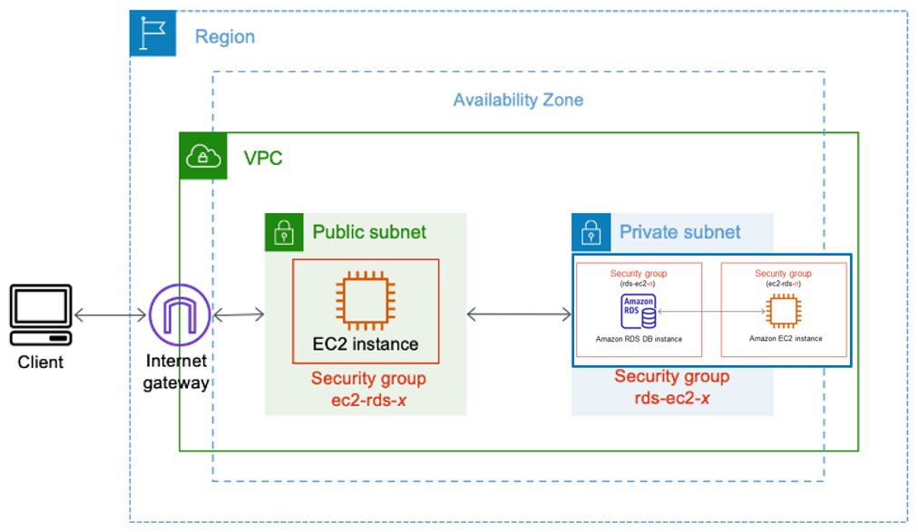
Sample layout of how the website connected to the database look like

Slide 4
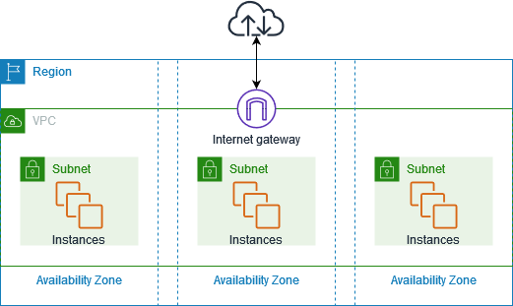
What is Virtual Private Cloud (VPC)
Amazon Virtual Private Cloud (Amazon VPC) enables you to launch AWS resources into a virtual network that you've defined. VPC is a virtual network similar to traditional network that you'd operate in your own data center, with the benefits of using the scalable infrastructure of AWS. After you create a VPC, you can add subnets.
Link:
https://docs.aws.amazon.com/vpc/latest/userguide/what-is-amazon-vpc.html
Notes:
The following diagram shows an example VPC. The VPC has one subnet in each of the Availability Zones in the Region, EC2 instances in each subnet, and an internet gateway.
have you ever heard of Amazon VPC? It's a way to create your own virtual network on Amazon Web Services (AWS) that's just like a traditional network you might have in your own data center. But with Amazon VPC, you can take advantage of the scalable infrastructure of AWS.
Here are some of the features of Amazon VPC that you might find interesting:
Virtual private clouds: A VPC is a virtual network that's similar to a traditional network you might have in your own data center. After you create a VPC, you can add subnets.
Subnets: A subnet is a range of IP addresses in your VPC. After you add subnets, you can deploy AWS resources in your VPC.
IP addressing: You can assign IP addresses to your VPCs and subnets, both IPv4 and IPv6. You can also bring your public IP addresses to AWS and allocate them to resources in your VPC.
Routing: Use route tables to determine where network traffic from your subnet or gateway is directed.
Gateways and endpoints: A gateway connects your VPC to another network. Use an internet gateway to connect your VPC to the internet. Use a VPC endpoint to connect to AWS services privately.
Peering connections: Use a VPC peering connection to route traffic between the resources in two VPCs.
Traffic Mirroring: Copy network traffic from network interfaces and send it to security and monitoring appliances for deep packet inspection.
Transit gateways: Use a transit gateway to route traffic between your VPCs, VPN connections, and AWS Direct Connect connections.
VPC Flow Logs: A flow log captures information about the IP traffic going to and from network interfaces in your VPC.
VPN connections: Connect your VPCs to your on-premises networks using AWS VPN.
If you're just starting out with Amazon VPC, your AWS account already includes a default VPC in each AWS Region. You can also create additional VPCs with the subnets, IP addresses, gateways, and routing that you need. You can manage your VPCs using the AWS Management Console, AWS Command Line Interface, AWS SDKs, or the Query API.

Slide 5
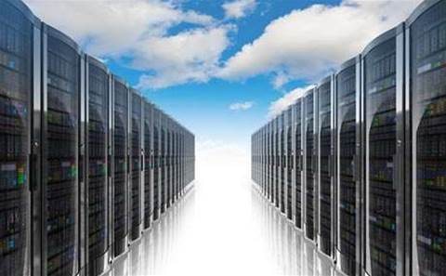
What is Elastic Compute Cloud (EC2)
Amazon Elastic Compute Cloud (Amazon EC2) provides scalable computing capacity in the Amazon Web Services (AWS) Cloud. Using Amazon EC2 eliminates your need to invest in hardware up front, so you can develop and deploy applications faster. You can use Amazon EC2 to launch as many or as few virtual servers as you need, configure security and networking, and manage storage. Amazon EC2 enables you to scale up or down to handle changes in requirements or spikes in popularity, reducing your need to forecast traffic.
Amazon EC2 provides different instance types to enable you to choose the CPU, memory, storage, and networking capacity that you need to run your applications.
Link:
https://docs.aws.amazon.com/AWSEC2/latest/WindowsGuide/concepts.html
Notes:
Amazon Elastic Compute Cloud, or Amazon EC2 for short, is a service provided by Amazon Web Services (AWS) that allows you to rent virtual servers in the cloud. Instead of buying and managing your own physical servers, you can use Amazon EC2 to launch virtual servers whenever you need them. You can choose how much computing power, memory, and storage you need for your virtual servers, and you can scale up or down as needed. Amazon EC2 provides many features to help you manage your virtual servers, such as secure login information, storage volumes, firewall protection, and virtual networks. You can access Amazon EC2 through a web-based user interface or a command line interface.

Slide 6
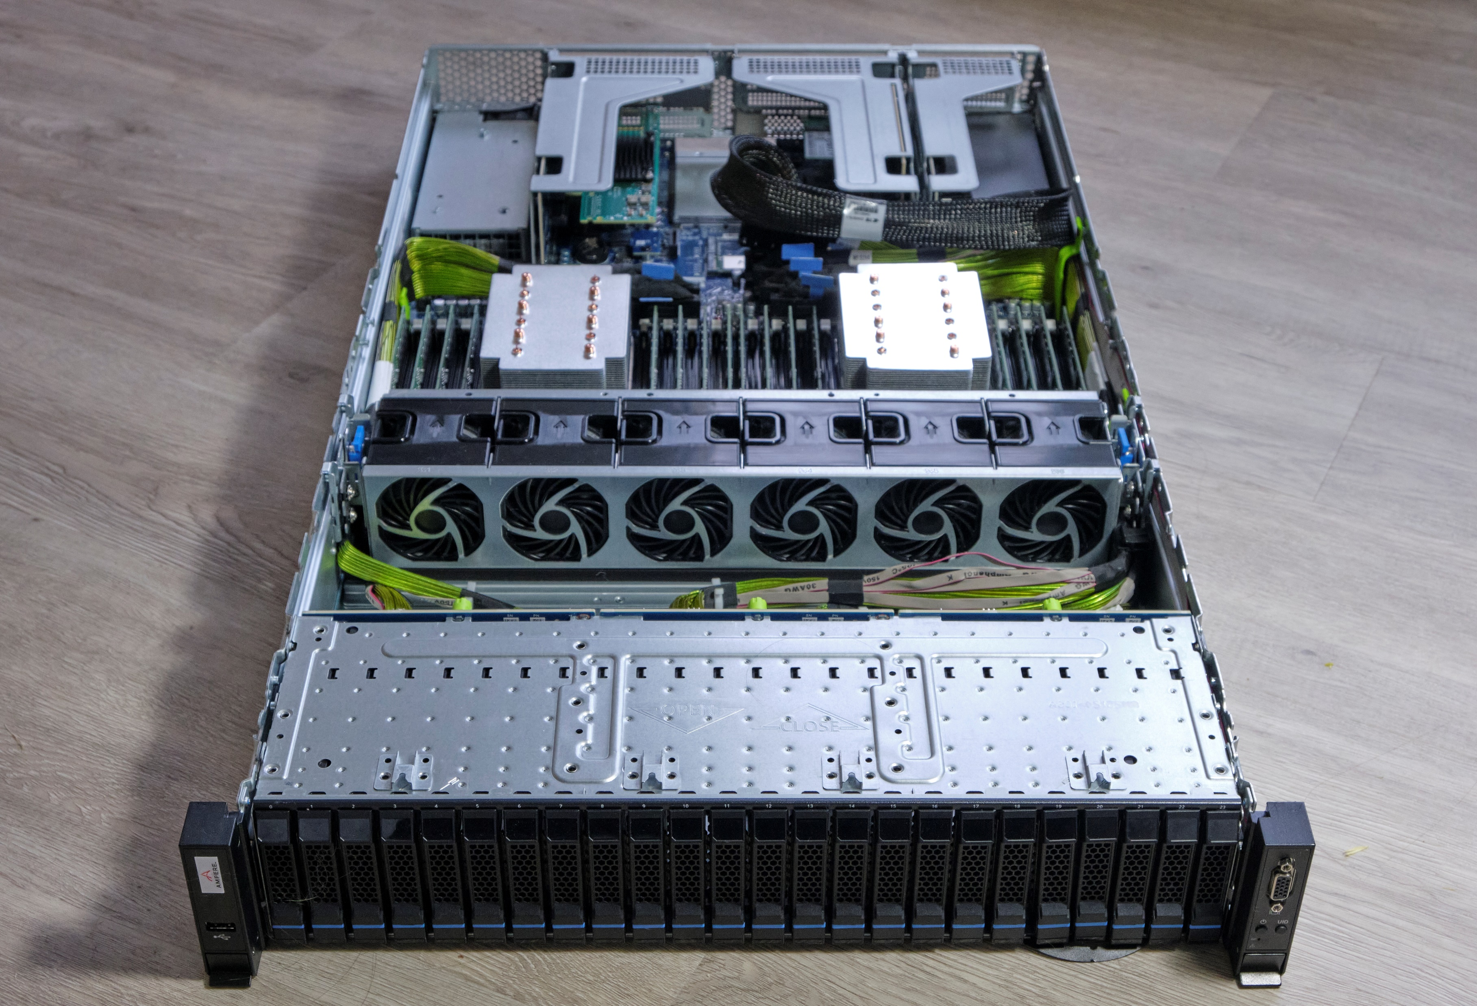
What is Instances
an Amazon EC2 instance is a virtual server in the cloud.
You can launch different types of instances. An instance type essentially determines the hardware of the host computer used for your instance. Each instance type offers different compute and memory capabilities. Select an instance type based on the amount of memory and computing power that you need for the application or software that you plan to run on the instance.
Notes:
Have you ever heard of virtual servers in the cloud? Well, an instance is one of those virtual servers. When you launch an instance, you get a copy of an image that you specified called an AMI. There are different types of instances you can launch, each with different memory and computing power. You should choose an instance type based on what you plan to do with it.
Your instance needs storage too. The root device is where the image is stored, and it can be either an Amazon Elastic Block Store (EBS) volume or an instance store volume. There are also local storage volumes called instance store volumes that you can use, but they're best for temporary data.
When it comes to security, it's important to control access to your AWS resources, including your instances. You can use AWS Identity and Access Management (IAM) to do this. You should also restrict access to trusted hosts or networks and review the rules in your security groups regularly. And don't forget to disable password-based logins for instances launched from your AMI!
Finally, you can stop or terminate your instance at any time. When you stop an instance, all of its Amazon EBS volumes remain attached, and you won't be charged for additional usage while it's stopped. When you terminate an instance, the root device volume is deleted by default, but any attached Amazon EBS volumes are preserved by default. Make sure to control the behavior of an instance shutdown and prevent accidental termination.

Slide 7
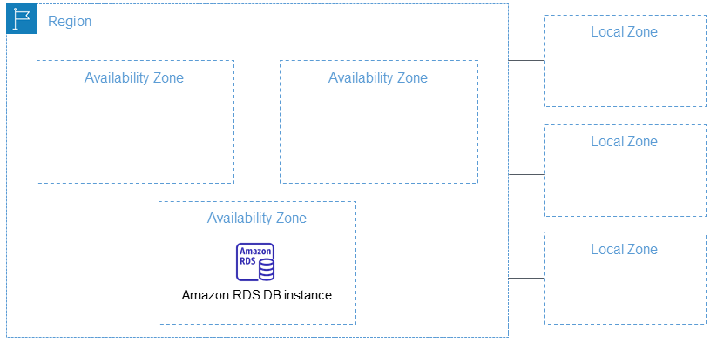
What is Relational Database Service (RDS)
Amazon Relational Database Service (Amazon RDS) is a web service that makes it easier to set up, operate, and scale a relational database in the AWS Cloud. It provides cost-efficient, resizable capacity for an industry-standard relational database and manages common database administration tasks.
Notes:
Amazon Relational Database Service (Amazon RDS) is a web service that makes it easier for you to set up, operate, and scale a relational database in the AWS Cloud. Essentially, Amazon RDS provides a cost-efficient and resizable capacity for an industry-standard relational database and manages common database administration tasks.
Why do you want to run a relational database in the AWS Cloud? Because AWS takes over many of the difficult and tedious management tasks of a relational database. This means that you can focus more on your application and users.
There are other AWS products and services available, but we recommend Amazon RDS as your default choice for most database deployments. It provides advantages such as managing backups, software patching, automatic failure detection, and recovery. You can also use read replicas to increase read scaling and get high availability with a primary instance and a synchronous secondary instance that you can fail over to when problems occur.
Amazon RDS supports database products you might already be familiar with, such as MariaDB, Microsoft SQL Server, MySQL, Oracle, and PostgreSQL. It also allows you to control who can access your RDS databases using AWS Identity and Access Management (IAM) to define users and permissions, and put them in a virtual private cloud (VPC) to help protect your databases.
Amazon RDS Custom is an RDS management type that gives you full access to your database and operating system. You can use the control capabilities of RDS Custom to access and customize the database environment and operating system for legacy and packaged business applications. Meanwhile, Amazon RDS automates database administration tasks and operations.

Slide 8
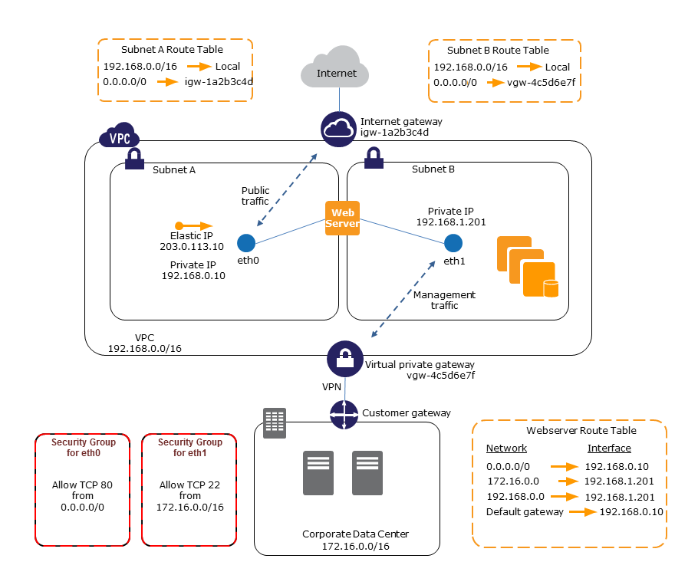

Slide 9
What is Elastic Ip
An Elastic IP address is a static IP address designed for dynamic cloud computing that is associated with your AWS account. It is a public IP address, reachable from the Internet. If your instance doesn’t have a public IP address, you can associate an Elastic IP address with the instance to enable communication with the Internet.
Notes:
An Elastic IP address is a special kind of internet address that is used by cloud computing. When you use an Elastic IP address, it stays the same until you decide to get rid of it. This means you can easily change the computer or software that it points to without having to change the address itself.
Elastic IP addresses are also used to make sure your computer can connect to the internet. Without an Elastic IP address, it may not be possible to connect to the internet.
It's important to know that there may be a small fee if you are not using your Elastic IP address. However, if you are using it with a running computer, there is no fee.
To use an Elastic IP address, you first have to "allocate" one for your account, and then "associate" it with your computer or software. You can also "disassociate" an Elastic IP address from one computer or software and "associate" it with another.
You can allocate an Elastic IP address using the Amazon EC2 console or command line interface.

Slide 10
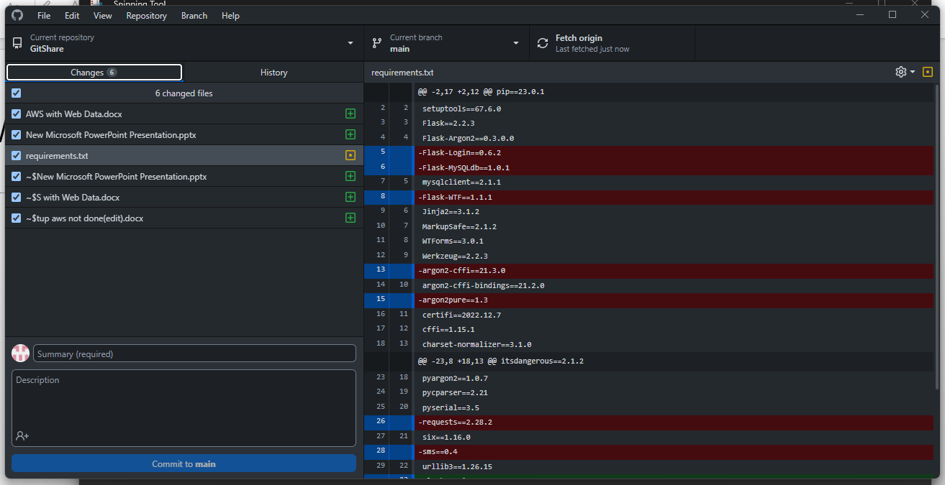
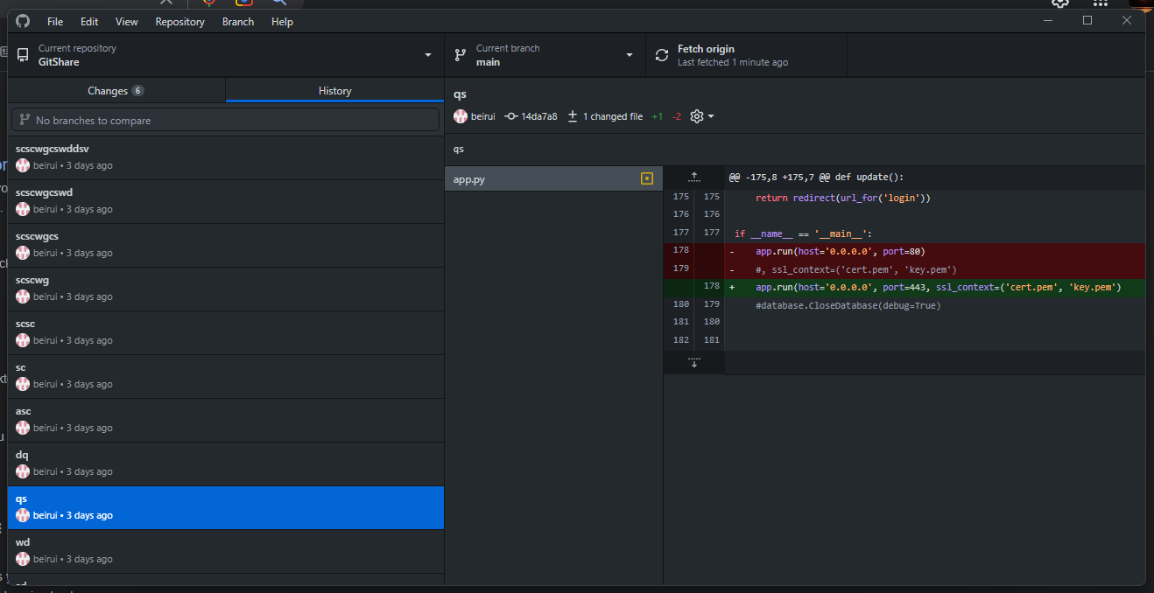
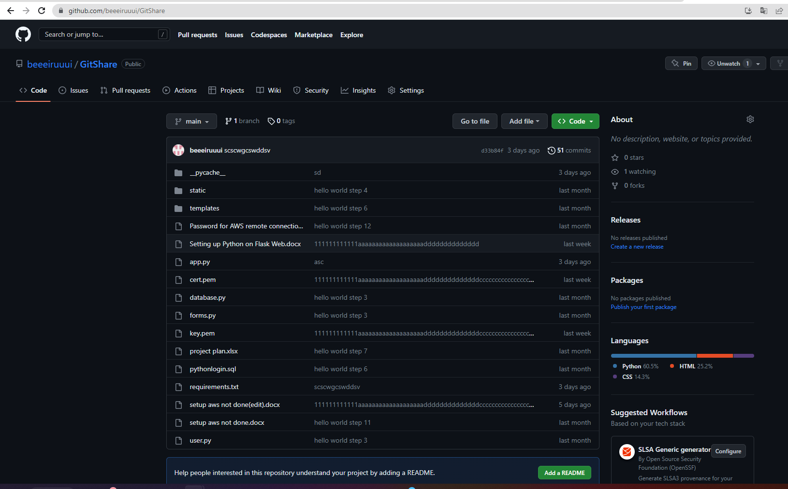
What is GitHub Web and Desktop
GitHub Desktop is an open source tool that enables you to be more productive. GitHub Desktop encourages you and your team to collaborate using best practices with Git and GitHub.
Just a few of the many things you can do with GitHub Desktop are:
Add changes to your commit interactively
Quickly add co-authors to your commit
Checkout branches with pull requests and view CI statuses
Compare changed images

Slide 11
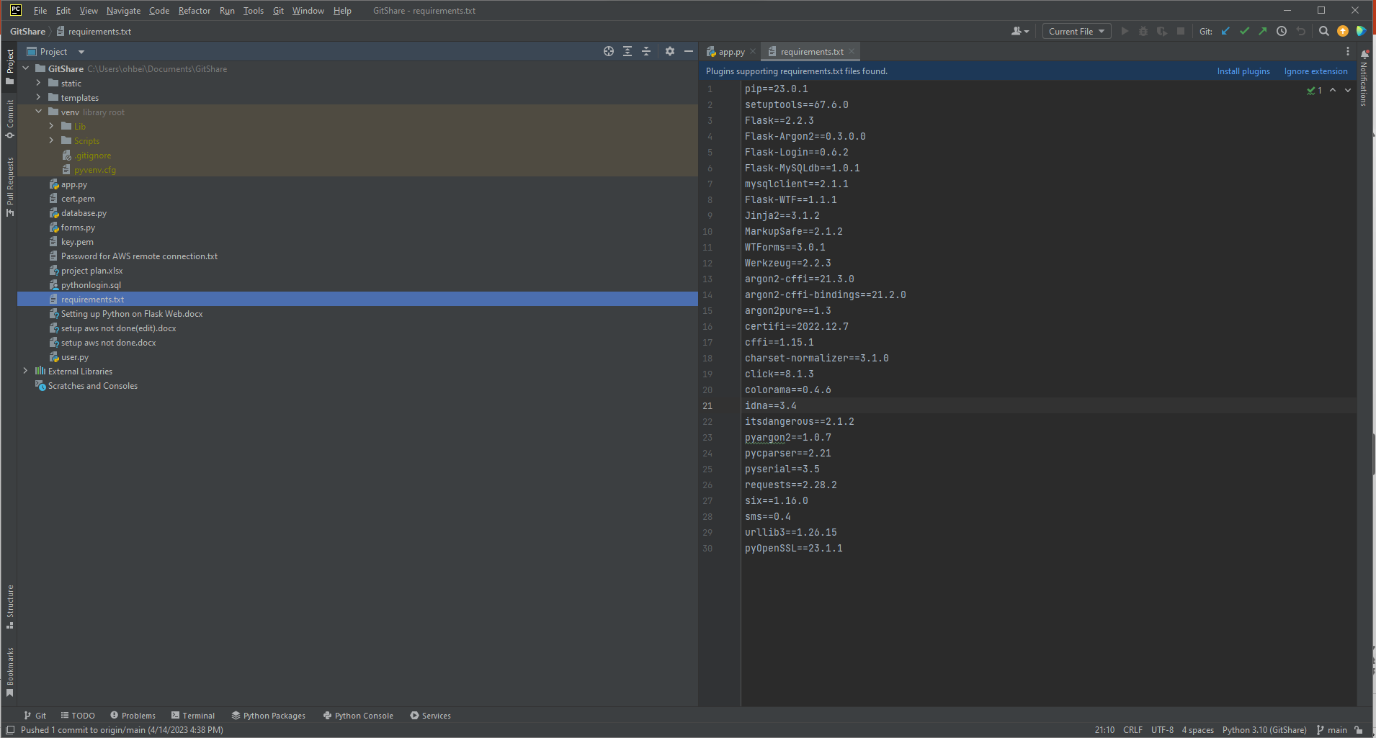
What is PyCharm

Slide 12
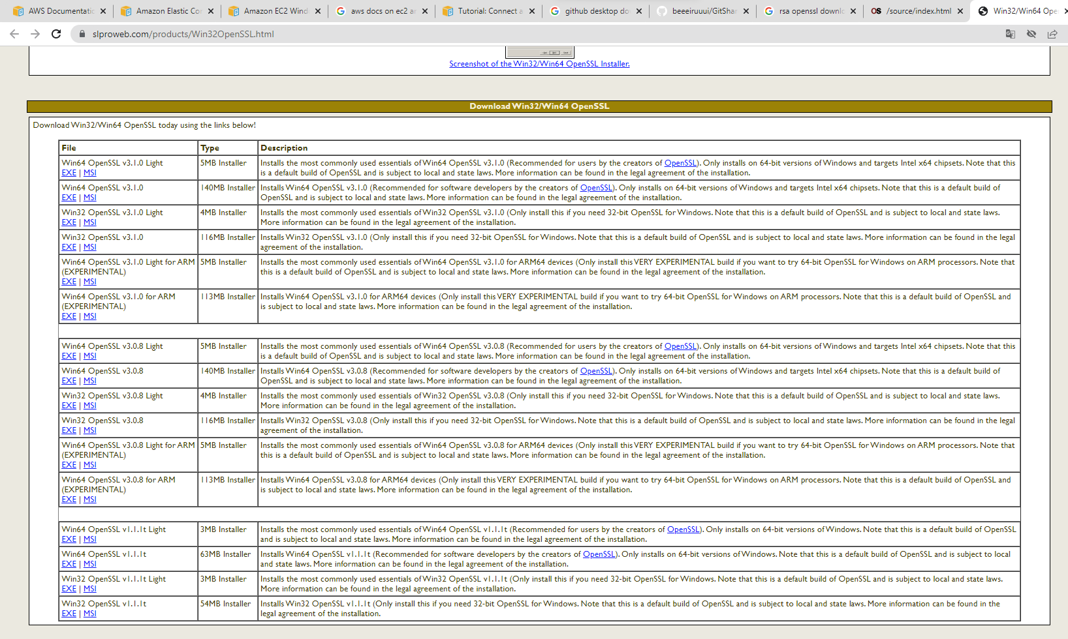
What is SSL

Slide 14
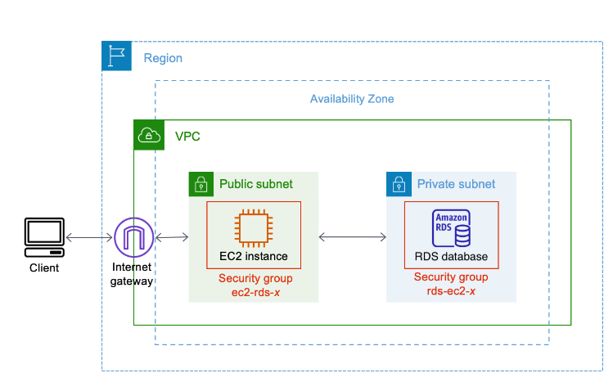
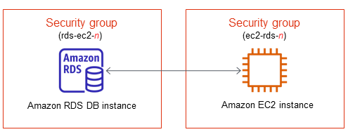
Layout of how the whole picture look like

