Slide 1
IP Detector Built on AWS
Ian Ho

Slide 2
Agenda
Application Architecture
Services
Alternative Solution with ECS
Deployment
Test Results
Know Issues
Q & A

Slide 3
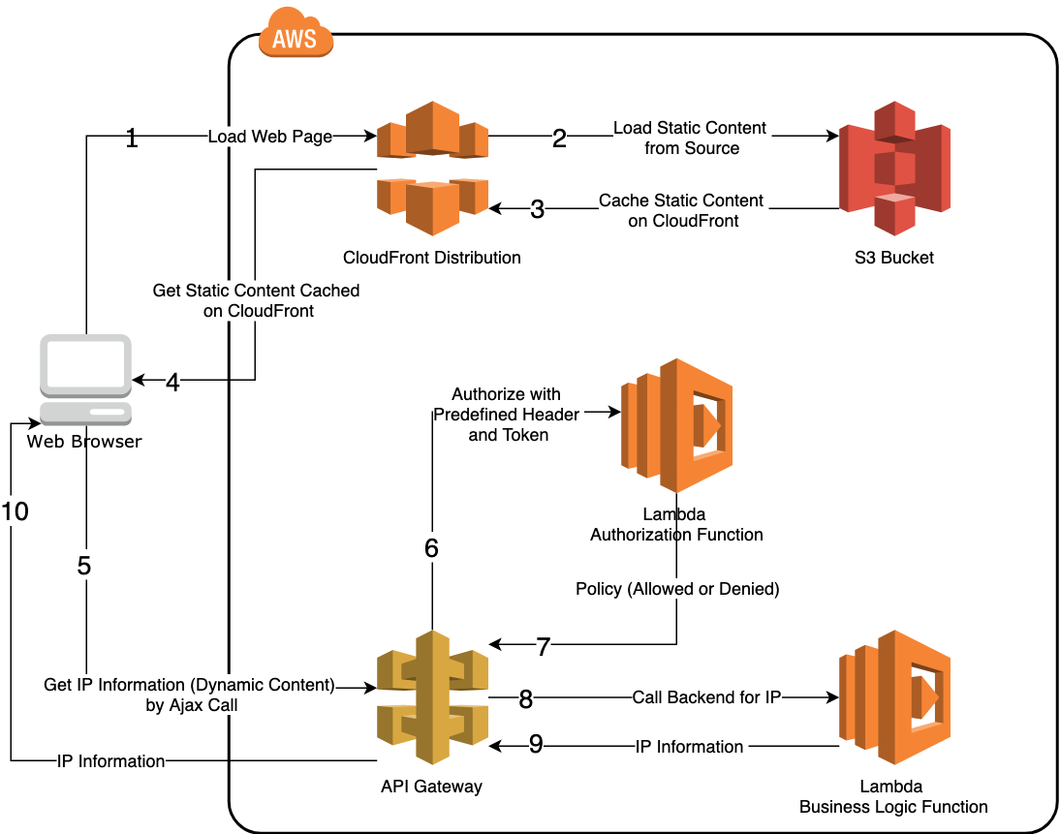
Application Architecture

Slide 4
Services
CloudFront for CDN
Domain Name: ​d3ucfn7czb26to.cloudfront.net
High performance, high availability and scalability.
Serves static content from the closet edge server.
OAI (Origin Access Identity): always access S3 content using CloudFront URLs.

Slide 5
Services
S3 for Static Content Storage
Bucket Name: ​ip-detector-yichan-ho
Public access settings to disallow public access.
Bucket policy: Add a policy to enable OAI and access scope.
Host all static content including images, index.html, and required JavaScript files.

Slide 6
Services
API Gateway for API Entry Point
URL: https://171nk3xfcb.execute-api.ap-northeast-1.amazonaws.com/prod/detectip
HTTP GET method
Requires a predefined header and value to make it through: Authorization = allow
The header is set through the Authorizers configuration of API Gateway.

Slide 7
Services
Lambda for Authentication
Function Name: ​javaTokenAuthorizer
Implemented in Java 8
Check if the authorization token == allow
Yes ➔ Allow Policy
No ➔ Deny Policy
The authorization header must be configured as AllowedHeader in CORS configuration of S3.
Once created, make it an Authorizer in API Gateway.

Slide 8
Services
Lambda for Backend Logic
Function Name: ​detectIp
Implemented in Java 8
Get the first IP in the list stored in
X-Forwarded-For​ header.
Header origin: It’s the domain name of CloudFront and we translate it into IP by InetAddress.getAllByName().
Add Access-Control-Allow-Methods and Access-Control-Allow-Headers as the headers to the response to resolve CORS.

Slide 9
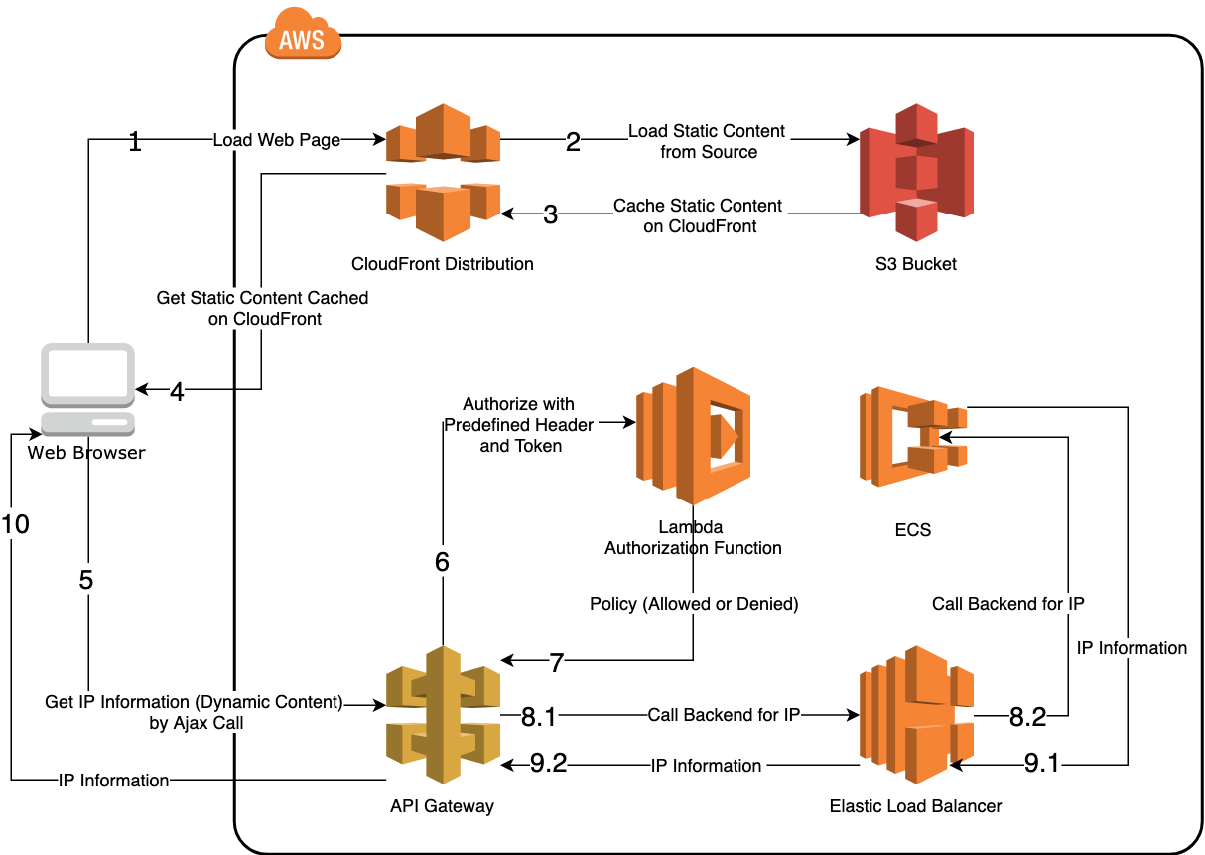
Alternative Solution with ECS
The difference

Slide 10
Alternative Solution with ECS
Java Tomcat Application
Developed in Java 8 with Spring Boot 2.1.4
Docker Image
Create the docker image with a Dockerfile.
Test the image locally.
ECR as Repository
Create a repository on ECR for the docker image.
Push the image to ECR by AWS CLI.

Slide 11
Alternative Solution with ECS
Elastic Load Balancer
Application Load Balancer
Should create a target group to associate with ECS
ip-detector-elb-1446914079.ap-northeast-1.elb.amazonaws.com
ECS
Cluster
A group of container instances
Created in AWS console with template of EC2 Linux + Networking
Where we specify the EC2

Slide 12
Alternative Solution with ECS
ECS
Task
To specify container information (e.g. Where the image is)
Created by AWS CLI
Service
To specify number of tasks (running containers)
To specify target group to associate with.
Created in AWS console.

Slide 13
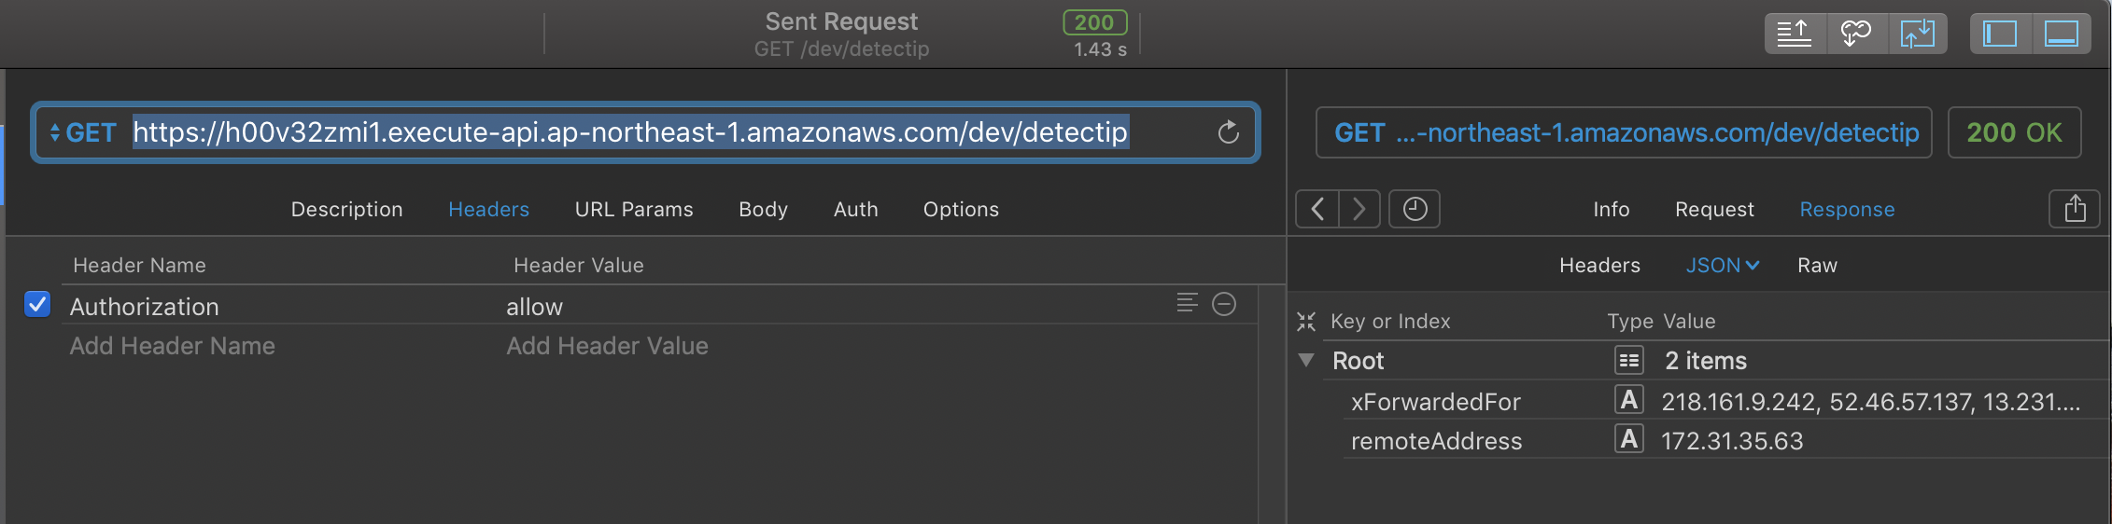
Alternative Solution with ECS
API Gateway
Create another API Gateway
Integration Type: HTTP
Endpoint URL: http://ip-detector-elb-1446914079.ap-northeast-1.elb.amazonaws.com

Slide 14
Deployment
Manual deployment with AWS console.
Partial deployment with CloudFormation:
Lambda for backend logic
Lambda for authorization
API Gateway
Template JSON: https://s3-ap-northeast-1.amazonaws.com/tam-test-yichan-ho/IpDetectorCloudFormation.json

Slide 15
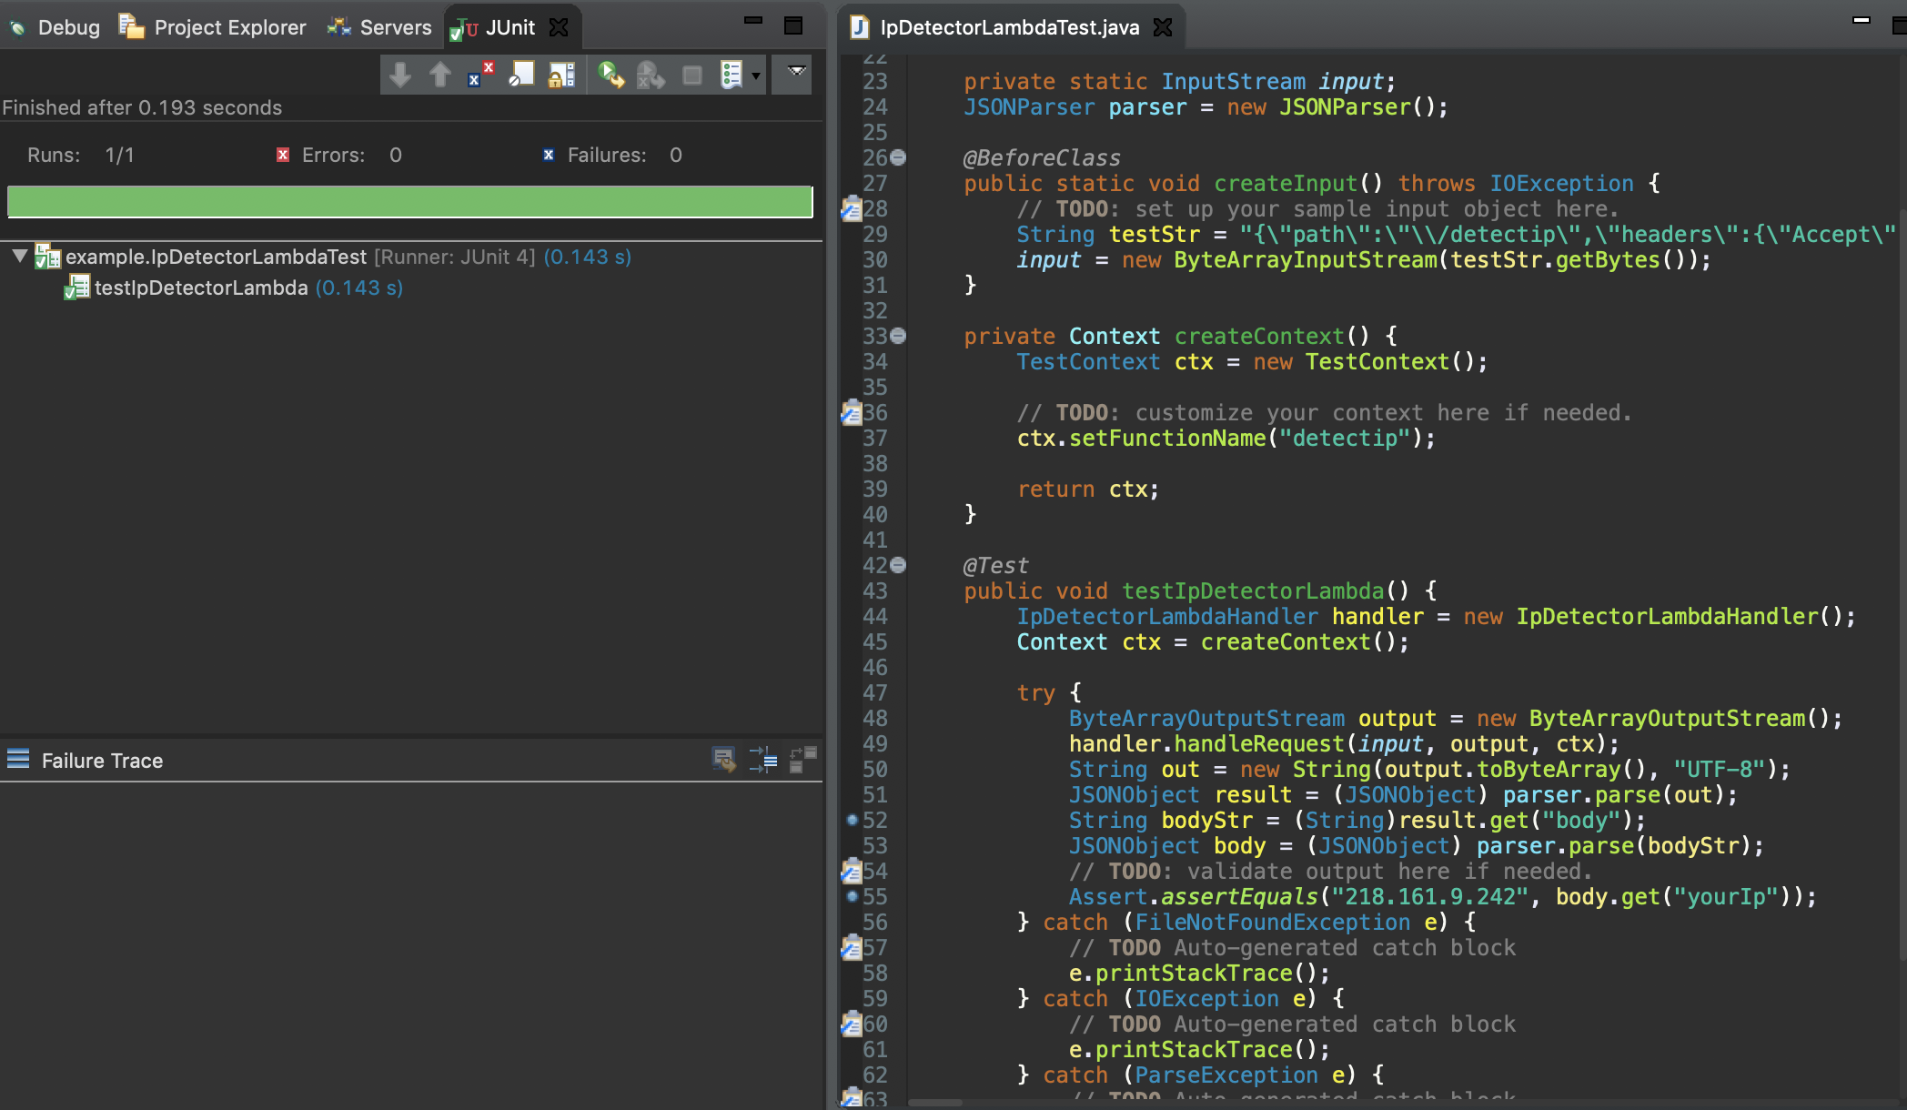
Test Result
Java Unit Test
Given the mock input with 218.161.9.242 in X-Forwarded-For, assert the return IP equals 218.161.9.242
Test Result: Pass

Slide 16
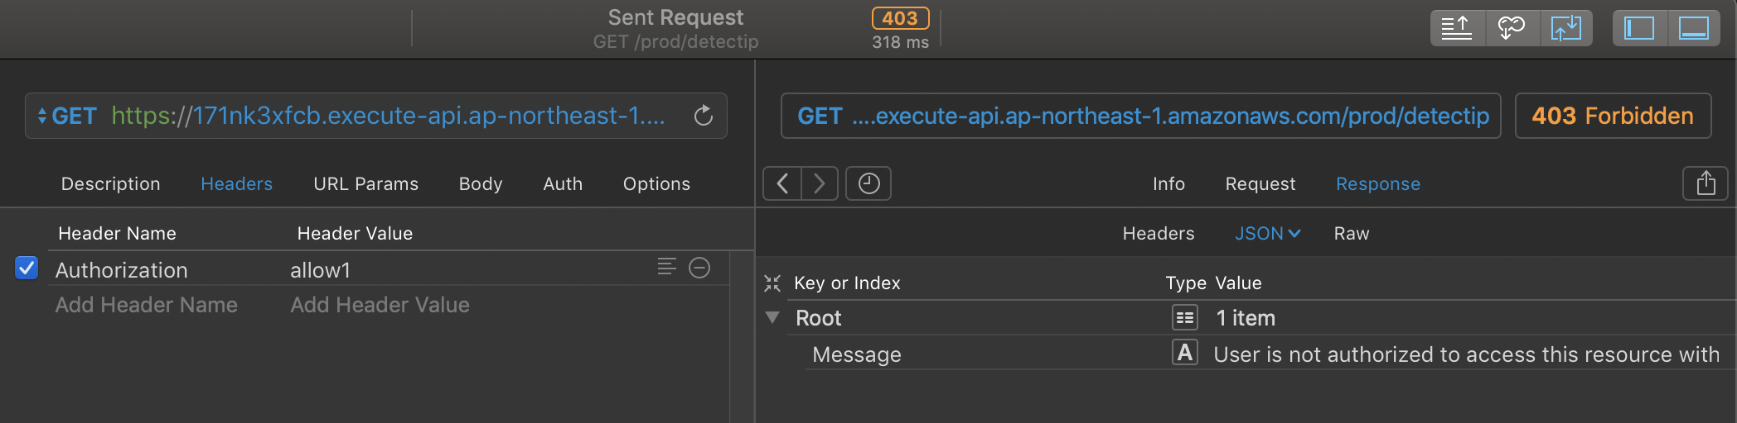
Test Result
PAW Unit Test
Case 1: Enter the Authorization header with illegal value
Expected Result: 403 Forbidden and not getting IP Information.
Test Result: Pass

Slide 17
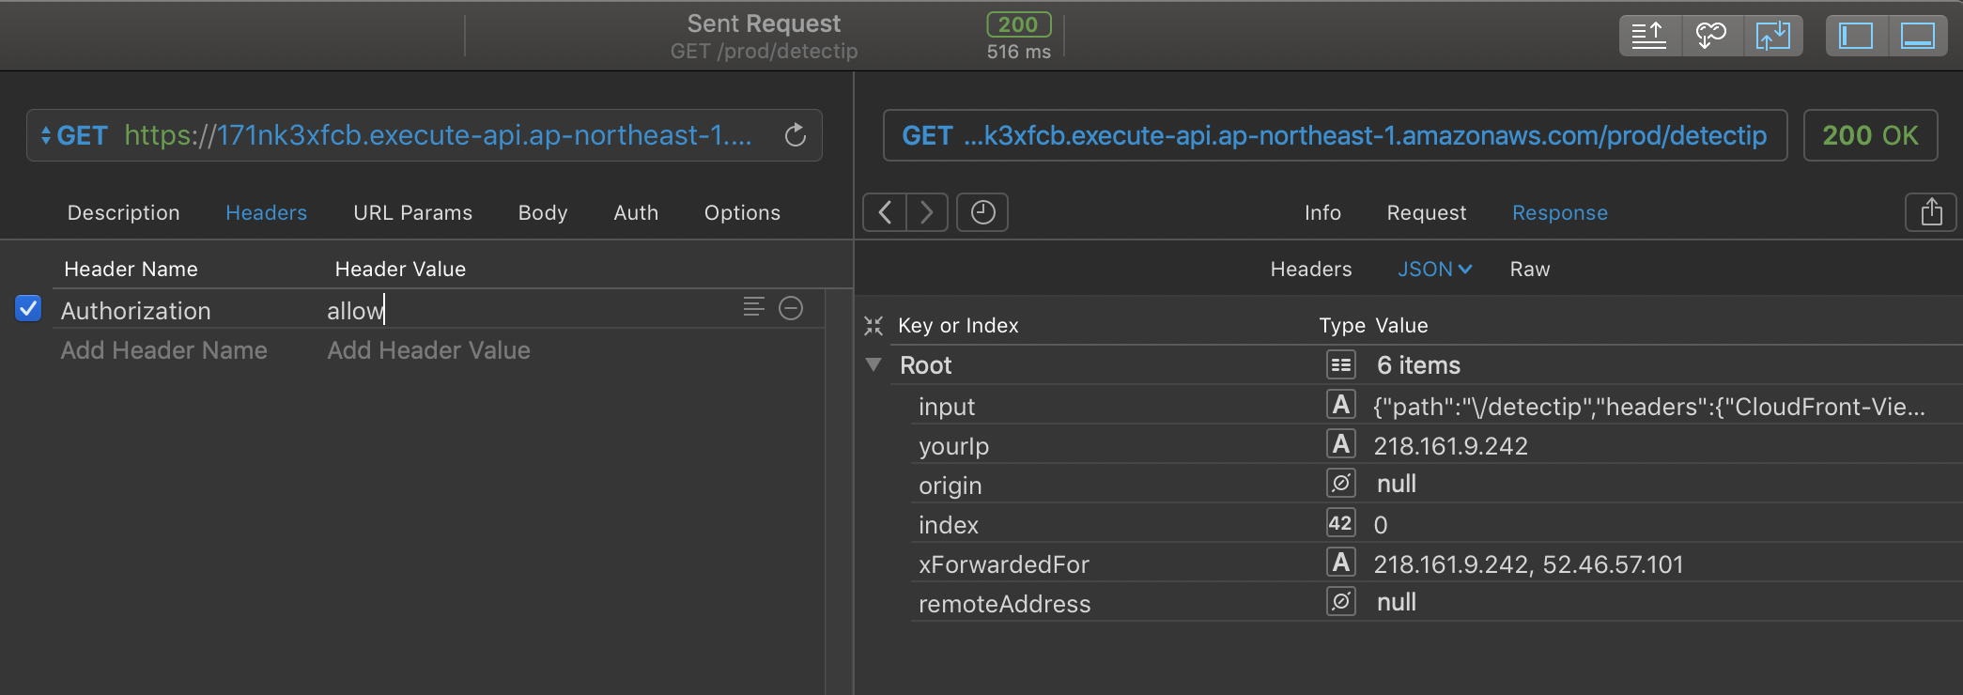
Test Result
PAW Unit Test
Case 2: Enter the Authorization header with allow
Expected Result: 200 Ok and get IP Information.
Test Result: Pass

Slide 18
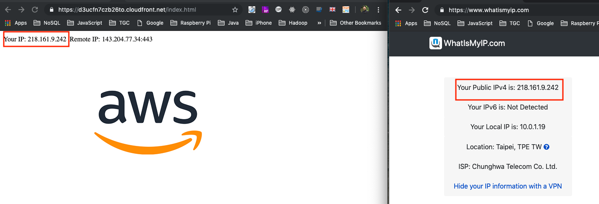
Test Result
Function Test
Case 1: Compare Application’s IP with 3rd party IP service.
Expected Result: IPs are the same.
Test Result: Pass

Slide 19
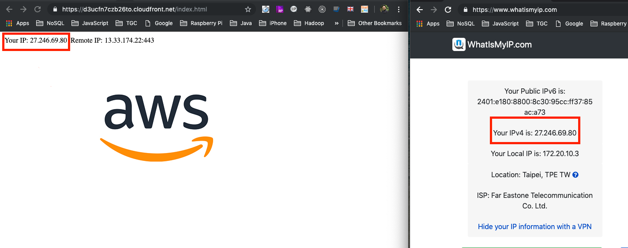
Test Result
Case 2: Switch to 4G network and compare Application’s IP with 3rd party IP service.
Expected Result: IPs are the same.
Test Result: Pass

Slide 20
Known Issues
Not able to resolve the domain name to the same IP as a browser does.
CloudFormation to achieve partial deployment.
Fail to give API Gateway the permission to invoke Lambda function with CloudFormation.
Not able to finish the alternative solution with ECS before delivery, but get a chance to implement it later.

Slide 21
Q & A

