Slide 1
Steps To build Alif ML Examples on Windows Machine

Slide 2
Alif E7 ML Development Kit Demos Repository
Examples Guide (valid only on MacOs or Unix based systems, we adapted as Wadix technologies those examples to works on Windows):
https://github.com/alifsemi/alif_ml-embedded-evaluation-kit/blob/main/ML_Embedded_Evaluation_Kit.md
Repository Cloning:
git clone https://github.com/alifsemi/alif_ml-embedded-evaluation-kit.git

Slide 3
Alif E7 ML Development Kit: Windows Configuration
Enable Windows to accept pah longer than 260 characters:
Run gpedit.msc
Go to Local Computer Policy > Computer Configuration > Administrative Templates > System > Filesystem
Enable “Enable Win32 long paths”
Reboot
For any Git repository, also enable support of long paths handling on current cloned Repo:
1) git config --system core.longpaths true

Slide 4
Alif E7 ML Development Kit Tools Setup
Clone wadix-tools Git Repository under C:\Alif-project :
git clone https://github.com/WadixTech/wadix-tools.git
Execute Install Power-Shell script as Below (to set environment variable on windows machine), to be executed on Power-Shell session:
1. Open Power-Shell Session (User Account)
2. Set-ExecutionPolicy RemoteSigned -Scope Process (Allow Execution of the scipt)
3. Run the Power-Shell script : .\install-env.ps1
To revert the environment variables settings execute the Uninstall Power-Shell Script:
1. Open Power-Shell Session (User Account)
2. Set-ExecutionPolicy RemoteSigned -Scope Process (Allow Execution of the scipt)
3. Run the Power-Shell script : .\uninstall-env.ps1

Slide 5
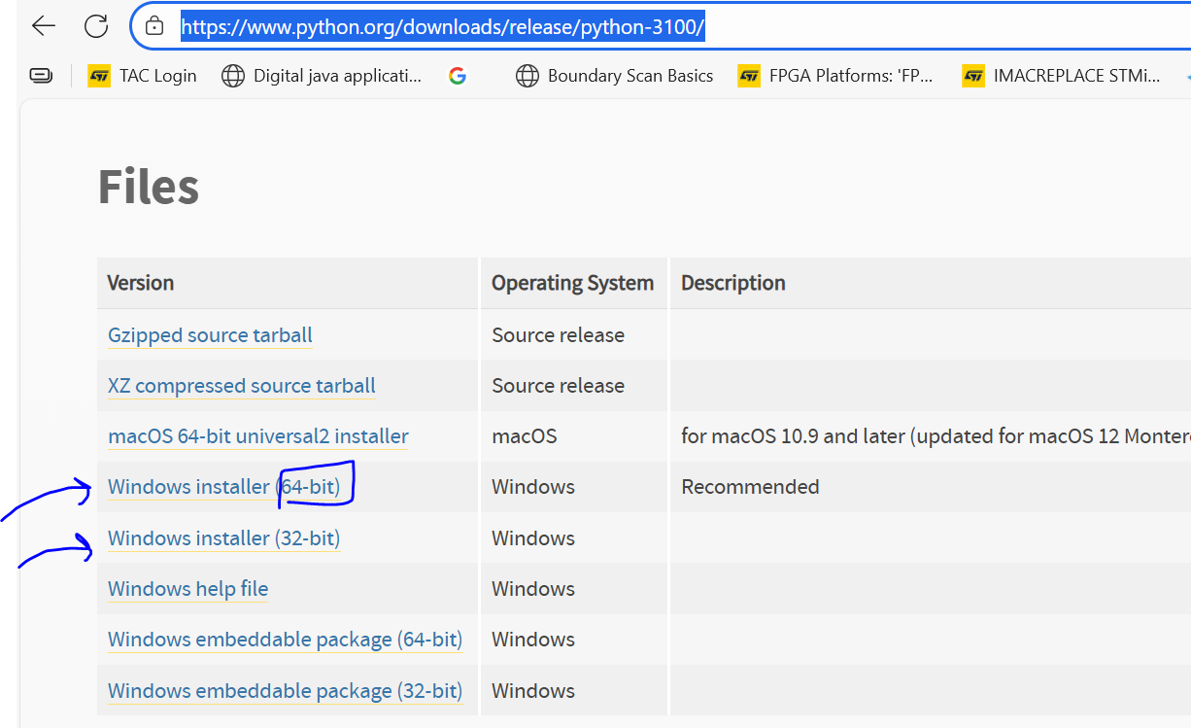
Alif E7 ML Development Kit Tools Setup: Python Installation
Python 3.10.0 or later needed to be installed for windows machine:
https://www.python.org/downloads/release/python-3100/

Slide 6
Alif E7 ML Development Kit: Examples Building
Clone Alif Examples Repository under C:\Alif-project\
git clone https://github.com/alifsemi/alif_ml-embedded-evaluation-kit.git
Clone Wadix Technologies Labs Repository:
git clone https://github.com/WadixTech/wadixcourses.git
Go to wadixcourses\TinyML-tflm-ethos-npu and copy over to
C:\Alif-project\alif_ml-embedded-evaluation-kit\ below build directories scripts:
build_m55_kws_he
build_m55_img_class_hp

Slide 7
Alif E7 ML Development Kit: KWS Example Building
Go to C:\Alif-project\alif_ml-embedded-evaluation-kit\build_m55_kws_he and run batch script cmake_config.bat
→ The batch script will trigger cmake configure stage, generate ninja back-end build file
Under same directory C:\Alif-project\alif_ml-embedded-evaluation-kit\build_m55_kws_he execute command ninja:
→ ninja command will trigger building the project using ninja build system
→ ninja ethos-u-alif_kws -j4
The build may takes some minutes, outcome will be ethos-u-alif_kws.axf and ethos-u-alif_kws.bin Under C:\Alif-project\alif_ml-embedded-evaluation-kit\build_m55_kws_he\bin directory

Slide 8
Alif E7 ML Development Kit: Image Classification Example Building
Go to C:\Alif-project\alif_ml-embedded-evaluation-kit\build_m55_img_class_hp and run batch script cmake_config.bat
→ The batch script will trigger cmake configure stage, generate ninja back-end build file
Under same directory C:\Alif-project\alif_ml-embedded-evaluation-kit\build_m55_img_class_hp execute command ninja:
→ ninja command will trigger building the project using ninja build system
→ ninja ethos-u-alif_img_class -j4
The build may takes some minutes, outcome will be ethos-u-alif_img_class.axf and ethos-u-alif_img_class.bin Under C:\Alif-project\alif_ml-embedded-evaluation-kit\build_m55_imag_class_hp\bin directory

Slide 9
Alif E7 ML Development Kit: Run Examples
Run Prebuild Images which are under Wadix Technologies Examples repository (C:\Alif-project\wadixcourses\TinyML-tflm-ethos-npu) using below scripts:
wadixcourses\TinyML-tflm-ethos-npu\ethos-u-alif_kws_appkit.bat → kws
wadixcourses\TinyML-tflm-ethos-npu\ethos-u-alif_img_class_appkit.bat → img_class
If you want to run the fresh built images done locally, then copy over those images ethos-u-alif_kws.bin and ethos-u-alif_img_class.bin to wadixcourses\TinyML-tflm-ethos-npu\prebuild_images\images (replace old images)

