Slide 1
Cascading Failure in Distributed Systems
Midterm Mastery - II

Slide 2
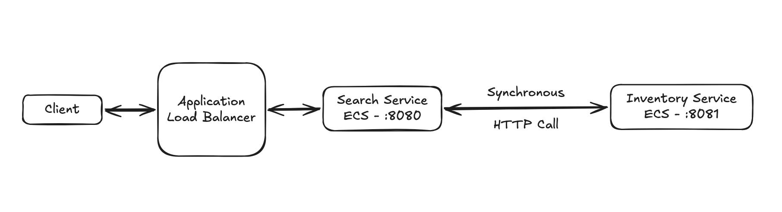
Architecture
Search makes synchronous call to Inventory
Inventory intentionally slow + unreliable
Load: 100 concurrent users
Tight synchronous coupling between Search and Inventory.

Slide 3
Problematic Deployment
Inventory:
Latency up to 3000ms
30% failure rate
Search:
No timeout
Blocking downstream call
Results:
p95 ≈ 3000ms
15–20 failures/sec
~60 RPS
Under load, Search blocked on slow Inventory responses.

Slide 4
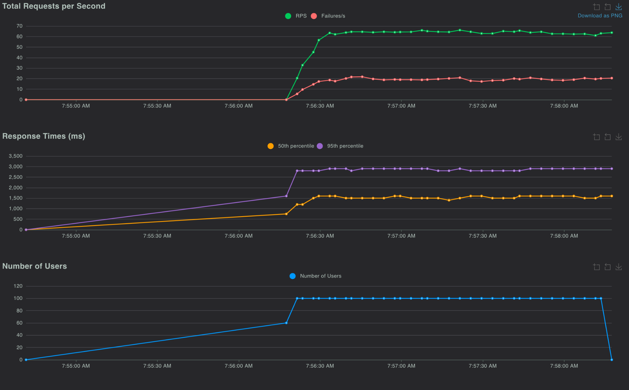
Locust Results

Slide 5
Root Cause
No timeout on downstream dependency.
Slow Dependency
Thread blocking
Request buildup
Latency amplification
5xx errors

Slide 6
Resilience Strategy
Fail-Fast Pattern
200ms timeout
Fallback response
Prevent blocking
Code snippet: context.WithTimeout(200 * time.Millisecond)
Bounded downstream wait time to 200ms.

Slide 7
Improved Results
Fail-Fast Pattern
Same load (100 users)
p95 ≈ 200ms
Failures ≈ 0
430+ RPS
Latency bounded and system stabilized under identical load.

Slide 8
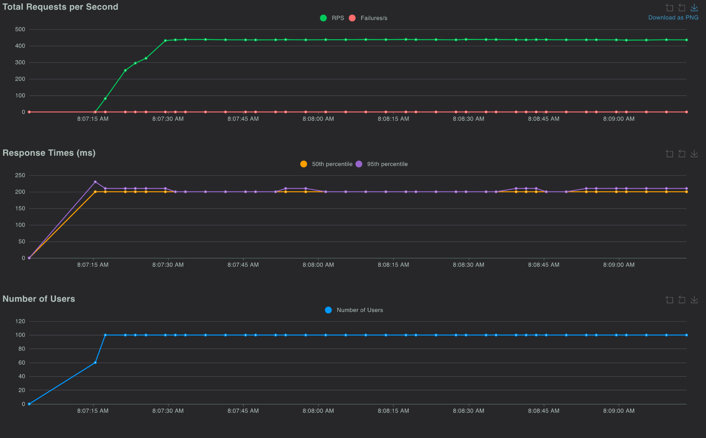
Improved Locust Results

Slide 9
Thank You!

