Slide 1
PMW 120
asdf
24 July 2026
Prepared by:
Juan Bautista
Assistant Program Manager – Engineering (APM-E)
323-807-7747 Mobile, juan.j.bautista.civ@us.navy.mil
27 FEB 2026

Slide 2
3
BLUF
4
NCE Scorecard
5
Areas of Success & What Worked Well
6
Areas for Improvement & Pain Points
7
120 NCE Enhancement Requests
10
Backup Slides

Slide 3
Moving to NCE from OSA
Migrate without ATO
When???

Slide 4


BLUF
1. Successfully Completed 3 NCE Pilots
Oct – Dec 2025
2. Recommend we Move Forward!
3. Developing Customizable IMS Template to Onboard All PMW 120 Programs this Year!
Working with Contracts & PSS to develop template

Slide 5
NCE Scorecard
Pilot Assessment Coverage + NCE Capability Score
Pilot Assessment Coverage: Breadth / Depth of PMW 120 Testing
NCE Capability Score: Completeness / Maturity of NCE Platform

Slide 6

Areas of Success & What Worked Well
Capabilities
Teams should adopt NCE quickly, it is a modern, cloud based, fully featured DevSecOps platform
Consistent across IL5, IL6, and IL7 enclaves, based on GitLab and AWS
Lift & Shift of non-NCE containerized apps were successfully deployed & run w/in NCE (IL5, IL6, IL7)
Created new pipelines within NCE and deployed to AWS
Containers pulled from external repositories & successfully deployed
Environment
Containers & pipeline automation highly supported w/in GitLab
SAST, DAST, Container, & ACAS Scans fully supported in pipelines
Lead Capability Integrator (LCI) Directive
LCI Issues Management will migrate to NCE GitLab Issues at portfolio / 120 level in IL7
Supports IL5 & IL6 visibility with generic data labels
Value Stream Management (VSM) will be implemented using GitLab
Capabilities
Environment
LCI Directive

Slide 7
Areas for Improvement & Pain Points
Individual Onboarding, SAAR Processing, Documentation
Account creation takes too long; unpredictable duration
Technical documentation is not mature
NCE Support Teams
Tier 1 & Tier 2 issue resolution and responsiveness has been uneven
Program Onboarding / TEMs, Communication
CONOPS TEM to get AWS account is a lengthy process
PMW 120 is NCE’s Pilot customer for Cross Domain Solution (CDS)
GitLab Differences Between IL5, IL6, & IL7
GitLab Releases (e.g. 17.x vs 18.x)
User Permissions
Container Registry only enabled on IL 5 Currently
package registry is enabled in all enclaves
NCE Cost Model is Immature
$50K Per Project cost per year is high for small & medium size programs (fair for large)
In discussion with NCE Finance team to set an appropriate cost for small programs
Per Seat cost of $1,300/user/yr is more than fair
direct passthrough of GitLab cost
single license covers all enclaves (IL5. IL6, & IL7)

Slide 8
120 NCE Enhancement Requests
+ Add GitLab Pages
+ Add GitLab Agile Planner
+ Add Automated Workflow for Onboarding
Streamlines generation of project documentation & integrated into GitLab DevOps platform
Allows for hosting of static websites directly from your Git repository using CI/CD pipelines to build and deploy them
Ideal for project documentation and leverage existing code & build processes to publish content automatically
Boosts productivity by integrating end-to-end traceability from planning through delivery
Facilitates non-developer team members integration into software development lifecycle
Cost of Planner license being discussed with NCE
Needed to streamline and shorten the Onboarding process
Discussions ongoing about added this functionality
+ Get RAISE Accreditation
known process to acquire across IL5, IL6, & IL7

Slide 9
Pilot Customer Feedback
AWS & GitLab Integration: Provided seamless automated deployment workflows capable of deploying within minutes to the AWS environment.
Permissions to Environments: Once provisioned environments provided flexibility and self-sufficiency.
Clear Path to Production: Known process to deploy in production utilizing NCE resources. Significant inheritable ATO controls from NCE for program production environments
Outdated/inaccurate technical documentation & scattered CI catalog (improving via wiki).
Manage Runners by NCE: Reduced workload & resources on program team/environments; increased reliance on external NCE team which compounds the pain because their support latency is too high.
Environment Inconsistencies: Different GitLab versions across enclaves cause import/recreation problems; IL5 has newer features (Issues, container registry) unavailable on IL6/IL7. GitLab container registry and Hardened AMIs available in IL5 but not IL6+IL7
Excessive Account Creation Times: GitLab (IL5/IL7) delayed to 9/29/2025, AWS to 11/6/2025, IL6 not until 12/19/2025—due to unclear processes and SAAR-N approval bottlenecks.
Provisioning Errors: Missing NCE IAM roles, identity providers, and IA roles (some manually added); persistent provider/ticket issues.
Slow Ticket Handling: NCE responses 3–4 days, initial resolutions 14+ days; post-TEM 5 sustainment shows faster closures, but some tickets remain extended.
Notes:
TLDR
Environment is great; reasonable access to GitLab, good access to AWS, CDS with Artifacts (CISO signature required)
Technical pain points
Insufficient access to runners – significant long-term risk that may be difficult to fix/change (evolving/discussing, not sure how it’s going to shake out yet)
Process pain points
Responsiveness on issue resolution (fixable)
Time required to create accounts (fixable)
Time required to onboard new programs (fixable)
PMW-120 hits many pain points being the “first of” for NCE

Slide 10
Thank you

Slide 12
Backup Slides

Slide 13
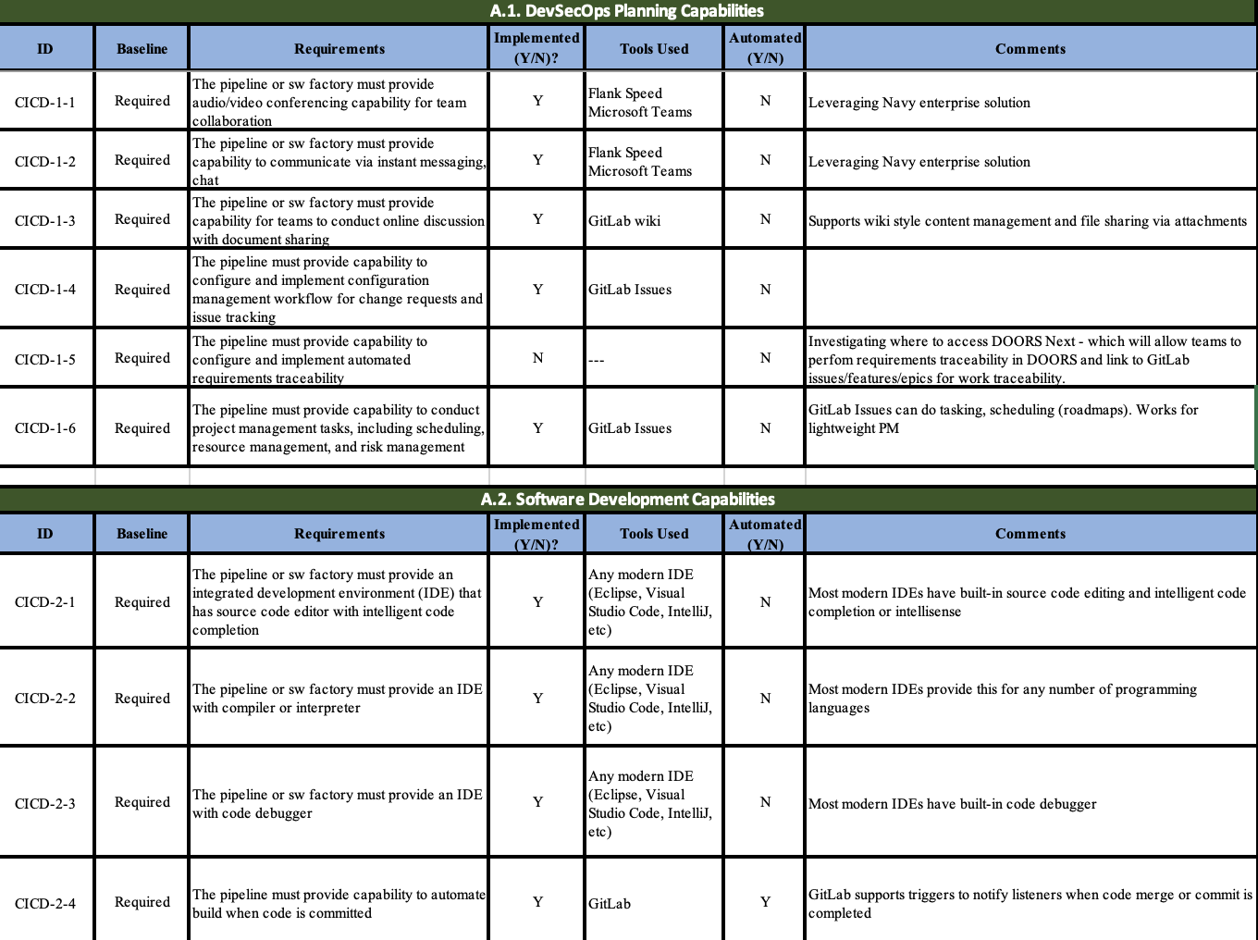
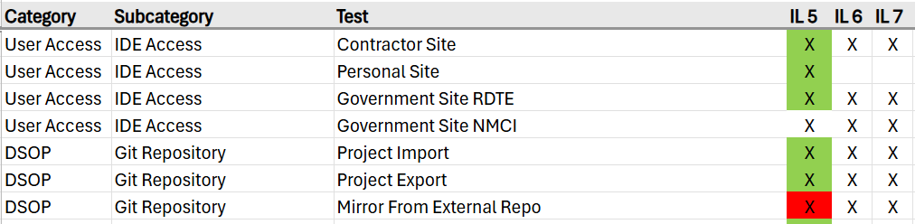
NCE Assessment Evaluation Process & Data
Sample of NAVWAR CI-CD Criteria
Leveraged NAVWAR CI-CD requirements spreadsheet
Pilots for the assessment covered the SDLC from dev through cloud deployment & included approximately ten technical staff across three programs, over three months
Scorecard summary derived from the detailed Checklist data
Sample of Checklist Data

