Slide 1

Meserete Hiwot
The Sunday School's All-in-One Digital App
System overview — Mezmur, education, programs and attendance, service selection, member services and administration
Meserete Hiwot Sunday School
Debre Enqu St. Lideta Lemaryam Church
16 October 2026 (Tikimt 6, 2019 E.C.) · App version 1.5.3
Notes:
Welcome. Today we present the digital app of the Meserete Hiwot Sunday School. The app brings Mezmur, education, programs and attendance, holiday service selection, member services and administration together in one place. Everything in this presentation has been verified against the app's current code; items still in development are shown separately.

Slide 2




Introduction and Purpose
Meserete Hiwot is a digital app that brings the Sunday School's spiritual service, education and administration together on one platform.
1 app
For Android phones and the web (browser)
Deliver Mezmur and lessons to every member's phone
3 sections
Keep attendance, contribution and property records reliably
Mezmur · Education · About Me
Give leaders clear reports and decision-making information
2 languages
Protect members' personal information carefully
Amharic (primary) and English
Notes:
The app has four main goals: delivering Mezmur and lessons to every member, keeping records reliably, giving leaders clear information, and protecting members' personal data. It is a single app that runs on Android phones and in a web browser; its main language is Amharic, and it is also available in English.

Slide 3


Problems the App Solves
Before
Now with the app
Attendance lists kept on paper
Attendance recorded by QR and signature — even offline
Scattered Mezmur lyrics and audio
An organized Mezmur library and player
Service selection results calculated by hand
Selection results calculated automatically by clear rules
Contribution and property records hard to track
Contributions by Ethiopian month and tracked borrowing
Messages scattered across many channels
Messages delivered through one notification center
Notes:
These are everyday problems the app solves. Paper attendance lists, scattered Mezmur collections, hand-calculated selection results and messages spread across many channels are left behind. In their place come attendance recorded by QR and signature, an organized Mezmur library, results calculated by clear rules, and one notification center.

Slide 4




System Overview
Home (Hub)
After sign-in, members choose a section
Mezmur
Education
About Me
Mezmurs, programs, library and notifications
Classes, learning platform, attendance, assignments and marks
My ID card, departments, monthly contributions and attendance
Admin panel — 10 admin groups, each visible only with the right permissions
One shared server and database connect all sections — data entered once appears everywhere
Notes:
After signing in, members see three main sections on the home screen: Mezmur, Education and About Me. People with responsibilities also see the admin panel, and each person sees only what they are permitted to. Because all sections share one server and one database, attendance recorded once, for example, appears directly in reports and in selection results.

Slide 5










Main Services at a Glance
Mezmur
Education
Programs
Attendance
Lyrics, audio and downloads
Classes, marks and learning platform
Schedules and reminders
By QR, signature and offline
Holiday service selection
Monthly contribution
Property and borrowing
Projects and tasks
Results by clear rules
Recorded by Ethiopian month
Including signatures and fines
Budgets, expenses and reports
Department chat
Notifications
Reports and audit
Guidance and help
Group and private messages
In-app, push, email and Telegram
PDF, Excel and CSV
56 help articles and guided tours
Notes:
This slide shows the app's twelve main services at a glance. We will look at each of them in detail on the following slides.

Slide 6
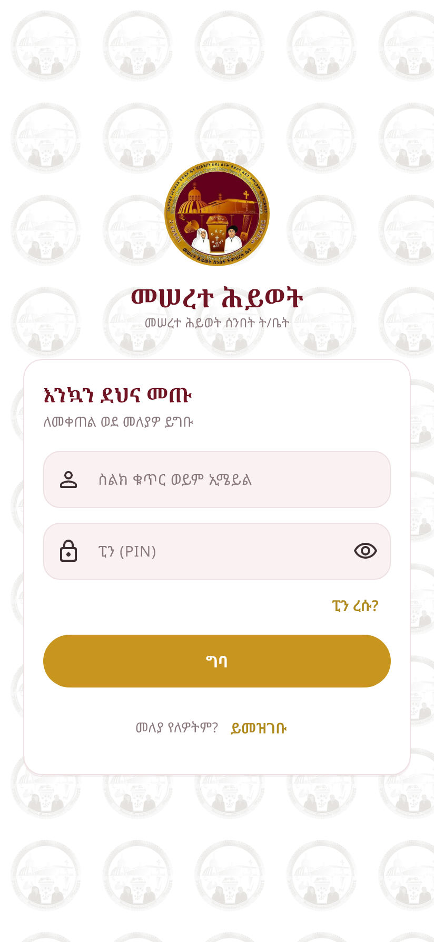
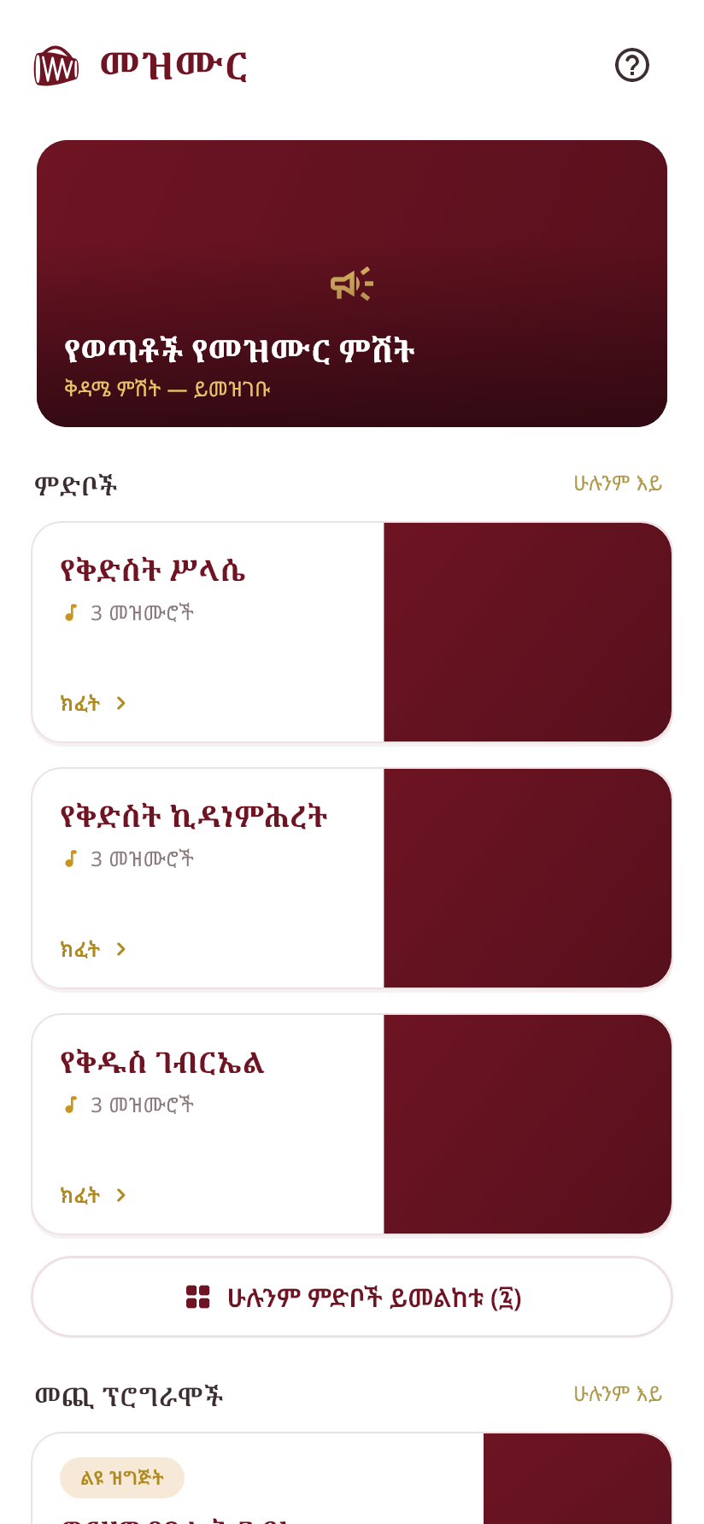
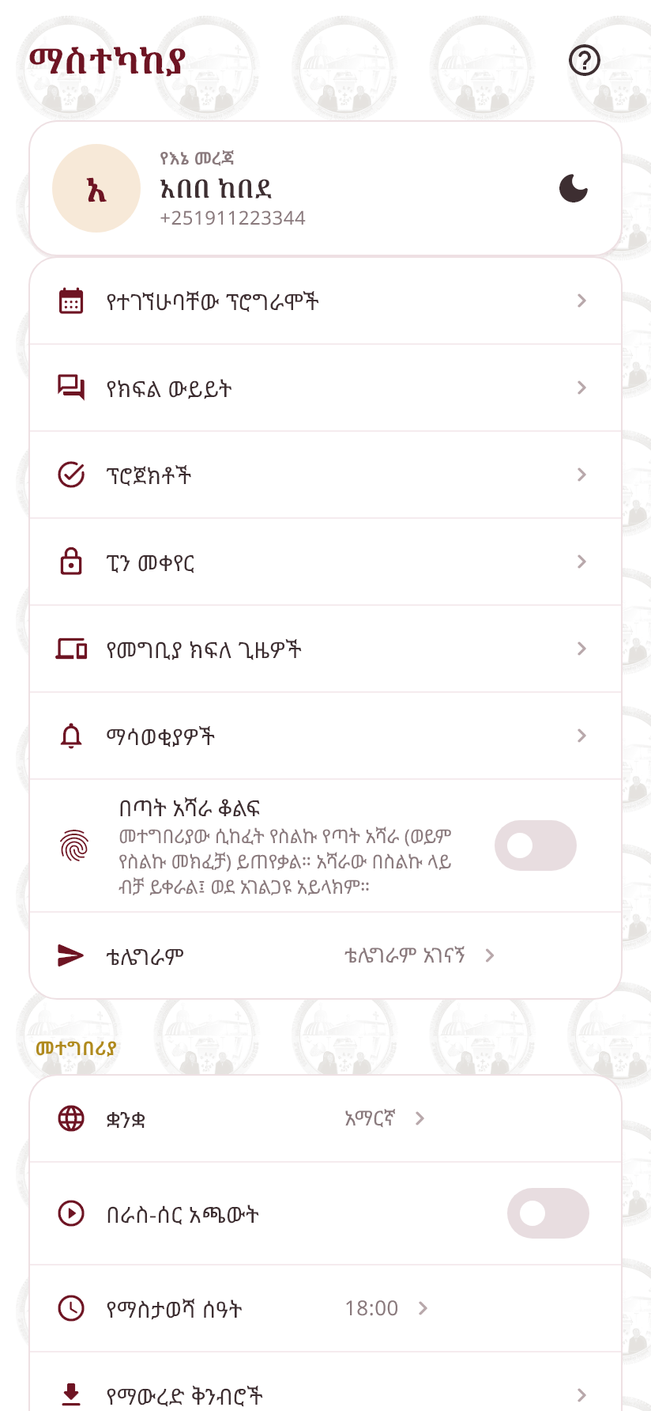





User Experience
Simple sign-in — phone number and a 4 or 6 digit PIN
Church colors and emblem; light and dark themes
Amharic as the main language; English also available
Contextual help and guided tours on every main screen
Fingerprint lock available
Sign-in
Mezmur home
Settings
Screens are taken from the app itself (Amharic interface) with sample data
Notes:
The app is designed to be easy to use. Members sign in with their phone number and a short PIN; the church's colors and emblem appear on every screen; and light and dark themes are available. The question-mark icon on each screen offers help for that screen. The images on this slide were taken from the app with sample data.

Slide 7
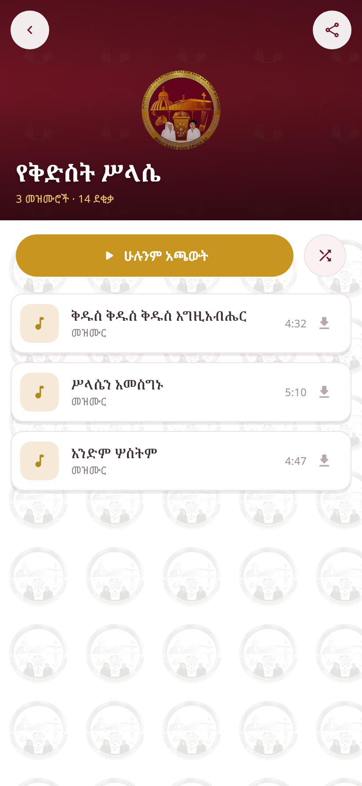






The Mezmur Library
Tiered categories and the category of the day
Search, recent and popular Mezmurs
Lyrics with adjustable font size
Lyrics that follow the audio (LRC)
Favorites and downloads for offline use
YouTube links and sharing
For administrators
Add and publish Mezmurs, upload audio and cover images, lyric timing editor (LRC maker), bulk category assignment and bulk import from Excel
Category page
Notes:
The Mezmur section is organized by category. Members can search for Mezmurs, read the lyrics at a comfortable font size and listen to the audio. For Mezmurs with timed lyrics, the lyrics are highlighted along with the audio. Downloaded Mezmurs work offline. Administrators add Mezmurs, upload audio and images, and can import them in bulk from Excel.

Slide 8








Audio Player and Controls
Background playback
Lock-screen controls
Mezmur queue
Shuffle
Keeps playing while other apps are open
Control playback with the phone locked
Line up the next Mezmurs
Mix up the queue
Repeat
Playback speed
Sleep timer
Mini player
One Mezmur or all
Listen slowly for practice
At a set time or when the Mezmur ends
Visible on every screen
Notes:
The player includes all the controls you would expect from a modern music app: background playback, lock-screen controls, a queue, shuffle, repeat, speed control and a sleep timer. Changing the speed is especially helpful for those practicing a Mezmur.

Slide 9





User Accounts, Profiles, Groups and Security
Account and profile
Account security
Registration by phone number and PIN; member type and membership form
Permanent member ID number and a digital ID card with QR (available offline)
Profile changes are approved by an administrator; the change history is kept
Administrators can register and manage members
One member — one trusted phone
5 wrong attempts → locked for 15 minutes
Forgotten PIN: code via Telegram or email
Screenshots of personal screens are blocked
Member types
Children
Youth & Adults
Married
Distance
See and end signed-in devices
Notes:
Each member registers with a phone number and PIN and receives a permanent member ID number and a digital ID card with a QR code. To change their name or phone number, members submit a request; once an administrator approves it, the change is recorded along with its history. For security, each member signs in on one trusted phone only, and repeated wrong attempts lock the account for a short time.

Slide 10





Programs and Events
Recurrence types
One-time
Weekly
Monthly
Twice a month
Ethiopian dates
Special event
e.g. Sunday classes
By date or weekday
Every 2 weeks
e.g. monthly feast days
For all members or invitees only; registration and capacity limits
Reminders 2 days, 1 day, 6 hours or 1 hour before
Reminders repeating every 15 days; mandatory reminders
Phone alarms that work offline (including snooze)
A single date can be cancelled or rescheduled
Categories: General · Education & Training · Hymns & Arts · Programs & Conferences
Notes:
Programs can repeat once, weekly, monthly, twice a month, or on Ethiopian calendar days — which makes it possible to schedule monthly feast days. A program can be open to everyone or to invitees only. Members receive reminders before a program, and the phone alarm works even without an internet connection.

Slide 11




How Attendance Is Recorded
1
2
3
4
5
Taker assigned
Opens
“Start”
Recording
Closes
Human Resources (HR) assigns one attendance taker for each program date
The session opens 15 minutes before the program starts
The clock starts when the taker presses Start
By QR or by name; “Present” needs the member's signature; “Excused” needs a reason
When the taker presses “End” or the program's scheduled time ends
Expected members who were not recorded are marked “Absent” automatically
After closing, changes are made only through correction requests and approval
Works offline too; records are sent automatically when the connection returns
A member cannot be recorded twice
Notes:
Attendance recording is designed to be fair and accountable. For each program date, the Human Resources department assigns one attendance taker. The session opens 15 minutes before the program; the clock starts when the taker presses Start. Each member who is present is recorded by QR and signs. Once the session closes, changes are made only through correction requests and approval. Recording also works offline.

Slide 12
Attendance Rules, Punctuality, Scoring and Reports
15 min
Punctuality: The “Late” status has been removed; instead, the exact time of recording and the minutes elapsed since “Start” are stored
Excuse requests: Before a deadline, with monthly and quarterly limits; an excuse approved by mistake can be cancelled with a reason
Corrections: After closing, by request, review and audit trail
For members: Their own attendance calendar and statistics
Reports: For each program date in PDF, Excel or CSV — Ethiopian date, taker, time, signature
In development: Attendance percentages by elapsed-minute intervals for selection (not yet released)
How early the session opens before the program
1 taker
For each program date
Signature
For every “Present” record (groups can be exempted)
Notes:
The former “Late” status has been removed, because there was no clear standard for deciding who was late. Instead, every record now stores the exact time of recording and the minutes elapsed since Start. A calculation that gives percentages by elapsed-minute intervals, using this data, is in development and has not yet been released. Members can submit excuse requests to be absent from a program.

Slide 13
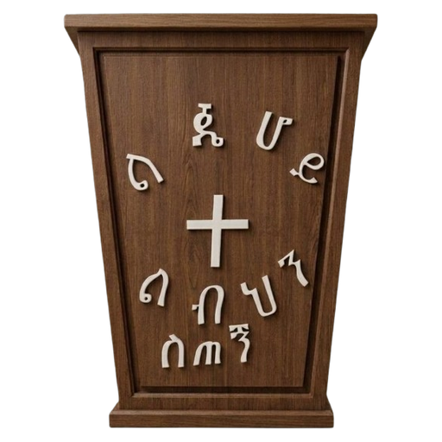
Education and Training Management
Classes, courses, schedules, regular and distance learning
Student registration, transfers and promotion to the next class
Teacher assignments with history — only active teachers enter marks
Assignments (individual and group), submission and grading
Student requests (class change, add/drop a course) and complaints
The Education module can be switched off for selected members
Changing marks
After publication, marks change only with a written reason, and every change is kept in the history. Classes or exams with marks cannot be deleted — they are archived.
Marks workflow
Draft
Submitted
Approved
Published
Entered by the teacher
Sent for review
By another officer (no self-approval)
Now visible to the student
Notes:
The Education module manages the Sunday School's teaching from enrolment to results. Students are registered and teachers are assigned. Marks pass through four stages: the teacher enters them as a draft and submits them for review, another officer approves them, and they are then published. Students see only published marks. This helps prevent errors and bias.

Slide 14
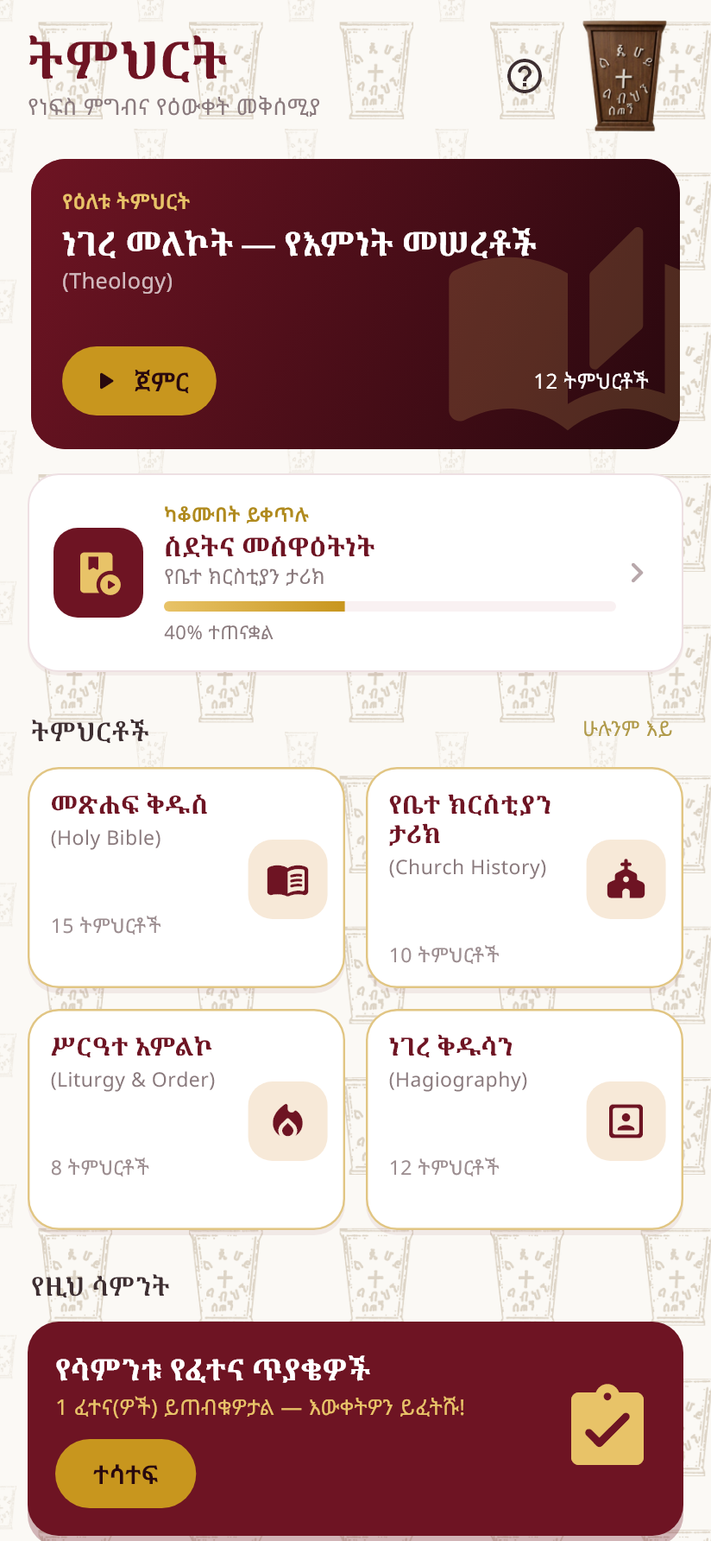
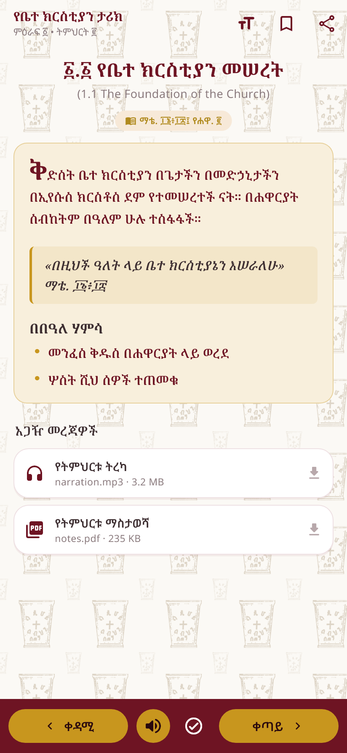
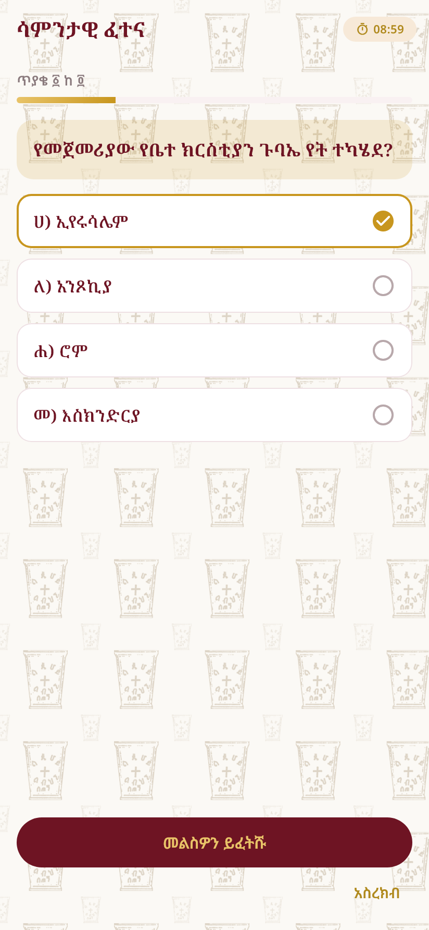
Learning Platform (Online Learning)
Categories
Holy Bible
Church History
Liturgy & Order
Hagiography
Category → Subject → Unit → Lesson
Text, Bible references, documents, audio and video links
Progress tracking, bookmarks and “continue where you left off”
Quizzes: time limits, number of attempts, manual grading
Quiz results feed into the official marks workflow
Active teachers prepare content for the subjects they teach
Education home
Lesson
Quiz
Notes:
The learning platform lets members study on their phones. Lessons are organized into four categories: Holy Bible, Church History, Liturgy & Order, and Hagiography. Each lesson can include text, references, documents and audio. Quizzes have time limits; a score linked to an official exam stays hidden from the student until the official mark is published.

Slide 15
Holiday Mezmur Service Selection — Scoring
43
Default passing score — adjustable by administrators
Each component has a minimum; all must be met to qualify
A component without data is not counted — the rest are weighted proportionally
Weights, minimums and counted programs are set by administrators
Each member sees their own detailed calculation and any shortfall
Notes:
The holiday Mezmur service selection is calculated from five criteria: class attendance, exams, Mezmur attendance, monthly contributions and department participation. The weights shown and the passing score of 43 are default values; administrators can change them for each selection. A criterion without data is not counted as zero — it is left out of the calculation. Note: the department-based criteria scheme was removed at the church's request.

Slide 16
Selection Workflow — From Draft to Publication
1
2
3
4
5
6
Draft
Open
Review
Finalized
Service category
Published
The selection is created and configured
Results are calculated automatically and refreshed as new data arrives
The relevant departments approve or reject
After all departments approve; results are locked
Assignment to Wereb or Mezmur service
All applicants are notified and can give feedback
Reviewing departments (default)
Override
Other Mezmur services
Hymns & Arts
Education & Training
Human Resources Management
Only during review, with a written reason; the calculated result is kept alongside it and recorded in the audit log
Participants for wedding services are selected manually by an authorized administrator
Notes:
The selection has six stages. It is prepared as a draft; when it is open, each applicant's result is calculated automatically. In the review stage, the Mezmur, Education and Human Resources departments review the results; only after all of them approve can the selection be finalized, and the results are then locked. Mezmur administrators assign service categories, and finally the results are published and every applicant receives a message.

Slide 17





Monthly Contributions
Recorded by Ethiopian month (Pagume counts with Nehase)
Example
A student member pays the contributions for Meskerem, Tikimt and Hidar at once.
Amount = monthly rate × 3 months
All three months show as “Paid”.
One payment can cover 1 to 12 consecutive months
Rates by member type (student / worker); children do not pay
Receipt attachment and verification by another administrator
Payments made after the month are recorded as “Paid after due month” — the month still counts as paid
Note: the app records contributions but does not collect money (there is no online payment).
Members see their own history and percentage; reports in PDF, Excel, CSV
Notes:
Monthly contributions are recorded by Ethiopian month. One payment can cover up to twelve months; the amount is calculated from the rate for the member's type, and children do not pay. A payment made after the month is recorded as “Paid after due month” for financial tracking, but the month still counts as paid. The app does not collect money; it only records what was paid.

Slide 18


Property, Borrowing and Library
Property and items
Borrowing
Library
Categories: books, musical instruments, electronics, office items…
Code, quantity, condition and location
Change history
Direct or with approval; bulk issue
Member's signature on hand-over
Renewal; condition recorded on return
Fines per day or week (can be waived with a reason)
Digital books (PDF) readable only inside the app
Printed books: request → approval → hand-over with signature
Due-date reminders
Department property request
Draft
Submitted
Under review
Approved
Issued
Returned
Reviews are done by the Finance & Property department, and stock levels update instantly when items are issued and returned
Notes:
The property module tracks the Sunday School's items by category, code and quantity. When an item is borrowed, the member signs; if it is not returned on time, a fine is calculated according to the policy. Digital books can be read only inside the app, while printed books are borrowed through a request and approval. Departments submit requests when they need property, and the Finance & Property department reviews them.

Slide 19




Departments, Projects and Tasks
7 departments
Projects
Tasks
Hymns & Arts
Education & Training
Human Resources Management
Finance & Property
Programs & Conference Preparation
Planning & Development
Information & Internal Communications
Team, deadlines, priority and progress
Multiple assignees, statuses with reasons, deadline reminders
Budget and expenses
Issues and ideas
Approved by Finance & Property; spending over budget is not allowed
Ideas become tasks; files and comments
Department chat
Task Bot
Leaders record their members' monthly participation scores
Group chat, private messages, meeting links
Task updates arrive in the chat with action buttons
Notes:
The seven departments manage their projects and tasks in the app. Each task can have several assignees, and reminders are sent as deadlines approach. Only the Finance & Property department approves money, and spending over budget is not allowed. Each department has its own chat group, and the Task Bot posts task updates in the chat.

Slide 20


Notifications, Reminders and Announcements
Notification center
Push notifications
Email
Telegram
Inside the app
Directly on the phone
To a registered email
For linked accounts
8 topics: programs, attendance, projects, departments, education, property, Mezmur, system — members can turn off what they don't need
Essential messages (announcements, admin messages, borrowing due dates) always get through
Administrators send to one person, a selection, a group or everyone, and track delivery
Other communication channels
Banners on the home screen
Internal pages with images and action buttons
Program, borrowing and personal reminders
Shareable Mezmur and program links
Notes:
Messages are delivered in four ways: the in-app notification center, push notifications, email and Telegram. Members can turn off topics they don't need, but essential messages always get through. Administrators can send a message to one person or to everyone and track its delivery.

Slide 21
Administrative Hierarchy, Roles and Access Permissions
63
14
7
10
Access permissions
Roles
Departments
Admin groups
Role levels
High Administrator
Level 50
Principles
Access = role permissions + department role + direct grants − revocations
Unauthorized pages are hidden, and the server blocks them independently
Attendance control is in the hands of HR
Money is approved by the Finance & Property department
Area leads (Mezmur, HR, payments, education)
Level 20
Department administrators (7) and education registrar
Level 15
Administrator
Level 10
Members — teachers, attendance takers and others with direct permissions
Notes:
Administration in the app is permission-based. Sixty-three detailed permissions are organized into fourteen roles. Each person sees and does only what they are permitted to; even though the app hides what is not allowed, the server checks independently. Permissions can also be granted to or revoked from an individual person.

Slide 22
Reports, Audit Log and Accountability
15 report types
PDF
Print-ready with logo, Ethiopian date, page numbers and reference
Users
Mezmurs
Attendance
Borrowing
Notifications
Admin activity
Excel
Summary sheet plus one sheet per table
Audit log
User activity
Monthly contribution
CSV
A simple table for other systems
Service selection
Projects
Education
Programs
Education marks
Mezmur selection
Accountability
Every admin action and every exported report is kept in the audit log — who, what, when
Notes:
Leaders can export fifteen types of reports in PDF, Excel or CSV. Each report has its own permission; for example, only education administrators can export student marks. Because every admin action and exported report is kept in the audit log, it is always possible to know who did what.

Slide 23

Working Offline and Synchronization
Works offline
How it syncs
Downloaded Mezmurs and favorites
1
Saved on the phone — signatures encrypted
Own ID card and QR code
2
When back online — sent automatically
Personal reminders and program alarms
Recording attendance (assigned takers)
3
Server verifies — the server has the final say
Borrowing and returns (property staff)
4
If not accepted — sent to HR for review — never lost
Task status updates
Previously viewed pages (read-only)
Limitation: most administrative tasks still need a connection; full offline work is planned.
Notes:
In places without an internet connection, the app keeps many tasks going. Downloaded Mezmurs, the member's own ID card and reminders work offline. Assigned takers can record attendance, and property staff can record borrowing, without a connection. When the connection returns, everything is sent automatically; any attendance record the server does not accept is not lost — it goes to the Human Resources department for review. Most administrative tasks, however, still need a connection.

Slide 24




Privacy and Security
Permission-based access
Encrypted personal data
Private storage
Everyone sees only what their role requires
Sensitive member data, messages and notes are stored encrypted in the database
Signatures, chat files and books open only for authorized users
Sign-in protection
Audit log
On-device protection
PIN, temporary lockout, one trusted phone and session control
All admin actions and reports are recorded
Encryption, fingerprint lock and screenshot blocking
Notes:
Protecting members' information is a priority. Each person sees only what their work requires. Sensitive personal data is stored encrypted in the database, and signatures and books are kept in private storage. Students see only their own published marks. For security reasons, technical details are not included in this presentation.

Slide 25




How the System Works Technically
Users
Server
External services
Android app
Sign-in and permission checks
Service logic — Mezmur, education, attendance, selection, contributions…
Firebase (Push)
Web app
HTTPS
Background jobs — reminders, fines, cleanup
Email
Local storage on the phone (offline)
Database
File storage
Telegram
Technologies: Flutter (app) · Laravel 12 / PHP (server) · MariaDB/MySQL (database)
Notes:
This slide gives a simple view of how the system works technically. Members use the Android app or the web. The app talks to the server over a secure connection. The server first checks identity and permissions, then performs the work and stores the data in the database and file storage. Notifications are sent through Firebase, email and Telegram. When there is no connection, the phone uses its own local storage.

Slide 26
Ethiopian Calendar and Language
1
2
3
4
Dates are shown in the Ethiopian calendar (E.C.), with an Ethiopian date picker
Monthly contributions are counted by Ethiopian month
Programs can repeat on Ethiopian calendar days
Reports include the Ethiopian date and month name
Time follows Addis Ababa local time
Amharic is the primary language; English is one tap away
Ge'ez script displays cleanly on all screens and reports
Meskerem
Tikimt
Hidar
Tahsas
5
6
7
8
Tir
Yekatit
Megabit
Miyazya
9
10
11
12
Ginbot
Sene
Hamle
Nehase
13
Pagume
For payments, Pagume counts with Nehase
Notes:
The app is designed for the Ethiopian context. Dates are shown in the Ethiopian calendar, contributions are counted by Ethiopian month, programs can repeat on Ethiopian dates such as monthly feast days, and reports carry the Ethiopian date. The thirteenth month, Pagume, counts with Nehase for payments.

Slide 27

Benefits — for Leaders, Departments and Members
For leaders
For departments
For members
Timely, reliable reports
Selection results calculated by clear rules
Accountability verified by the audit log
Summaries that support decisions
Projects, tasks and budgets in one place
Department chat and Task Bot
Property requests and tracking
Member participation records
Mezmur and lessons in your pocket
Program reminders
View your own attendance, contributions and results
Digital ID card and QR
Notes:
The app benefits everyone. Leaders get timely reports and transparent results. Departments manage their projects, budgets and discussions in one place. Members carry Mezmur and lessons in their pocket and can see their own records.

Slide 28
Current Implementation Status
Latest official release
1.5.3 (build 16) — October 2026
Older versions are required to update
Built and in testing (not yet released)
Academic years, terms and class levels (1–12)
Class attendance through programs
Selection elapsed-minute scoring and configuration versions
Contribution month-range fix
Offline records kept safe when signing out
Automated tests: all 176 app tests pass
Notes:
Ninety-eight features have been verified from the app's code. Seventy-nine of them are working in the official release, version 1.5.3 build 16. Six are built and in testing, seven are partially built, and four are planned. The department-based selection criteria were removed at the church's request. An iPhone version has been set up, but its build has not been verified.

Slide 29
Next Development Priorities
+17
Keep offline records from being lost; contribution month-range fix
Decisions needed from leadership
+18
Academic years, terms and class levels; exclusive enrolment
Certificate wording, signatory and seal
How existing books move to the new library
Formula for participation and academic scores
What happens when signing out with unsent records
Rule for the selection service bonus
+19
Class attendance through programs; elapsed-minute scoring for selection
+20
Offline work for all screens and administrators
+21
Education results workflow: pass marks, retakes, question banks
+22
Certificates, student dashboard and engagement scores
+23
Digital and printed library (an ID for every copy)
+24
Settings, guidance and screen-adaptation improvements
Numbers (+17…+24) are planned build numbers; the first three are in testing
Notes:
The next work is organized in a plan. The first three stages are built and in testing; next come full offline work, the education results workflow, certificates and the library. Some stages require leadership decisions before they can begin — for example, the certificate wording and signatory.

Slide 30





Future Opportunities (Proposals)
Proposals only — not yet decided or built
iPhone (iOS) version
Automatic backups
Monitoring and alerts
The project is set up; building and distribution remain
Regular off-server backups of the database and files
Notify leads when the server is down or a job fails
Scheduled job runner
Online payment option
Automated quality checks
So reminders go out at the exact time (cron)
For discussion — requires a leadership decision
Every change tested automatically before release
Notes:
These are proposals only; they have not been decided or built. Examples include an iPhone version, automatic backups, server monitoring, a scheduled job runner so reminders go out at the exact time, and an online payment option for discussion. Leadership will decide which ones get priority.

Slide 31
Conclusion and Next Steps
Summary
Next steps
Meserete Hiwot brings the Sunday School's main activities together in one app
Attendance, marks and selection work transparently and accountably
Members' information is carefully protected
Most features work today; the rest are on a clear plan
1
Test and release the pending updates
2
Make the pending leadership decisions
3
Change server passwords and strengthen security
4
Encourage members to install the app
5
Train administrators, teachers and attendance takers
Notes:
In summary: Meserete Hiwot brings the Sunday School's main activities together in one app; attendance, marks and selection work transparently; and members' information is protected. The next steps are to test and release the pending updates, make the pending decisions, strengthen security, encourage members to install the app, and provide training.

Slide 32
Thank You
Questions and Feedback
Download the app: app.hersolan.pro/download
Meserete Hiwot Sunday School · Debre Enqu St. Lideta Lemaryam Church
Notes:
Thank you for your attention. We are now happy to take your questions and feedback. The app can be downloaded from the download page.

