Slide 1

Azure Cosmos DB PowerShell

Slide 2
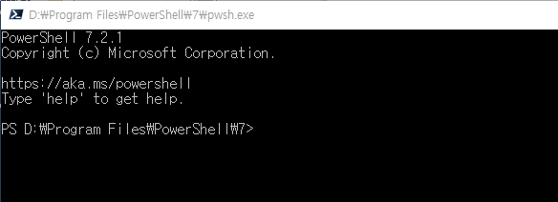
Install the Azure Az PowerShell module
VSCode에서 진행 가능
Update PowerShell and download Az PowerShell
PowerShell 7.0.6 LTS and PowerShell 7.1.3 or higher
Check your PowerShell version
$PSVersionTable.PSVersion
Install the latest version of PowerShell
https://docs.microsoft.com/en-us/powershell/scripting/install/installing-powershell?view=powershell-7.2

Slide 3
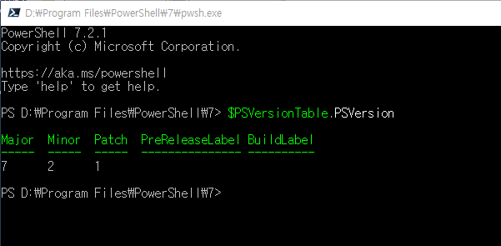
Check Version
Set-ExecutionPolicy -ExecutionPolicy RemoteSigned -Scope CurrentUser
Install-Module cmdlet
Install-Module -Name Az -Scope CurrentUser -Repository PSGallery –Force -AllowClobber

Slide 4
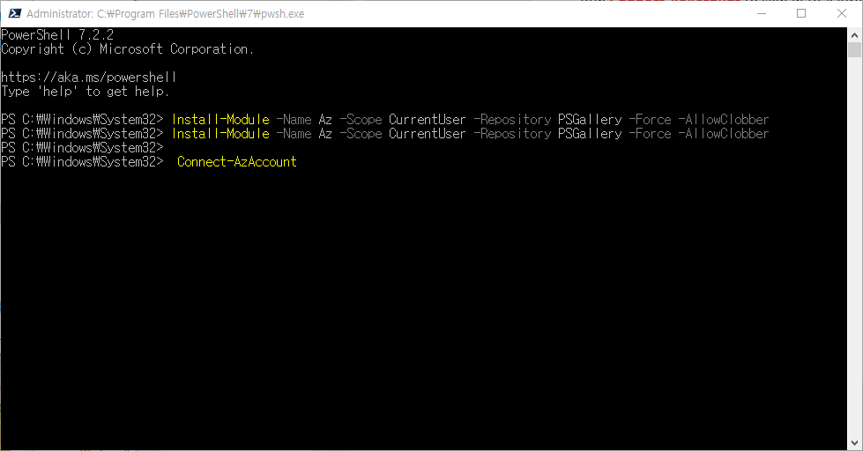
Run Connect-AzAccount to sign in to Azure.

Slide 5
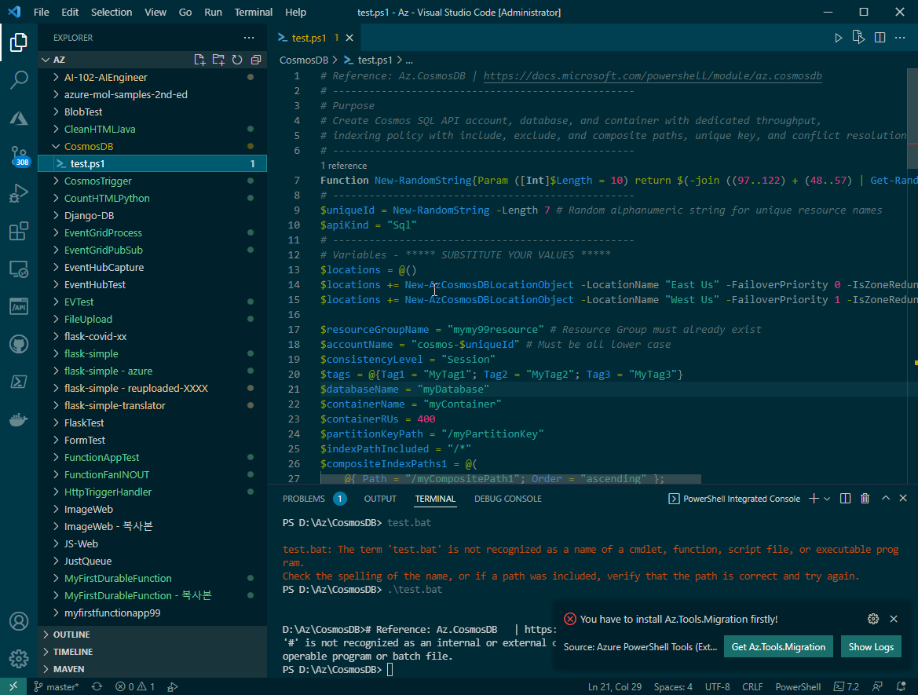
VSCode는 admin mode로 실행!

Slide 6
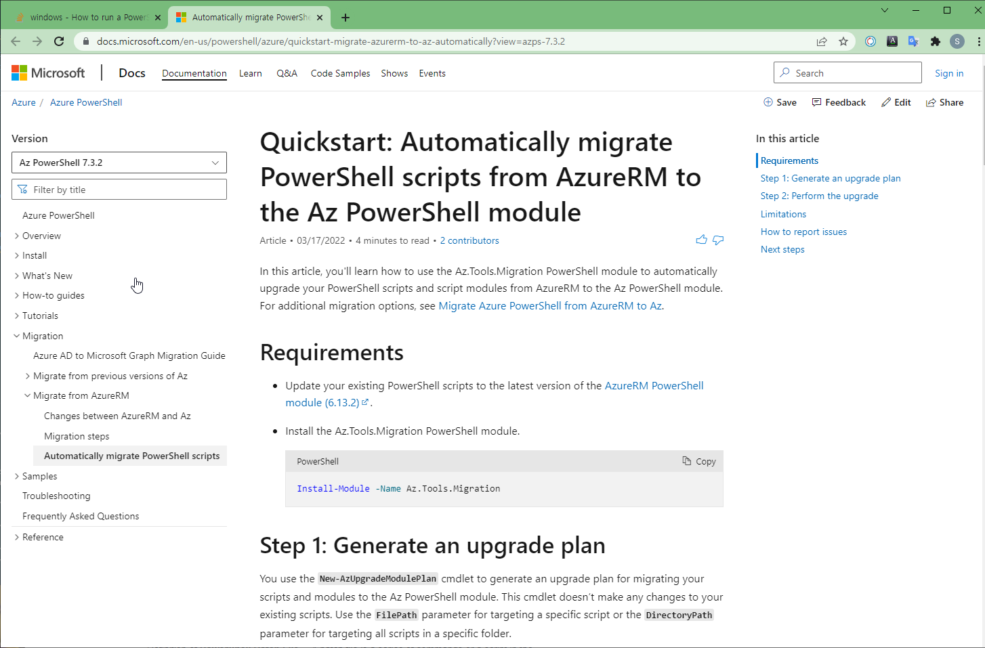
PowerShell → Azure PowerShell 사용하기 위해

Slide 7
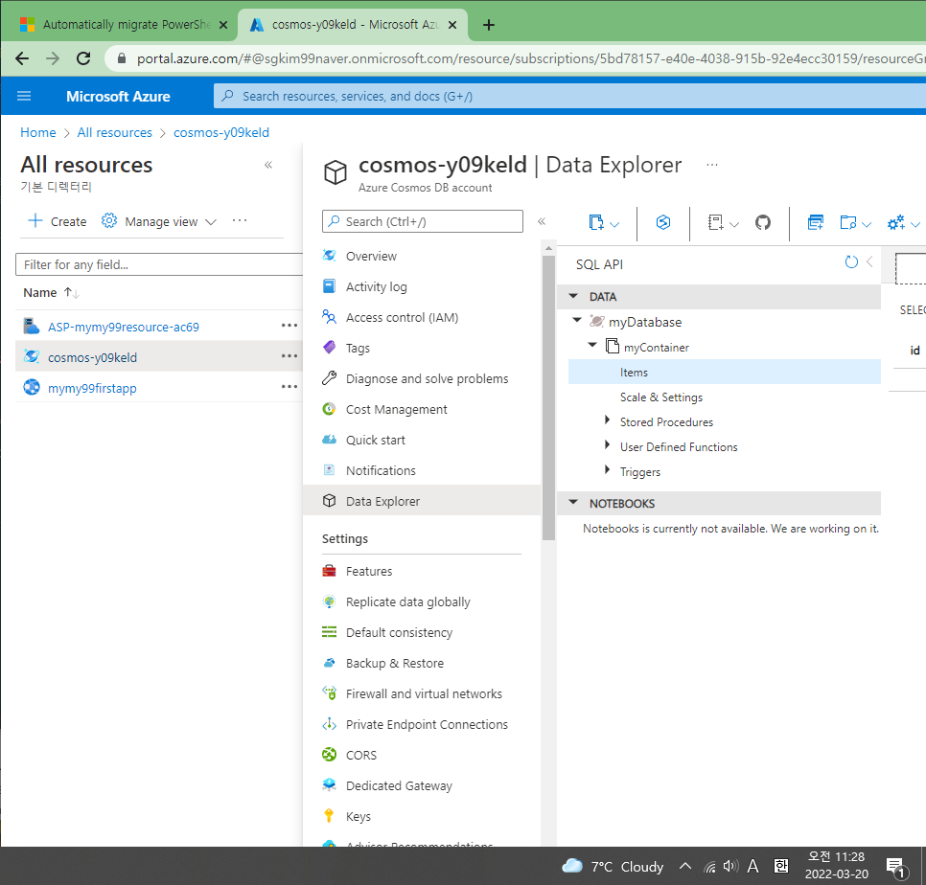
Azure powershell scrip를 수행한 후의 portal

Slide 8
# Create Cosmos SQL API account, database, and container with dedicated throughput,
# indexing policy with include, exclude, and composite paths, unique key, and conflict resolution
# --------------------------------------------------
Function New-RandomString{Param ([Int]$Length = 10) return $(-join ((97..122) + (48..57) | Get-Random -Count $Length | ForEach-Object {[char]$_}))}
# --------------------------------------------------
$uniqueId = New-RandomString -Length 7 # Random alphanumeric string for unique resource names
$apiKind = "Sql"
# --------------------------------------------------
# Variables - ***** SUBSTITUTE YOUR VALUES *****
$locations = @()
$locations += New-AzCosmosDBLocationObject -LocationName "East Us" -FailoverPriority 0 -IsZoneRedundant 0
$locations += New-AzCosmosDBLocationObject -LocationName "West Us" -FailoverPriority 1 -IsZoneRedundant 0
$resourceGroupName = "myResourceGroup" # Resource Group must already exist
$accountName = "cosmos-$uniqueId" # Must be all lower case
$consistencyLevel = "Session"
$tags = @{Tag1 = "MyTag1"; Tag2 = "MyTag2"; Tag3 = "MyTag3"}

Slide 9
$databaseName = "myDatabase"
$containerName = "myContainer"
$containerRUs = 400
$partitionKeyPath = "/myPartitionKey"
$indexPathIncluded = "/*"
$compositeIndexPaths1 = @(
@{ Path = "/myCompositePath1"; Order = "ascending" };
@{ Path = "/myCompositePath2"; Order = "descending" }
)
$compositeIndexPaths2 = @(
@{ Path = "/myCompositePath3"; Order = "ascending" };
@{ Path = "/myCompositePath4"; Order = "descending" }
)
$indexPathExcluded = "/myExcludedPath/*"
$uniqueKeyPath = "/myUniqueKeyPath"
$conflictResolutionPath = "/myResolutionPath"
$ttlInSeconds = 120 # Set this to -1 (or don't use it at all) to never expire
# --------------------------------------------------
Write-Host "Creating account $accountName"
$account = New-AzCosmosDBAccount -ResourceGroupName $resourceGroupName `
-LocationObject $locations -Name $accountName -ApiKind $apiKind -Tag $tags `
-DefaultConsistencyLevel $consistencyLevel `
-EnableAutomaticFailover:$true

Slide 10
Write-Host "Creating database $databaseName"
$database = New-AzCosmosDBSqlDatabase -ParentObject $account -Name $databaseName
$uniqueKey = New-AzCosmosDBSqlUniqueKey -Path $uniqueKeyPath
$uniqueKeyPolicy = New-AzCosmosDBSqlUniqueKeyPolicy -UniqueKey $uniqueKey
$compositePath1 = @()
ForEach ($compositeIndexPath in $compositeIndexPaths1) {
$compositePath1 += New-AzCosmosDBSqlCompositePath `
-Path $compositeIndexPath.Path `
-Order $compositeIndexPath.Order
}
$compositePath2 = @()
ForEach ($compositeIndexPath in $compositeIndexPaths2) {
$compositePath2 += New-AzCosmosDBSqlCompositePath `
-Path $compositeIndexPath.Path `
-Order $compositeIndexPath.Order
}

Slide 11
$includedPathIndex = New-AzCosmosDBSqlIncludedPathIndex -DataType String -Kind Range
$includedPath = New-AzCosmosDBSqlIncludedPath -Path $indexPathIncluded -Index $includedPathIndex
$indexingPolicy = New-AzCosmosDBSqlIndexingPolicy `
-IncludedPath $includedPath `
-CompositePath @($compositePath1, $compositePath2) `
-ExcludedPath $indexPathExcluded `
-IndexingMode Consistent -Automatic $true
# Conflict resolution policies only apply in multi-master accounts.
# Included here to show custom resolution path.
$conflictResolutionPolicy = New-AzCosmosDBSqlConflictResolutionPolicy `
-Type LastWriterWins -Path $conflictResolutionPath
Write-Host "Creating container $containerName"
$container = New-AzCosmosDBSqlContainer `
-ParentObject $database -Name $containerName `
-Throughput $containerRUs -IndexingPolicy $indexingPolicy `
-PartitionKeyKind Hash -PartitionKeyPath $partitionKeyPath `
-UniqueKeyPolicy $uniqueKeyPolicy `
-ConflictResolutionPolicy $conflictResolutionPolicy `
-TtlInSeconds $ttlInSeconds

Slide 12
Az CosmosDB Script
New-AzCosmosDBAccount | Creates a Cosmos DB Account.
New-AzCosmosDBSqlDatabase | Creates a Cosmos DB SQL Database.
New-AzCosmosDBSqlUniqueKey | Creates a PSSqlUniqueKey object used as a parameter for New-AzCosmosDBSqlUniqueKeyPolicy.
New-AzCosmosDBSqlUniqueKeyPolicy | Creates a PSSqlUniqueKeyPolicy object used as a parameter for New-AzCosmosDBSqlContainer.
New-AzCosmosDBSqlCompositePath | Creates a PSCompositePath object used as a parameter for New-AzCosmosDBSqlIndexingPolicy.
New-AzCosmosDBSqlIncludedPathIndex | Creates a PSIndexes object used as a parameter for New-AzCosmosDBSqlIncludedPath.
New-AzCosmosDBSqlIncludedPath | Creates a PSIncludedPath object used as a parameter for New-AzCosmosDBSqlIndexingPolicy.
New-AzCosmosDBSqlIndexingPolicy | Creates a PSSqlIndexingPolicy object used as a parameter for New-AzCosmosDBSqlContainer.
New-AzCosmosDBSqlConflictResolutionPolicy | Creates a PSSqlConflictResolutionPolicy object used as a parameter for New-AzCosmosDBSqlContainer.
New-AzCosmosDBSqlContainer | Creates a new Cosmos DB SQL Container.
Remove-AzResourceGroup | Deletes a resource group including all nested resources.

Slide 13
Azure Cosmos DB Python - VSCode

Slide 14
Clone the sample application
Azure portal – create Cosmos DB(previous PPT)
Open a command prompt, create a new folder named git-samples
mkdir git-samples
cd git-samples
git clone https://github.com/Azure-Samples/azure-cosmos-db-python-getting-started.git

Slide 15
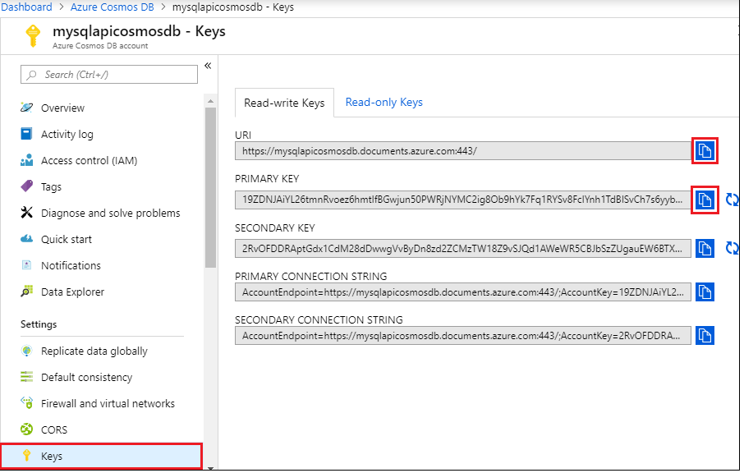
Update your connection string
In your Azure Cosmos DB account in the Azure portal

Slide 16
In Visual Studio Code, open the cosmos_get_started.py file in \git-samples\azure-cosmos-db-python-getting-started.
Then copy your PRIMARY KEY value from the portal and make it the value of the key in cosmos_get_started.py.
key = 'FILLME'

Slide 17
The CosmosClient is initialized. Make sure to update the "endpoint" and "key" values as described in the Update your connection string section.
client = CosmosClient(endpoint, key)
A new database is created.
database_name = 'AzureSampleFamilyDatabase'
database = client.create_database_if_not_exists(id=database_name)

Slide 18
A new container is created, with 400 RU/s of provisioned throughput.
lastName as the partition key, which allows us to do efficient queries that filter on this property.
container_name = 'FamilyContainer'
container = database.create_container_if_not_exists(
id=container_name,
partition_key=PartitionKey(path="/lastName"),
offer_throughput=400
)

Slide 19
Some items are added to the container.
Containers are a collection of items (JSON documents) that can have varied schema.
The helper methods get_[name]_family_item return representations of a family that are stored in Azure Cosmos DB as JSON documents.
for family_item in family_items_to_create:
container.create_item(body=family_item)

Slide 20
key value lookups using the read_item method. for family in family_items_to_create:
for family in family_items_to_create:
item_response = container.read_item(item=family['id'], partition_key=family['lastName'])
request_charge = container.client_connection.last_response_headers['x-ms-request-charge']
print('Read item with id {0}. Operation consumed {1} request units'.format(item_response['id'], (request_charge)))

Slide 21
A query is performed using SQL query.
partition key values : lastName in the WHERE clause, Azure Cosmos DB will efficiently route this query to the relevant partitions, improving performance.
query = "SELECT * FROM c WHERE c.lastName IN ('Wakefield', 'Andersen')"
items = list(container.query_items(
query=query,
enable_cross_partition_query=True
))
request_charge = container.client_connection.last_response_headers['x-ms-request-charge']
print('Query returned {0} items. Operation consumed {1} request units'.format(len(items), request_charge))

Slide 22
Run the app - Visual Studio Code
View > Command Palette.
At the prompt, enter Python: Select Interpreter and then select the version of Python to use.
Select View > Integrated Terminal to open the Visual Studio Code integrated terminal.
In the integrated terminal window, change to azure-cosmos-db-python-getting-started folder.
Run the following command to install the azure-cosmos package.
pip install --pre azure-cosmos
Run VS Code as an administrator.

Slide 23
Run the following command to run the sample and create and store new documents in Azure Cosmos DB. (or Press Run button)
python cosmos_get_started.py
To confirm the new items were created and saved, in the Azure portal, select Data Explorer > AzureSampleFamilyDatabase > Items.
View the items that were created.
sample JSON document for the Andersen family:
{
"id": "Andersen-1569479288379",
"lastName": "Andersen",
"district": "WA5",
"parents": [
{
"familyName": null,
"firstName": "Thomas"
},
{
"familyName": null,
"firstName": "Mary Kay"
}
],
…………….

Slide 24
Azure Cosmos DB Python – VSCode More…

Slide 25
# These examples are ingested by the documentation system, and are
# displayed in the SDK reference documentation. When editing these
# example snippets, take into consideration how this might affect
# the readability and usability of the reference documentation.
# All interaction with Cosmos DB starts with an instance of the CosmosClient
# [START create_client]
from azure.cosmos import exceptions, CosmosClient, PartitionKey
import os
url = "https://mXXXazure.com:443/" ##os.environ["ACCOUNT_URI"]
key = "BWYItxXXXXXAuRWOgFJg==" ##os.environ["ACCOUNT_KEY"]
client = CosmosClient(url, key)
# [END create_client]
# Create a database in the account using the CosmosClient,
# specifying that the operation shouldn't throw an exception
# if a database with the given ID already exists.
# [START create_database]
database_name = "testDatabase"
try:
database = client.create_database(id=database_name)
except exceptions.CosmosResourceExistsError:
database = client.get_database_client(database=database_name)
# [END create_database]
# Create a container, handling the exception if a container with the
# same ID (name) already exists in the database.
# [START create_container]
container_name = "products"
try:
container = database.create_container(
id=container_name, partition_key=PartitionKey(path="/productName")
)
except exceptions.CosmosResourceExistsError:
container = database.get_container_client(container_name)
# [END create_container]
# Create a container with custom settings. This example
# creates a container with a custom partition key.
# [START create_container_with_settings]
customer_container_name = "customers"
try:
customer_container = database.create_container(
id=customer_container_name,
partition_key=PartitionKey(path="/city"),
default_ttl=200,
)
except exceptions.CosmosResourceExistsError:
customer_container = database.get_container_client(customer_container_name)
# [END create_container_with_settings]
# Retrieve a container by walking down the resource hierarchy
# (client->database->container), handling the exception generated
# if no container with the specified ID was found in the database.
# [START get_container]
database = client.get_database_client(database_name)
container = database.get_container_client(container_name)
# [END get_container]
# [START list_containers]
database = client.get_database_client(database_name)
for container in database.list_containers():
print("Container ID: {}".format(container['id']))
# [END list_containers]
# Insert new items by defining a dict and calling Container.upsert_item
# [START upsert_items]
container = database.get_container_client(container_name)
for i in range(1, 10):
container.upsert_item(
dict(id="item{}".format(i), productName="Widget", productModel="Model {}".format(i))
)
# [END upsert_items]
# Modify an existing item in the container
# [START update_item]
item = container.read_item("item2", partition_key="Widget")
item["productModel"] = "DISCONTINUED"
updated_item = container.upsert_item(item)
# [END update_item]
# Query the items in a container using SQL-like syntax. This example
# gets all items whose product model hasn't been discontinued.
# [START query_items]
import json
for item in container.query_items(
query='SELECT * FROM products p WHERE p.productModel <> "DISCONTINUED"',
enable_cross_partition_query=True,
):
print(json.dumps(item, indent=True))
# [END query_items]
# Parameterized queries are also supported. This example
# gets all items whose product model has been discontinued.
# [START query_items_param]
discontinued_items = container.query_items(
query='SELECT * FROM products p WHERE p.productModel = @model AND p.productName="Widget"',
parameters=[dict(name="@model", value="DISCONTINUED")],
)
for item in discontinued_items:
print(json.dumps(item, indent=True))
# [END query_items_param]
# Delete items from the container.
# The Cosmos DB SQL API does not support 'DELETE' queries,
# so deletes must be done with the delete_item method
# on the container.
# [START delete_items]
for item in container.query_items(
query='SELECT * FROM products p WHERE p.productModel = "DISCONTINUED" AND p.productName="Widget"'
):
container.delete_item(item, partition_key="Widget")
# [END delete_items]
# Retrieve the properties of a database
# [START get_database_properties]
properties = database.read()
print(json.dumps(properties, indent=True))
# [END get_database_properties]
# Modify the properties of an existing container
# This example sets the default time to live (TTL) for items in the
# container to 3600 seconds (1 hour). An item in container is deleted
# when the TTL has elapsed since it was last edited.
# [START reset_container_properties]
# Set the TTL on the container to 3600 seconds (one hour)
database.replace_container(container, partition_key=PartitionKey(path='/productName'), default_ttl=3600)
# Display the new TTL setting for the container
container_props = database.get_container_client(container_name).read()
print("New container TTL: {}".format(json.dumps(container_props['defaultTtl'])))
# [END reset_container_properties]
# Create a user in the database.
# [START create_user]
try:
database.create_user(dict(id="Walter Harp"))
except exceptions.CosmosResourceExistsError:
print("A user with that ID already exists.")
except exceptions.CosmosHttpResponseError as failure:
print("Failed to create user. Status code:{}".format(failure.status_code))
# [END create_user]
Examples.py

Slide 26
import azure.cosmos.cosmos_client as cosmos_client
import azure.cosmos.exceptions as exceptions
# ----------------------------------------------------------------------------------------------------------
# Prerequistes -
#
# 1. An Azure Cosmos account -
# https://docs.microsoft.com/azure/cosmos-db/create-sql-api-python#create-a-database-account
#
# 2. Microsoft Azure Cosmos PyPi package -
# https://pypi.python.org/pypi/azure-cosmos/
# ----------------------------------------------------------------------------------------------------------
# Sample - demonstrates the basic CRUD operations on a Database resource for Azure Cosmos
#
# 1. Query for Database (QueryDatabases)
#
# 2. Create Database (CreateDatabase)
#
# 3. Get a Database by its Id property (ReadDatabase)
#
# 4. List all Database resources on an account (ReadDatabases)
#
# 5. Delete a Database given its Id property (DeleteDatabase)
# ----------------------------------------------------------------------------------------------------------
##client = CosmosClient(url, key)
HOST = "https://mymXXXXXXdb.documents.azure.com:443/" ##os.environ["ACCOUNT_URI"]
MASTER_KEY = "BWYItXXXXXXXXRWOgFJg==" ##os.environ["ACCOUNT_KEY"]
DATABASE_ID = "testDatabase"
def find_database(client, id):
print('1. Query for Database')
databases = list(client.query_databases({
"query": "SELECT * FROM r WHERE r.id=@id",
"parameters": [
{ "name":"@id", "value": id }
]
}))
if len(databases) > 0:
print('Database with id \'{0}\' was found'.format(id))
else:
print('No database with id \'{0}\' was found'. format(id))
def create_database(client, id):
print("\n2. Create Database")
try:
client.create_database(id=id)
print('Database with id \'{0}\' created'.format(id))
except exceptions.CosmosResourceExistsError:
print('A database with id \'{0}\' already exists'.format(id))
def read_database(client, id):
print("\n3. Get a Database by id")
try:
database = client.get_database_client(id)
database.read()
print('Database with id \'{0}\' was found, it\'s link is {1}'.format(id, database.database_link))
except exceptions.CosmosResourceNotFoundError:
print('A database with id \'{0}\' does not exist'.format(id))
def list_databases(client):
print("\n4. List all Databases on an account")
print('Databases:')
databases = list(client.list_databases())
if not databases:
return
for database in databases:
print(database['id'])
def delete_database(client, id):
print("\n5. Delete Database")
try:
client.delete_database(id)
print('Database with id \'{0}\' was deleted'.format(id))
except exceptions.CosmosResourceNotFoundError:
print('A database with id \'{0}\' does not exist'.format(id))
def run_sample():
client = cosmos_client.CosmosClient(HOST, {'masterKey': MASTER_KEY} )
try:
# query for a database
find_database(client, DATABASE_ID)
# create a database
create_database(client, DATABASE_ID)
# get a database using its id
read_database(client, DATABASE_ID)
# list all databases on an account
list_databases(client)
# delete database by id
delete_database(client, DATABASE_ID)
except exceptions.CosmosHttpResponseError as e:
print('\nrun_sample has caught an error. {0}'.format(e.message))
finally:
print("\nrun_sample done")
if __name__ == '__main__':
run_sample()
Management.py

