Slide 1
HOWARD Gesture-based triage system

Slide 2


HOW ARE YOU TODAY ?
Howar

Slide 3
WHAT challenge Howard solves?

Slide 4

The challenge of going to…
Many patients in the waiting room?
There’s a chance of irresponsible behavior?
What should patients do?
How can hospitals protect medical staff, patients and their connections?
Maybe we need self-evaluation before entering hospital ?
HOWARD can help !

Slide 5
The challenge of going to…
Many patients in the waiting room?
Person
can be infected and not know it!
AI evaluation before entering hospital can help?
How can hospitals protect medical staff, patients, their connections, protected/safe areas?
HOWARD can help

Slide 6
WHO is Howard?

Slide 7
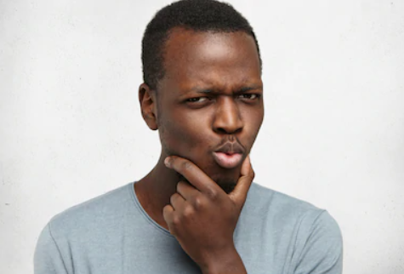
Howard interactive triage…
Interactive screen equipped with camera helps with self-evaluation
Touchless communication – no close contact, infection free
Usage is simple:
Stand in front of screen
It asks questions and user shows answer by hand
Questions are about health status
Answers are yes/no/not-known(neutral) gestures
In case of doubt of positive suspicion of Covid-19
Medical staff comes or present specific instructions
Howard is GDPR safe
Detects only gesture, no video or picture is stored
Saving only conclusions (positive/negative doubt for Covid-19)

Slide 8
HOW is it working?

Slide 9
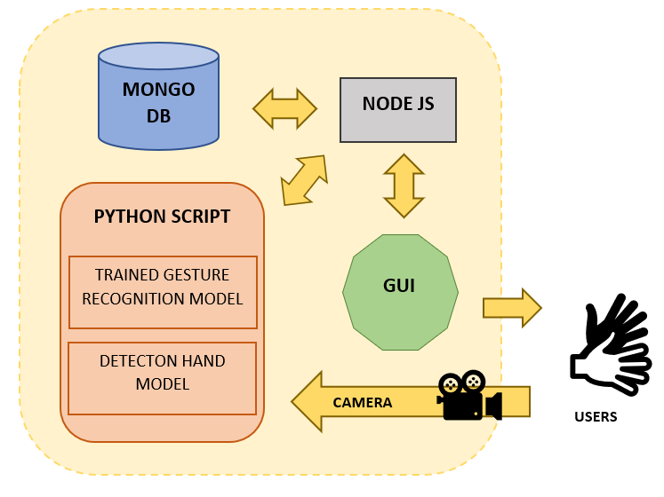
Howard team made this solution using…
AI trained model gesture recognition
Hand-detection model
MongoDB with timestamp, false/true Covid-19 triage answers and end result
friendly GUI interface
NODE JS gluing all elements of edge solution
Backend with Tomcat WS collecting results, providing notifications, comms channel and analytics for administration

Slide 10
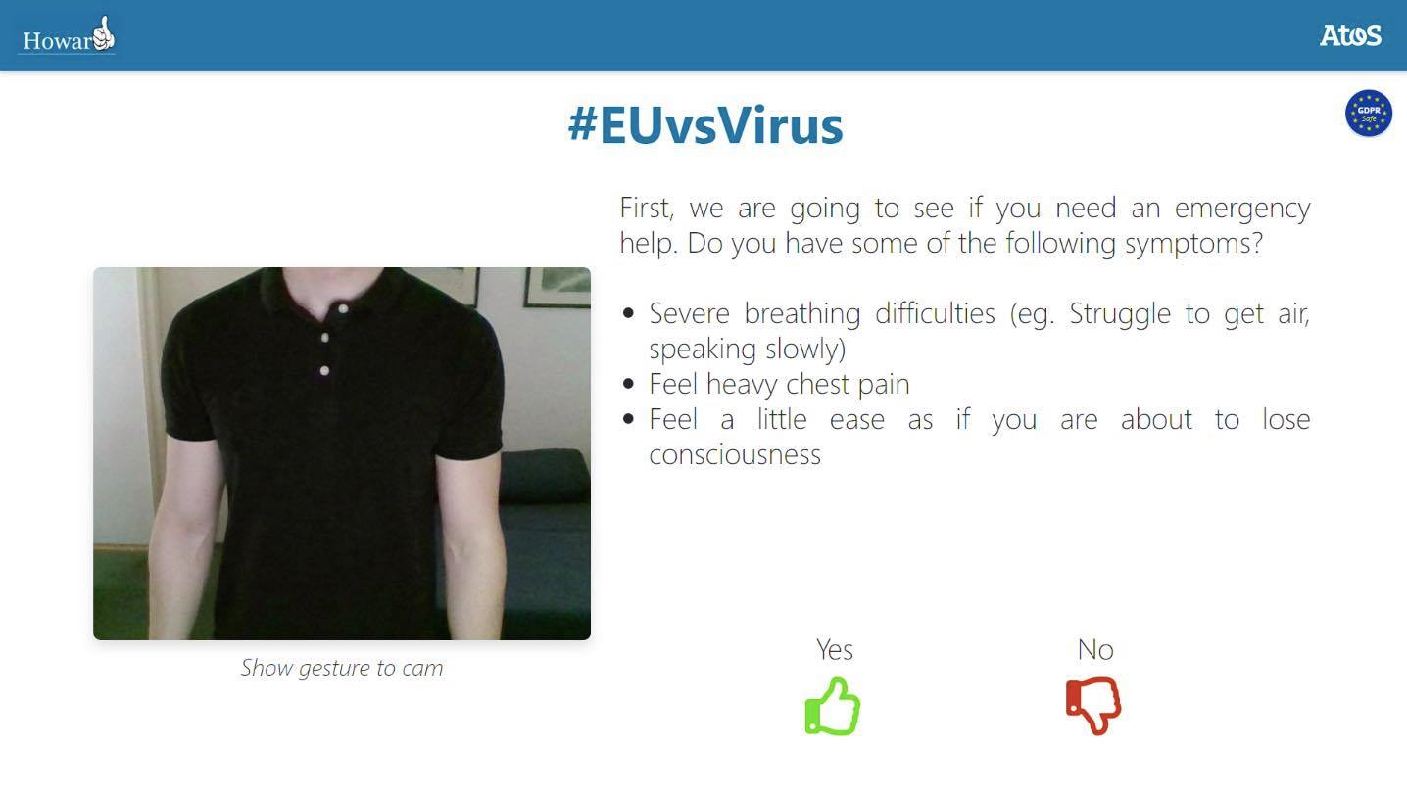
Types of questions asked
Would you like to take a triage questionnaire?
Do you have any of the following symptoms:
Severe breathing difficulties (struggle to breathe, speaking slowly)
Feel heavy chest pain
Feel as if you are about to lose consciousness
Have you been in close contact with someone who is confirmed as having Covid-19 in the last 14 days?
Have you been to a country with confirmed Covid-19 cases?

Slide 11
WHY is Howard needed?

Slide 12
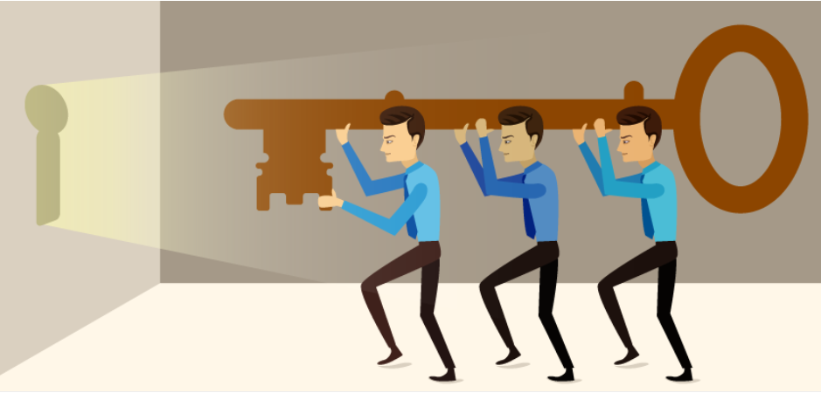
Why does HOWARD helps in crisis?
Removes infection vector, saves nurses and doctors – it’s TOUCHLESS
Enables self-detection of potentially suspect case patients
Moves first line of defense out of protected areas (front-entrance)
Sending immediate notifications to medical staff / security
Count people entering/exiting area
Medical staff gets quick evaluation
Suspect case detection assistant
Uses calming design approach and directs help immediately
Scalable and fast to use by thousands daily, 24/7/365

Slide 13
WHICH environment it requires?

Slide 14
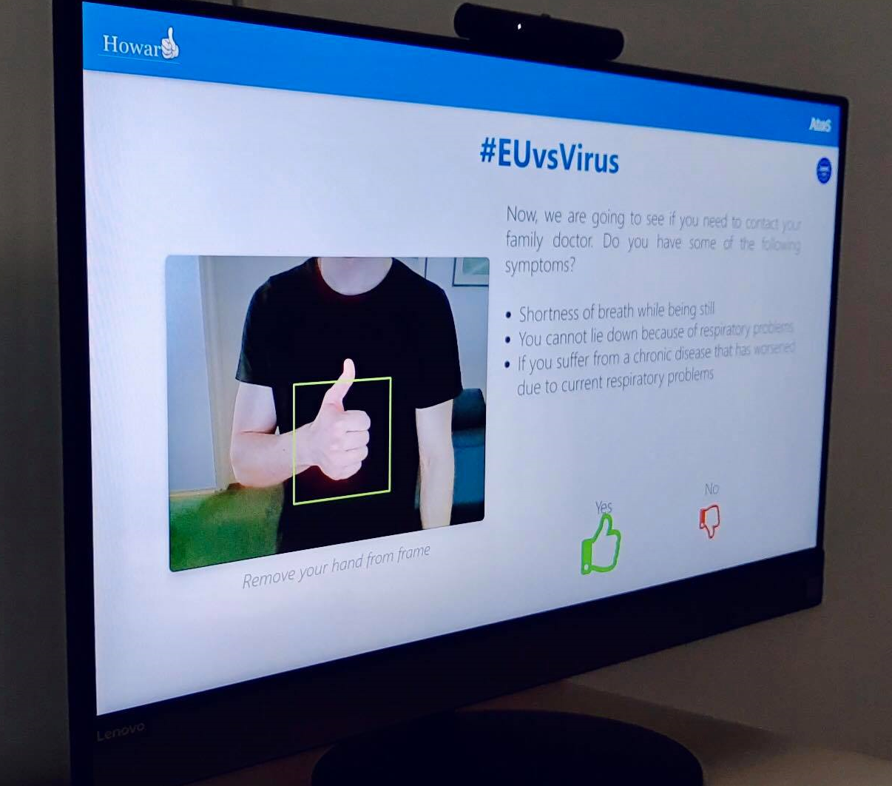
HOWARD system runs..
Various systems
All-in-one machine with screen & audio/video devices
IoT devices used over central backend with multiple displays
In the cloud or on premises
Deployable on mobile devices (perspective)
OSS (open source software) with proprietary solution on top
Single and easily distributable package
Commodity hardware
machines available in local stores
Micro-systems (raspberry-pi, dedicated edges – perspective)

Slide 15
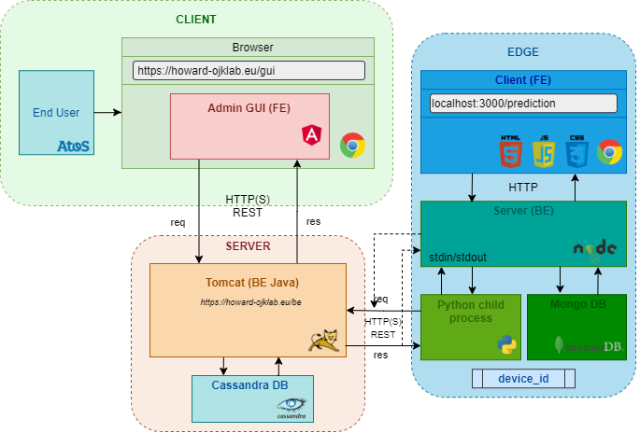
Overall architecture…

Slide 16
WHEN should we stop using it?

Slide 17
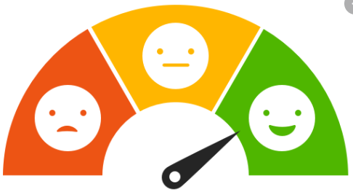
WHEN to stop?
No need to stop using it!
Howard helps in current crisis but it is also helpful afterwards
Howard stores a database for further analyzing
Centralized database for every Howard in the world
Howard can change questions asked using campaign management
Counting numbers of people getting in/out
Serve as information / point-of-contact stand
Evaluation of people satisfaction
Deployed on any entrance:
Small ambulances, police stations
Galleries, museums, schools & colleges

Slide 18
WHERE we can find HOWARD?

Slide 19
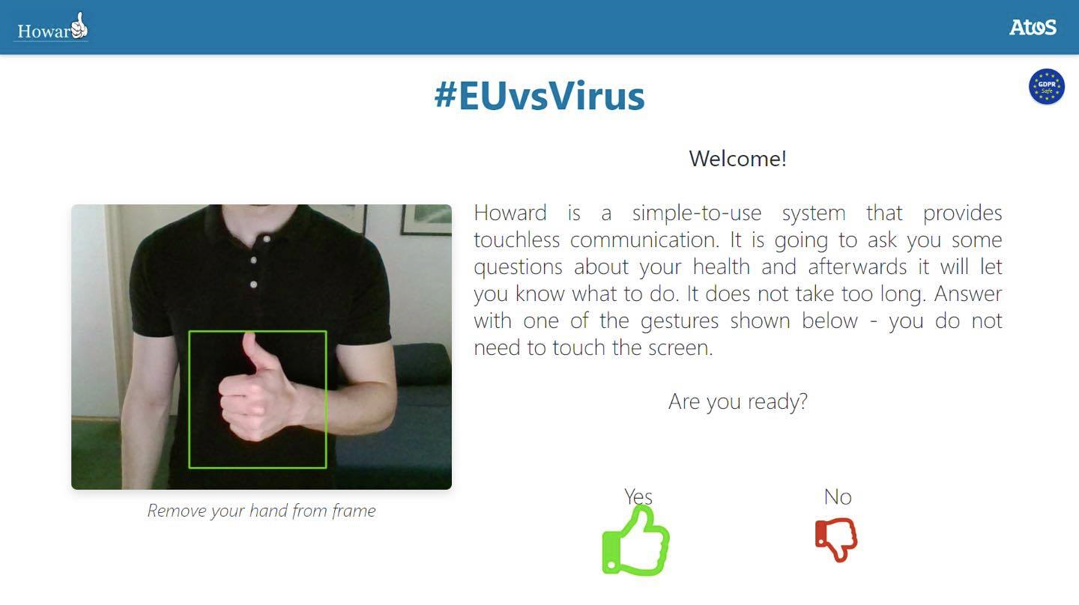
WHERE is HOWARD?
Click on the link below for a video
demonstration pitch <insert_final_link>
Download additional documents in
the link below <insert_final_link>
HOWARD is available as a delivery on all-in-one machine provided by Atos! At this point team is not sharing sources due to policy. In order to get further information please contact: blaz.vincetic@atos.net

Slide 20
Thank you For more information please contact: M+ 385 91 4215908 blaz.vincetic@atos.net

