Slide 1
PROCEDURAL MAP W/ RECOMBINATOR
Sean Boeger & Zachery Lewis
12/5/2017

Slide 2
PROCEDURAL MAP W/ RECOMBINATOR
What is Recombinator
How we use Recombinator
Improvements to Recombinator

Slide 3


Slide 4
Recombinator? What is it? Does it taste
good?
A redesign-oriented tool that allows us to specify an alternative structure for a process by creating different combinations of its specializations

Slide 5
What?
Basically…
Take different parts
Combine parts together
Get a structure

Slide 6

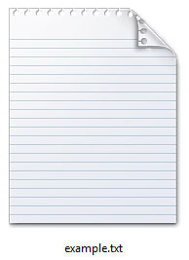
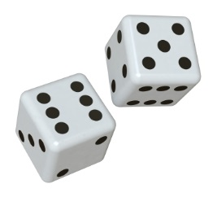
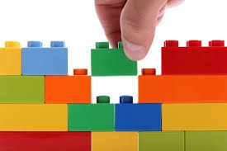
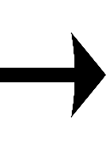
How we used recombinator

Slide 7
Demo

Slide 8
How to improve recombinator
Smart Objects

Slide 9
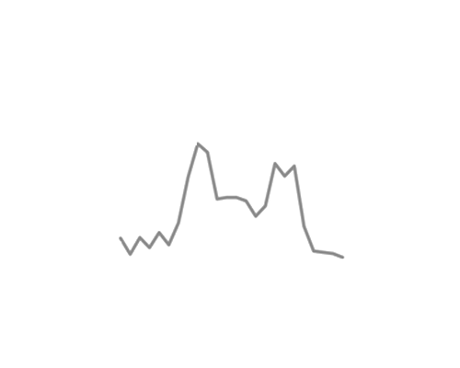
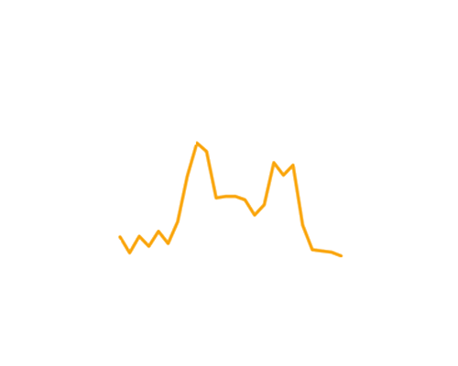
Get rid of noise, decoration, and chart junk
The title should explain the point of the slide
Candidate Applications
The number of candidates dropped
over the last six years
Candidate Applications Per Year
500
456
400
385
300
Applications
200
155
100
94
1985
1990
1995
2000
2005
1985
1993
1998
2008
23

Slide 10
Make your PowerPoints better
Use less ink
No chart junk
No gifs
No crowding
No walls of text
No decoration/background
Use one highlight color
Sentences as titles – So What?
Allow your slides to breathe
Fewer bullets or no bullets
Text appears as you talk about it
Interesting and relevant images
Aesthetically balance your slides
Consistency between all slides

Slide 11
Make your Delivery better
Figure out your key message
Practice, practice, practice
Adapt to your audience
Empathize with the audience
Give a performance
Involve the audience
Show up early and test
Extinguish idiosyncrasies
Use repetition to make it stick
Be a storyteller
Vary your pacing and pitch
Show your excitement
End strong – stick the landing
Tell them what to remember

Slide 12
Questions/Comments

