Slide 1
Week 4_STAT131 Measuring Uncertainty

Slide 2
Measuring Uncertainty
In an uncertain world many things are unpredictable
Will it rain tomorrow?
Will there be snow next week in Malaysia?
Will there be an earthquake or lightening strike?
In such situations, it is impossible to predict with
certainty what will happen.
Notes:
In an uncertain world many things are unpredictable
• Will it rain tomorrow?
• Will the Steelers win next week?
• Will my daughter survive her surgery?
• Will the telstra share prices continue to grow?
• Will the train be late to Sydney this evening?
• Will Howard call for a double dissolution by October?
Information leads to better predictions BUT accurate predictions are not possible in many situations.
When the question "what is the probability of the event that the Steelers win next week? " was asked in class we had a variety of answers. The more hopeful amongst us gave a higher estimate than others. This approach based on our varying knowledge provides us with one 'measure' of probability. If well informed it may be a good subjective measure of uncertainty.

Slide 3
Probability is used to quantify and describe precisely this unpredictability

Slide 4
Provide a measure for these...
...Or if you can’t, decide how you would measure
The probability that it will snow in Malaysia.
The probability that it will rain tomorrow
The probability that the train after the last STAT131 lecture to KL Central will be late.

Slide 5
What is the probability of...
Getting a 6 when I toss this equal sided die?
Getting a 2 or a 3 when I toss this equal sided die?
Getting a 6 when I toss this unequal sided die?
What thinking gave you these answers?
Notes:
This involved measuring the probability of getting a 5 in the roll of a die with six equal sides.
Of course we all agreed that if it were a fair die the probability would be 1/6 to get a five. As indeed it would be 1/6 to get a 1; 1/6 to get a 2; 1/6 to get a 3; 1/6 to get a four; and 1/6 to get a six. The total probability of 1 was the summation of all the probabilities for the different possible outcomes. This answer was based on the idea that with the dice being symmetrically constructed, that there would be an equally likely chance of each side of the dice landing up.
The activity with the unequal sided die. This involved determining the probability of getting a 6 with a die which had unequal sides. How would you measure the probability of getting a 6 with this die?
What is the probability of getting a 6 with this die?
As the class suggested by repeatedly carrying out the experiemt of rolling the die. In this manner we could see how many times a three was rolled out of the total number of rolls of the die.
After the first throw the relative frequency for throwing a three will be one of two values, what are they? One if it was a three, zero if it was not a three

Slide 6
What is the probability of...
Getting a 6 when I toss this equal sided die?
Getting a 2 or a 3 when I toss this equal sided die?
Getting a 6 when I toss this unequal sided die?
What thinking gave you these answers?
These are based on Equally Likely Outcomes
Notes:
This involved measuring the probability of getting a 5 in the roll of a die with six equal sides.
Of course we all agreed that if it were a fair die the probability would be 1/6 to get a five. As indeed it would be 1/6 to get a 1; 1/6 to get a 2; 1/6 to get a 3; 1/6 to get a four; and 1/6 to get a six. The total probability of 1 was the summation of all the probabilities for the different possible outcomes. This answer was based on the idea that with the dice being symmetrically constructed, that there would be an equally likely chance of each side of the dice landing up.
The activity with the unequal sided die. This involved determining the probability of getting a 6 with a die which had unequal sides. How would you measure the probability of getting a 6 with this die?
What is the probability of getting a 6 with this die?
As the class suggested by repeatedly carrying out the experiemt of rolling the die. In this manner we could see how many times a three was rolled out of the total number of rolls of the die.
After the first throw the relative frequency for throwing a three will be one of two values, what are they? One if it was a three, zero if it was not a three

Slide 7
Language and Notation
Experiment
Outcome
Sample Space
Null Event
Event (E)
The observation of any phenomenon
that is uncertain
The outcome of an experiment that
cannot be reduced to any simpler results
(S) the collection of all outcomes
{} or φ is the collection of no outcomes
Collection of outcomes
Notes:
Language and notation
In studying probability there is a specific usage of language.
Whilst think about our dice experiment answer the following:
• What is an experiment?
• When I throw this die what possible outcomes can I get?
This collection of all possible outcomes is the sample space.
•What is the probability of getting a 0 when I throw the die?
• What is the probability of the event that the die when thrown will give an even number?
• What is an event?
• What is the minimum probability of some event occuring?
• What is the maximum probability of some event occurring?

Slide 8
Probability as a measure
Event certain to happen
Event equally likely to happen as not
Event impossible to occur
1.00
0.5
0.00

Slide 9
P(E)
We write P(E) for the probability that event E will happen. So ...
P(I will die some day) = 1.0
P(I will live forever) = 0.0

Slide 10
Events A and B are mutually exclusive
P(A intersection B)=0
P(A and B)=0
S
A
No overlap
B
P(A happens or B happens)=
P(A) + P(B)

Slide 11
Events A and B are NOT mutually exclusive
S
overlap
B
A
P(A happens or B happens)=
P(A)+P(B) - P(A and B)

Slide 12
Rules of Probability
Whichever type of probability is used, it must obey the rules of probability:
1. For any event E, 0 ≤ P(E) ≤ 1.
2. P(S) = 1 (S = sample space)
P(A happens or B happens) = P(A) + P(B)
ie P(AUB) = P(A) + P(B)
if A and B are events with no outcomes in common (mutually exclusive events).

Slide 13
Rules of probability
4. If A and B are NOT mutually exclusive then
P(A happens of B happens)=P(A)+P(B) - P(A and B)
5. P(E occurs) + P(E does not occur)=1
Can be written in different notation

Slide 14
Rules of Probability
A very useful consequence of these rules is:
P(E occurs) = 1 - P(E does not occur)
Often the easiest way to find P(E occurs) is to find the probability that E does NOT occur and then to use this result.

Slide 15
Rules of Probability
6. Independence
Events A and B are independent if

Slide 16
7. Conditional Probability
If A and B are two events, where P(A)  0 and P(B)  0, then the probability of A, given that B has already occurred is written P(A⬅B)
We read this as “The probability of A, given B”

Slide 17
Events A and B
A Not A Total
B 10 20 30
Not B 20 40 60
Total 30 60 90
Are events A and B independent?

Slide 18
Events A and B
A Not A Total
B 10 20 30
Not B 20 40 60
Total 30 60 90
P(A)=30/90
P(B)=30/90
P(A).P(B)=30/90*30/90=1/9=P(A and B)=10/90
Therefore A and B are independent

Slide 19
Independence in Population Grade and Attendance
B Not B
A
Not A
To show independence, show P(A)x P(B)=P(A intersection B)
Conclude: As P(A)x P(B) does not equal the intersection of A and B
The variables are NOT independent

Slide 20
Probability Example Exploring Attendance Vs grade
(a) P(collected)=
(a) P(not collected)=

Slide 21
Probability Example Exploring Attendance Vs grade
(a) P(collected)=
80/137
(a) P(not collected)=
57/137

Slide 22
Row Marginals
(a) P(Fail)=
(b) P(Pass)=

Slide 23
Row Marginals
(a) P(Fail)=
(b) P(Pass)=
54/137 =.394
83/137 =.606

Slide 24
Q2 Intersection, A and B occur together
(c) P(Collected & fail)=
(c) P(Collected & Pass)=
(c) P(NotCollected & Fail)=
(c) P(Not collected & Pass)=
24/137
56/137
30/137
27/137

Slide 25
Question 2 Conditional, given information
(d) P(Fail|Collected)=
(d) P(Pass|Collected)=

Slide 26
Question 2 Conditional, given information
(d) P(Fail|Collected)=
(d) P(Pass|Collected)=
24/80
56/80

Slide 27
Question 2 Conditional, given information
(d) P(Collected|Fail)=
(d) P(Not collected| Fail)=

Slide 28
Question 2 Conditional, given information
(d) P(Collected|Fail)=
(d) P(Not collected| Fail)=
24/54
30/54

Slide 29
EXERCISE
A coin and a die are thrown together. Find the probability of obtaining (a) a head (b) a number greater than 4 (c) a head or a number greater than 4 (d) a head and a number greater than 4
In a group of 20 adults, 4 out of the 7 women and 2 out of the 13 men wear glasses. What is the probability that a person chosen at random from the group is a woman or someone who wears glasses?

Slide 30

3. For events A and B it is known that P(A) = P(B) and P(AB) = 0.1 and P(AB) = 0.7. Find P(A).
4. In a survey, 15% of the participants said they had never bought lottery tickets or a premium bond, 73% had bought lottery tickets and 49% had bought premium bonds. Draw a Venn Diagram. Find the probability that a person chosen at random
a)had bought lottery tickets or premium bonds.
b)had bought lottery tickets and premium bonds.
c) had bought lottery tickets only.
(0.85, 0.37, 0.36)
5.

Slide 31
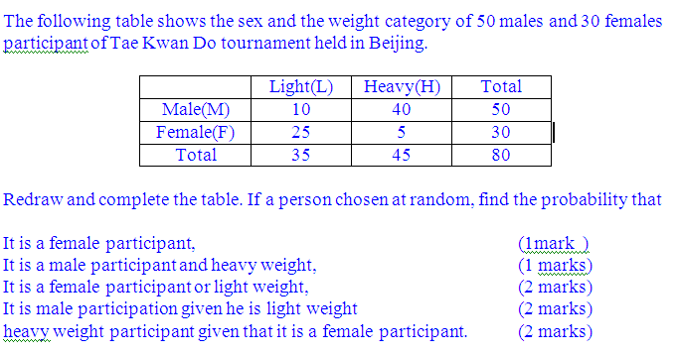
6.

Slide 32
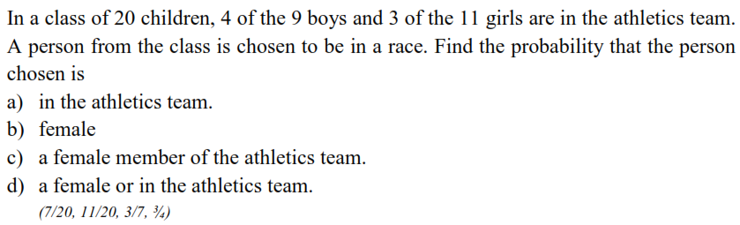
7.

Slide 33
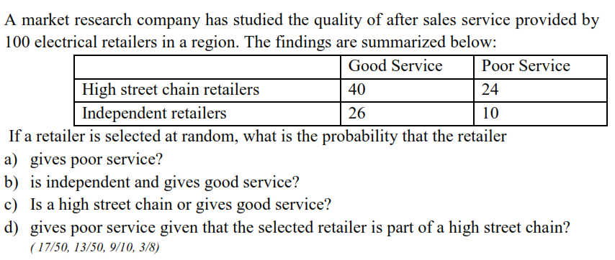
8.

Slide 34
