Slide 1
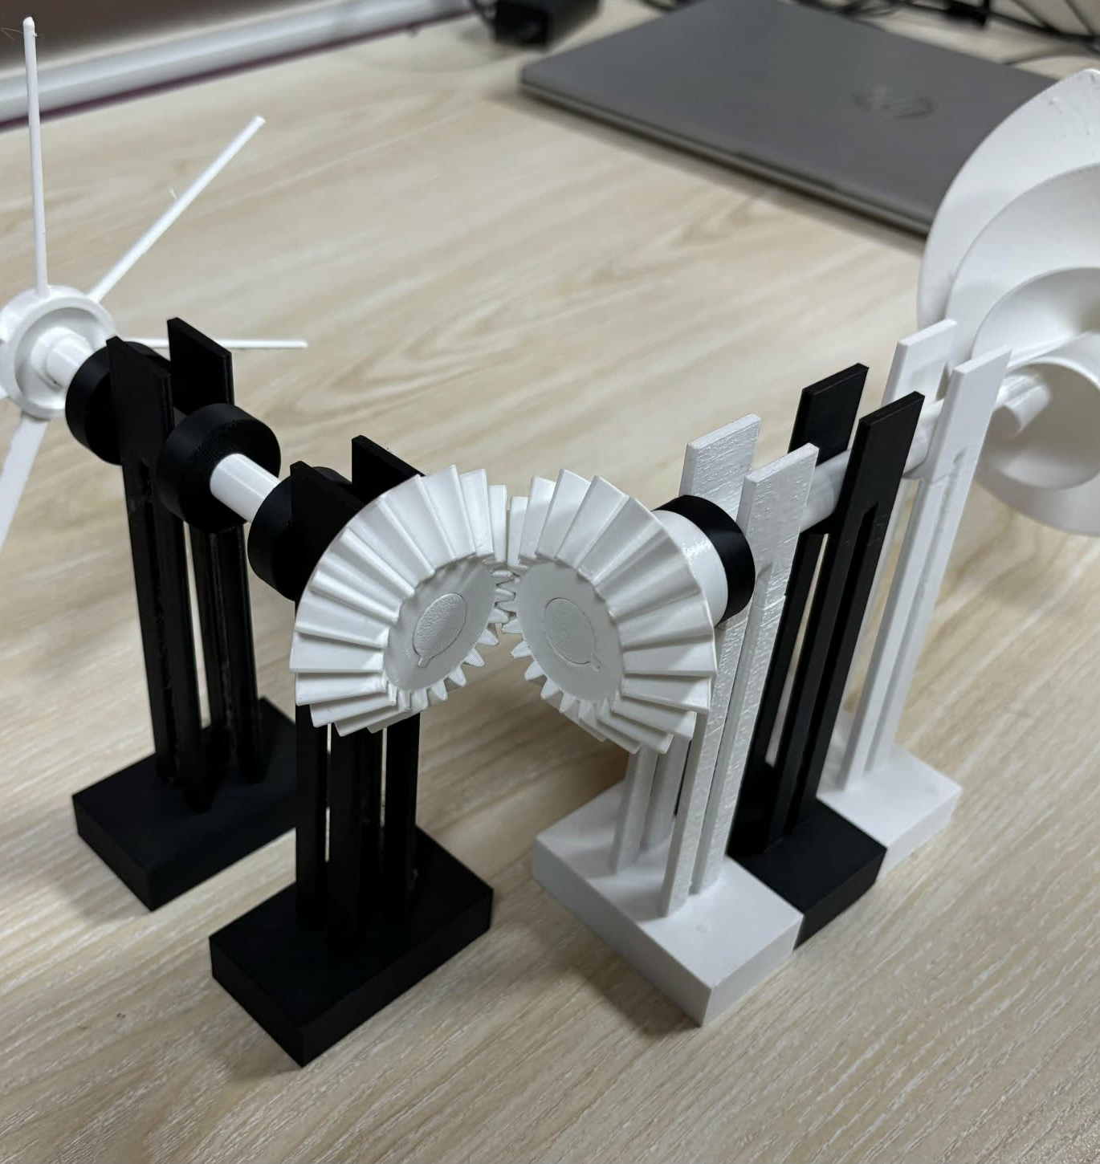
ZeroWatt
Wind
Harvest the wind.
Deliver the motion.
Wind-driven ventilation
and pond aeration
Islamic University of Technology
Bangladesh
01
Notes:
ZeroWatt Wind is a mechanical concept that uses wind to drive a fan or a surface paddle wheel. The photograph shows the small printed demonstrator. No electricity is needed by the uninstrumented mechanical core while sufficient wind is available.
Sources: ZeroWatt Wind_Poster.pdf; ZeroWattWind-CezeriProject (1).pdf pp. 2–7; website assets/prototype-white.jpg.

Slide 2
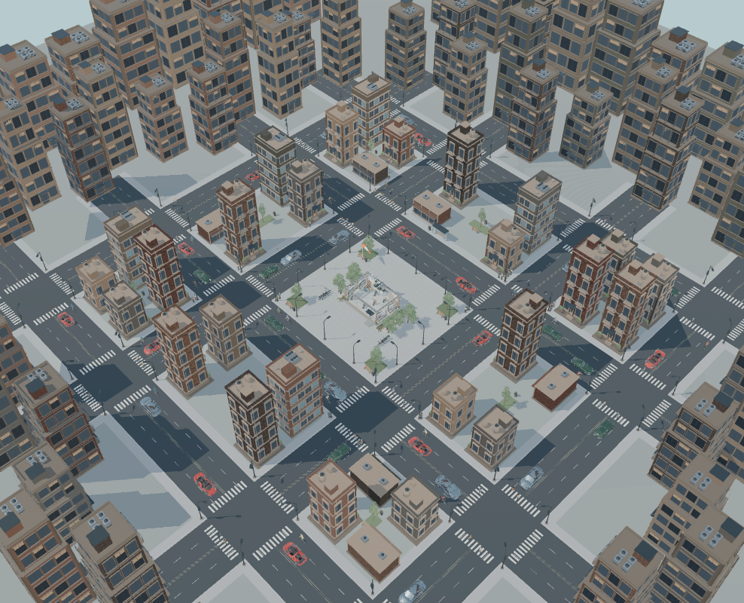
The urban airflow problem
Inside buildings
Poorly ventilated rooms depend on powered fans. Outages can interrupt air exchange.
In urban ponds
Stagnant water needs mixing and oxygen exchange. Powered aeration adds an energy cost.
Urban setting shown in the website simulation
02
Notes:
The project targets rooms with poor airflow and an exposed, windy roof, plus ponds that may benefit from supplementary surface aeration. Natural ventilation remains useful where openings and wind are adequate. The website city image illustrates the context and is not field evidence. Avoid claiming continuous ventilation or adequate pond oxygen without measured wind and load data.
Sources: Poster problem statement; Cezeri project pp. 3–4; costing document FAQ; local website docs/cars/citywide-clear.png.

Slide 3
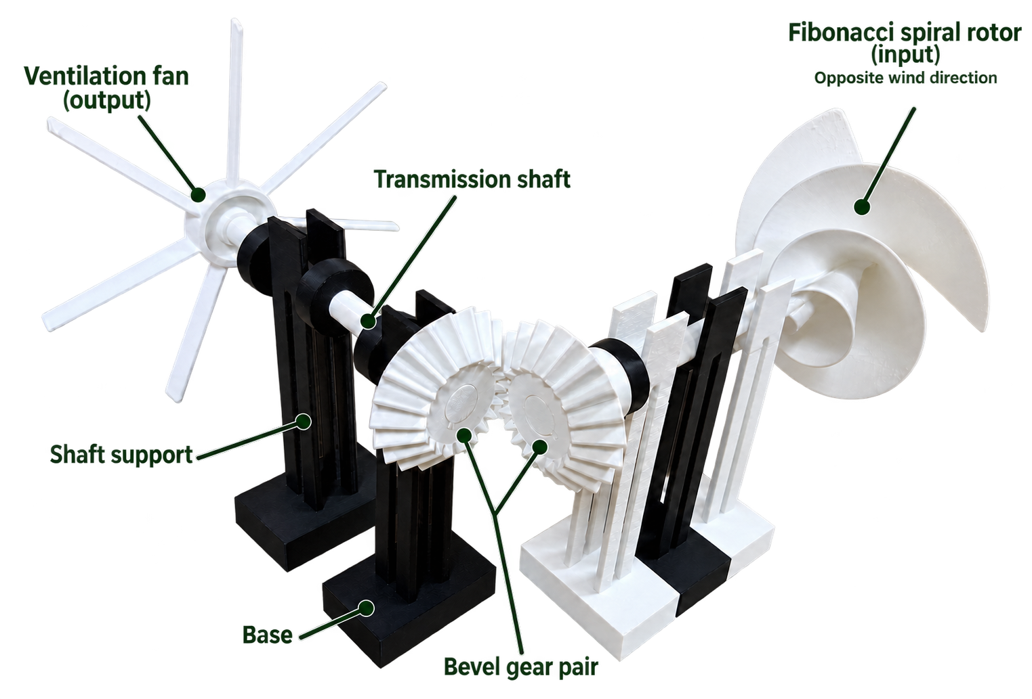
The mechanical drive
01 Wind capture
A spiral rotor converts wind into shaft rotation.
02 Power transmission
Shafts and bevel gears redirect rotation through 90°.
03 Useful motion
A fan moves air, or a paddle wheel mixes water.
03
Notes:
The submission describes a two-stage right-angle bevel drivetrain. One mechanism serves two separate applications. A ventilation installation and a pond installation each need their own system. The spiral geometry and NACA 65-810 profile are design choices, not proof of higher efficiency or lower starting wind speed.
Sources: Poster annotated prototype; Cezeri project pp. 3, 5–6. Image extracted directly from supplied poster.

Slide 4
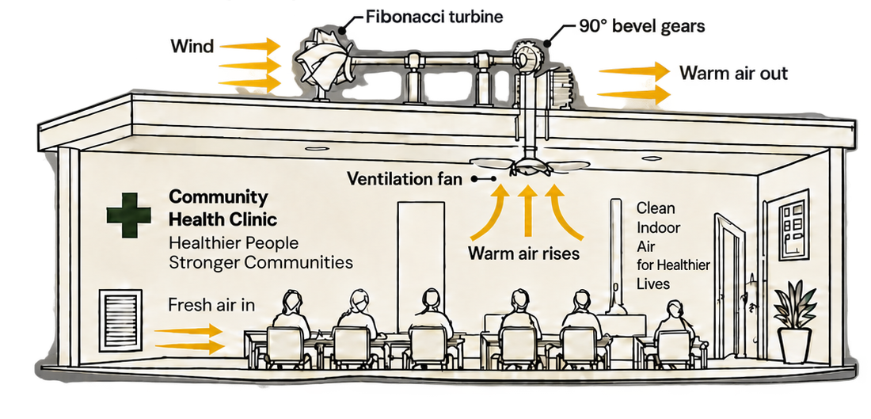
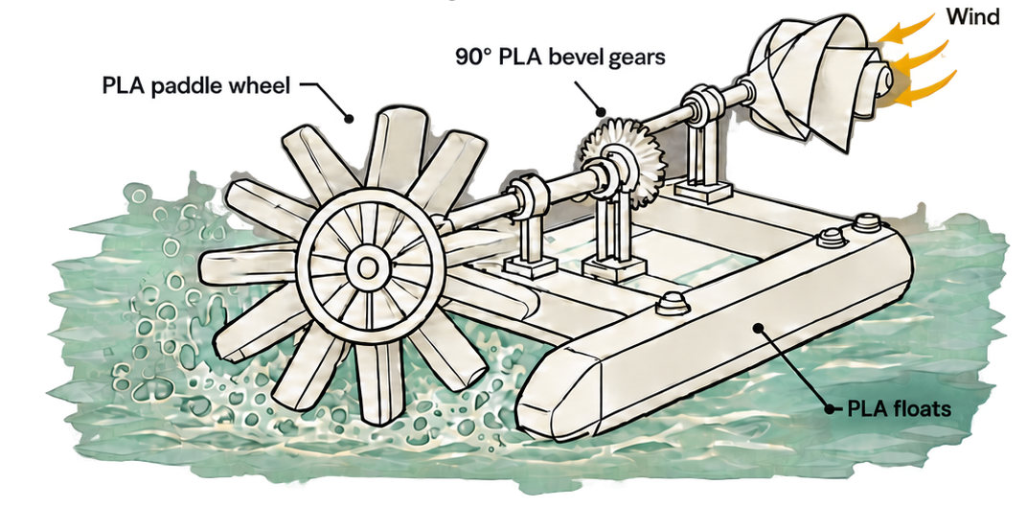
Two applications for the same concept
Building ventilation
Supplementary pond aeration
A rooftop rotor drives an exhaust fan. Fresh air enters through a planned intake.
A wind-driven paddle disturbs the surface to promote air–water exchange.
Both applications depend on available wind. Performance remains to be measured.
04
Notes:
These drawings are concepts, not installed systems. Ventilation requires an intake path and a pressure-loss assessment. Outdoor air is not always cooler, drier or clean. Pond aeration is supplementary until oxygen-transfer measurements demonstrate adequacy, especially through calm periods.
Sources: Poster application illustrations and intended impact; Cezeri project pp. 3–4.

Slide 5
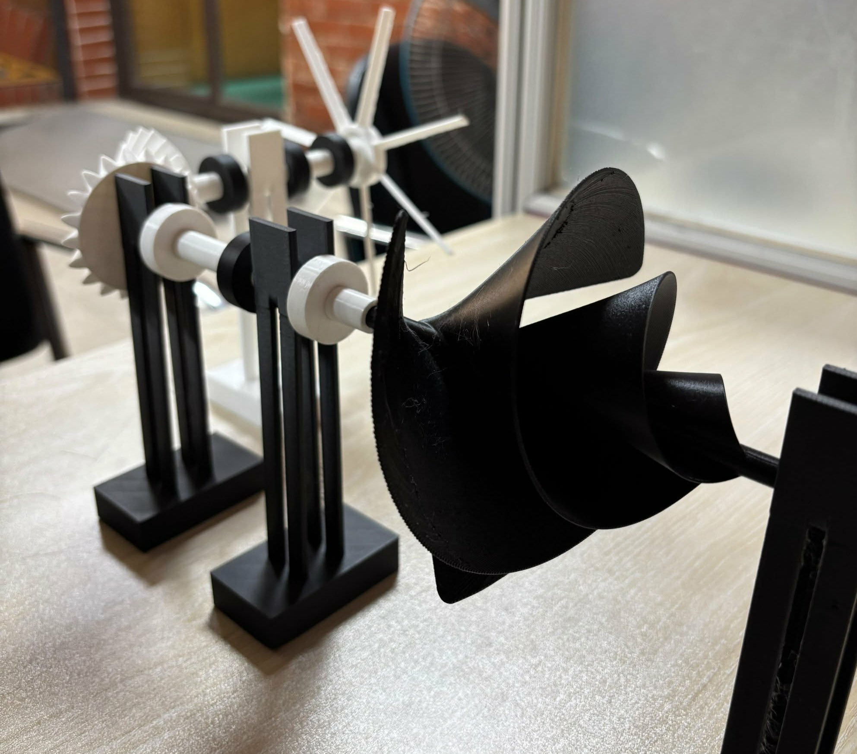
A fabricated prototype
SolidWorks design
Rotor, shafts, supports and bevel gears form the mechanical assembly.
3D-printed demonstrator
The submission specifies PLA parts, printed on a Bambu Lab P1S.
Python and SciPy supported the NACA 65-810 fan geometry.
05
Notes:
The team has designed and fabricated a small demonstrator. The project video is linked in the submission: https://youtu.be/nL_0LNzpgFc . The poster explicitly says that starting wind speed, torque, airflow, drivetrain efficiency and oxygen transfer remain unmeasured. The written specification says PLA, while one slicer screenshot labels PETG, so confirm the material before discussing production suitability.
Sources: Cezeri project pp. 5–8; poster fabrication section; website assets/prototype-black.jpg.

Slide 6
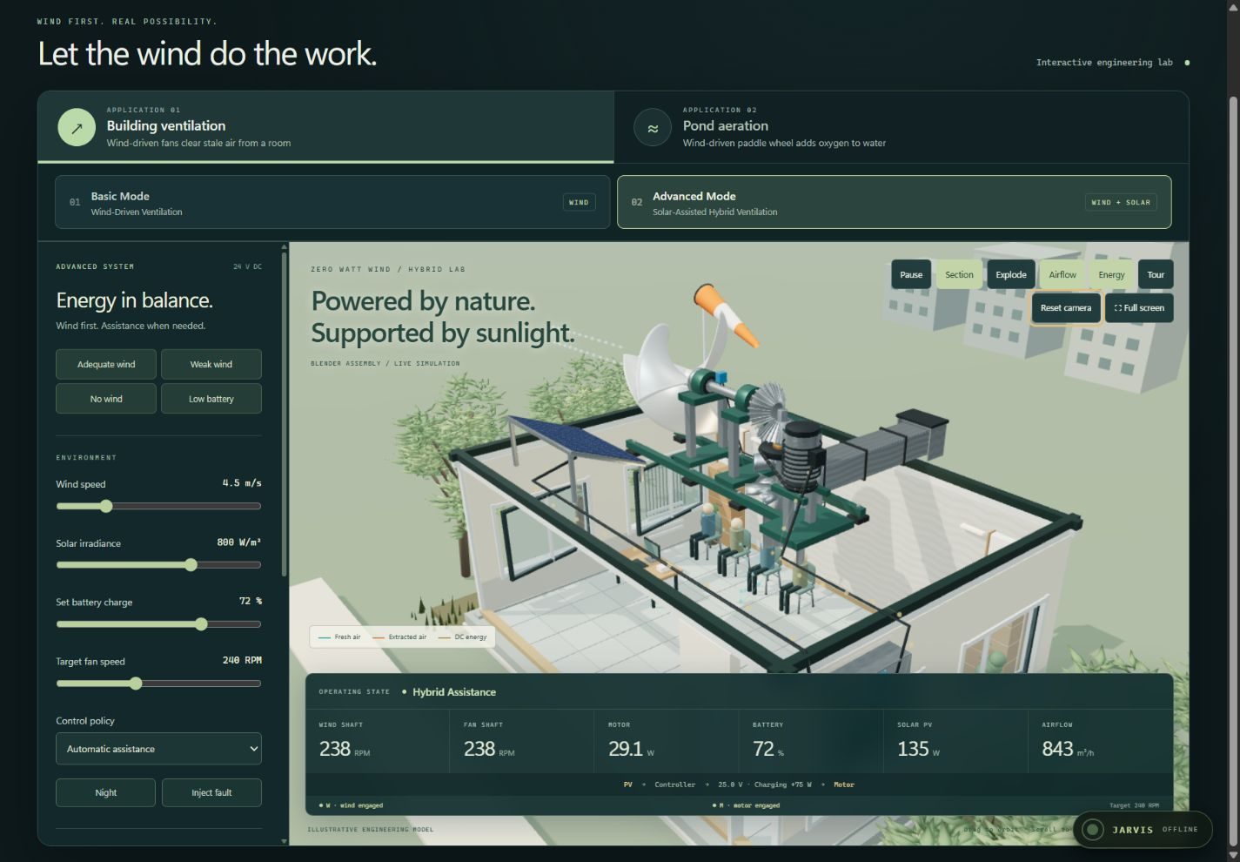
The interactive engineering website
Wind-driven core
Explore ventilation and pond scenarios.
Solar-assisted concept
Explore battery and motor support when wind drops.
Simulation outputs are illustrative and await physical calibration.
06
Notes:
Use the website as an interactive explanation of the design. Basic mode models wind-driven ventilation and pond aeration. Advanced mode demonstrates solar, battery and motor assistance. Advanced hybrid mode uses electricity and is separate from the mechanical component estimate. The screenshot is an existing project screenshot, not a newly measured experiment. Launch the local site using START-SERVER.bat and visit http://127.0.0.1:5500. Any public website address can be inserted later.
Sources: Local website index.html, app.js, model.js, src/advanced/hybrid-model.js, HYBRID-GUIDE.md; docs/hybrid/desktop-browser.png.

Slide 7
Estimated mechanical component cost
Ventilation
Pond aeration
BDT 4,043
BDT 6,752
Component | Ventilation (BDT) | Pond (BDT)
Spiral rotor | 2,700.00 | 2,700.00
Bevel gears | 81.00 | 162.00
Fan / paddle wheel | 72.60 | 3,000.00
Collars and supports | 189.72 | 189.72
Casing / brackets / fasteners | 1,000.00 | 700.00
Component subtotal | 4,043.32 | 6,751.72
Calculated from the supplied costing sheet. These are component estimates, not installed prices.
Installation, labour, ducting, testing and hybrid electrical parts are outside this subtotal.
07
Notes:
Arithmetic from costing_zero_watt_wind.docx. Currency is treated as BDT because the FAQ uses taka and Bangladesh suppliers. Ventilation: rotor 4.5×600=2700; gears 2×0.162×250=81; fan 0.121×600=72.60; collars 4×0.030×600=72; supports 3×0.327×120=117.72; casing and nuts 1000. Total 4043.32. Pond: paddle 3000; brackets/couplings/nuts 700; rotor 2700; gears 4×0.162×250=162; collars 72; supports 117.72. Total 6751.72. Displayed headlines round to the nearest BDT. The source narrative says about 4000 and 6500, but the listed expressions total 4043.32 and 6751.72. Rates and quantities are unverified estimates. No quoted installation labour, bearings, transport, maintenance or contingency allowance is established. Hybrid solar/battery costs are separate. Payback and electricity savings are not measured, so they are omitted.
Sources: G:/new_8/costing_zero_watt_wind.docx, component tables.

Slide 8
A measured field pilot
The next development step
01
Measure starting wind speed, shaft torque and transmission losses.
02
Test airflow under duct resistance and oxygen transfer in water.
03
Check mounting safety, weather durability and installed cost.
Proposed support: test equipment, technical mentorship and a pilot site.
Mohammad Rafiul Islam · Tasnia Basharat Mahi · Masrura Sara Mohima
08
Notes:
This is a proposed next step, not a committed programme or a claim that field trials are complete. The three names follow the supplied poster. The earlier Cezeri competition submission lists two participants, so update the presenter names for the specific competition rules. Evaluate calm-period backup needs and compare any later savings claim against measured, equal-service operation.
Sources: Poster fabrication section and contributor line; Cezeri project pp. 1–2 and 6–7; costing document.

