Slide 1

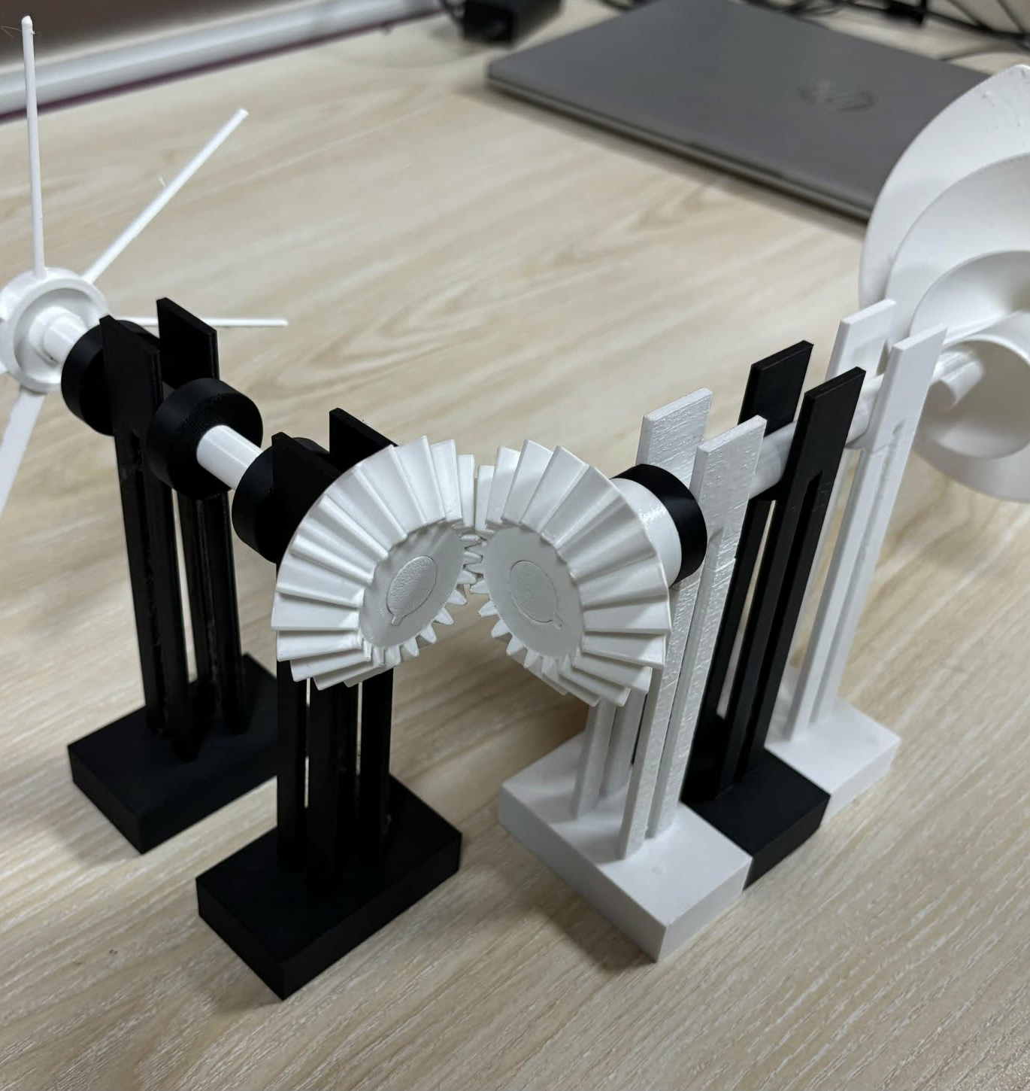
ZeroWatt
Wind
Harvest the wind.
Deliver the motion.
Wind-driven ventilation
and pond aeration
Islamic University of Technology
Bangladesh
Notes:
ZeroWatt Wind is a mechanical concept that uses wind to drive a fan or a surface paddle wheel. The photograph shows the small printed demonstrator. No electricity is needed by the uninstrumented mechanical core while sufficient wind is available.
Sources: ZeroWatt Wind_Poster.pdf; ZeroWattWind-CezeriProject (1).pdf pp. 2–7; website assets/prototype-white.jpg.
Slide background: original Blender studio scene, tmp/pitch-v2/ZeroWatt_Backgrounds.blend. Decorative wind ribbons do not represent measured airflow.

Slide 2

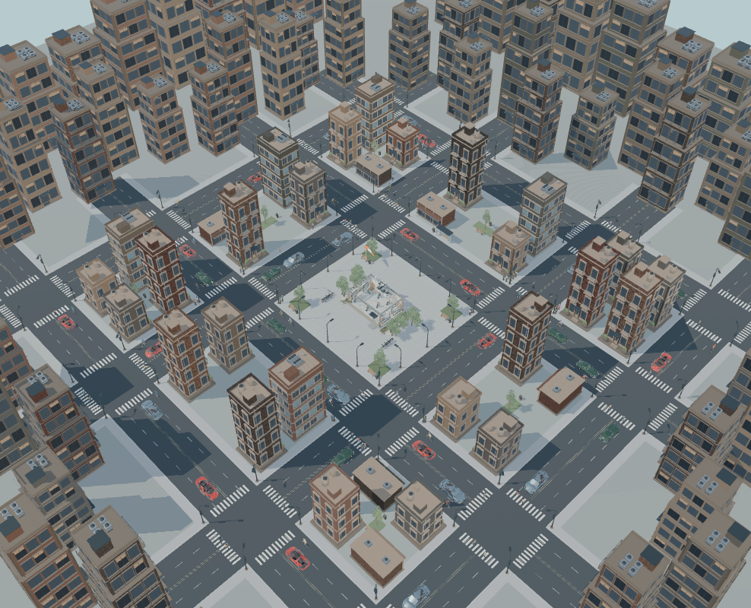
The urban airflow problem
Inside buildings
Poorly ventilated rooms depend on powered fans. Outages can interrupt air exchange.
In urban ponds
Stagnant water needs mixing and oxygen exchange. Powered aeration adds an energy cost.
Urban setting shown in the website simulation
02
Notes:
The project targets rooms with poor airflow and an exposed, windy roof, plus ponds that may benefit from supplementary surface aeration. Natural ventilation remains useful where openings and wind are adequate. The website city image illustrates the context and is not field evidence. Avoid claiming continuous ventilation or adequate pond oxygen without measured wind and load data.
Sources: Poster problem statement; Cezeri project pp. 3–4; costing document FAQ; local website docs/cars/citywide-clear.png.
Slide background: original Blender studio scene, tmp/pitch-v2/ZeroWatt_Backgrounds.blend. Decorative wind ribbons do not represent measured airflow.

Slide 3
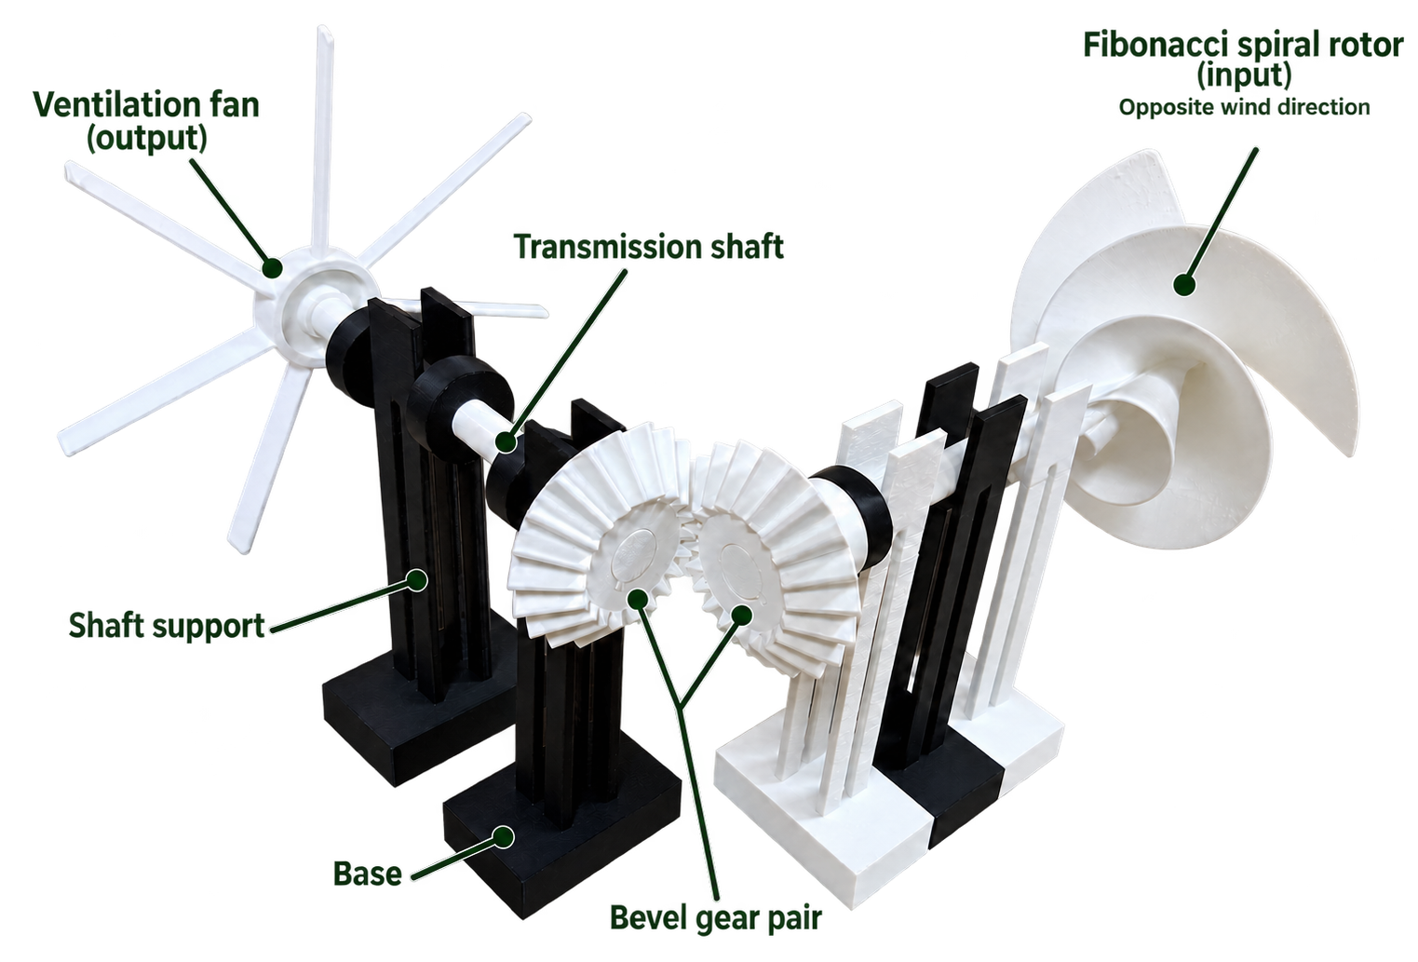
The mechanical drive
01 Wind capture
A spiral rotor converts wind into shaft rotation.
02 Power transmission
Shafts and bevel gears redirect rotation through 90°.
03 Useful motion
A fan moves air, or a paddle wheel mixes water.
03
Notes:
The submission describes a two-stage right-angle bevel drivetrain. One mechanism serves two separate applications. A ventilation installation and a pond installation each need their own system. The spiral geometry and NACA 65-810 profile are design choices, not proof of higher efficiency or lower starting wind speed.
Sources: Poster annotated prototype; Cezeri project pp. 3, 5–6. Image extracted directly from supplied poster.
Slide background: original Blender studio scene, tmp/pitch-v2/ZeroWatt_Backgrounds.blend. Decorative wind ribbons do not represent measured airflow.

Slide 4

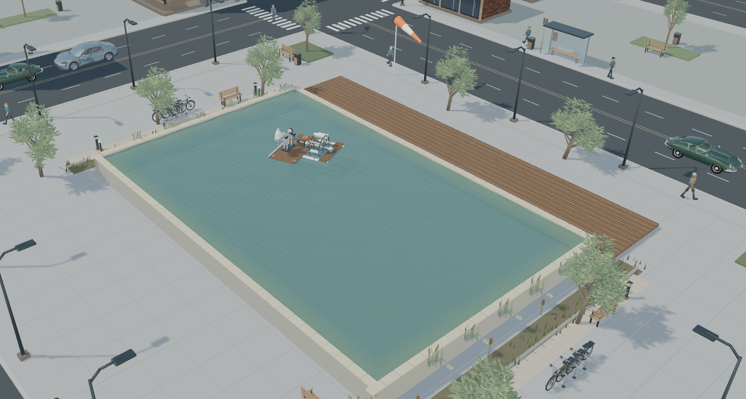
Two applications for the same concept
Building ventilation
Supplementary pond aeration
A rooftop rotor drives an exhaust fan. Fresh air enters through a planned intake.
A wind-driven paddle disturbs the surface to promote air–water exchange.
Both applications depend on available wind. Performance remains to be measured.
04
Notes:
The two images are supplied website simulation screenshots, not photographs of field installations. The left shows wind capture, exhaust and fresh-air intake. The right shows the pond paddle-wheel concept. Both depend on wind. Source: user attachments, ventilation.png and pond.png. Background: original Blender render.

Slide 5
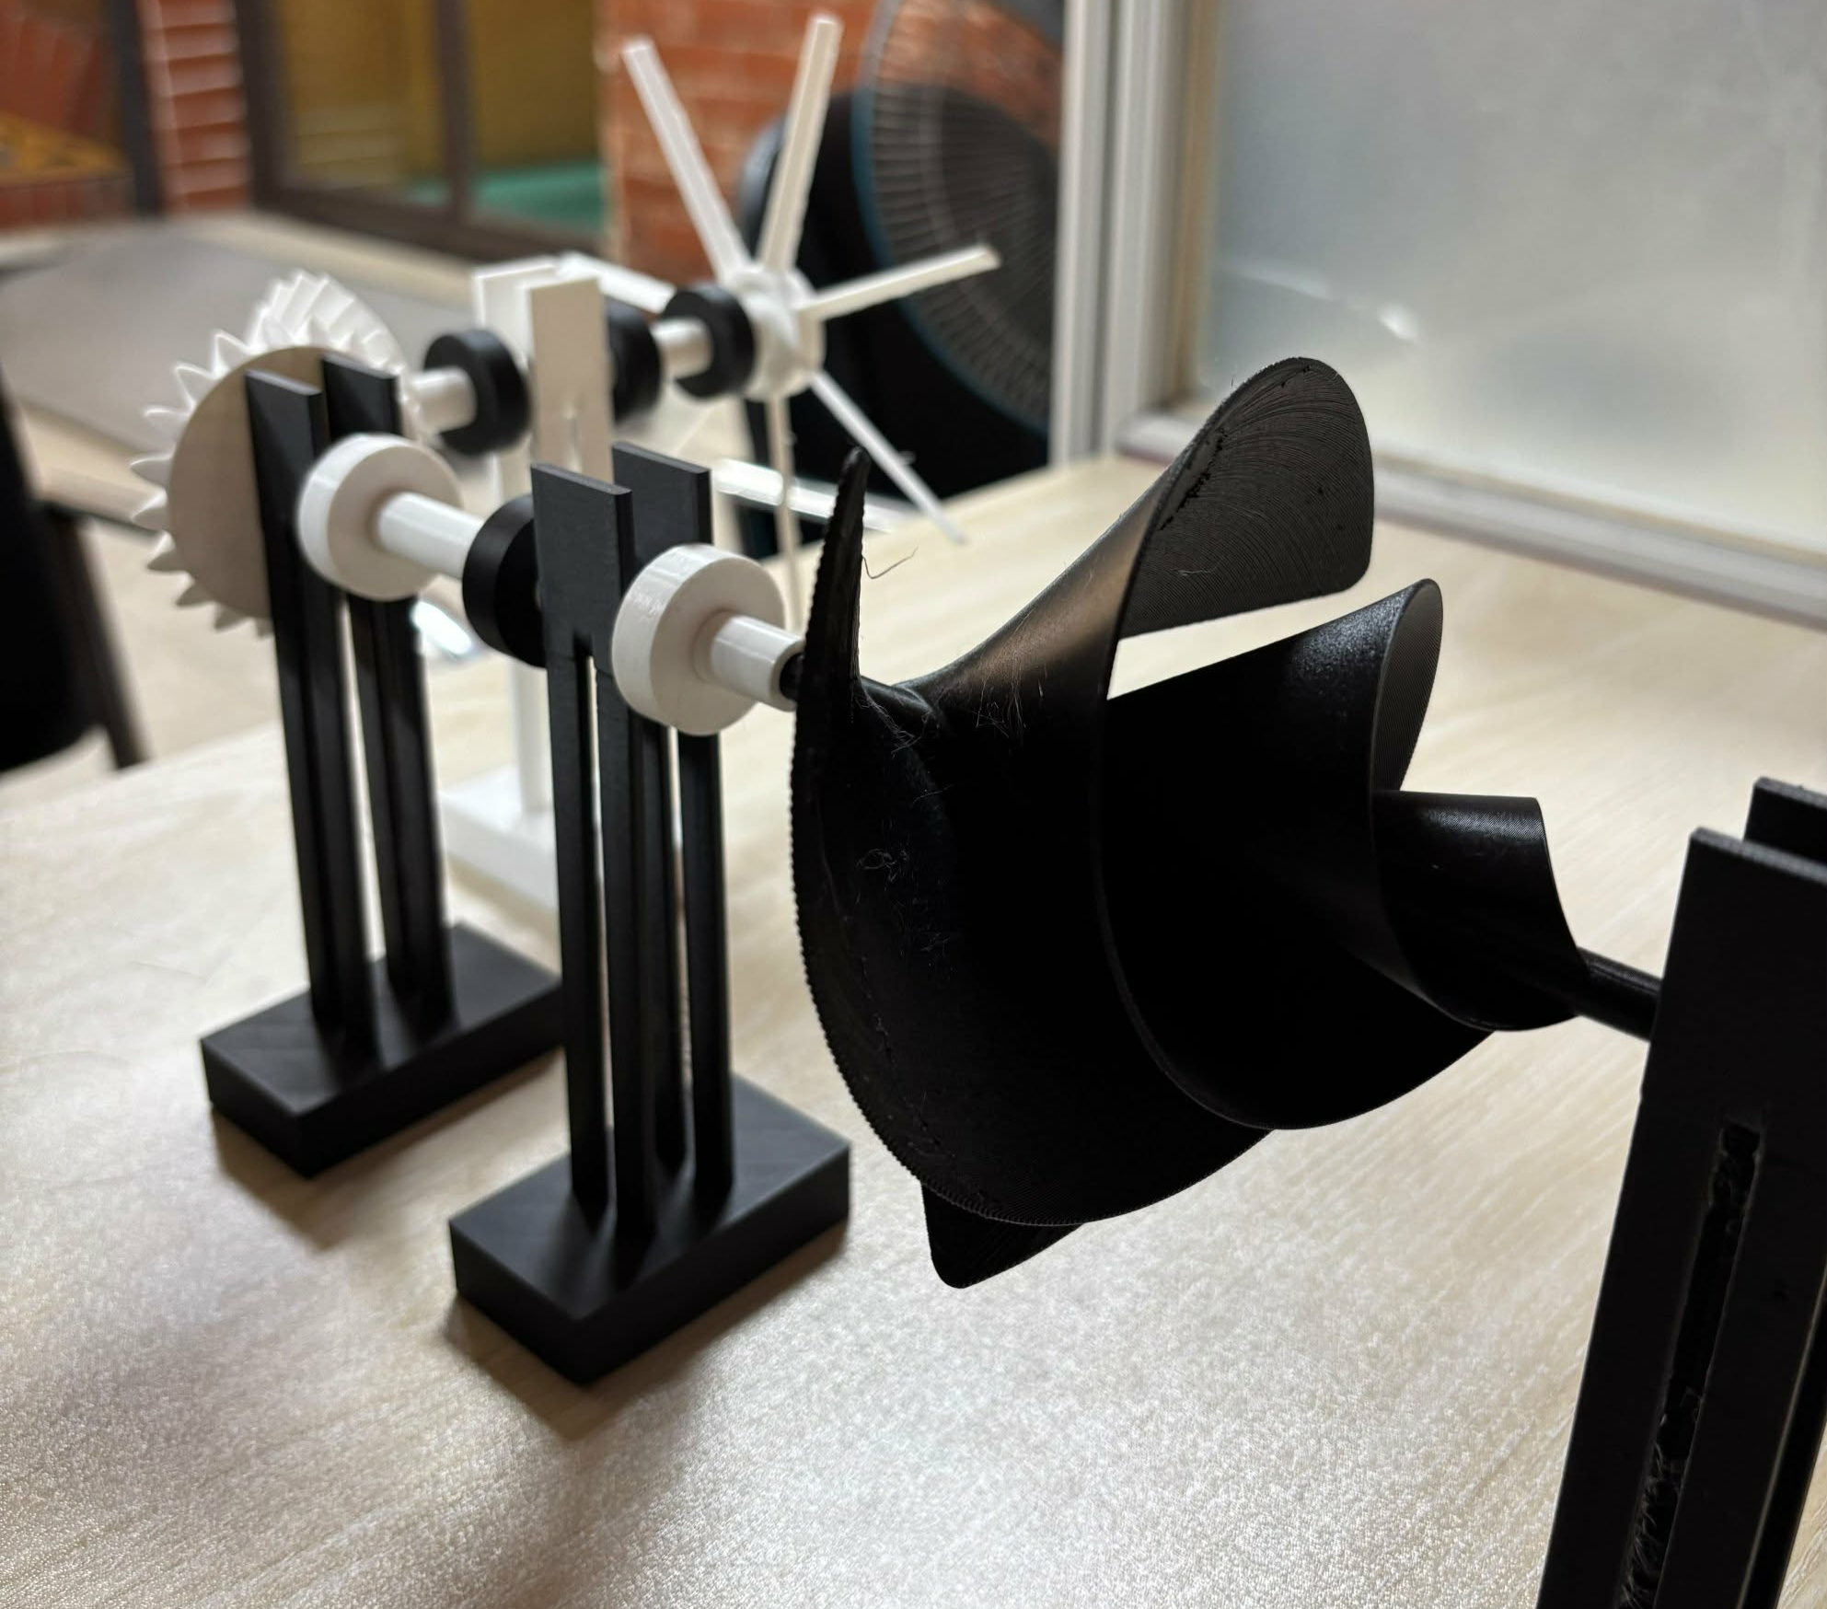
A fabricated prototype
SolidWorks design
Rotor, shafts, supports and bevel gears form the mechanical assembly.
3D-printed demonstrator
The submission specifies PLA parts, printed on a Bambu Lab P1S.
Python and SciPy supported the NACA 65-810 fan geometry.
05
Notes:
The team has designed and fabricated a small demonstrator. The project video is linked in the submission: https://youtu.be/nL_0LNzpgFc . The poster explicitly says that starting wind speed, torque, airflow, drivetrain efficiency and oxygen transfer remain unmeasured. The written specification says PLA, while one slicer screenshot labels PETG, so confirm the material before discussing production suitability.
Sources: Cezeri project pp. 5–8; poster fabrication section; website assets/prototype-black.jpg.
Slide background: original Blender studio scene, tmp/pitch-v2/ZeroWatt_Backgrounds.blend. Decorative wind ribbons do not represent measured airflow.

Slide 6
Estimated mechanical component cost
Ventilation
Pond aeration
BDT 4,043
BDT 6,752
Component | Ventilation (BDT) | Pond (BDT)
Spiral rotor | 2,700.00 | 2,700.00
Bevel gears | 81.00 | 162.00
Fan / paddle wheel | 72.60 | 3,000.00
Collars and supports | 189.72 | 189.72
Casing / brackets / fasteners | 1,000.00 | 700.00
Component subtotal | 4,043.32 | 6,751.72
Calculated from the supplied costing sheet. These are component estimates, not installed prices.
Installation, labour, ducting, testing and hybrid electrical parts are outside this subtotal.
06
Notes:
Arithmetic from costing_zero_watt_wind.docx. Currency is treated as BDT because the FAQ uses taka and Bangladesh suppliers. Ventilation: rotor 4.5×600=2700; gears 2×0.162×250=81; fan 0.121×600=72.60; collars 4×0.030×600=72; supports 3×0.327×120=117.72; casing and nuts 1000. Total 4043.32. Pond: paddle 3000; brackets/couplings/nuts 700; rotor 2700; gears 4×0.162×250=162; collars 72; supports 117.72. Total 6751.72. Displayed headlines round to the nearest BDT. The source narrative says about 4000 and 6500, but the listed expressions total 4043.32 and 6751.72. Rates and quantities are unverified estimates. No quoted installation labour, bearings, transport, maintenance or contingency allowance is established. Hybrid solar/battery costs are separate. Payback and electricity savings are not measured, so they are omitted.
Sources: G:/new_8/costing_zero_watt_wind.docx, component tables.
Slide background: original Blender studio scene, tmp/pitch-v2/ZeroWatt_Backgrounds.blend. Decorative wind ribbons do not represent measured airflow.

Slide 7
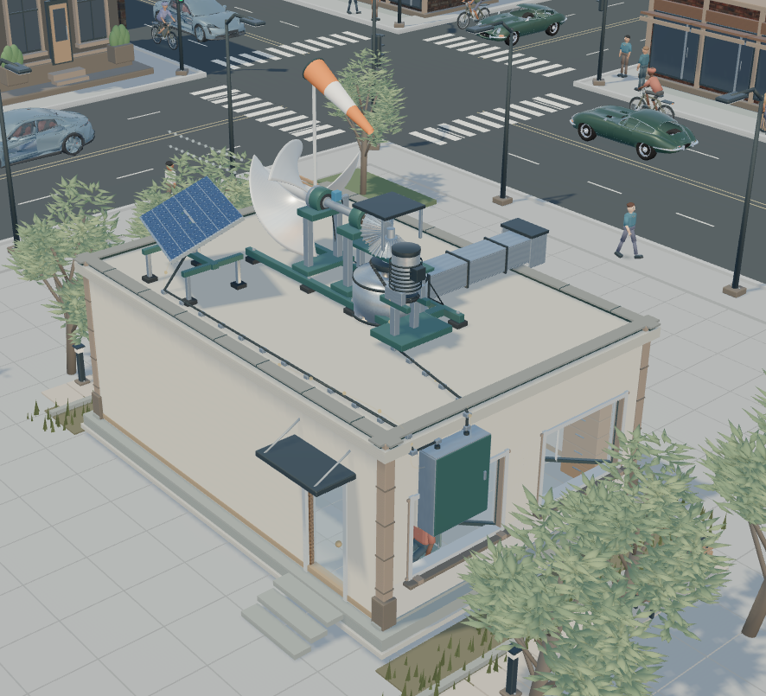
Future scope: hybrid ventilation
Why combine wind with an existing solar setup?
Solar works during daylight. Useful wind can also occur after sunset, helping drive the fan and conserve battery energy . We are not providing a hybrid system in 4000tk, we are talking about the complementary scenario. Solar setup can cost about 40k with external duct for ventilation . For advanced mode, we have two type of cost(solar system implementation cost and ventilation implem e ntation cost). Both cost will round up to 45k. Though thinking about this cost is a very big number, but solar cell can easily cover up our whole house’s electricity whereas we can set up our zero watt wind in messy room’s rooftop so it can keep that room cool and will work in the non operating hours of solar cell and reduce electricity bill with battery demand.
Hybrid concept
Illustrative costs. Whole-house supply and savings depend on system sizing and site conditions.
07
Notes:
Future scope. The question and answer reproduce the hybrid FAQ from G:/new_8/costing_zero_watt_wind.docx, with whitespace normalised. The 4000tk, 40k and 45k amounts are draft team figures, not verified quotes. The household-energy statement is an aspiration, not a sized or tested result. Hybrid components require electricity and are outside the mechanical component subtotal. Image: user supplied hybrid.png. Background: original Blender render.

Slide 8
Why buy this when natural ventilation and exhaust fans already exist?
FAQ
Natural ventilation works well when a building has suitable openings and enough wind. Our product targets buildings with poor airflow but an exposed, windy roof. It uses wind to help extract stale air, reducing powered-fan operation. Advanced mode adds solar assistance and battery backup. Our best customers are buildings needing ventilation for long hours , not buildings where opening a window already solves the problem.
Performance depends on wind, the intake path and installation conditions.
08
Notes:
Question and answer reproduced from the team costing document, FAQ 1. Whitespace normalised. The answer describes intended use and proposed benefits, not measured field savings. Source: G:/new_8/costing_zero_watt_wind.docx. Background: original Blender render.

Slide 9
Why buy ours instead of a ৳1,500 exhaust fan?
FAQ
Yeah, looking from the surface it is 1500tk but if we wanna calculate the electricity bill it may draws about 2400tk yearly(considering 55W fan running 12hours daily) and electricity bill is increasing rapidly. Whereas our system may have higher initial cost but it can reduce the electricity bill and it has a payback period of only 2.5 years.
Team estimate. The stated payback is illustrative and has not been field-validated.
09
Notes:
Question and answer reproduced from costing_zero_watt_wind.docx, FAQ 2. The original 2400tk annual electricity cost and 2.5-year payback are team assumptions. The source does not establish a tariff, equal-service operating comparison, verified wind output or installed cost sufficient to validate payback. Preserve this qualification while presenting the supplied wording. Background: original Blender render.

Slide 10
Why would a fish farmer buy the pond-aeration version?
FAQ
Our initial aim is supplementary aeration that reduces some powered operation. For example, an aerator drawing 1.5 kW for eight hours daily , at ৳10 per unit , costs roughly ৳3,600 monthly or ৳43,200 annually . If a ৳10,000 installed wind add-on demonstrably reduces that electricity by 20% while maintaining pond oxygen , it saves ৳8,640 annually , giving about 1.2 years’ simple payback before maintenance . But if it can meetup the demand, it is so much budget friendly . From this website, https://nscbd.com/4-paddle-wheel-aerator-2hp-price-in-bangladesh/ we found that Paddle wheel aerator price is 41k, while our zero watt wind is only 6.5k and it don’t draw any electricity either. So, if one of them isn’t enough to meet the demand, fish farmer can buy multiple of them. Our system is not a replacement of the natural ventilation, it’s a complementary solution which can increase the flow rapidly at a very low cost and sustain energy as well.
Illustrative scenario. Supplier prices are unverified, and oxygen performance still requires testing.
10
Notes:
Question and answer reproduced from costing_zero_watt_wind.docx, FAQ 4. The annual example uses 1.5kW × 8h/day × 360days × BDT10/kWh = BDT43,200; 20% is BDT8,640 and BDT10,000/8640 is about 1.2 years before maintenance. These are assumptions, not measured savings. The quoted 41k supplier price has not been rechecked, and the 6.5k narrative estimate differs from the component line-item total BDT6,751.72 shown in this deck. Multiple units cannot be assumed adequate without wind and oxygen-transfer measurements. Keep emergency backup where needed. Source: G:/new_8/costing_zero_watt_wind.docx. Background: original Blender render.

Slide 11
We are Team ZeroWatt Wind
Islamic University of Technology
IUT-OIC, Bangladesh
Mohammad Rafiul Islam
Tasnia Basharat Mahi
Masrura Sara Mohima
Harvest the wind. Deliver the motion.
11
Notes:
Contributor names and institutional affiliation follow the supplied ZeroWatt Wind poster. The earlier Cezeri competition submission lists only Mohammad Rafiul Islam and Tasnia Basharat Mahi. This introduction follows the three-person poster team, as in the earlier deck. No roles, qualifications or biographies are invented. Source: ZeroWatt Wind_Poster.pdf contributor line. Background: original Blender render.

