Slide 1
Hockaday Institute for Social Impact Data Visual Wireframe
Jake Rastberger
jrastberger@mail.smu.edu

Slide 2
Agenda
Mock Data
Current Visuals
Potential Visuals

Slide 3
Mock Data

Slide 4
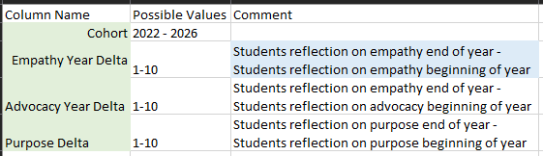
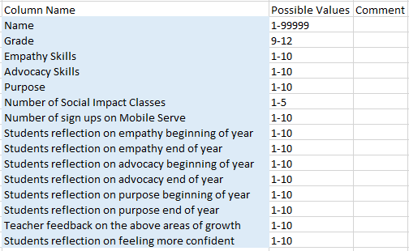
Columns
5 different cohorts with “graduation dates” from 2022-2026
10 fake students in each cohort.
Randomly generated data for all possible values based on provided columns

Slide 5
Current Visuals

Slide 6
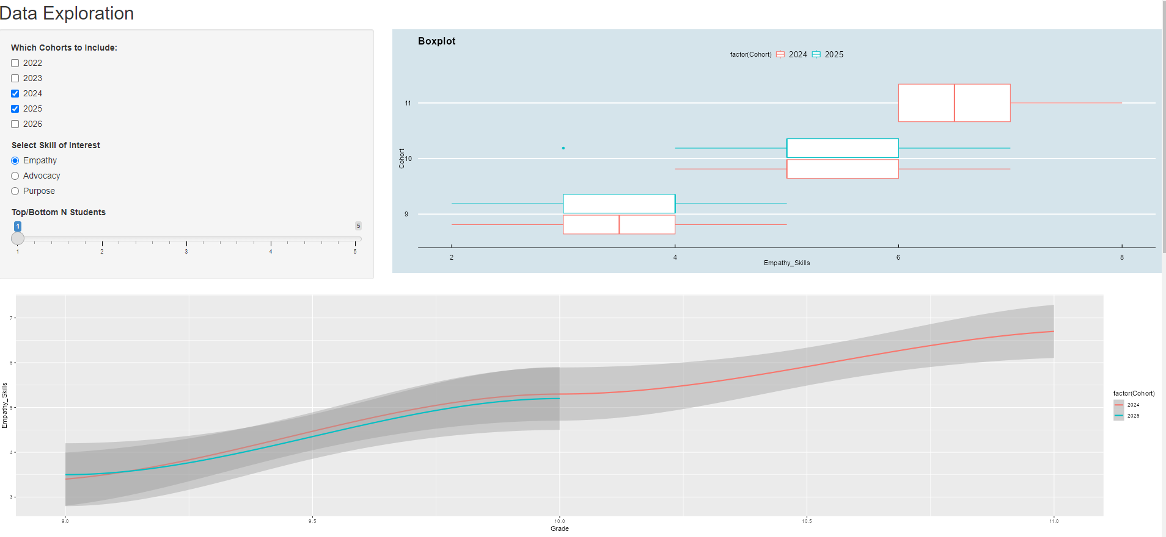
Skills Over Time
Ability to filter to different cohorts
Can display different skills of interest.

Slide 7
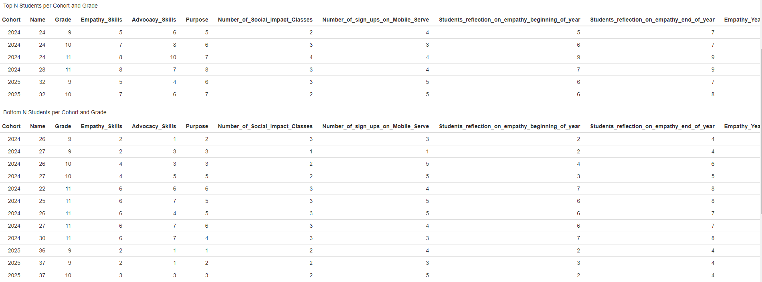
Exploration of Outliers
You can explore in more detail top and bottom students based on selected skill to get a better understanding of potential contributing factors.
Ties are enabled here we can turn that off or on based on feedback.

Slide 8
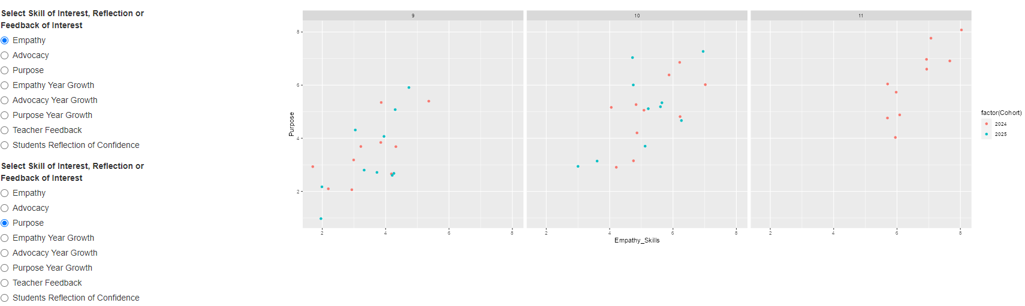
Dynamic Scatter Plot
Dynamic scatter plot to visualize relationship between two selected variables.
If there is interest, we can also add 3D plot

Slide 9
Potential Visuals

Slide 10

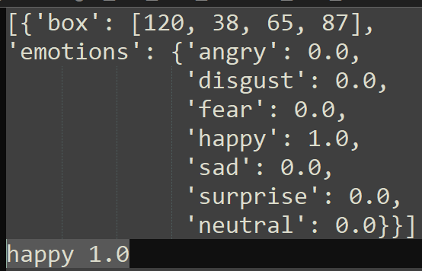
Emotion Recognition from Facial Expressions
We can input pictures tied to student name/ID and get back some amount of confidence in what emotion they are experiencing.
Current emotions we can detect are angry, disgust, fear, happy, sad, surprise, and neutral, but we can explore possibility to detect more.

Slide 11
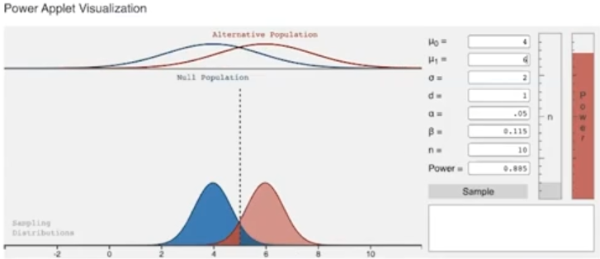
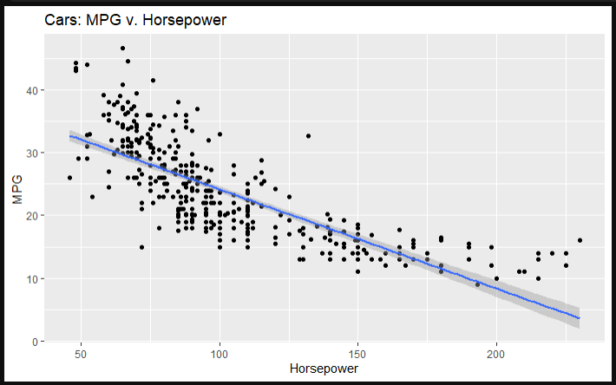
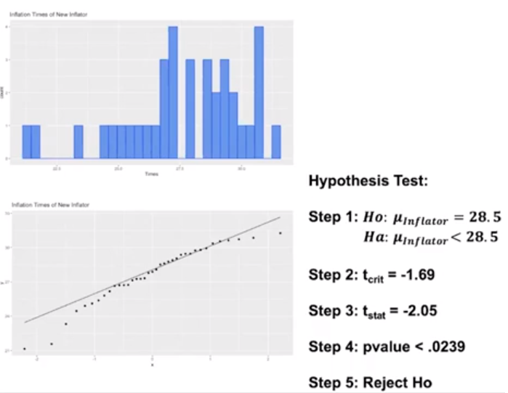
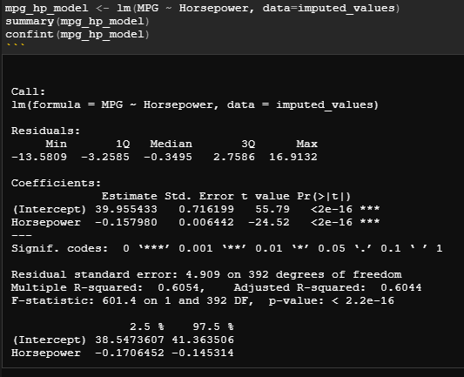
Statistical Output
Separate Tab
Any statistical tests on the data

