Slide 1

Updated Data Visual Wireframe
Jake Rastberger
jrastberger@mail.smu.edu

Slide 2
Agenda
Updated Data
Updated Visuals
Data Exploration

Slide 3
Updated Data

Slide 4
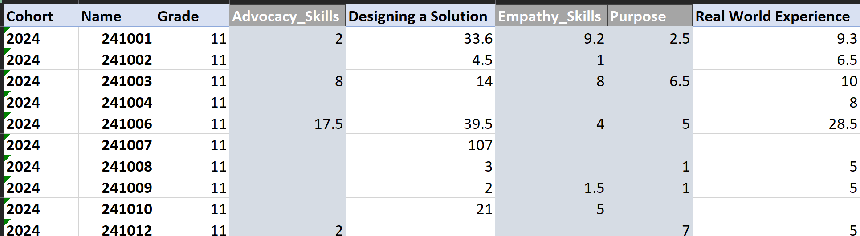
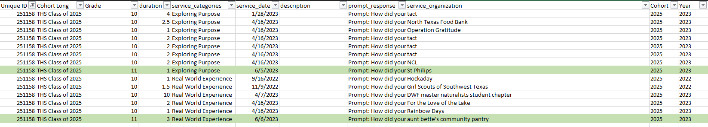
Columns
Everything is based on the columns provided besides grade which changes in June
Skills of Interest
Empathy
Advocacy
Purpose
Designing a Solution
Real World Experience
Hours

Slide 5
Missing Data
In the synthetic data we also had:
Can calculate once years of data received
Empathy Year Growth
Advocacy Year Growth
Purpose Year Growth
Would need to have added back to data
Teacher Feedback
Student Reflection

Slide 6
Current Visuals

Slide 7
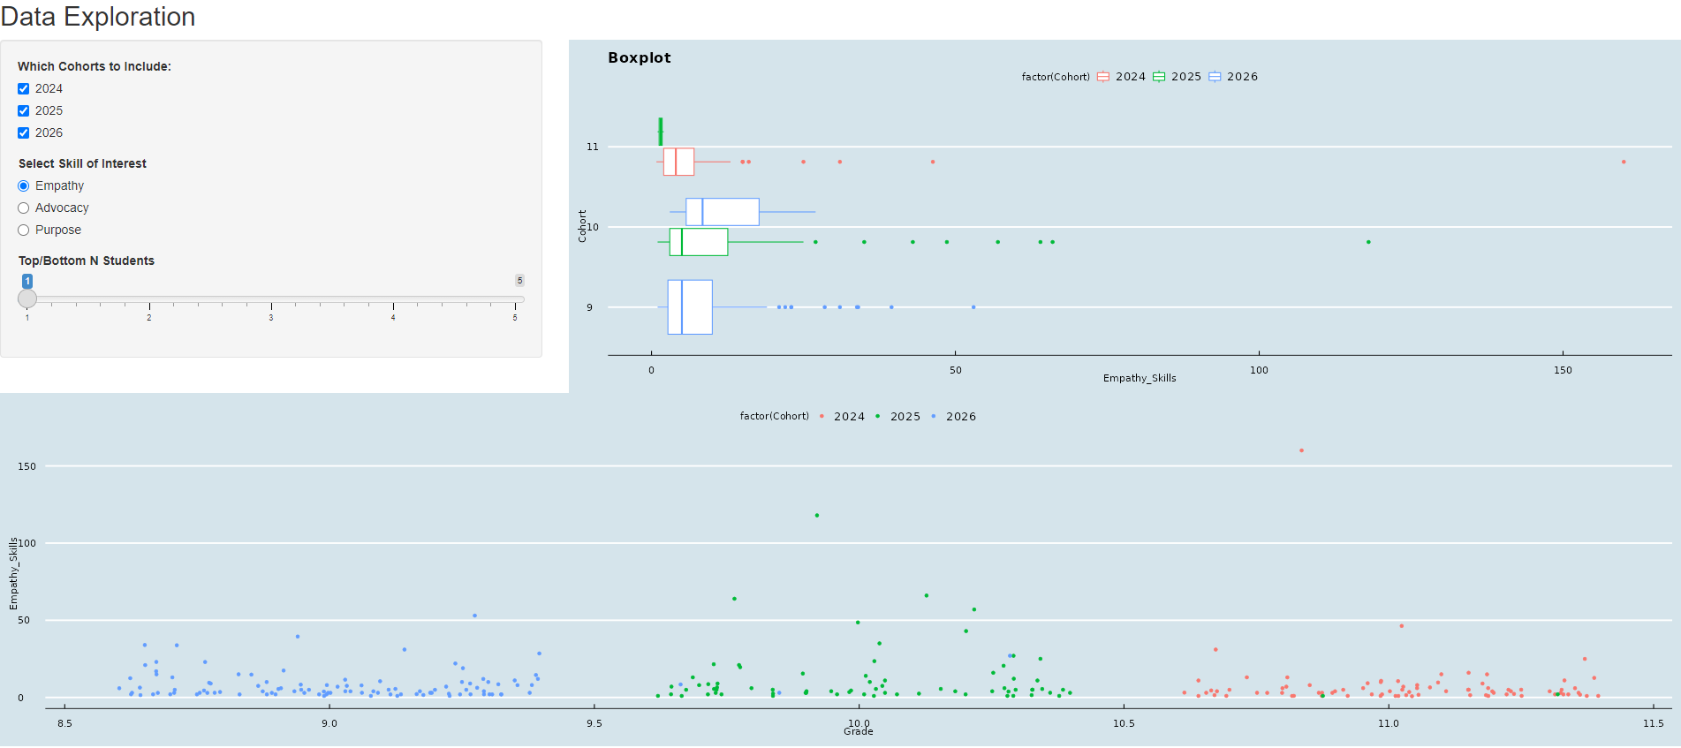
Skills Over Time
Ability to filter to different cohorts
Can display different skills of interest.
Link to tool
Only one year of data so line graph can’t be created yet

Slide 8
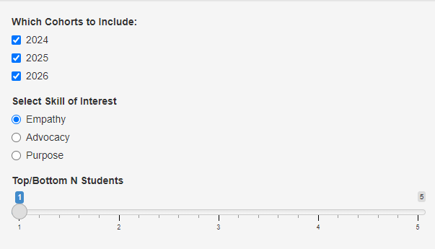
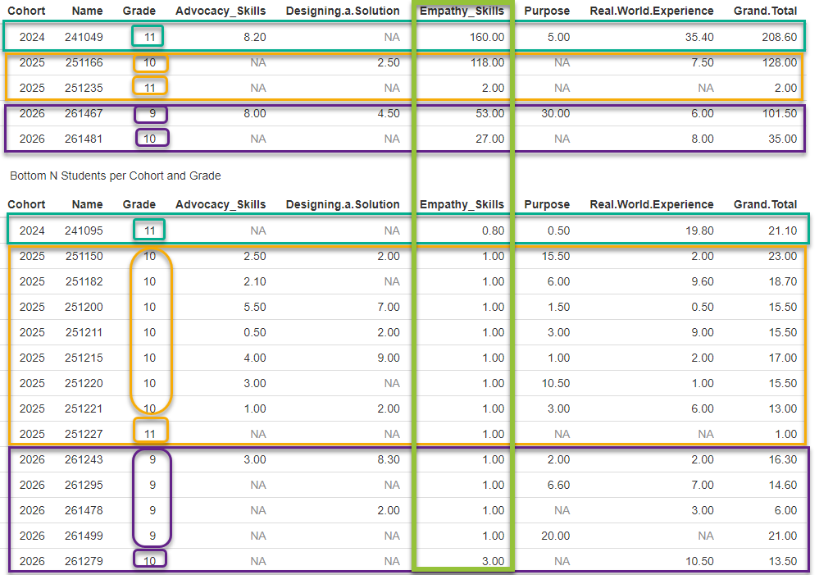
Exploration of Outliers
You can explore in more detail top and bottom students based on selected skill to get a better understanding of potential contributing factors.
Ties are enabled here we can turn that off or on based on feedback.

Slide 9
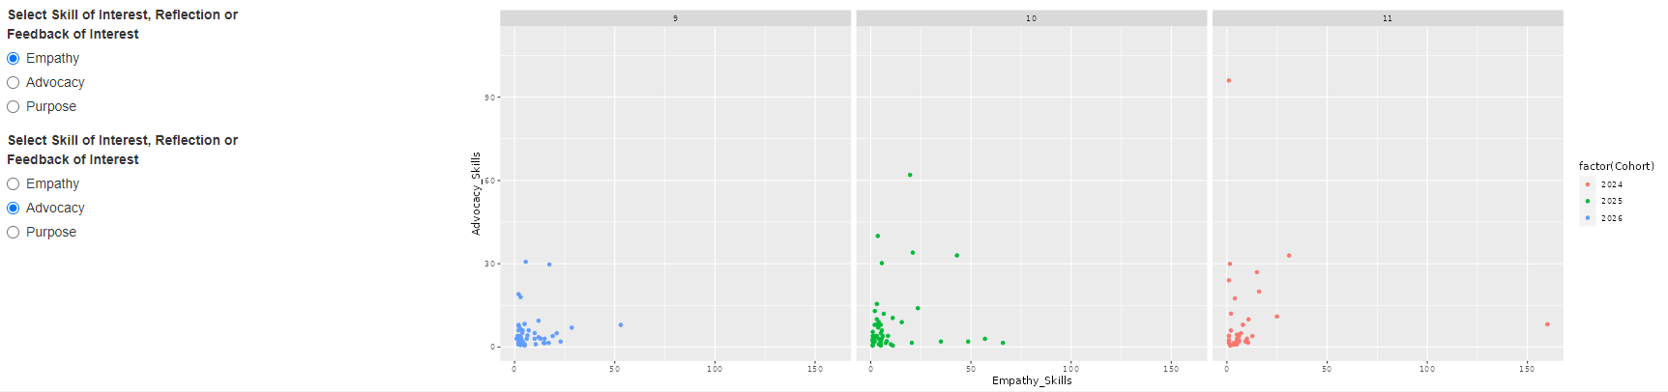
Dynamic Scatter Plot
Dynamic scatter plot to visualize relationship between two selected variables.
If there is interest, we can also add 3D plot

Slide 10
Data Exploration

Slide 11
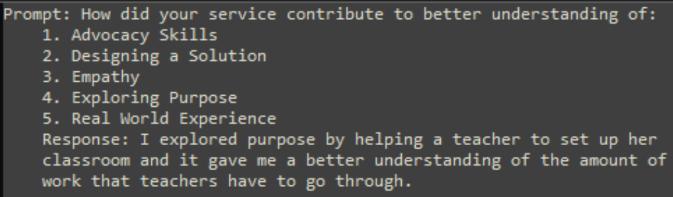
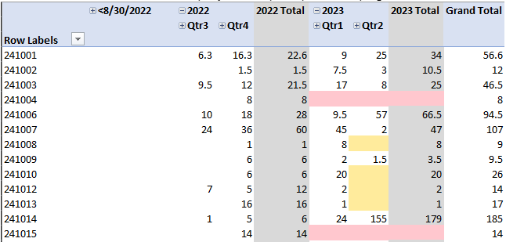
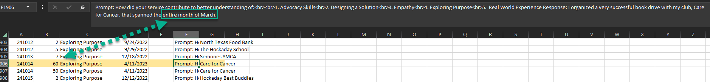
Data Questions
Prompt Response seems super interesting to me
Chat GPT?
Text sentiment analysis?
Any value to tracking hours over the course of the year
Classifying type of student?
Rockstar
Summer Super Star
Short bursts
Identifying students who stop participating
Anything that maybe signals something like this might be coming?
Does maybe classifying service organization in some way seem interesting?
Hockaday vs Non-Hockaday
Always the same organization
Always different organizations
Do they vary across years?
Do certain Cohorts gravitate to certain organizations?
Month long events do you want to try to break those up? Should they be classified differently?

Slide 12
Appendix

Slide 13

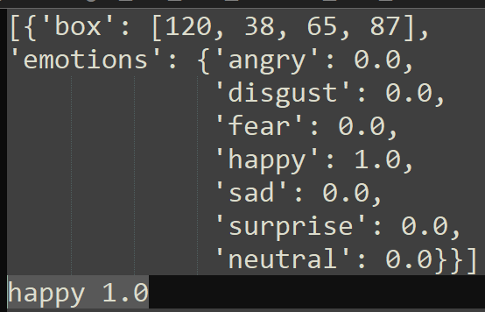
Emotion Recognition from Facial Expressions
We can input pictures tied to student name/ID and get back some amount of confidence in what emotion they are experiencing.
Current emotions we can detect are angry, disgust, fear, happy, sad, surprise, and neutral, but we can explore possibility to detect more.

Slide 14
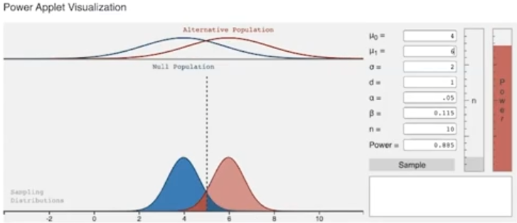
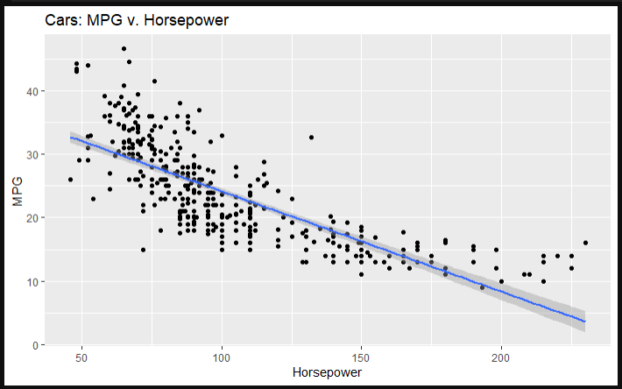
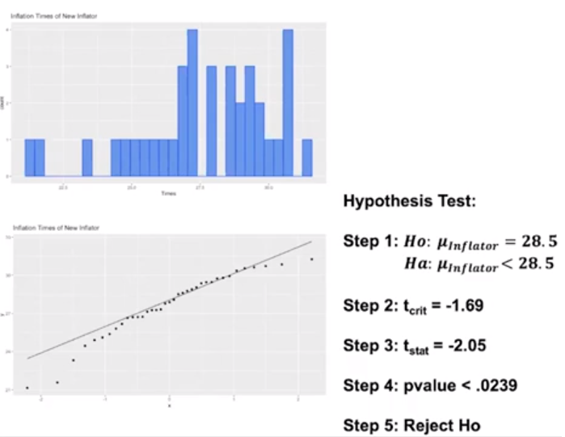
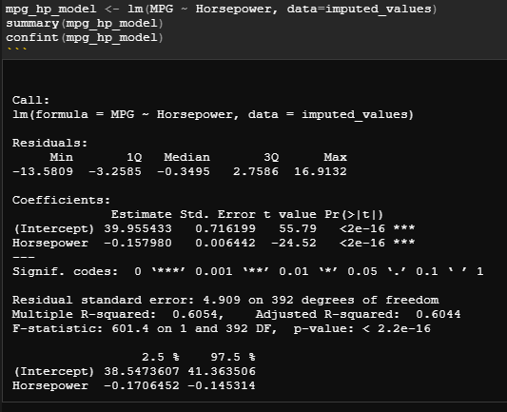
Statistical Output
Separate Tab
Any statistical tests on the data

