Slide 1
Hockaday
Data Discussion

Slide 2





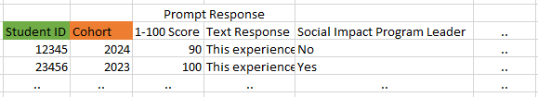

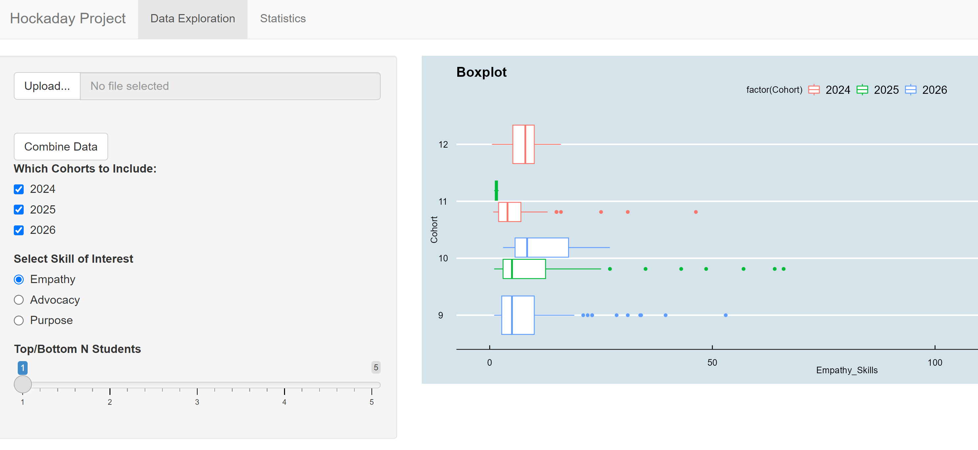
Hockaday
SMU
Hockaday Student Info
Mobile Serve Data
Each line is own Upload button
Social Impact Fellows
Google Form (EQ) Empathy Quotient
9th
12th
Teachers:
Middle and EOY
Students
BOY and EOY

