Slide 1


ABCD Stats Workshop- Module 3
Andrew Moore, PhD (he/him)
Lecturer
University of Oklahoma
Department of Psychology
Email: ajm9311@ou.edu

Slide 2

Agenda
Brief overview of inferential statistics
Walkthrough templates for:
  T-test
  ANOVA
  Simple Linear Regression
Practice updating templates
Wrap-Up + Plan for Module 4

Slide 3
Inferential Statistics
How do we predict who is going to go to start using cannabis prior to age 16?
Inferential Stats is one of many tools we can use to guide our decision making
Notes:
Imagine you are a pediatrician, and you are concerned about your kiddos starting to use cannabis
You think to yourself, “if only there was a way to predict which kids were the most likely to use cannabis”
So, your question is: How do we predict who is going to go to start using cannabis prior to age 16?
Don’t press enter until I tell you. Type your answer to this question into the chat and we will all press enter at the same time
Guess
Stereotypes
Data
Ask parents/teachers what they think
Big takeaway: Inferential Stats is one tool we can use to guide our decision making

Slide 4
Descriptive vs. Inferential Statistics
Descriptive Statistics
Inferential Statistics
Mean, Median, Mode
Standard Deviation
Interquartile Range
Graphs and Figures
T-Test
ANOVA
Regression
Correlation
Describe Data
Quantify Relationships
Notes:
Going to use both today

Slide 5
Terms to Reference
Terms
Inferential Statistics
Independent Variable (IV)
  Predictor Variable
Dependent Variable (DV)
  Outcome Variable
Continuous Variable
  On a Scale
Categorical Variable
  Discrete Categories
T-Test
ANOVA
Regression
Correlation
Notes:
Good to look back to so that we are all speaking the same language

Slide 6
Inferential Statistics- When to Use What
Inferential Statistics
T-Test
  Continuous DV
  2-Level Categorical IV
ANOVA
  Continuous DV
  +2-Level Categorical IV
Regression/Correlation
  Continuous DV and Continuous IV
Notes:
Good to come back to when you want to adapt our examples to match your own interests

Slide 7
Inferential Statistics- R Templates
T-Test
ANOVA
Regression
Something you can adapt and come back to later

Slide 8
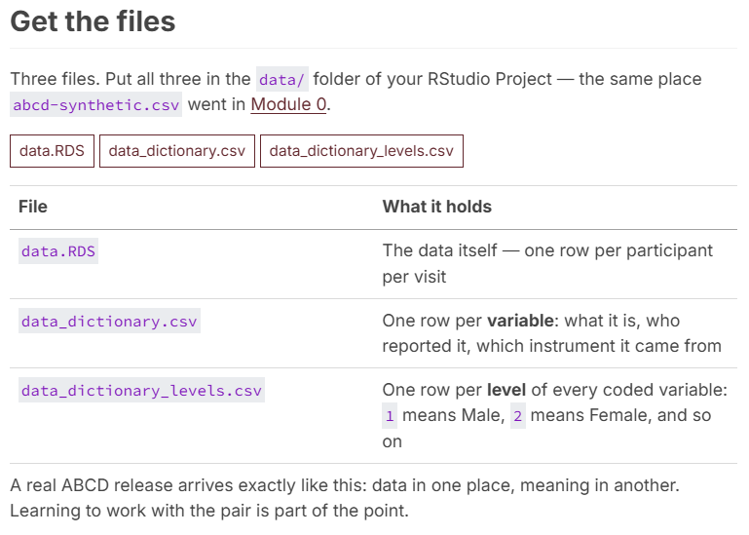
Inferential Statistics- R Data
Notes:
Also going to need the data and data dictionary
https://www.beepboopstats.com/r-stats-workshop/content/data.html

Slide 9
Title
Text
Primary Box
Secondary Box
Tertiary Box
Citations

