Slide 1
CS 659 Course Project Restaurant Revenue Prediction
Zhonghua Xi and Huangxin Wang
May. 2015

Slide 2


Introduction
Restaurant Revenue Prediction
A Kaggle Competition (2340 Teams participated)
Objective: predict revenue of restaurants
Impact: increase the effectiveness of investments in new restaurant

Slide 3
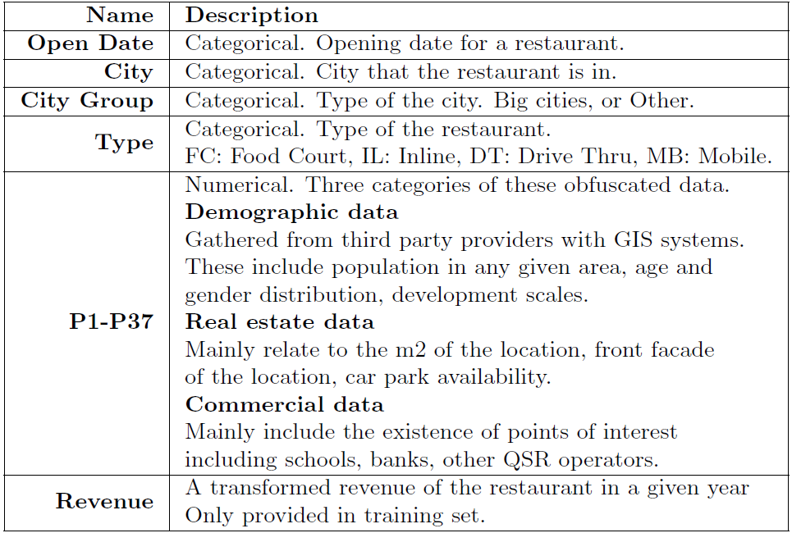
Dataset
Data set
Training / Test : 137 / 100,000 records
Attributes

Slide 4
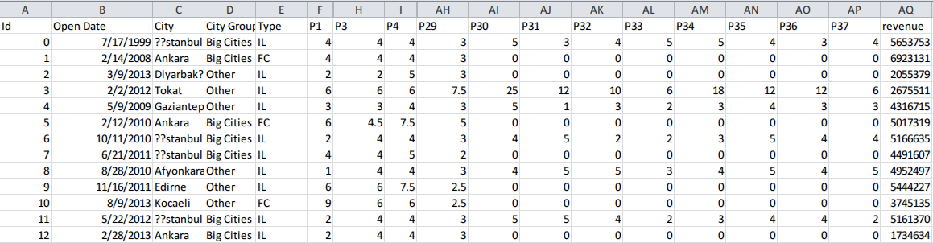
Dataset (Cont.)
Revenue (only available in training set)
TYPE: FC: Food Court, IL: Inline, DT: Drive Thru, MB: Mobile
37 obfuscated numeric attributes
Demographic data
Real estate data
Commercial data

Slide 5
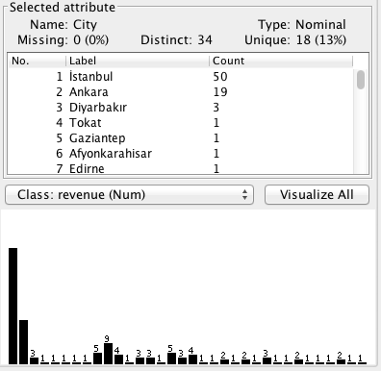
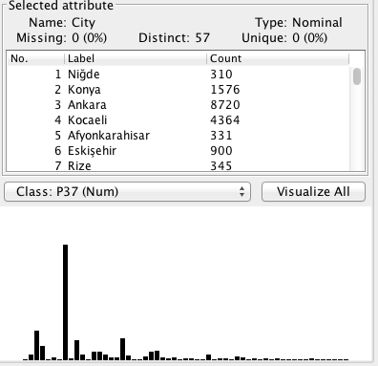
Data analysis
Missing categorical attributes
Type
City name
Training
Test
Notes:
What does missing value mean?

Slide 6
Data Pre-processing
Open Date
Convert from string to numeric type
Days opened till 2/1/2014
Categorical data
Convert to numerical data, assign distinct values to each distinct string
Feature Scaling
Standardize: zero mean, unit variance
Notes:
Feature scaling: measuring distance between records

Slide 7
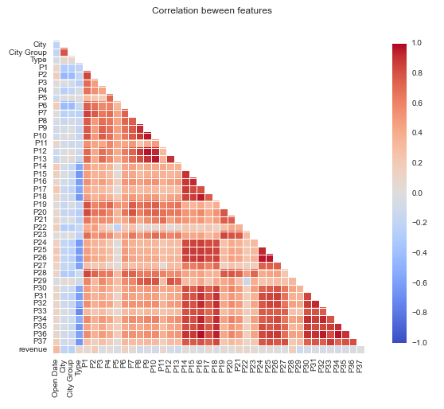
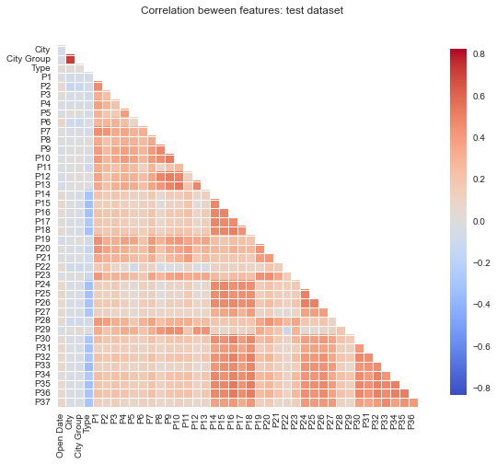
Exploring the Data
Correlations

Slide 8
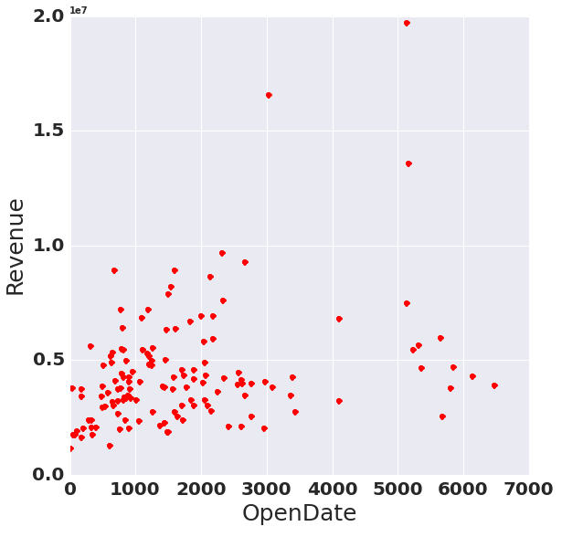
Exploring the Data
Correlations
Open-Date: the most correlated one!

Slide 9
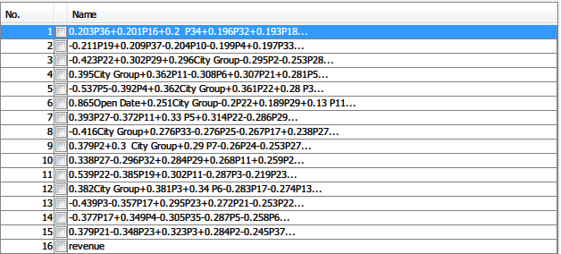
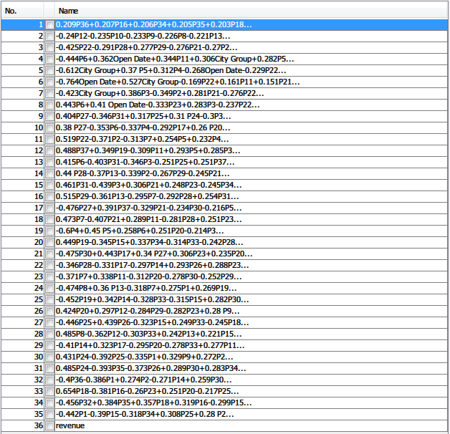
Exploring the Data-PCA
PCA of training set:
15 features, 95% variances
PCA of training and testing set:
35 features, 95% variances

Slide 10
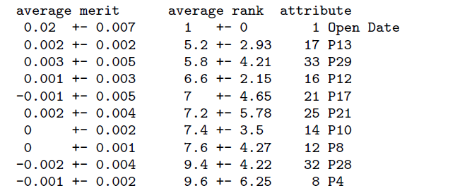
Exploring the Data
Feature Rank
Attribute evaluator: ReliefAttributeEval
Search method: Ranker
Notes:
Evaluates the worth of an attribute by repeatedly sampling an instance and considering the value of the given attribute for the nearest instance of the same and different class.
CfsSubsetEval :
Evaluates the worth of a subset of attributes by considering the individual predictive ability of each feature along with the degree of redundancy between them

Slide 11
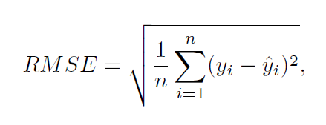
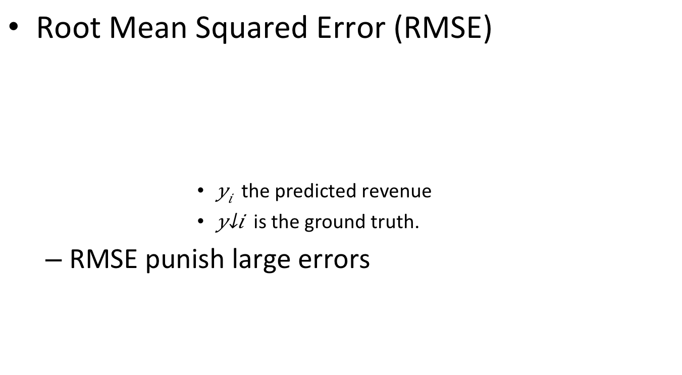
Evaluation
Root Mean Squared Error (RMSE)
the predicted revenue
is the ground truth.
RMSE punish large errors

Slide 12
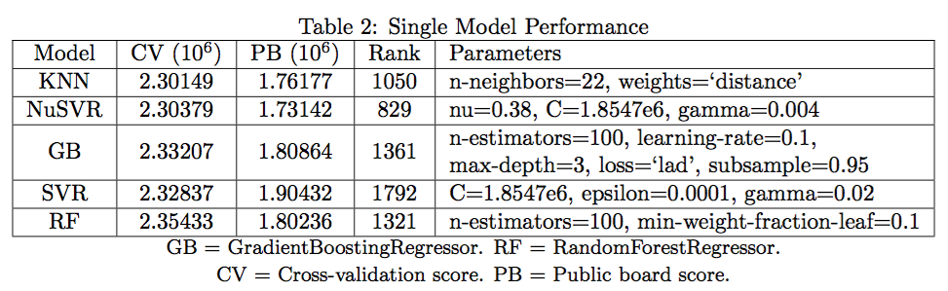
Model Selection
Scikit-Learn / Python
Use all raw features except city name and type
Train a single model
Parameters turned based on 5-folds cross validation
Evaluated on Public Board

Slide 13
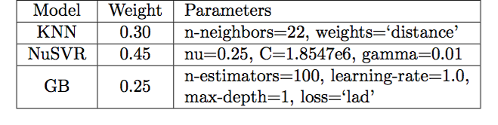
Ensemble
Weighted average of 3 models
Outperform all single models on PB (Ranked 132)

Slide 14
Results on Public Board
Ranked 132 / 2500+ teams

Slide 15
Issues
Overfitting (training set is too small)
Cross validation can not estimate the performance on test set

Slide 16
Conclusion
Performance of a single model is limited
Ensemble is a powerful technique to improve the performance with existing trained models
Overfitting is an issue when training set is small

Slide 17
Thank You!

Slide 18
Backup Slides
Alternative approach tried
Regression 1
Input
Classifier
Predicted
value
Regression 2

Slide 19
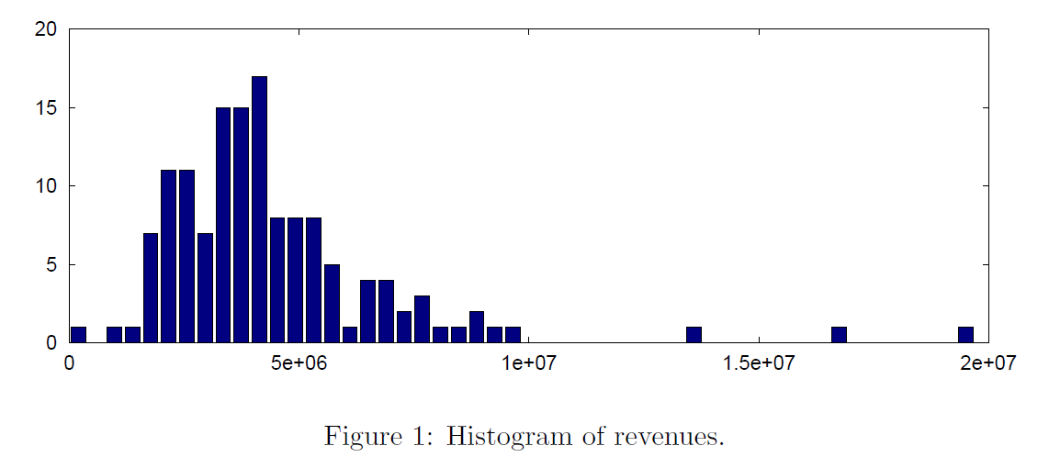
Histogram of revenues

Slide 20
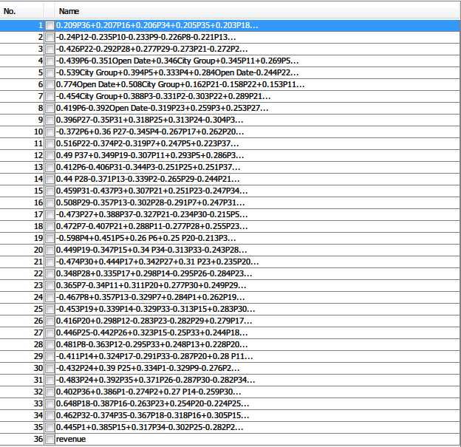
PCA-test

Slide 21
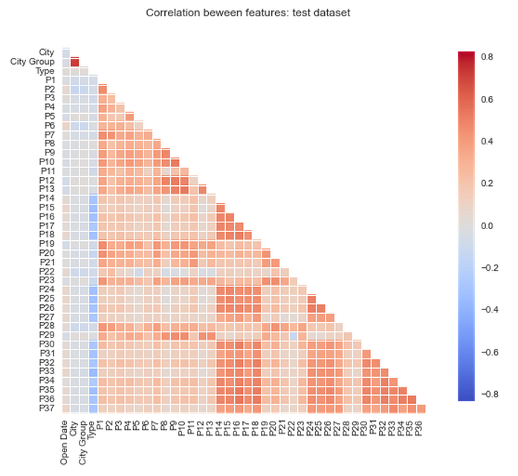
Correlation among testset

Slide 22
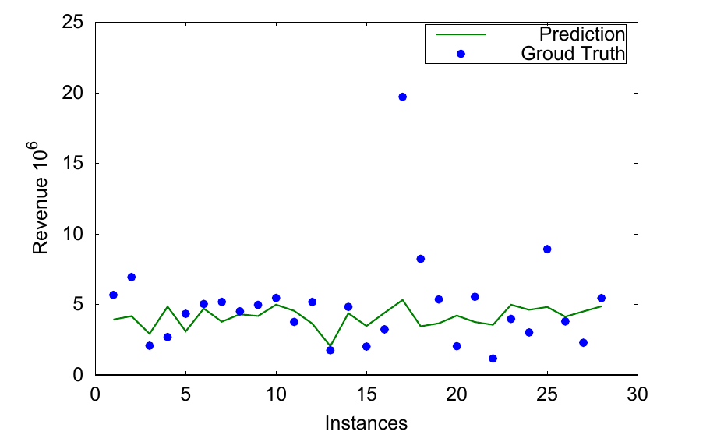
Visualize Validation
Example of prediction results: Ensemble Approach

