Slide 1
E-Assist (ISCG7427-Agile & Lean Software Delivery) Team – Black Pearl
Presentation by : Anshul Pandey #1526043
Beer Inder Singh #1525311
Tarun Batra #1526801

Slide 2
Team - Black Pearl
Star Members
Roles
Anshul Pandey
Beer Inder Singh
Tarun Batra
The Product Owner
The Developer
The Scrum Master

Slide 3
Problem Statement
Currently students are enrolled in number of activities in their institute and parents have to block their calendar for the activity date, time and menu. This process is time consuming and requires human effort. There might be chance that parents can forget to set the reminder or can set wrong reminder.

Slide 4
Vision
For | Parents and Students
Who | Want to acquire information about sports and educational activities being held by kindergarten.
The | E-Assist app
Is a | Web application
That | sends notification to the parent for the activities assigned to their kids
Unlike | Other applications where parents don’t get notification for the activities their child are enrolled in.

Slide 5
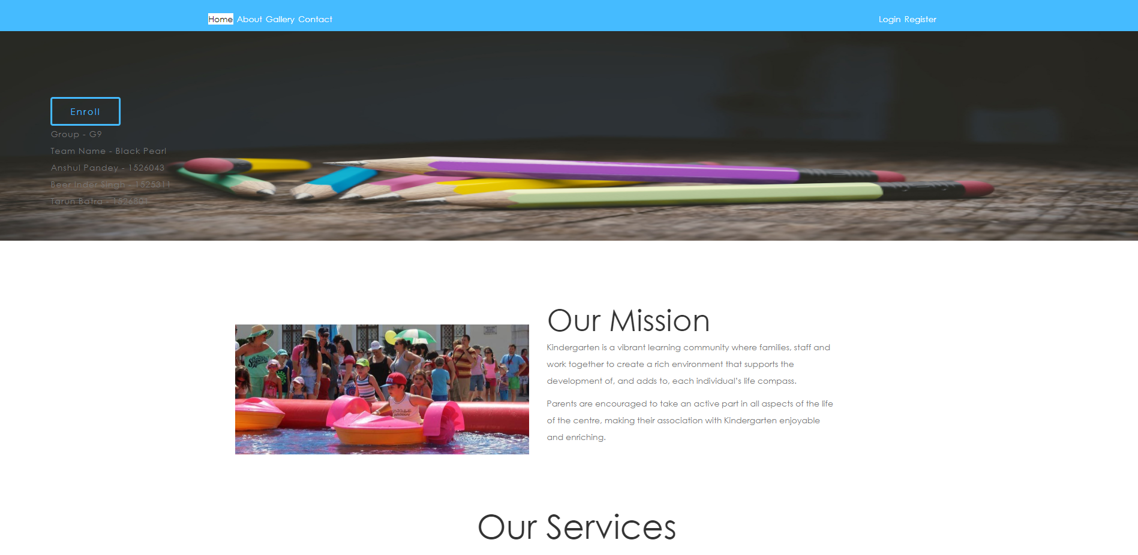
E-Assist

Slide 6
Backlog Items
Landing Page
Admin Login
Parent Sign-up/Sign-in
Child Enrolment
Activities Page
Activity Registration Page
Activity’s Notifications Page

Slide 7
Backlog Item Priorities
Priority - 1
Landing Page
Admin Login
Priority - 2
Parent Sing-up/Sign-in
Child Enrolment
Priority - 3
Activity Page
Activity Registration Page
Priority – 4
Activity’s notification Page

Slide 8
User Stories
The Sprint 0
The Sprint 1
5 User Stories
10 User Stories

Slide 9
Sprint User Stories
As an admin, I can register a new user (Parent) so that he/she can avail the services offered by web application.
As an admin, I can update the user information so that correct information is saved in the database.
As an admin, I can add additional information of the registered user.
As an admin, I can enrol child to the Kindergarten so that he can join our institute.
As an admin, I can update the children information so that correct information is saved in the database.

Slide 10
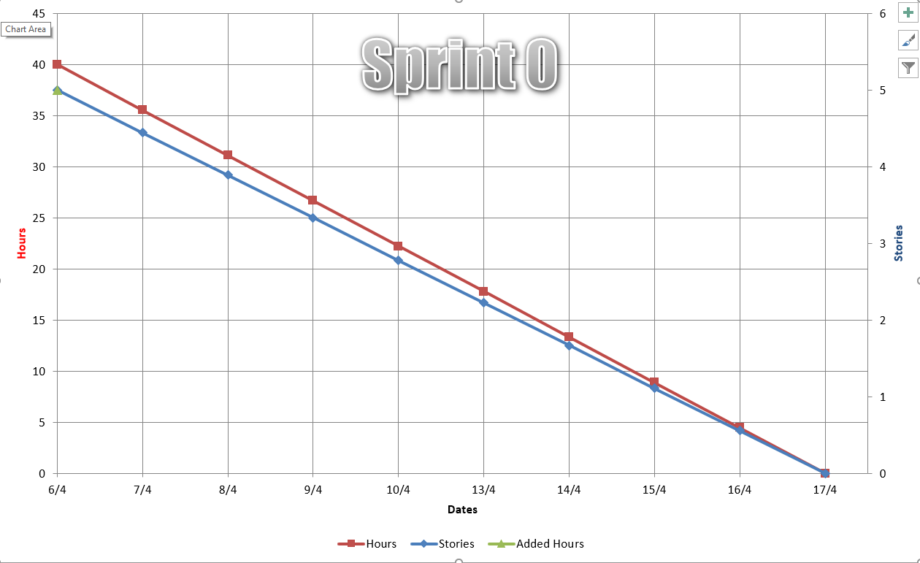
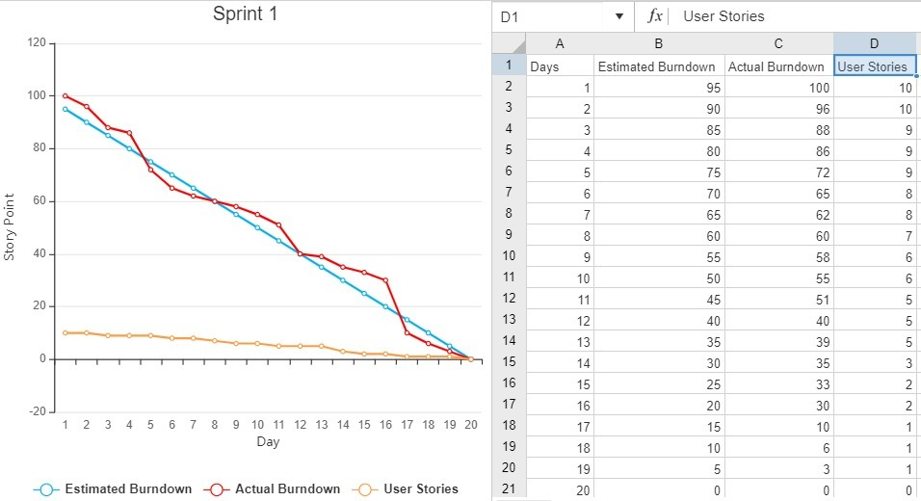
Burndown Chart
The Sprint 0
The Sprint 1

Slide 11
Velocity
Sprint-0 vELOCITY
Sprint-1vELOCITY
Project Velocity
We have committed 5 user stories with 4 stpry point each. Hence the overall Velocity for Sprint-0 is 20.
We have committed 10 user stories with 4 story points each. Hence the overall Velocity for Sprint-1 is 40.
We have committed 15 user stories with 4 story point each in total of 2 sprints. Hence the Velocity of overall Project is
30.

Slide 12
Testing
We have implemented unit testing for all the user stories using selenium web driver as well like user stories in sprint 0.

Slide 13
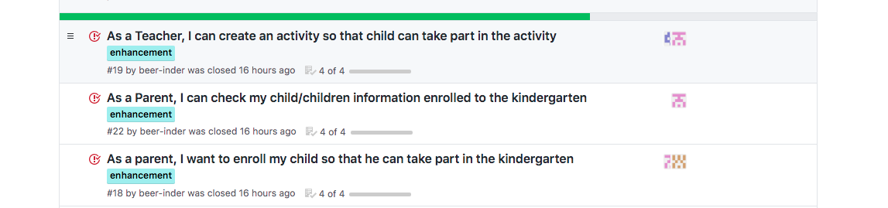
Agile/Lean Practices
Pair programming, where 2 programmers worked together at one workstation. One the driver and writes codes, where other observes and navigates, reviews each line of code. Alternatively switching roles between programmers.

Slide 14
Agile/Lean Practices
Test-driven development (TDD) as a development technique. It is the practice of writing test code before the code to be tested. Provided test word document and test ide from selenium.
Refactoring is a disciplined design skill to improve the structure of code without changing its external behaviour. And refactoring is part of the TDD cycle.

Slide 15
Stand-Up Meetings
We used to have weekly meetings. We have also maintained a stand-up meeting document on GitHub.

Slide 16
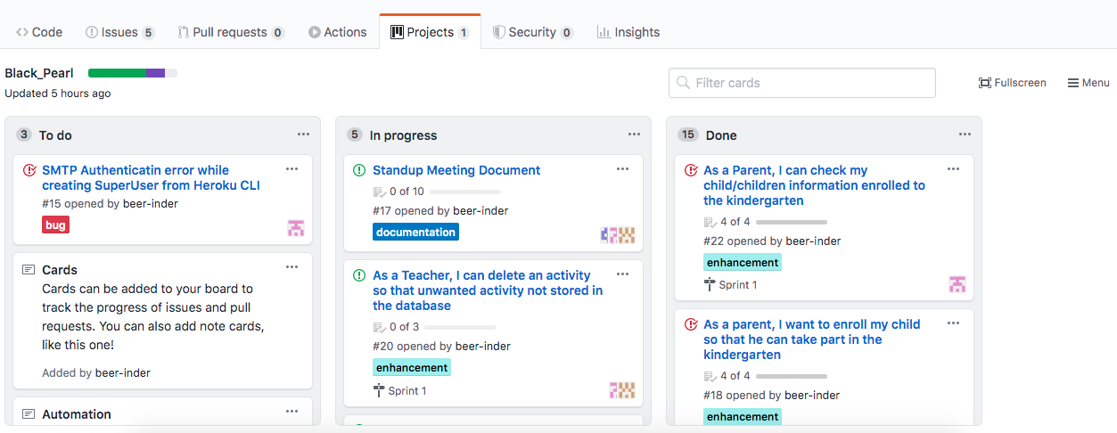
Automated Delivery Pipeline
Our Agile Board in GitHub shows the deliver pipeline that we have maintained during the project.

Slide 17
Retrospective Sprint Review
We have working knowledge of different development tool like PyCharm, Django.
We can also perform testing using selenium, that gives us multi IT skills.
We have learnt to work with you track and GitHub and creating the agile board.
We have learnt agile principles and how it is implemented in real world.
Daily standup meeting discussing the issue , and planning for next workflow.

Slide 18
Retrospective Sprint Review

Slide 19
Thank You

