Slide 1



SMART INDIA HACKATHON 2026
Problem Statement ID - SIH26199
Problem Statement Title -. Student Innovation-Technology ideas in tertiary sectors like Hospitality, Financial Services, Entertainment and Retail.
Theme - Miscellaneous
PS Category- Software & Hardware
Team ID - 172930
Team Name - SCANX

Slide 2

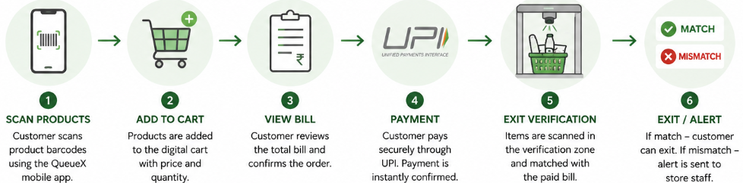
FLOWCHECKOUT
SCAN-X
Proposed Solution (Describe your Idea/Solution/Prototype)
Self-Checkout: Customers scan product barcodes through the Checkout app while shopping.
Digital Cart & Bill: Scanned products are automatically added with price and quantity.
UPI Payment: Customers pay directly through the app without waiting at a billing counter.
Exit Verification: A camera/barcode system checks the physical items against the paid bill.
Mismatch Detection: Extra or unpaid items trigger an alert for store staff.
Fast Exit: If everything matches, the customer gets a “Verified – You Can Exit” confirmation.

Slide 3
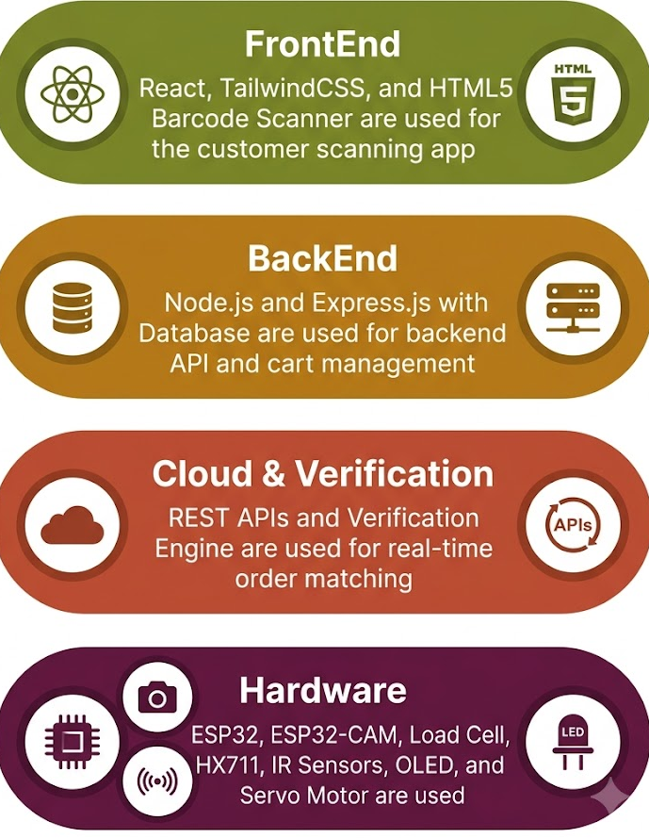
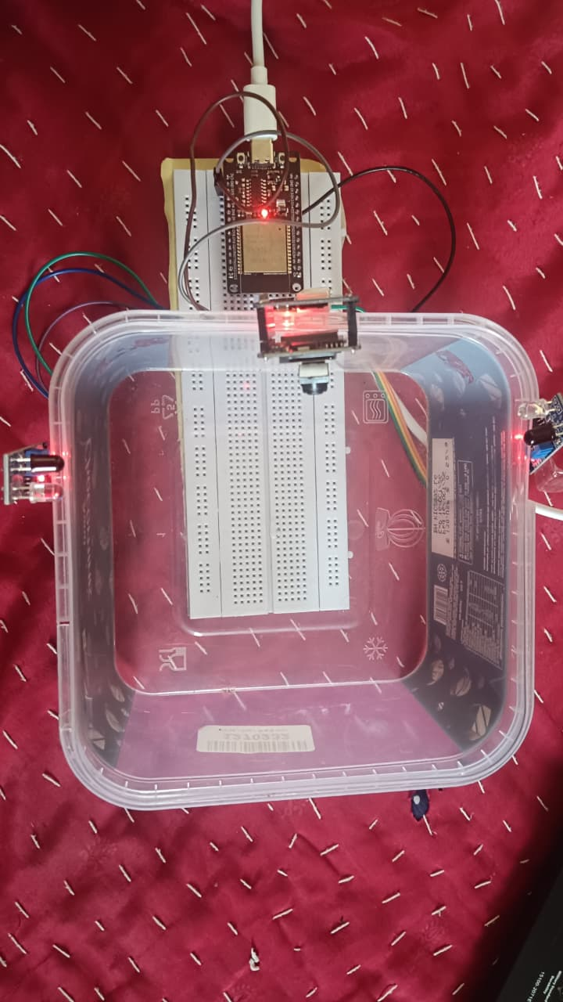
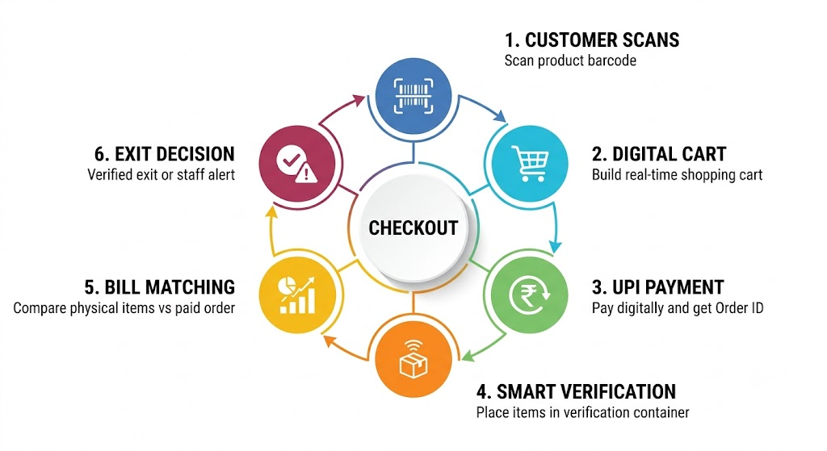
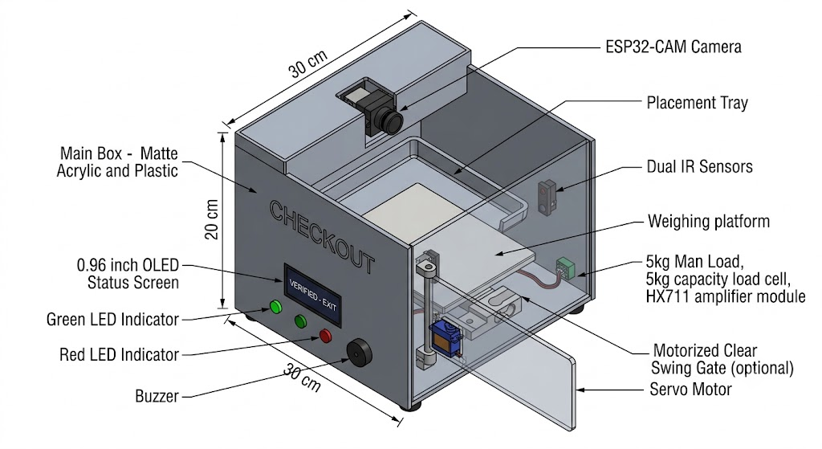

TECHNICAL APPROACH
SCAN-X
TECHNOLOGIES USED
Methodology & Circular Process
Architecture
Report GitHub

Slide 4





FEASIBILITY AND VIABILITY
SCAN-X
FEASIBILITY ANALYSIS
VIABILITY
BUSINESS POTENTIAL
Operational Cost Reduction: Lowers cashier overhead and frees staff for floor assistance and inventory restocking.
Infrastructure Reusability: Uses shoppers' smartphone no smart cart upgrades needed..
Proven Retail Concept: Delivers modern scan-and-go checkout without expensive ceiling sensor grids.
Rapid Return on Investment (ROI): Ultra-low setup cost (~₹2,000/unit) enables complete capital payback within weeks.
Low-Cost Deployment: Prototype costs only ~₹2,000, replacing costly commercial kiosks (₹2.5L+).
High Customer Acceptance: Instant UPI payment matches everyday habits with zero learning curve.
Scalable Integration: Deploys at a single lane and expands storewide with zero shelf modifications.
Operational Transparency: Auto-logs mismatch alerts for staff, eliminating arbitrary customer stops.
Minimal Maintenance: Low-power edge electronics need only basic periodic tare calibrations.

Slide 5
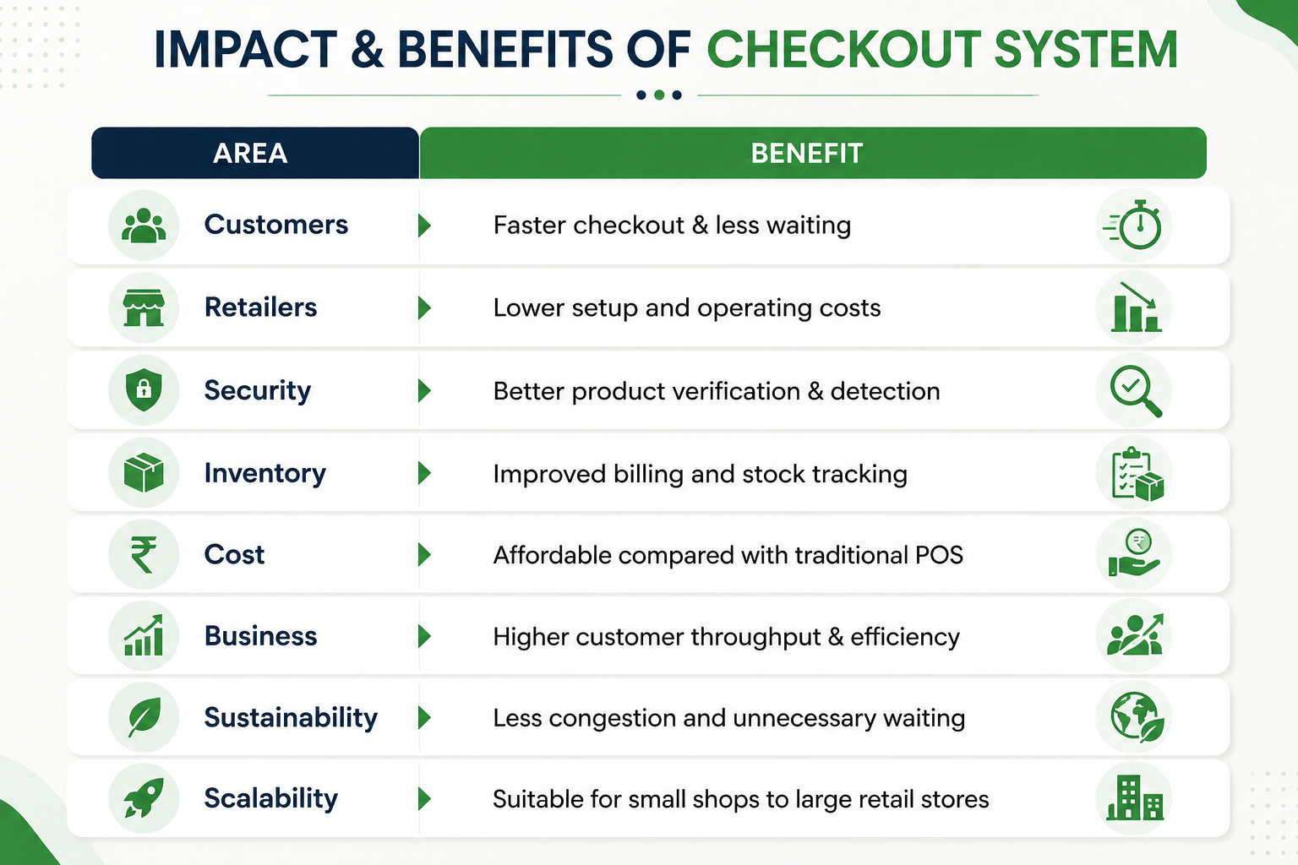
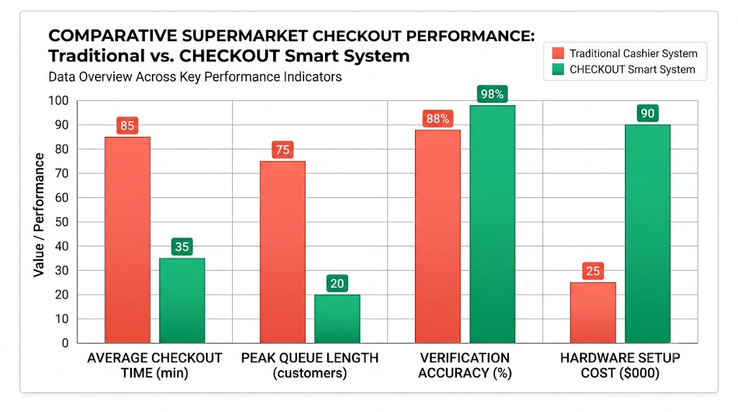
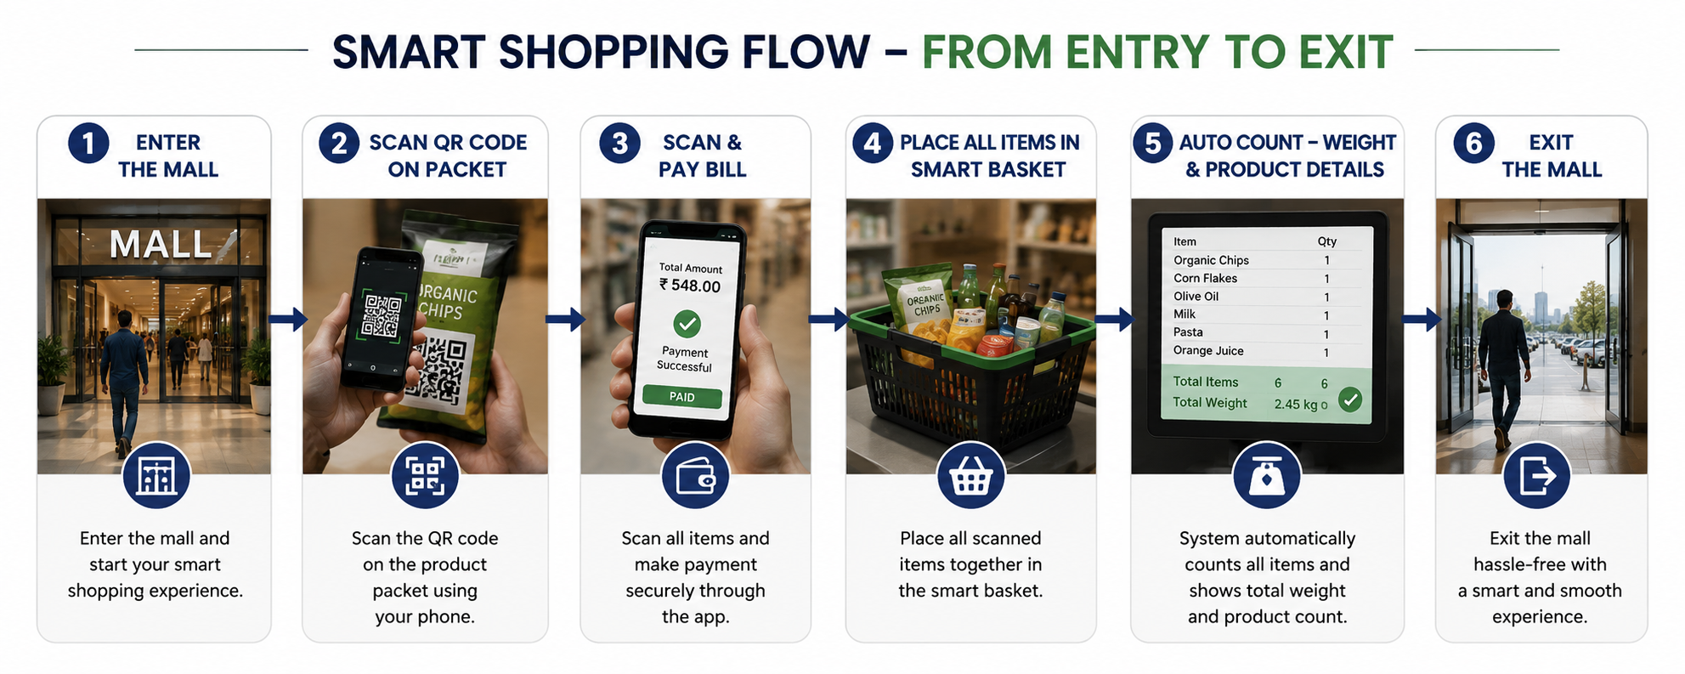
IMPACT AND BENEFITS
SCAN-X

Slide 6

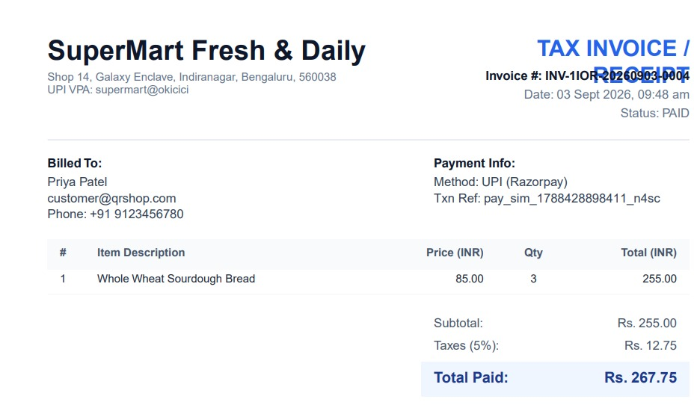
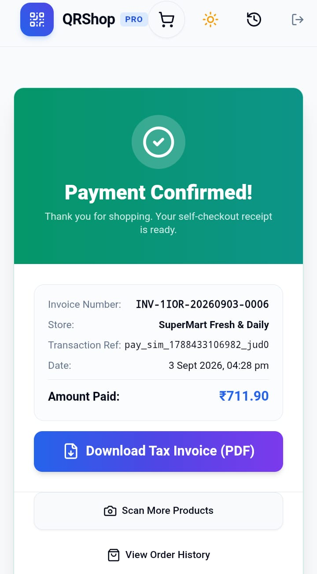
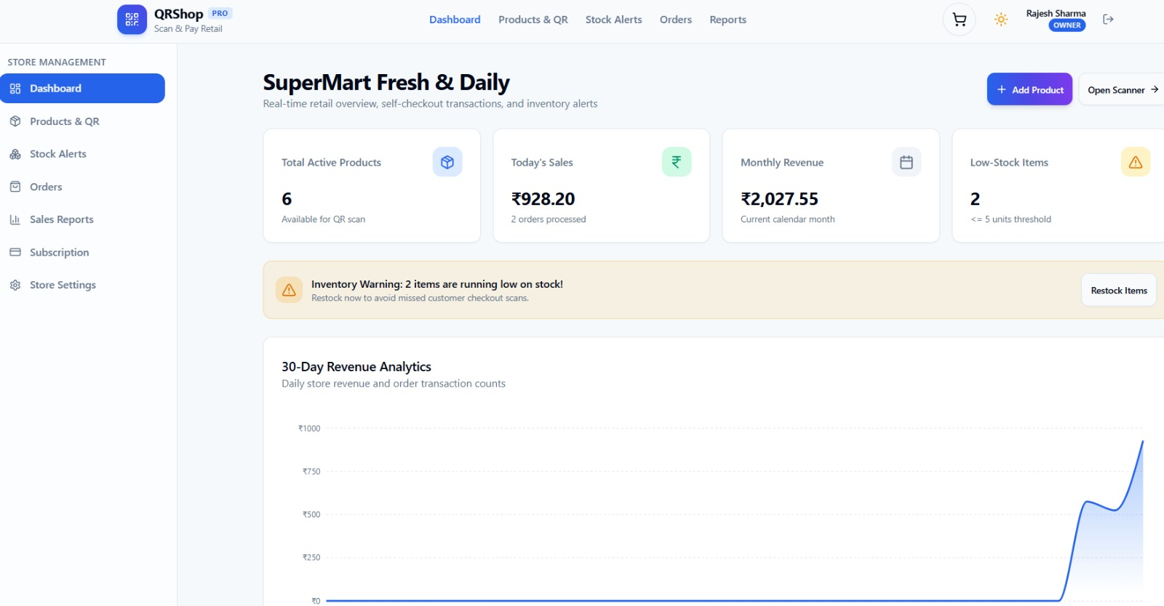
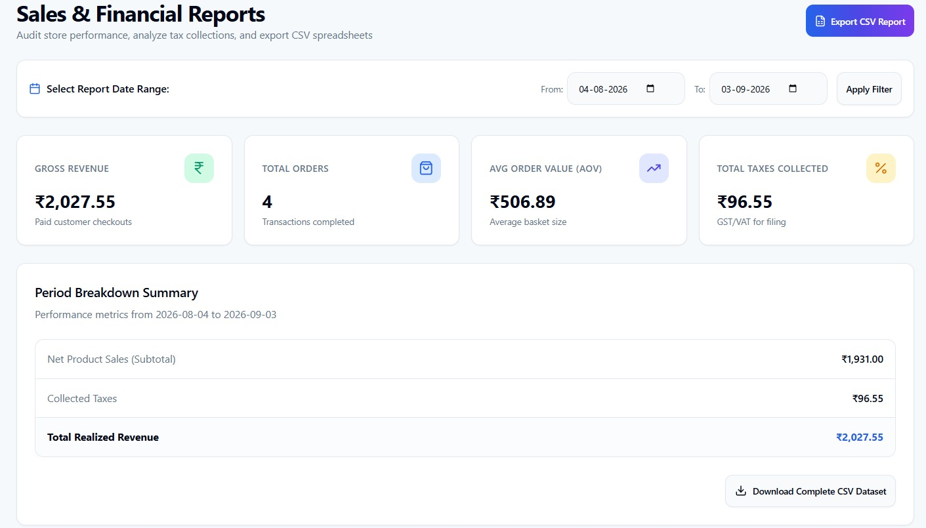

RESEARCH AND REFERENCES
SCAN-X
OWM RESEARCH WORK
Item Verification on Smart TrolleyIndonesia
IEEE/CVPR Open Access
arXiv — Vision-Based Retail
Amazon Dash Cart
LINK
LINK
LINK
LINK
LINK
UI/UX
PROJECT EXPLANATION

