Slide 1

HYSEA DESIGN-ATHON
presented by
Beeram Anusha
Bharat Institute of Engineering and Technology

Slide 2
Multipurpose Platform
AIM:
Identifying innovative ideas from young minds.
Celebrating Innovation.
Skill Development & Job Creation.
THEME:
Encourage design thinking.
Designing a platform which connects multiple organisational stakeholders to help students find matching jobs for their profile.

Slide 3
PROBLEM SOLUTION:
SHARED CONNECTED DATABASE
(Colleges affiliated to JNTUH)
Organisations
Spoc’s / TPO
Job Seeker’s
Educator
Create profiles.
Post jobs.
Internship Programs
Find qualified applicants.
Register & maintain College Profiles.
See job posts’
Use data to grant requests.
Advertise institutional capabilities.
Student Registers
Find local jobs and internships
Build resume and portfolio
Seek a job post and apply for the job
Track Student learning & skills.
Help student’s with matching jobs and their profile.
Focus student’s on Industry demands.
Mentoring student’s to apply for jobs.
* A Common Platform by considering the JNTUH so that the Skill set doesn’t vary.

Slide 4
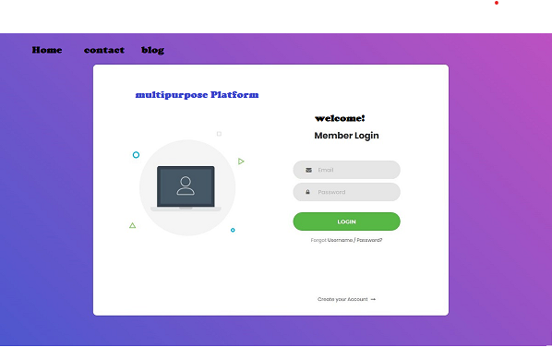
Home page
1)Provides multi login for students faculties,organisations.
2)Contains contact details
3)Blog contains the information regarding platform

Slide 5
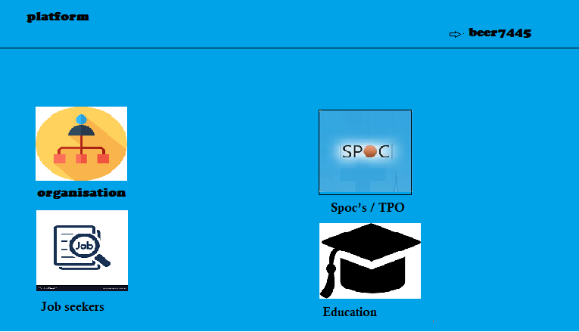

Slide 6
Thank You

