Slide 2
Flight Controller
Flight control including motor control, taking off and landing, manual flight modes
Aircraft state information such as attitude, position, speed
Sensor sub components such as compasses, IMUs, and positioning systems.
Aircraft sub components such as the landing gear
Flight limitation systems such as GEO Zones and the GEO System
Aircraft flight simulation for testing and debugging

Slide 3
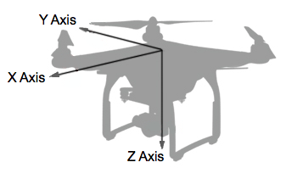
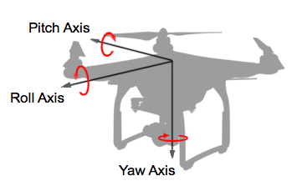
Fundamental Concepts
Concept1: Two Coordinate Systems
1.1 Body Coordinate System
using coordinate right hand rule
X axis is directed through the front of the aircraft;
Y axis through the right of the aircraft;
Z axis through the bottom of the aircraft.
Aircraft rotation
Using right hand rule to define the direction of positive rotation.
The X, Y and Z axes are renamed Roll, Pitch and Yaw.
For instance, if the aircraft rotates around the Pitch axis (Y axis) it will move in the X axis direction. Moreover, if the Pitch angle is positive, the direction will be backwards, or in the negative X axis.

Slide 4
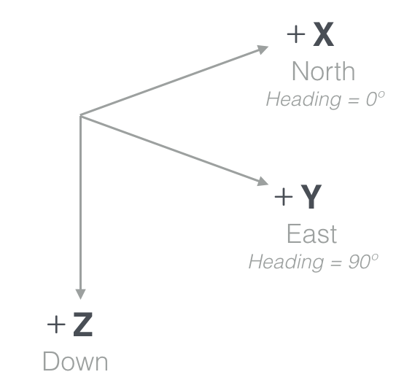
Concept1: Two Coordinate Systems
1.2 Ground (World) Coordinate System
A popular ground or world coordinate system used for aircraft aligns the positive X, Y and Z axes with the directions of North, East and Down. This convention is called North-East-Down or NED.

Slide 5
Concept2: Attitude and Flight
2.1Attitude
The orientation of the Aircraft and Gimbal, defined by the rotation of Pitch, Roll and Yaw axes.
To pitch forward, the back propellers spin faster and have more thrust than the front ones.
To roll left, the right propellers spin faster and have more thrust than the left propellers.
If one half spin faster than the other half, the aircraft will rotate around the yaw axis.
The flight controller balances the thrust/speed of each propeller and the DJI SDK provides APIs to set the Pitch/Roll/Yaw angles.

Slide 6
Concept2: Attitude and Flight
2.2 Throttle
Throttle controls the aircraft's Average Thrust from its propulsion system.
When the aircraft is level, adjusting the throttle will move the aircraft up or down as all the thrust is in the vertical direction. However, when the aircraft is not level (has non-zero pitch or roll), the thrust will have a horizontal component, and therefore the aircraft will move horizontally.

Slide 7
Concept3:Intelligent Orientation Control (IOC)
3.1IOC
IOC (referred to as Flight Orientation Mode in the Mobile SDK) defines how the aircraft will interpret horizontal flight commands (forward, backward, left and right).
There are 3 Flight Orientation Modes are provided : Aircraft Heading (which make movement relative to the aircraft), Course Lock and Home Lock( which make movement relative to the pilot instead of the aircraft).
These orientation modes only work when the remote controller flight mode switch is in "F" for remote controllers with an "F" mode option, and in "P" for all other remote controllers.
3.2 Aircraft Heading
The aircraft moves relative to the front of the aircraft.
Notes:
By default, the aircraft will fly relative to itself, so a left command causes the aircraft to fly to its left. This makes sense if an aircraft is being piloted from the first person view. However, when the aircraft is being piloted remotely from a fixed location it can be confusing or inconvenient.
When the pilot can't determine the heading of the aircraft, then it is hard to predict how the aircraft will move relative to the pilot. If the aircraft is facing the pilot, then from the pilot's perspective, the aircraft will move right when a left command is issued.

Slide 8
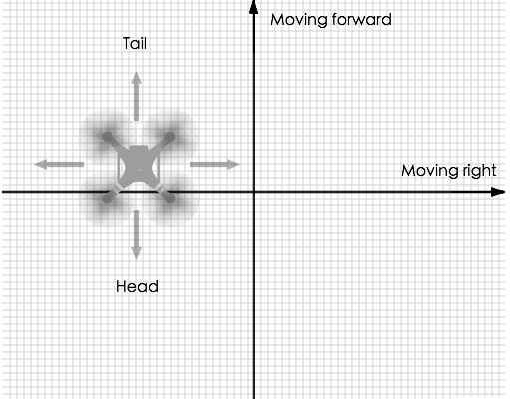
Concept3:Intelligent Orientation Control (IOC)
3.3 Course Lock
The Course Lock orientation mode makes the aircraft move relative to a fixed heading. If a heading of 0° (North) is chosen, then no matter the yaw of the aircraft, whenever a left command is given, the aircraft will move West.
The diagram below illustrates an aircraft that is oriented in the opposite direction of the course lock heading, and shows that when a forward or right command is issued, the aircraft will backwards or left respectively relative to itself.

Slide 9
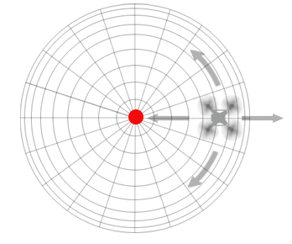
Concept3:Intelligent Orientation Control (IOC)
3.4 Home Lock
The Home Lock orientation mode makes the aircraft move radially relative to the home point. Forward and backwards commands will move the aircraft further from and closer to the home point respectively. Left and right commands will move the aircraft in a circle around the home point at the current radius.

Slide 10
State Information(10Hz)
Aircraft position, velocity and altitude
Remaining Battery and Flight time information
Home location
Sensor information (compass, IMU, Satellite positioning)
Return home status
Whether motors are on and aircraft is flying or not
Flight limitation and GEO system information

Slide 11
Flying
Motor Control
Motors can be turned on and off through APIs in the DJI Mobile SDK. Motors can only be turned off when the aircraft is not flying. Motors will not turn on if there are IMU or Compass calibration errors, or if the IMU is still pre-heating.

