Slide 1
Data Analytics Using Python
Introduction

Slide 2
Course Orientation
Email: All email should be sent to my email (mgalarny@gmail.com)
Contact by email is preferred. If necessary, I can setup a zoom meeting.
Please indicate: “Data Analytics using Python” in the subject line, otherwise I won’t know which one of my courses you are referring to.

Slide 3
Course Orientation
The project will be posted on the Blackboard web site.
Students are responsible for periodically logging onto the Blackboard web site.
A link to your one project or a zip file should be submitted via email.

Slide 4
Seeking Help
The instructor will not be able to rigorously debug student projects.
However, if you have a code error that has a student stumped, then the source code and associated error message should be copy and pasted on the course discussion list.
You can also post your code and errors on the unlisted youtube video if you wish

Slide 5
Course Content
Session 1: Install Anaconda + Python Basics (stings, lists, etc)
Session 2: Review Python Basics (tuples, dictionaries, functions)
Session 3: Pandas (data manipulation and analysis library)
How to load, manipulate, and export data
Integration with NumPy.
Session 4: Pandas + Matplotlib (plotting library)
Session 5: Matplotlib + Logistic Regression
Session 6: Decision Trees
Session 7: Decision Trees + Random Forests
Session 8: Clustering + Principal Component Analysis
Session 9: Topics of Interest and How to Learn Them
Lecture about topics we didn’t cover in this class and how and where to learn them
Notes:
A lot of this class is third party libraries as most of the time you wont build something from scratch using python’s standard libraries on your own.
integrate files and file handling.

Slide 6
Class Structure
Lessons (lecture videos)
Download Exercises
Supplementary Material

Slide 7
Getting Started/Python Distribution used in this Class
Anaconda Python Distribution (Python 3 preferably).
Install Anaconda on Windows: https://www.datacamp.com/community/tutorials/installing-anaconda-windows
Install Anaconda on Mac: https://www.datacamp.com/community/tutorials/installing-anaconda-mac-os-x
Notes:
Pause the video, take some time to install Aan

Slide 8
Why Anaconda?
Anaconda is the strongly recommended way of installing Jupyter/IPython (source: http://jupyter.org/install.html) which we will use for this class.
Anaconda comes with Microsoft VSCode (in case you want to use it as an IDE).
Anaconda is a package manager, an environment manager, and Python distribution
Data analytics projects require many different libraries/packages (numpy, scipy, pandas, scikit-learn to name a few), which an installation of Anaconda comes preinstalled with.

Slide 9
Why Anaconda?
If you need additional packages after installing Anaconda, you can use Anaconda’s package manager conda or pip to install those packages. This is highly advantageous as you don’t have to manage dependencies between multiple packages yourself. Conda even makes it easy to switch between Python 2 and 3 (you can learn more here: https://towardsdatascience.com/environment-management-with-conda-python-2-3-b9961a8a5097

Slide 10
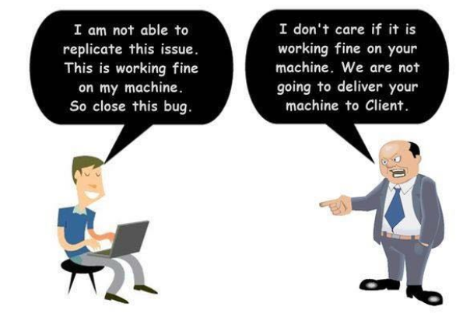
Why Anaconda?
Since this is not a Data Analytics/Science DevOps class, I don’t mind if you absolutely insist on using Python 2 (even if Python and major libraries are dropping support for it in 2020)
More on Anaconda later.
Source: https://towardsdatascience.com/devops-for-data-scientists-taming-the-unicorn-6410843990de
Notes:
While I heavily recommend installing Python 3 version of anaconda, this is not a DevOps class so if you have a strong reason for using Python 2, I wont stop you.

Slide 11
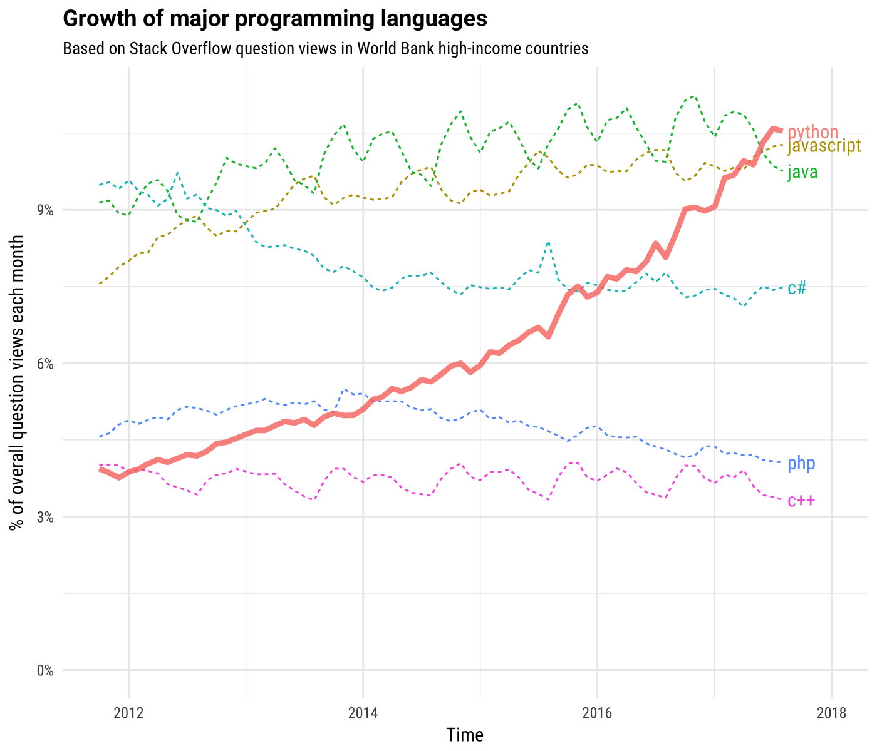
Introduction
Python has a solid claim to be the fastest-growing major programming language.
Source: https://stackoverflow.blog/2017/09/06/incredible-growth-python/

Slide 12
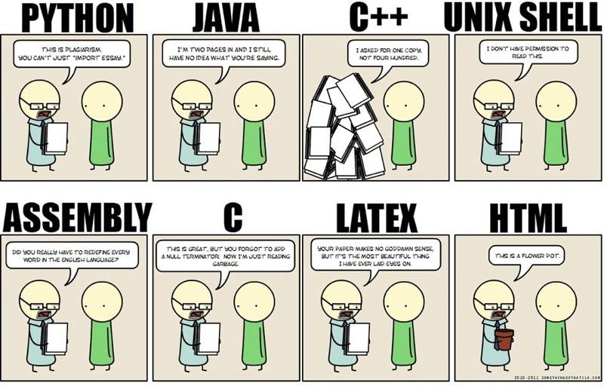
What is Covered in this Course
One thing you will find is that there is a python library for everything.
Part of this course will cover how to utilize libraries to accomplish analytical goals.

Slide 13
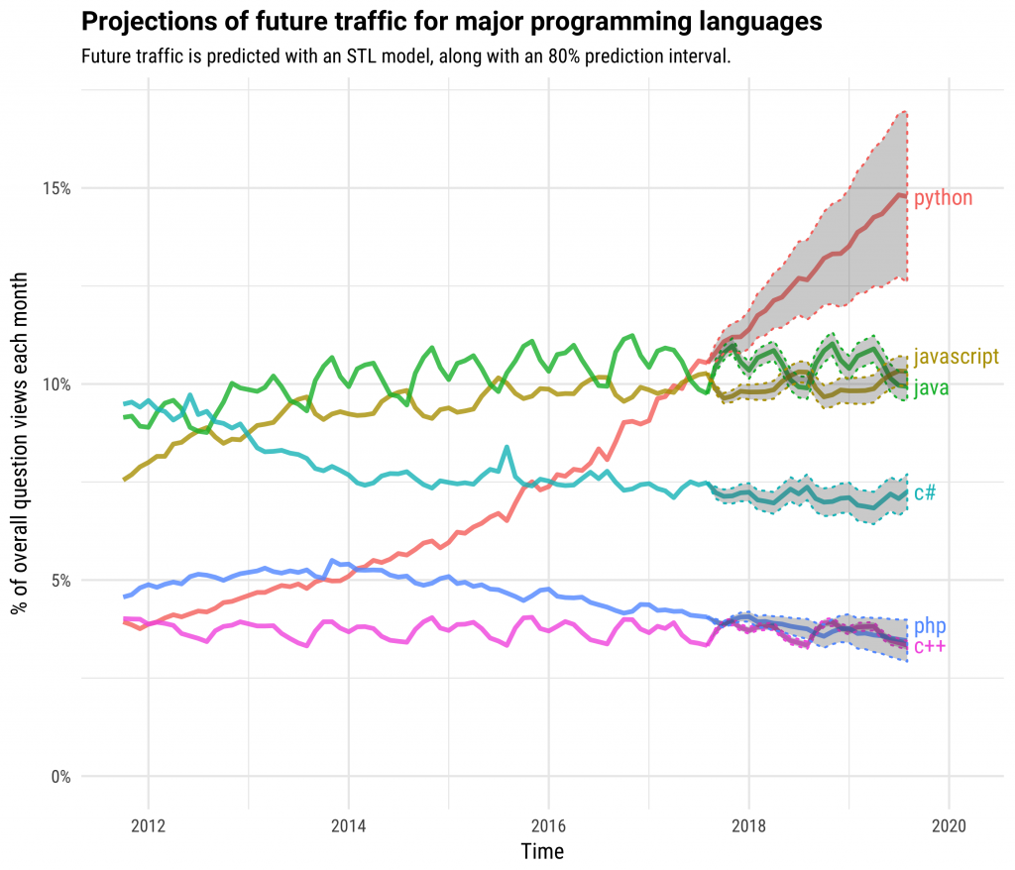
Predictions are Difficult to Make/Understand
Before making predictions on data, we need to understand how to use Python to load, manipulate, and understand data.
Even then, you need to be able to explain how your predictions work
Source: https://stackoverflow.blog/2017/09/06/incredible-growth-python/
Notes:
Statistical learning book pg 82 is wonderful because this is a prediction interval.

Slide 14
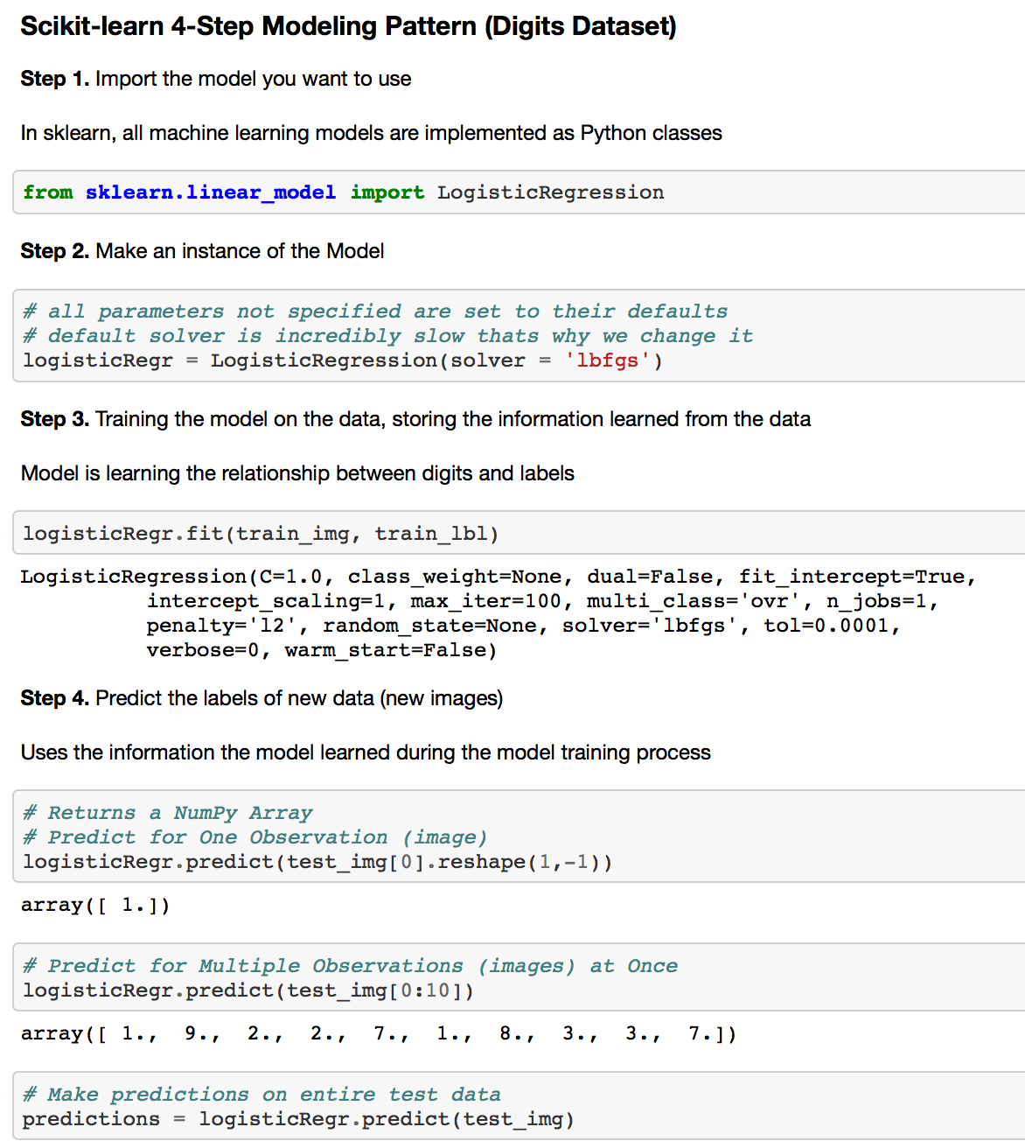
Why Jupyter/IPython?
The image on the right shows a Jupyter Notebook in action. Jupyter notebooks contain both code and rich text elements, such as figures, links, and equations. More references on Jupyter Notebooks here: https://youtu.be/HW29067qVWk?t=241
Keep in mind, notebooks aren’t perfect.
Python in a Jupyter Notebook
Notes:
Notebooks aren’t perfect: https://docs.google.com/presentation/d/1n2RlMdmv1p25Xy5thJUhkKGvjtV-dkAIsUXP-AL4ffI/edit#slide=id.g3d168d2fd3_0_36

Slide 15
Good Python References
These are Python books I use (not necessary or recommended to have):
Think Stats: Probability and Statistics for Programmers by Allen Downey http://greenteapress.com/thinkstats/thinkstats.pdf
Python for Data Analysis: Data Wrangling with Pandas, NumPy, and Ipython by Wes McKinney
Writing Idiomatic Python by Jeff Knupp

Slide 16
Extra Slides

Slide 18
Jupyter Integration with Shell Commands
It is common to find shell commands in Jupyter Notebooks alongside Python code
In Jupyter Notebook, you can access shell commands by escaping to the shell by using an !

Slide 19
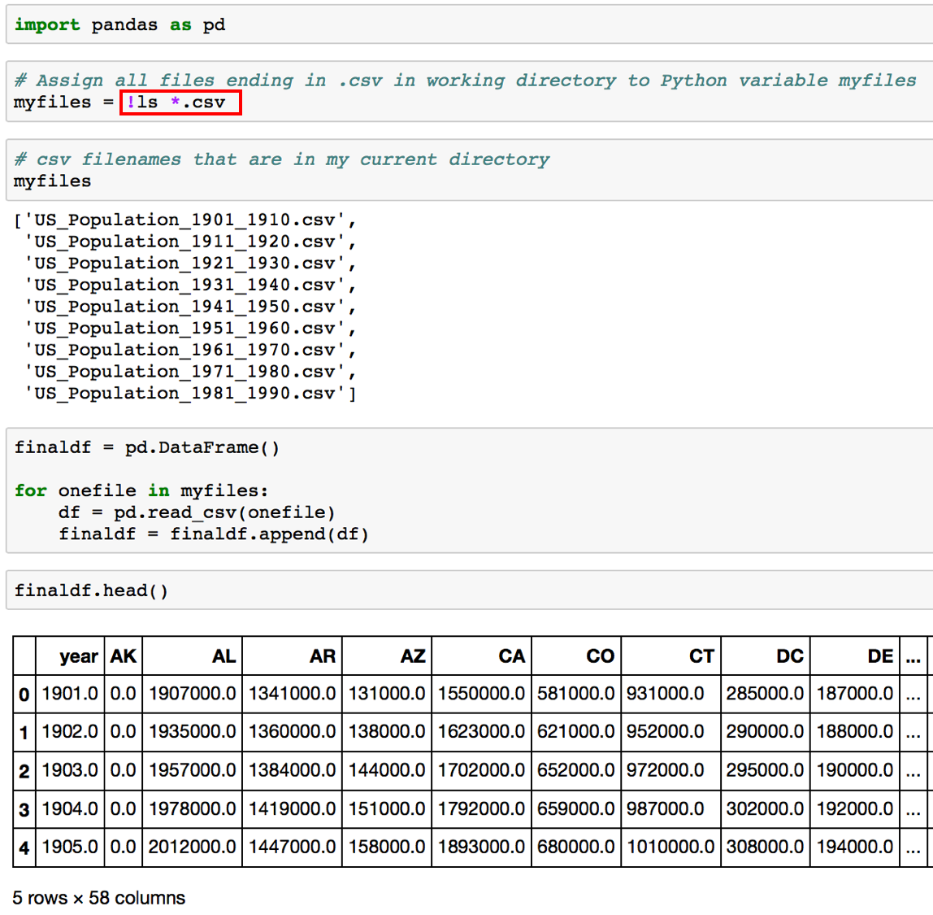
Jupyter Integration with Shell Commands
In the code below, the result of the shell command ls (which lists all the files in the current directory) is assigned to the Python variable myfiles (note `ls` is a Unix command).
myfiles = !ls
Python Code integrated in a workflow to combine multiple datasets. Notice a Unix Shell command (enclosed in the red rectangle) integrated in a Jupyter Notebook.

