Slide 1
Python Basics
Notes:
Make sure you have installed Anaconda before this lesson. Let me know if you have had any installation issues.
This is going to be review for most of you but I am including it as there are enough students without python experience taking this course.
as many of you don’t have python experience.

Slide 2
Presentation Notes
The following slides are review
If you don’t know everything in the slides, don’t worry.
I will do my best to include continuous review throughout the course (including much not shown in this lecture).
This is one of the few powerpoint lectures for this class.
Notes:
A string is a sequence of characters.
Unlike other languages, special characters such as \nhave the same meaning with both single ('...') and double ("...") quotes. The only difference between the two is that within single quotes you don’t need to escape " (but you have to escape \') and vice versa.
* https://docs.python.org/3/tutorial/introduction.html
String literals can span multiple lines. One way is using triple-quotes: """...""" or '''...'''. End of lines are automatically included in the string, but it’s possible to prevent this by adding a \ at the end of the line. The following example:
A character is simply a symbol. For example, the English language has 26 characters.
Computers do not deal with characters, they deal with numbers (binary). Even though you may see characters on your screen, internally it is stored and manipulated as a combination of 0's and 1's.
This conversion of character to a number is called encoding, and the reverse process is decoding. ASCII and Unicode are some of the popular encoding used.
In Python, string is a sequence of Unicode character. Unicode was introduced to include every character in all languages and bring uniformity in encoding. You can learn more about Unicode from here.
This conversion of character to a number is called encoding, and the reverse process is decoding. ASCII and Unicode are some of the popular encoding used.

Slide 3
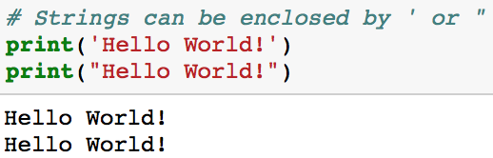
Strings
A string is a sequence of characters.
String literals may be enclosed in single quotes or double doubles with the same result*.
* https://docs.python.org/3/tutorial/introduction.html
Notes:
A string is a sequence of characters.
Unlike other languages, special characters such as \nhave the same meaning with both single ('...') and double ("...") quotes. The only difference between the two is that within single quotes you don’t need to escape " (but you have to escape \') and vice versa.
* https://docs.python.org/3/tutorial/introduction.html
String literals can span multiple lines. One way is using triple-quotes: """...""" or '''...'''. End of lines are automatically included in the string, but it’s possible to prevent this by adding a \ at the end of the line. The following example:
A character is simply a symbol. For example, the English language has 26 characters.
Computers do not deal with characters, they deal with numbers (binary). Even though you may see characters on your screen, internally it is stored and manipulated as a combination of 0's and 1's.
This conversion of character to a number is called encoding, and the reverse process is decoding. ASCII and Unicode are some of the popular encoding used.
In Python, string is a sequence of Unicode character. Unicode was introduced to include every character in all languages and bring uniformity in encoding. You can learn more about Unicode from here.
This conversion of character to a number is called encoding, and the reverse process is decoding. ASCII and Unicode are some of the popular encoding used.

Slide 4
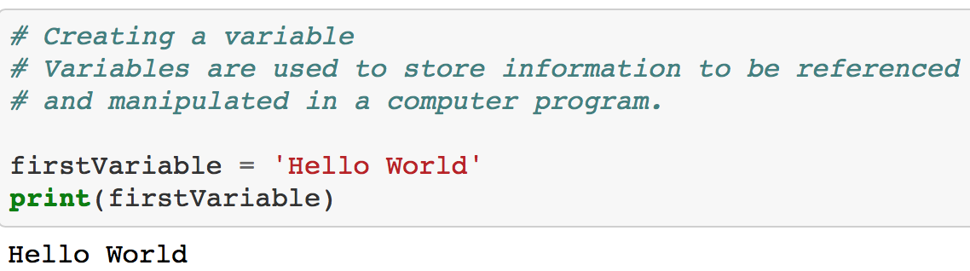
Variables
Variables are used to store information to be referenced and manipulated in a computer program
They are convenient “handles” to the data.
Variables are passed by assignment in Python (more on this later)
Notes:
Talk about reference and such.
One common question I get is:
In Python, are arguments passed by value or by reference in Python?
Arguments are passed by assignment in Python. Since assignment just creates references to objects, there’s no alias between argument name in the caller and callee, and so no call-by-reference per se (python documentation)
https://www.quora.com/Are-arguments-passed-by-value-or-by-reference-in-Python
If it were by reference, when you passed an int and modified the int within the method, the int outside the method would be affected, but it it is not.
If it were by value, then when you passed a list and modified the list within the method, the list outside the method would be unaffected, but it is.
Easy. A “variable” in Python isn’t a traditional variable. Instead, it’s a binding to an object. Essentially, a pointer, but to an object, not a memory location. With a list, this is easy to see.
https://docs.python.org/3/faq/programming.html#how-do-i-write-a-function-with-output-parameters-call-by-reference

Slide 5
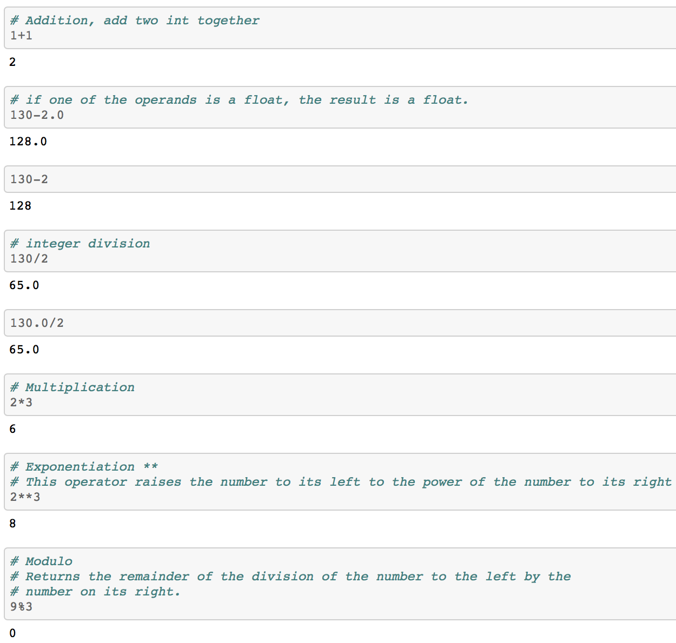
Basic Math
There are four distinct numeric types: plain integers, long integers, floating point numbers, and complex numbers. In addition, Booleans are a subtype of plain integers.
Notes:
https://github.com/mGalarnyk/Python_Tutorials/blob/master/Python_Basics/Intro/Python3Basics_Part1.ipynb
Python 2 vs 3 differences: https://www.youtube.com/watch?v=30ghRykclIU

Slide 6
Basic Math
There are four distinct numeric types: plain integers, long integers, floating point numbers, and complex numbers. In addition, Booleans are a subtype of plain integers.
Notes:
https://github.com/mGalarnyk/Python_Tutorials/blob/master/Python_Basics/Intro/Python3Basics_Part1.ipynb
Python 2 vs 3 differences: https://www.youtube.com/watch?v=30ghRykclIU

Slide 7
Basic Math
There are four distinct numeric types: plain integers, long integers, floating point numbers, and complex numbers. In addition, Booleans are a subtype of plain integers.
Notes:
https://github.com/mGalarnyk/Python_Tutorials/blob/master/Python_Basics/Intro/Python3Basics_Part1.ipynb
Python 2 vs 3 differences: https://www.youtube.com/watch?v=30ghRykclIU

Slide 8
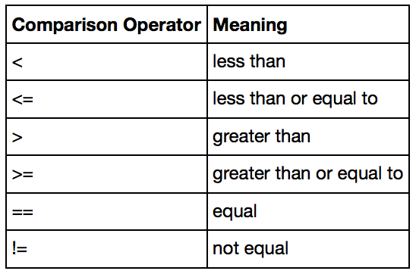
Comparison Operators
Sometimes you want to know the relationship between two values. Are they equal, greater than, less than, or something else.
Comparison operators allow you to test the relationship between values.
Comparison operators return booleans (True, False values) which are constants of type bool.
To sum up True and False in a sentence: they're alternative ways to spell the integer values 1 and 0
Notes:
https://youtu.be/khKv-8q7YmY?t=469
When working with numbers, you will often need to use comparisons.
Python's Booleans were originally added to Python with the primary goal of making code clearer
Python's Booleans were added with the primary goal of making code clearer. For example, if you're reading a function and encounter the statement return 1, you might wonder whether the 1 represents a Boolean truth value, an index, or a coefficient that multiplies some other quantity. If the statement is return True, however, the meaning of the return value is quite clear.
Update Image Soon.

Slide 9
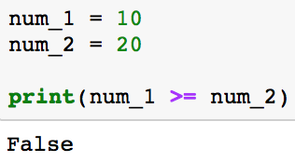
Comparison Operator Example
Sometimes you want to know the relationship between two values. Are they equal, greater than, less than, or something else.
Comparison operators allow you to test the relationship between values.
Comparison operators return booleans (True, False values) which are constants of type bool.
To sum up True and False in a sentence: they're alternative ways to spell the integer values 1 and 0
Notes:
https://youtu.be/khKv-8q7YmY?t=469
When working with numbers, you will often need to use comparisons.
Python's Booleans were originally added to Python with the primary goal of making code clearer
Python's Booleans were added with the primary goal of making code clearer. For example, if you're reading a function and encounter the statement return 1, you might wonder whether the 1 represents a Boolean truth value, an index, or a coefficient that multiplies some other quantity. If the statement is return True, however, the meaning of the return value is quite clear.
Update Image Soon.

Slide 10
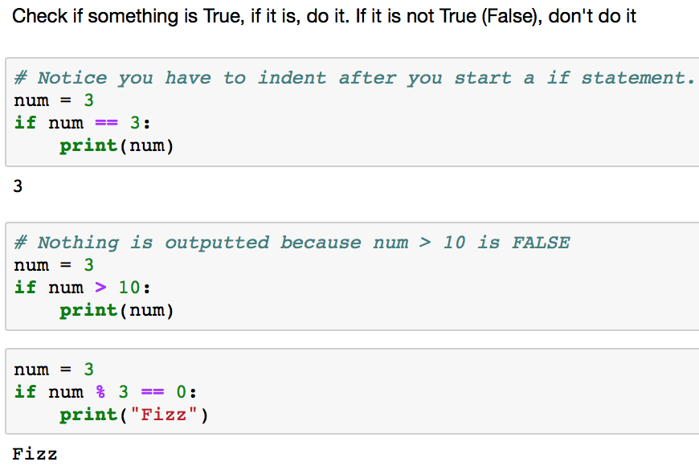
Conditionals
Purpose is to control what statements get executed depending on whether certain values evaluate to True or False .
Notes:
https://youtu.be/DZwmZ8Usvnk
In the examples, the print statements will only be executed if the condition in our print statement evaluates to True.
I have more practice on this in the notebook accompanying this presentation.
Python's Booleans were added with the primary goal of making code clearer
True and False are booleans which were added with the primary goal of making code cleaner
Next time be sure to indent so that we are writing code within our if block.
Python's Booleans were added with the primary goal of making code clearer. For example, if you're reading a function and encounter the statement return 1, you might wonder whether the 1 represents a Boolean truth value, an index, or a coefficient that multiplies some other quantity. If the statement is return True, however, the meaning of the return value is quite clear.
Update Image Soon.

Slide 11
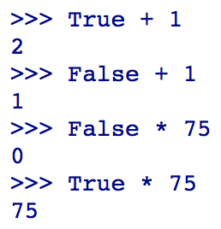
Caution
The Boolean type is a subclass of the int class so that arithmetic using a Boolean still work.
Notes:
https://docs.python.org/2.3/whatsnew/section-bool.html
https://github.com/mGalarnyk/Python_Tutorials/blob/master/Python_Basics/Intro/Python3Basics_Part1.ipynb
Update Image Soon.

Slide 12
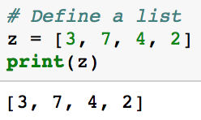
Lists
Lists store an ordered collection of items which can be of different types.
Lists are written within square brackets [].
Defining a List. The second row in this table index is how you access items in the list.
Notes:
https://hackernoon.com/python-basics-6-lists-and-list-manipulation-a56be62b1f95
Python mention lists don’t have to be homegeneous

Slide 13
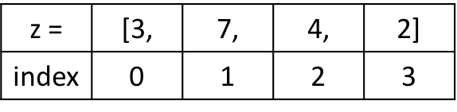
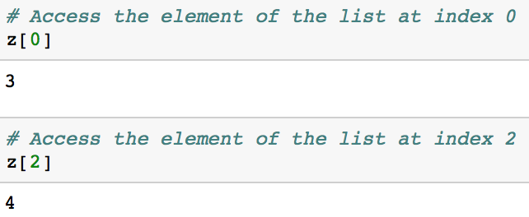
Access Values in Lists
Lists are an ordered sequences of items, just like lists.
Each item in a list has an assigned index value. It is important to note that python is a zero indexed based language. All this means is that the first item in the list is at index 0.
Defining a List. The second row in this table index is how you access items in the list
Notes:
https://hackernoon.com/python-basics-6-lists-and-list-manipulation-a56be62b1f95

Slide 14
Tuples
Tuples are an ordered sequences of items, just like lists.
The main difference between tuples and lists is that tuples cannot be changed (immutable) unlike lists which can (mutable).
# Initialize a Tuple z = (3, 7, 4, 2)
# Initialize a Tuple(without parenthesis) z = 3, 7, 4, 2
The two ways to initialize a tuple

Slide 15
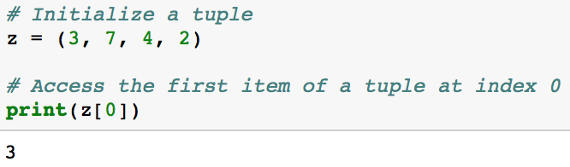
Access Values in Tuples
Tuples are an ordered sequences of items, just like lists.
The main difference between tuples and lists is that tuples cannot be changed (immutable) unlike lists which can (mutable).

Slide 16
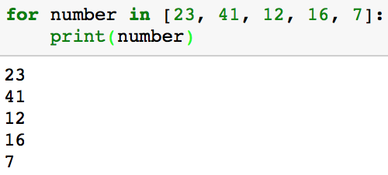
For Loops
A for loop is used for iterating over a sequence (list, a tuple, a dictionary, a set, string, etc).
In Python, code blocks are NOT surrounded by {}. Python uses indentation.
Notice that after the colon, the next line is indented.
Notes:
This is less like the for keyword in other programming languages, and works more like an iterator method as found in other object-orientated programming languages.
The for loop does not require an indexing variable to set beforehand. In this class, you will see that there are ways to make anything iterable (using the duner method __iter__

Slide 17
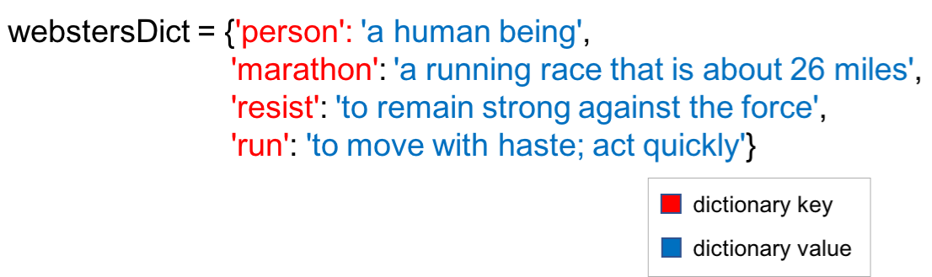
Dictionary and Dictionary Methods
Unordered collection of key-value pairs
Dictionary keys can be any immutable data type (numbers, strings, tuples etc).
Dictionary values can be just about anything (int, lists, functions, strings, etc).

Slide 18

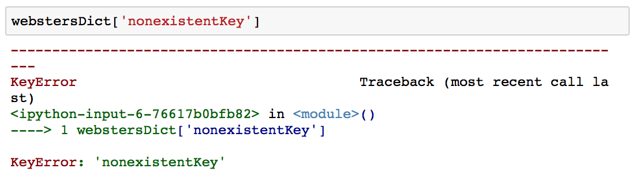
Access Values in a Dictionary
By supplying a dictionary key inside [], you can get its corresponding value.
Keep in mind that you will get a KeyError if you try to access a value for a key that does not exist.
The code uses the key ’marathon’ to access the value ‘a running race that is about 26 miles’.
Notes:
In the example, webstersDict used strings as keys in the dictionary, but

Slide 19
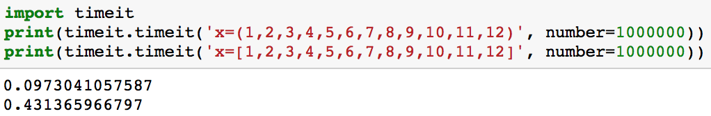
Tuples vs Lists
Tuples are faster than lists. If you’re defining a constant set of values and all you’re ever going to do with it is iterate through it, use a tuple instead of a list.
Notes:
The performance difference can be partially measured using the timeit library which allows you to time your Python code. The code below runs the code for each approach 1 million times and outputs the overall time it took in seconds

Slide 20
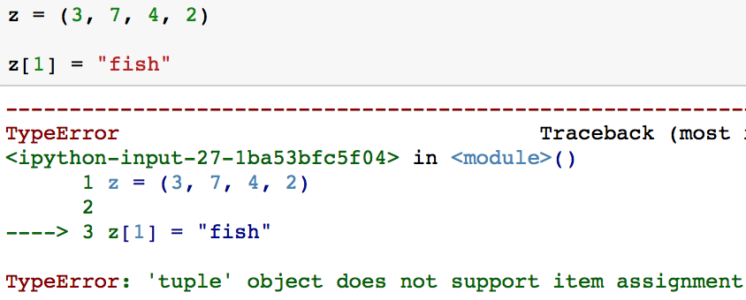
Tuples vs Lists
Lists and tuples are standard Python data types that store values in a sequence. A tuple is immutable whereas a list is mutable.
After initializing a tuple, it is impossible to update individual items in a tuple.
Notes:
Lists and tuples are standard Python data types that store values in a sequence. A tuple is immutable whereas a list is mutable.
Update image after figuring out format.

Slide 21
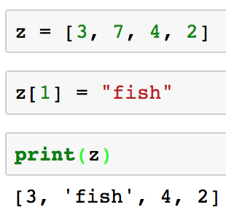
Tuples vs Lists
Lists and tuples are standard Python data types that store values in a sequence. A tuple is immutable whereas a list is mutable.
After initializing a list, you can update it.
Notes:
Lists and tuples are standard Python data types that store values in a sequence. A tuple is immutable whereas a list is mutable.
Update image after figuring out format.

Slide 22
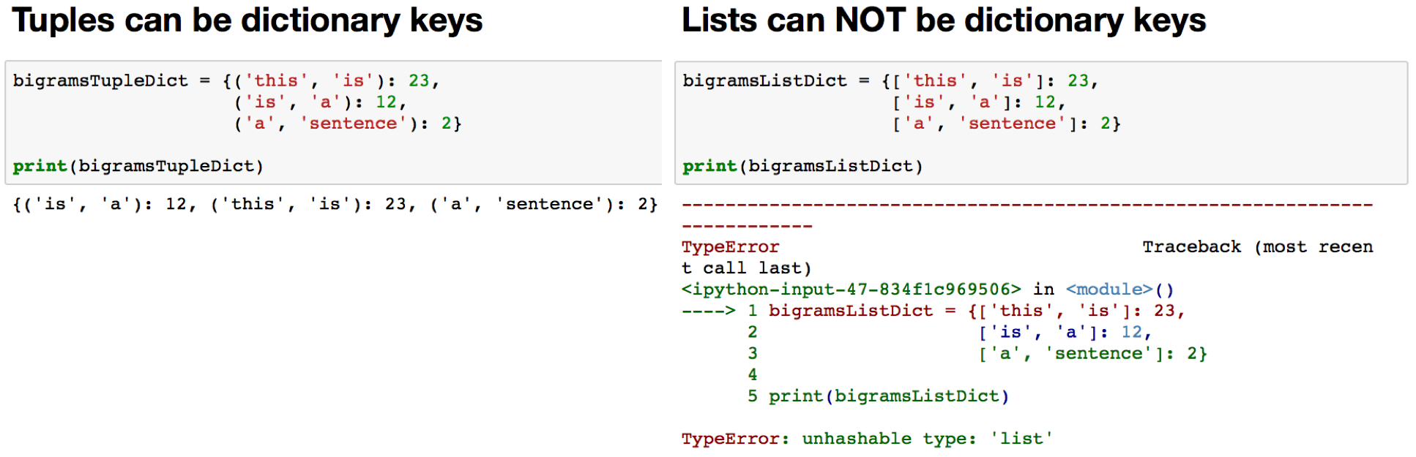
Tuples vs Lists
Some tuples can be used as dictionary keys (specifically, tuples that contain immutable values like strings, numbers, and other tuples). Lists can never be used as dictionary keys, because lists are not immutable.

Slide 23
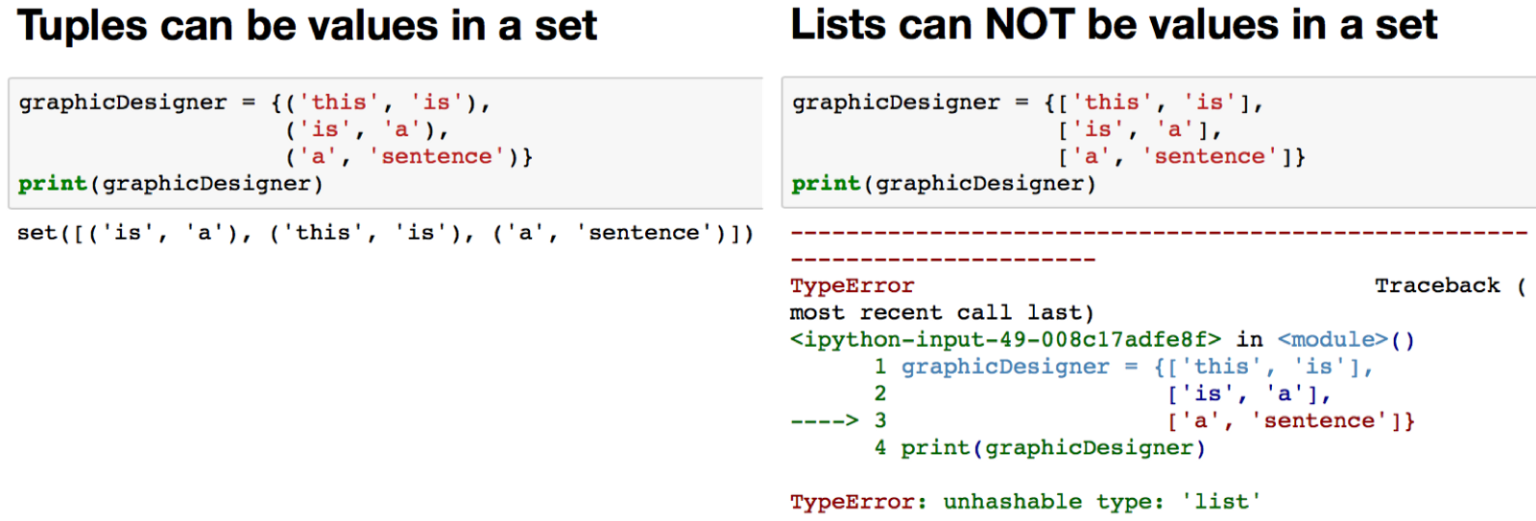
Tuples vs Lists
Tuples can be used as values in sets whereas lists can not.

Slide 24
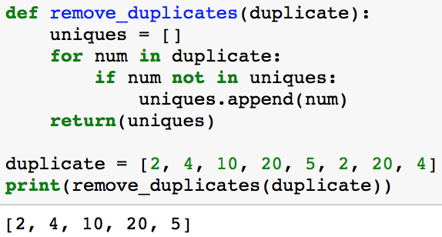
Python Functions
The purpose of functions is code re-use.
Functions can have zero or more arguments
Functions are created with the def keyword.
This is something we will go over throughout the course.
Python code to remove duplicates from a list. Could you do this another way?
Notes:
Another thing that is worth mentioning when you’re working with the return statement is the fact that you can use it to return multiple values. To do this, you make use of tuples.
Functions return tuples.
You use functions in programming to bundle a set of instructions that you want to use repeatedly or that, because of their complexity, are better self-contained in a sub-program and called when needed.
Code re-use Zero or more arguments May return data to caller
Created with the ‘def’ keyword

Slide 25
Python Collections Resources
Strings: https://codeburst.io/python-basics-1-hello-world-and-strings-de0d17857c93
Lists: https://hackernoon.com/python-basics-6-lists-and-list-manipulation-a56be62b1f95
Tuples: https://hackernoon.com/python-basics-9-tuples-tuple-manipulation-and-the-fibonacci-sequence-2d0da4e2d326
Dictionaries: https://hackernoon.com/python-basics-10-dictionaries-and-dictionary-methods-4e9efa70f5b9
Sets: https://towardsdatascience.com/python-sets-and-set-theory-2ace093d1607
Functions: https://www.python-course.eu/python3_functions.php
Notes:
Another thing that is worth mentioning when you’re working with the return statement is the fact that you can use it to return multiple values. To do this, you make use of tuples.
Functions return tuples.
You use functions in programming to bundle a set of instructions that you want to use repeatedly or that, because of their complexity, are better self-contained in a sub-program and called when needed.
Code re-use Zero or more arguments May return data to caller
Created with the ‘def’ keyword

Slide 26
Code Along
Open the notebook
Start the exercises!
Don’t worry if you are struggling, there is a video that goes over the exercises.
We will get to more fun stuff after going over the basics
Notes:
Need word count in this: https://codeburst.io/python-basics-11-word-count-filter-out-punctuation-dictionary-manipulation-and-sorting-lists-3f6c55420855
Another thing that is worth mentioning when you’re working with the return statement is the fact that you can use it to return multiple values. To do this, you make use of tuples.
Functions return tuples.
You use functions in programming to bundle a set of instructions that you want to use repeatedly or that, because of their complexity, are better self-contained in a sub-program and called when needed.
Code re-use Zero or more arguments May return data to caller
Created with the ‘def’ keyword

Slide 27
Extra Slides

Slide 29
Python Sets
Sets are a mutable collection of distinct (unique) immutable values that are unordered.
Because sets cannot have multiple occurrences of the same element, it makes sets highly useful to efficiently remove duplicate values from a list or tuple and to perform common math operations like unions and intersections.
dataScientist = set(['Python', 'R', 'SQL', 'Git', 'Tableau', 'SAS'])
dataEngineer = set(['Python', 'Java', 'Scala', 'Git', 'SQL', 'Hadoop'])
To intialize a set with values, you can pass in a list to set()
Notes:
Lists and tuples are standard Python data types that store values in a sequence. Sets are another standard Python data type that also store values. The major difference is that sets, unlike lists or tuples, cannot have multiple occurrences of the same element and store unordered values.
https://towardsdatascience.com/python-sets-and-set-theory-2ace093d1607

Slide 30
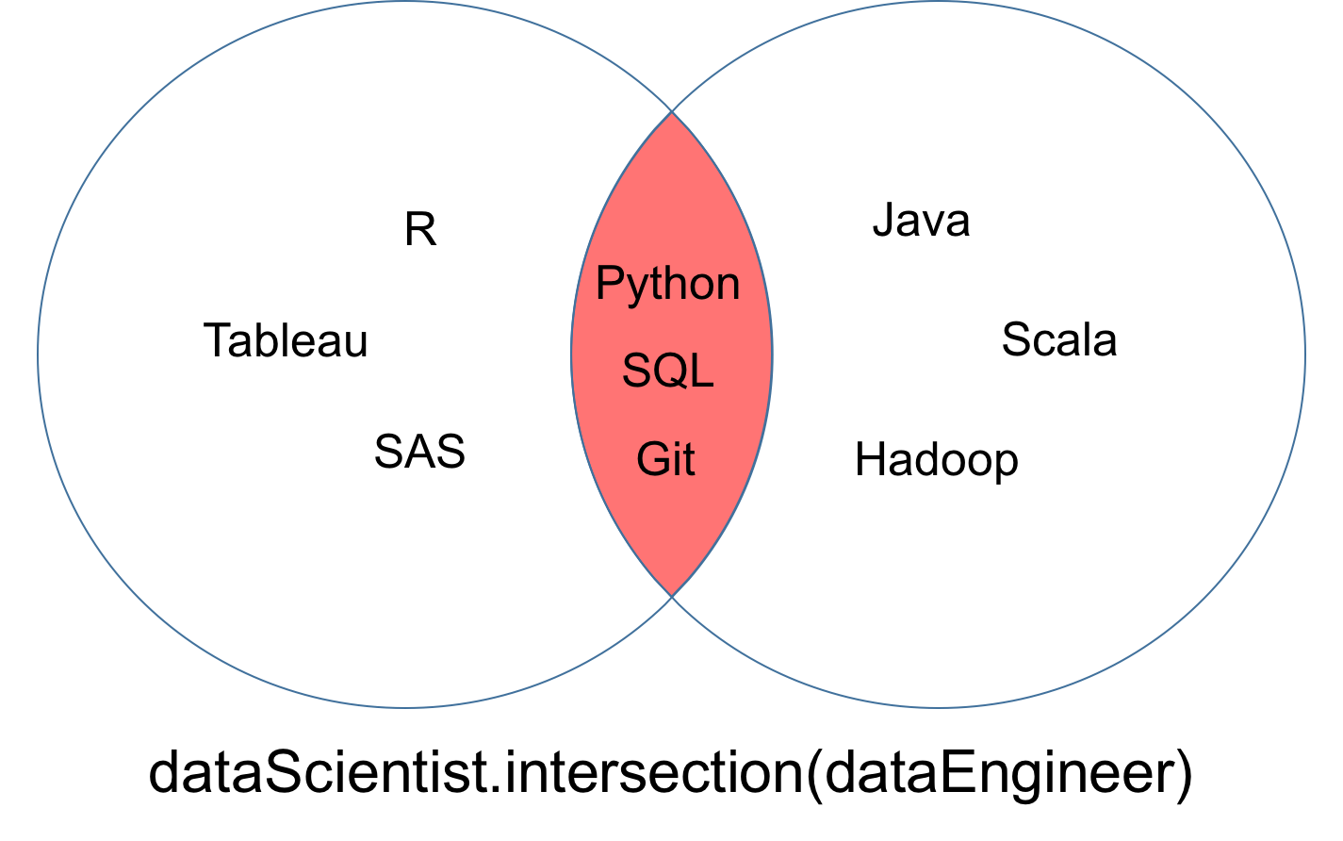
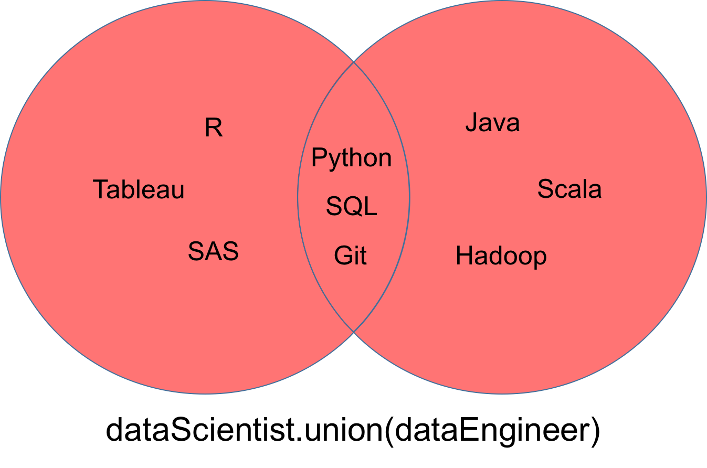
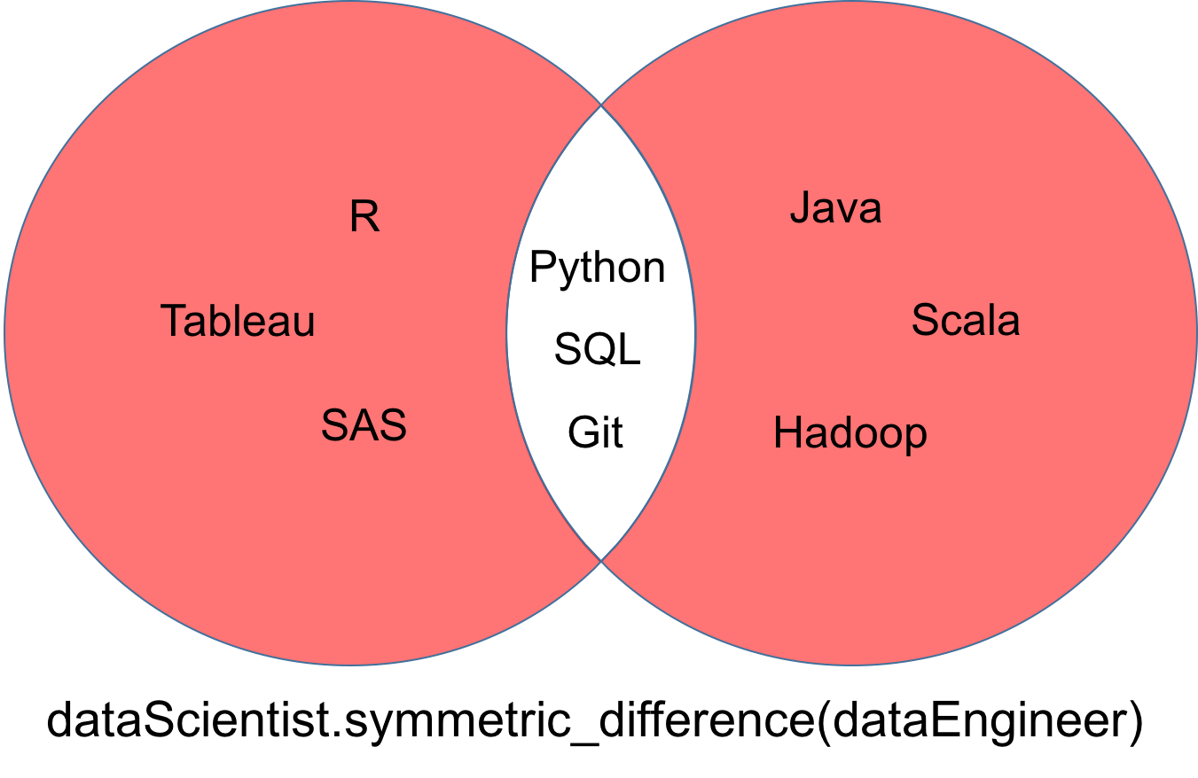
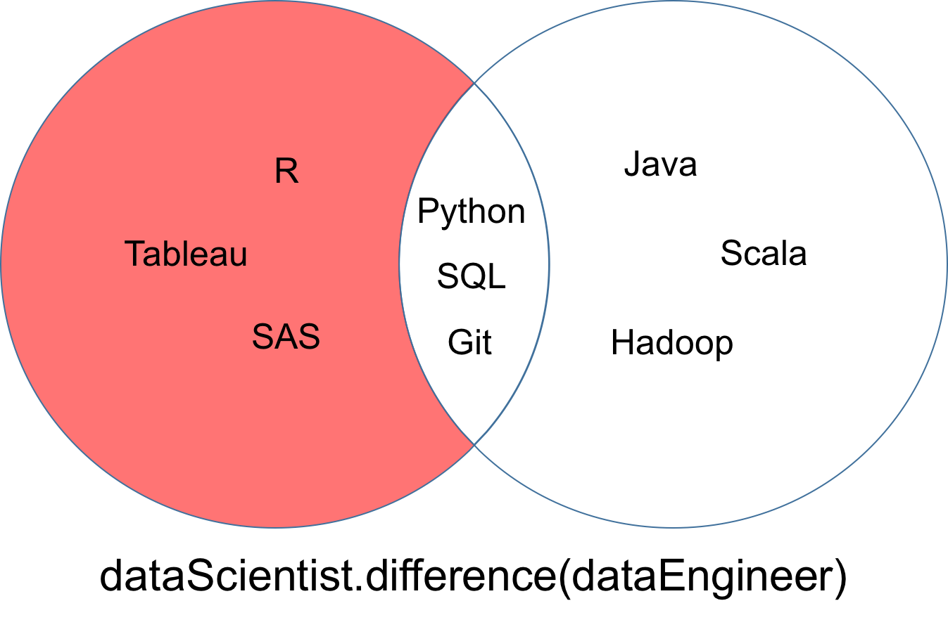
Python Sets
A common use of sets in Python is computing standard math operations such as union, intersection, difference, and symmetric difference.
The red part of each Venn diagram is the resultant set of a given set operation
Notes:
Lists and tuples are standard Python data types that store values in a sequence. Sets are another standard Python data type that also store values. The major difference is that sets, unlike lists or tuples, cannot have multiple occurrences of the same element and store unordered values.
https://towardsdatascience.com/python-sets-and-set-theory-2ace093d1607

