Slide 1
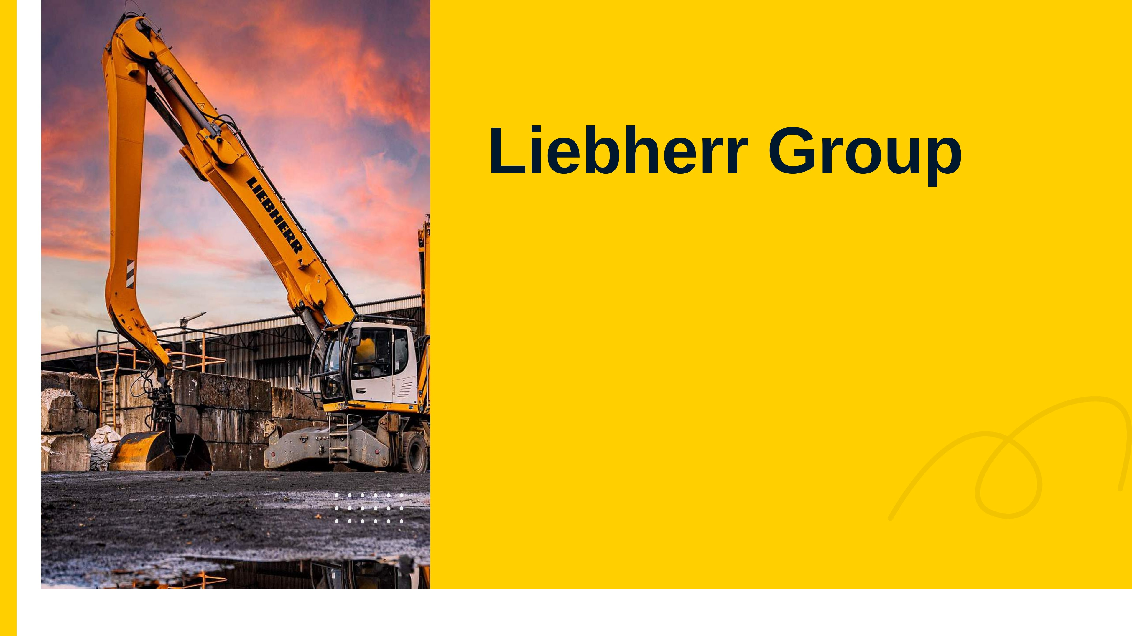


Notes:
Good morning everyone. We are Simon, Adam, Zofia, Philipp and Zarah, and we present our analysis of the Liebherr Group for 2022 to 2025.
Our report is written for a long-term investor who thinks about buying a minority stake. So our question is simple: should this investor invest – and if not, why not yet?

Slide 2
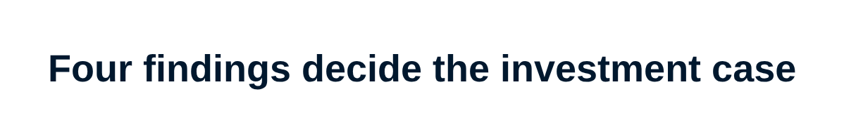
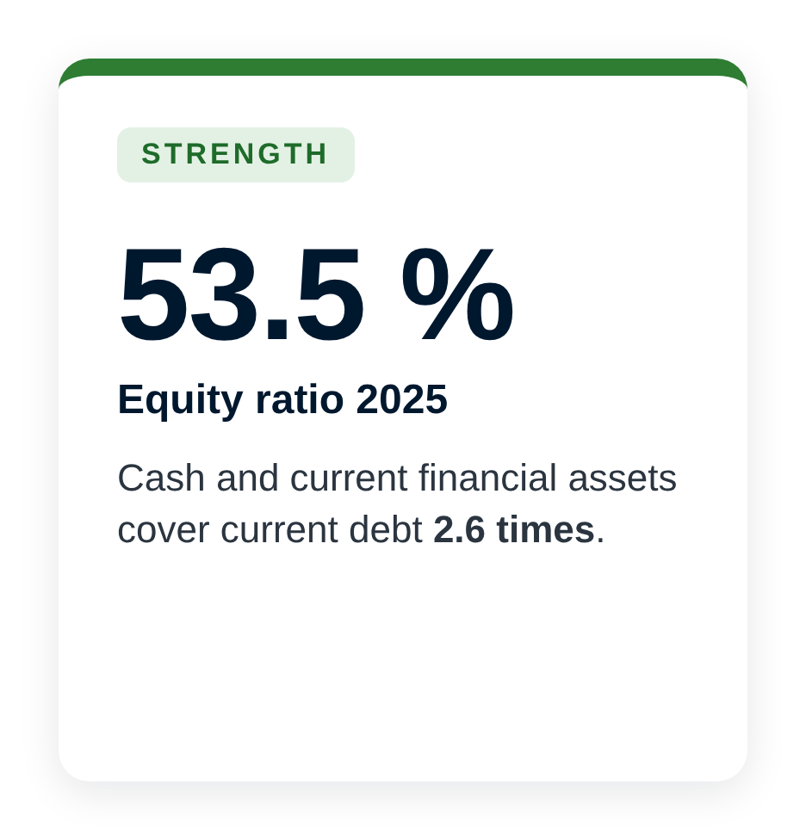
Notes:
We give you the answer first: not yet.
Liebherr is financially sound. Equity finances 53.5 per cent of total assets, and cash covers current debt 2.6 times, so the risk of financial distress is low.
But a strong balance sheet is not a good investment by itself. The operating margin was only 2.8 per cent – less than a fifth of Caterpillar and the industry – and free cash flow was negative in three of four years. Our accounting tests put the margin even lower, between 1.6 and 2.8 per cent.
So our advice: do not invest now, and reassess on the 2026 statements. Let us show you why.

Slide 3
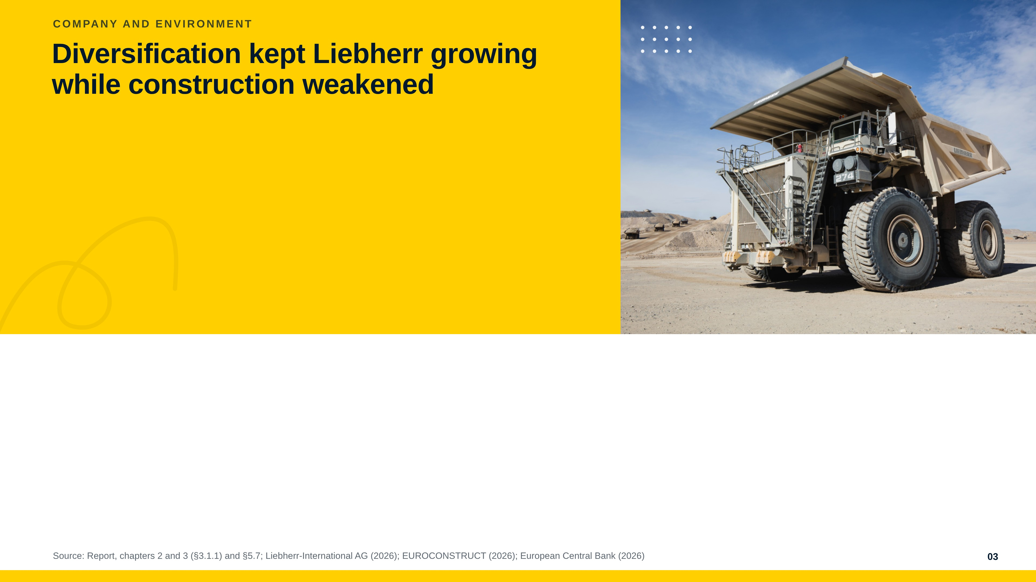
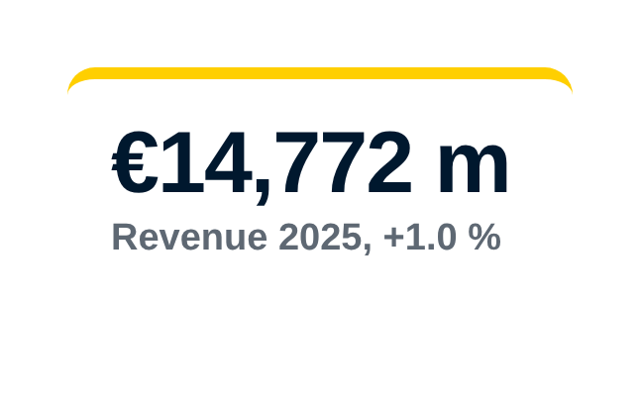
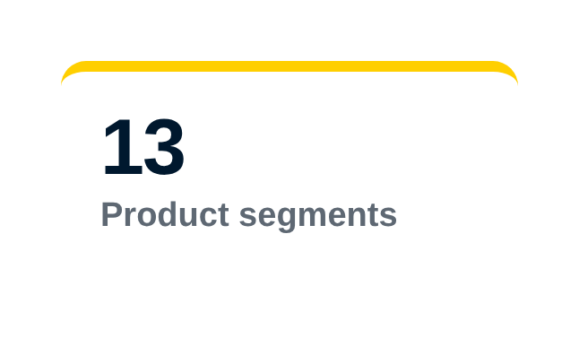
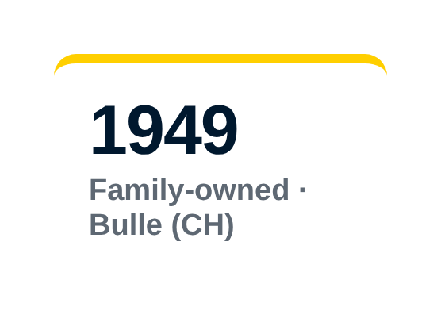
Notes:
Liebherr is a family-owned, unlisted group, founded in 1949, with almost 56,000 employees in 13 product segments.
In 2025 construction and mining – almost two thirds of revenue – fell by 5.5 per cent, but the other segments grew by 14.7 per cent. That is why the group still grew a little.
The environment is difficult: slow European construction growth, US tariffs and low-cost competitors, and higher interest rates for customers. Liebherr itself expects no real upswing before 2027. So how does Liebherr compete in this market?

Slide 4
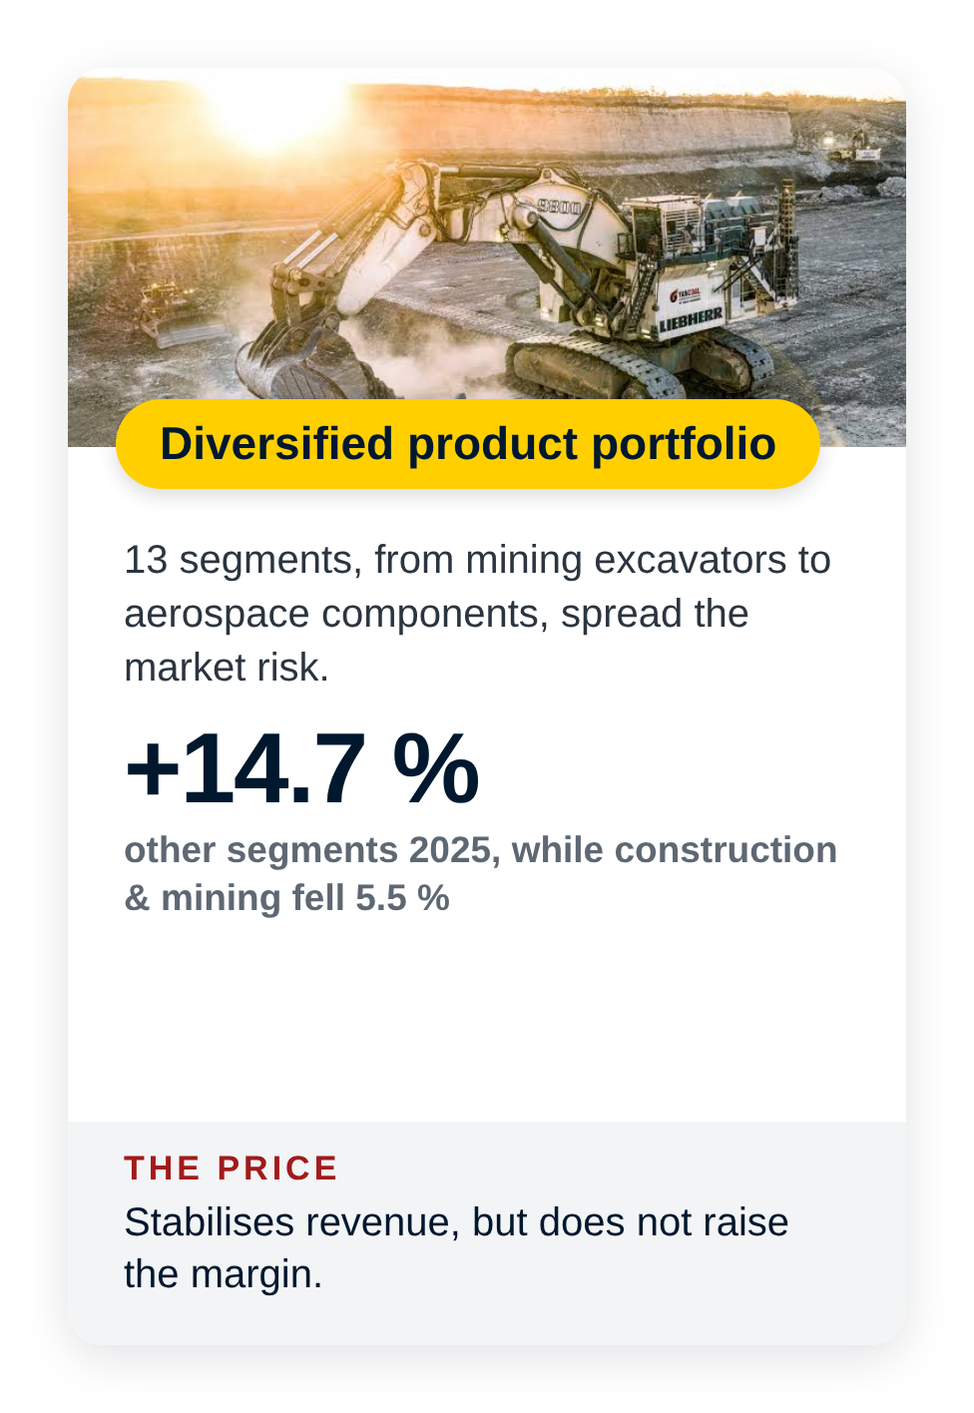
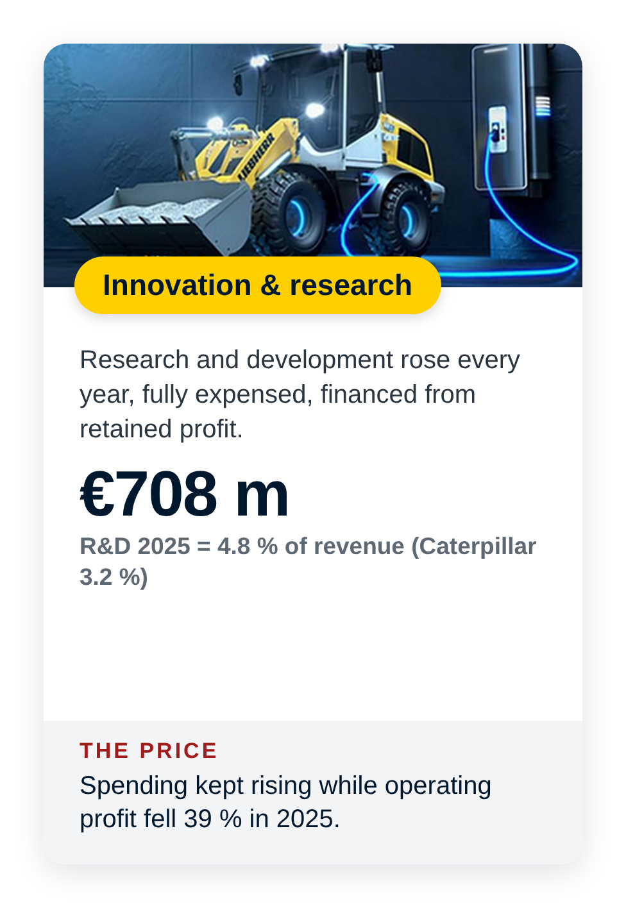
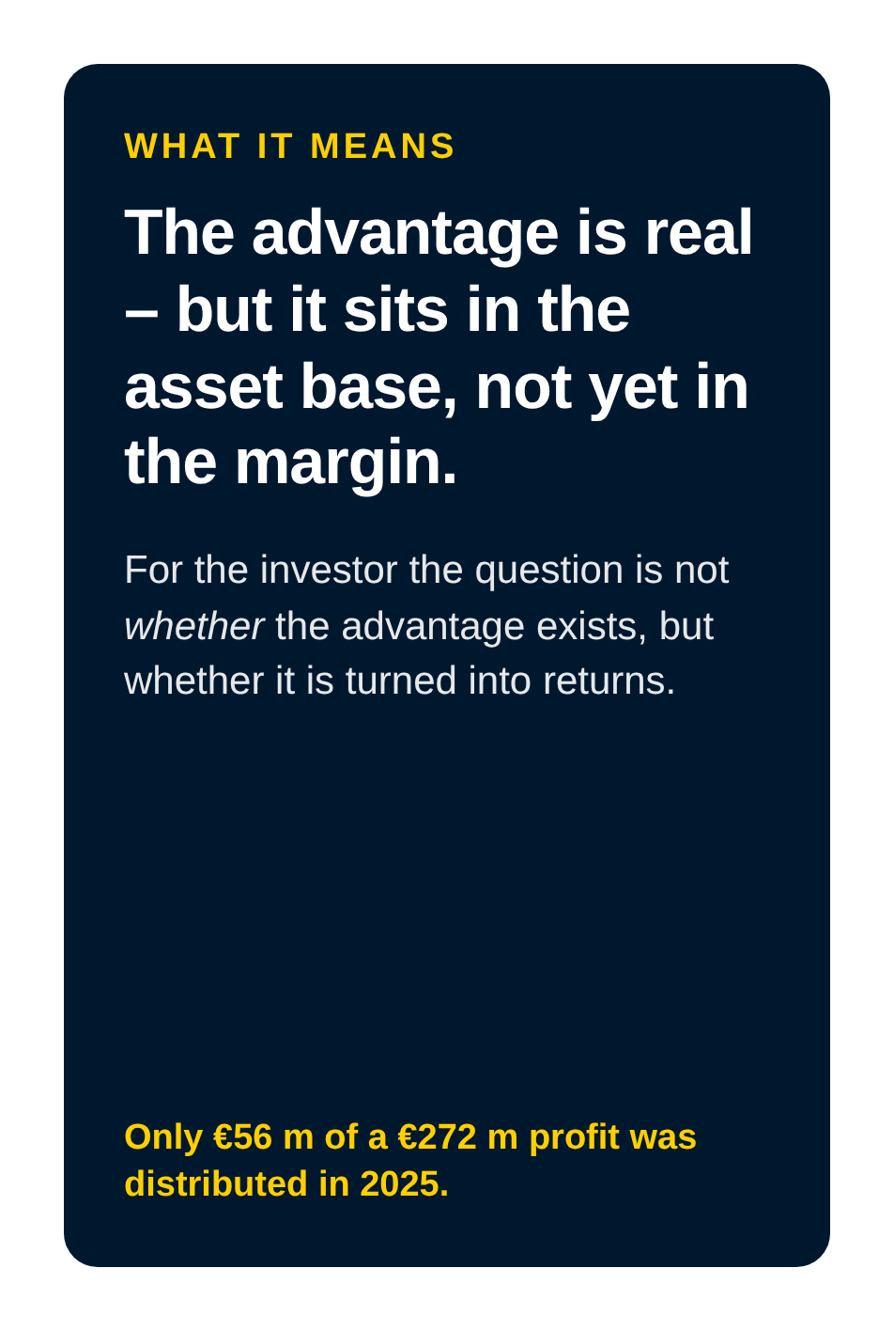
Notes:
Liebherr competes with differentiation in custom businesses like cranes and mining, and with scale in volume businesses like earthmoving. Three advantages support this.
First, diversification: 13 segments spread the risk – in 2025 the other segments grew while construction fell. Second, vertical integration: Liebherr builds key technologies itself and sells through its own companies, not through dealers. Third, innovation: R&D rose every year to 708 million euro, 4.8 per cent of revenue – more than Caterpillar.
But each advantage has a price: diversification does not raise the margin, vertical integration ties up capital, and R&D kept rising while profit fell.
So the advantage is real, but it sits in the asset base, not yet in the margin. Does it turn into returns? The numbers show it.

Slide 5
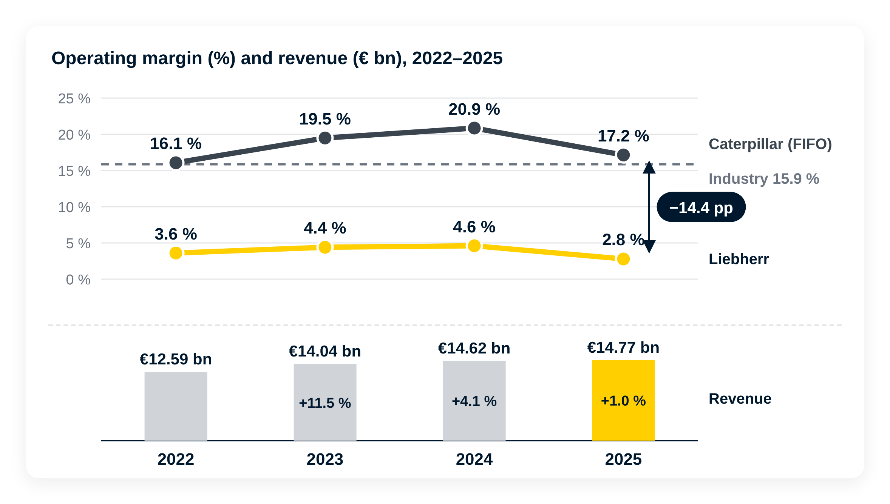
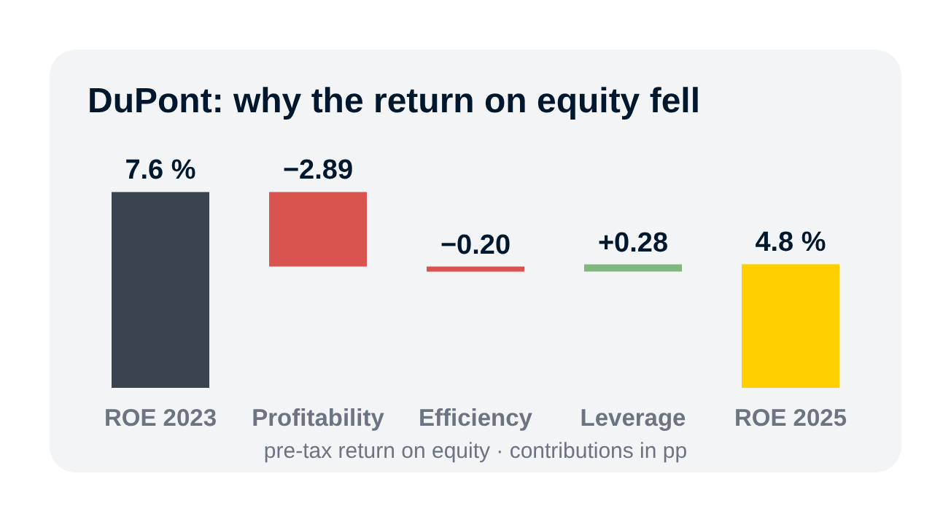
Notes:
The bars at the bottom show revenue: it grew 11.5 per cent in 2023, but only 1 per cent in 2025.
The lines above show the bigger problem. Liebherr's margin, in yellow, was around 4 per cent and fell to 2.8 per cent in 2025. Caterpillar earned 16 to 21 per cent, the industry 15.9. The gap existed in every single year – so this is not one bad year.
The bridge on the right explains 2025: personnel costs grew five times faster than revenue and cost 1.2 points, and other operating items cost another 1.25 points – without any explanation.
The DuPont analysis shows what this means for the owners: the pre-tax return on equity fell from 7.6 to 4.8 per cent, and almost all of it comes from lower profitability – not from efficiency or debt.
Each margin point is worth about 148 million euro. But can we trust the reported margin?

Slide 6
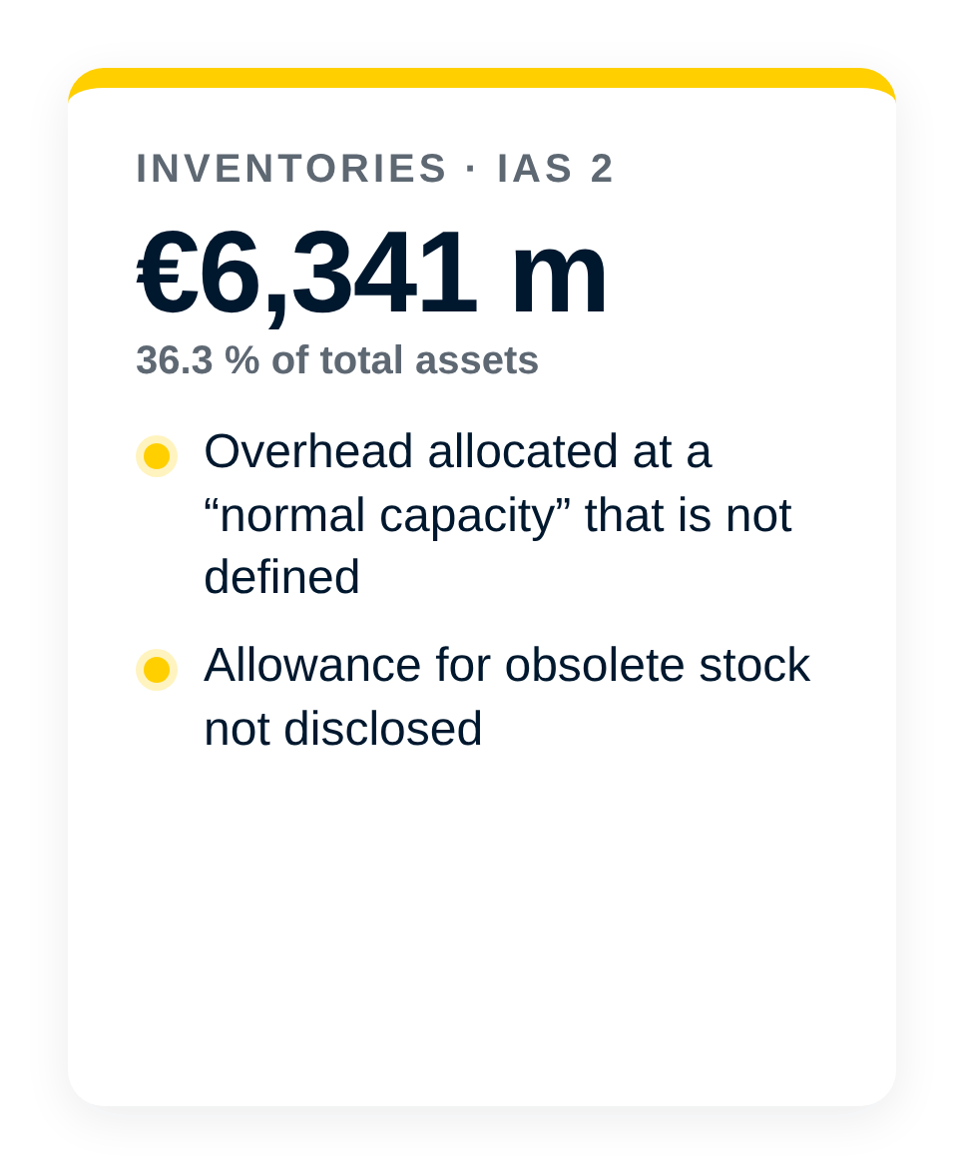
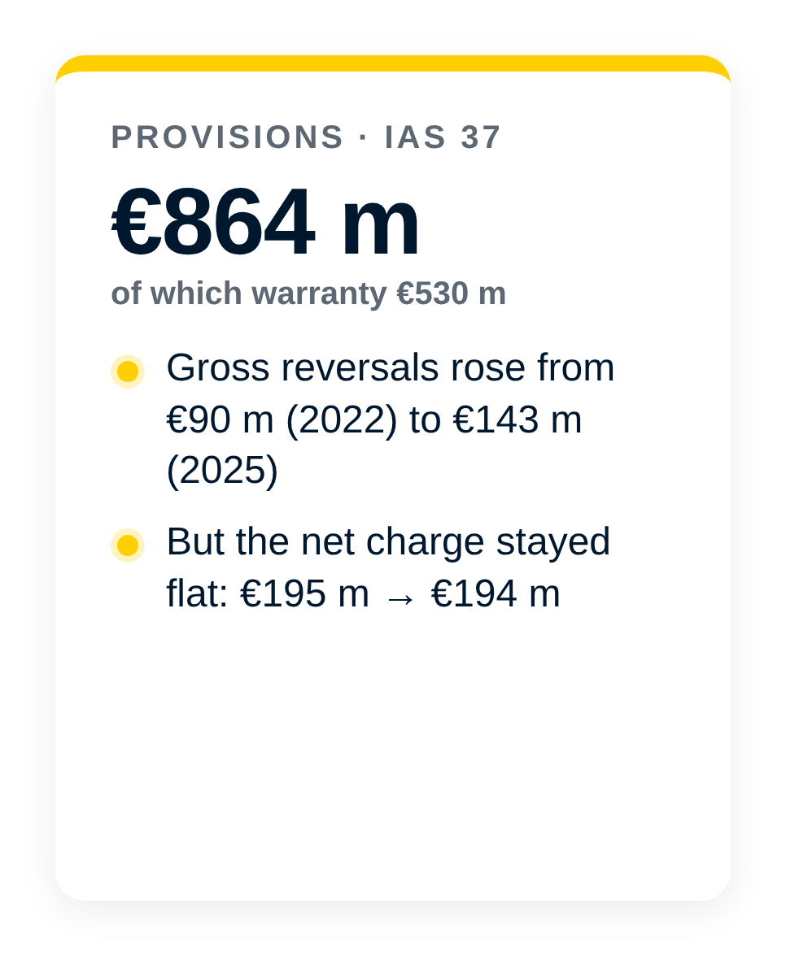
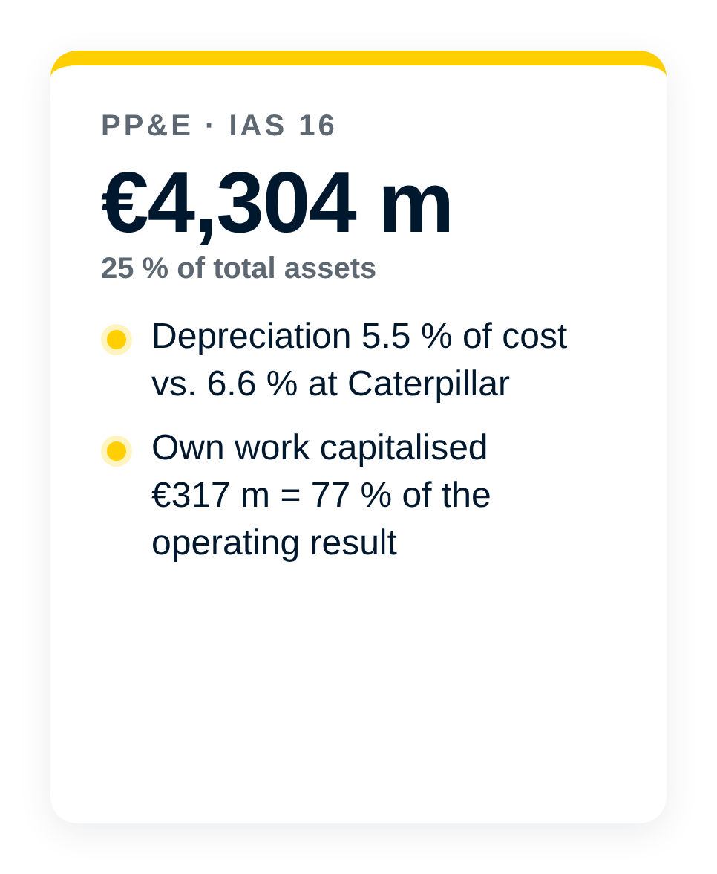

Notes:
Liebherr publishes only summary statements – the full audited statements are not public, and there is no segment note.
Three accounts carry most of the judgement. Inventories: overhead is allocated at a normal capacity that is not defined, and the allowance for old stock is not disclosed. Provisions: reversals rose to 143 million euro, but the net charge stayed flat. Fixed assets: Liebherr depreciates more slowly than Caterpillar, and own work capitalised equals 77 per cent of the operating result.
The fourth box matters most: other operating expenses rose by 228 million euro, and there is no note at all. So the biggest cost increase of 2025 cannot be explained. Four of our nine red-flag tests raised a flag.

Slide 7
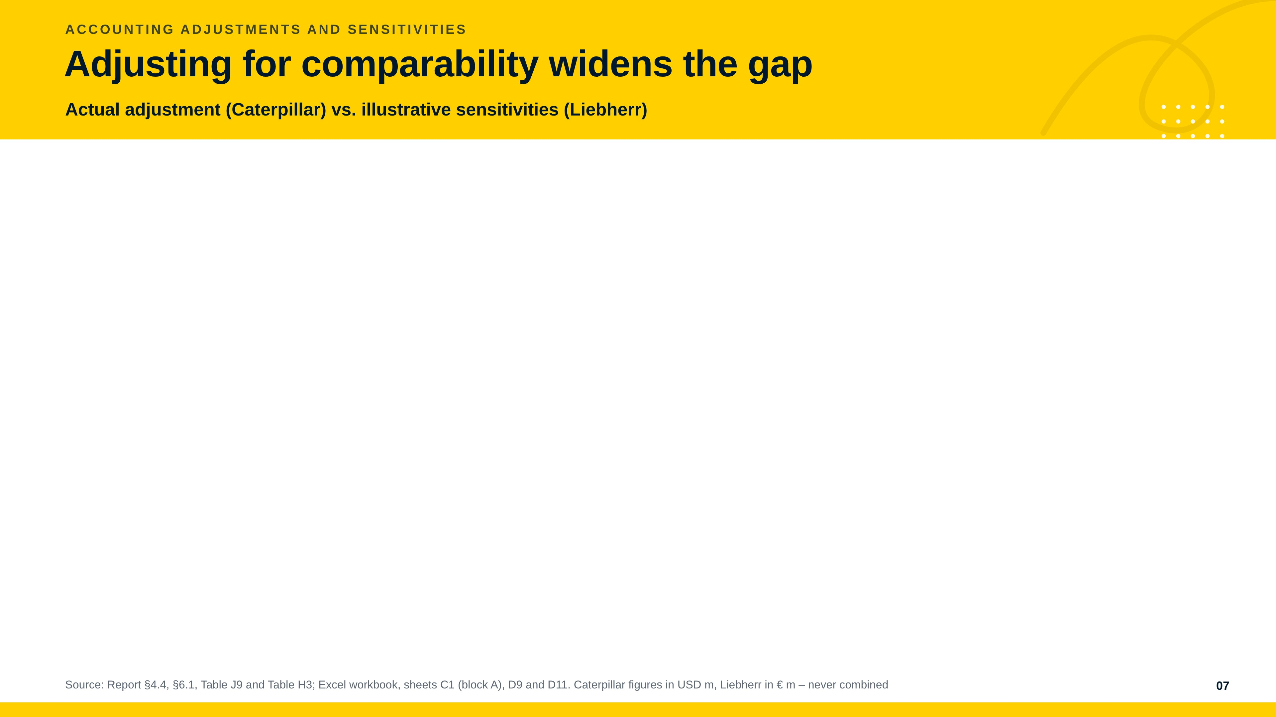
Notes:
On the left is an actual adjustment we made; on the right are sensitivities we only measured.
Caterpillar values most inventory with LIFO, which IAS 2 does not allow and Liebherr does not use. Caterpillar discloses its LIFO reserve, so the correction is exact: plus 4.3 billion dollars on inventories and equity, plus 441 million on operating profit. Its margin rises from 16.5 to 17.2 per cent – so the gap gets bigger, not smaller.
For Liebherr we only illustrate: with a normal provision charge the margin would be 2.4 per cent, at Caterpillar's depreciation rate 2.1, and both together about 1.6 per cent.
So the accounting does not hide a better company. But the balance sheet strength survives: the equity ratio stays around 50 per cent.

Slide 8
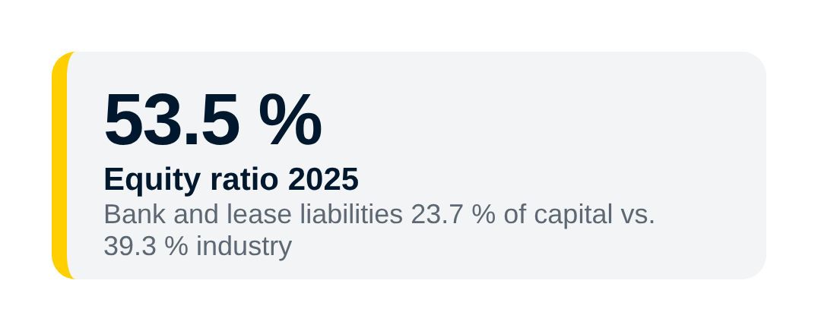
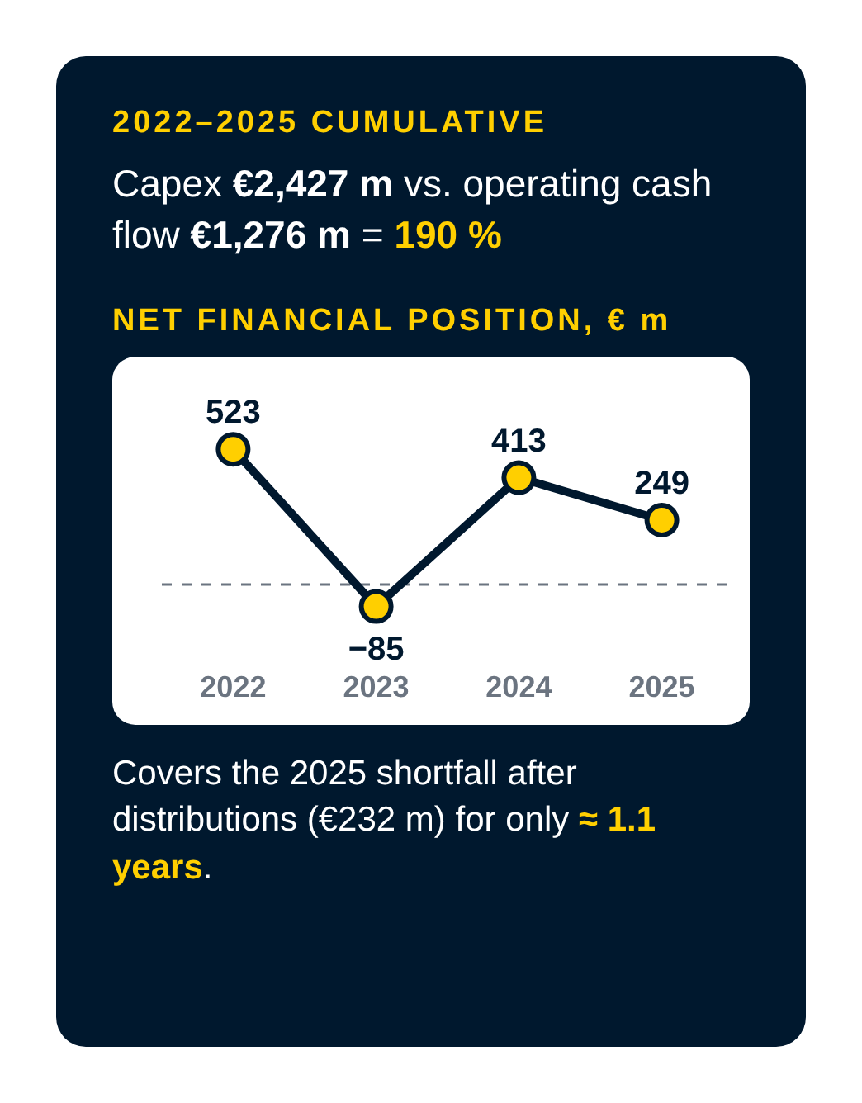
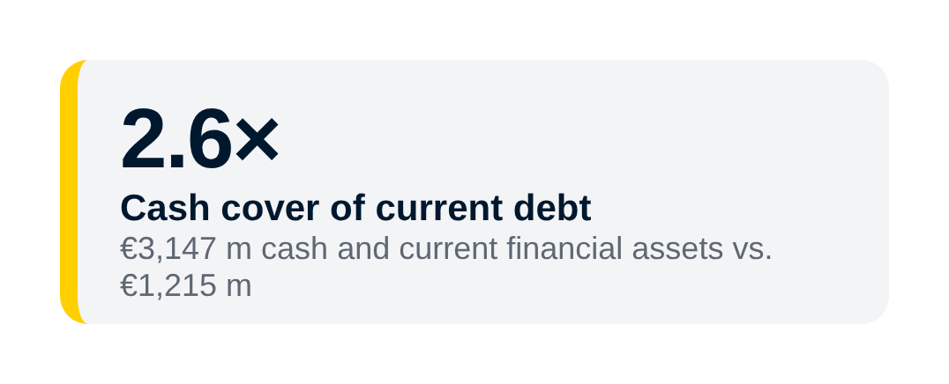

Notes:
The balance sheet is Liebherr's clearest strength: 53.5 per cent equity, much less debt than the industry, and cash covering current debt 2.6 times.
But look at the cash. Yellow is operating cash flow, grey is capital expenditure. In 2022 and 2023 operating cash flow was even negative because Liebherr built up stock. Over four years it invested 2.4 billion euro but generated only 1.3 billion from operations – 190 per cent. Free cash flow was negative in three of four years.
So the cushion shrinks: the net financial position fell from 523 to 249 million euro, and debt to EBITDA rose to 2.9, above the industry. If the 2025 shortfall repeated, the cushion would last only about 1.1 years. The balance sheet buys time – it does not replace returns.

Slide 9
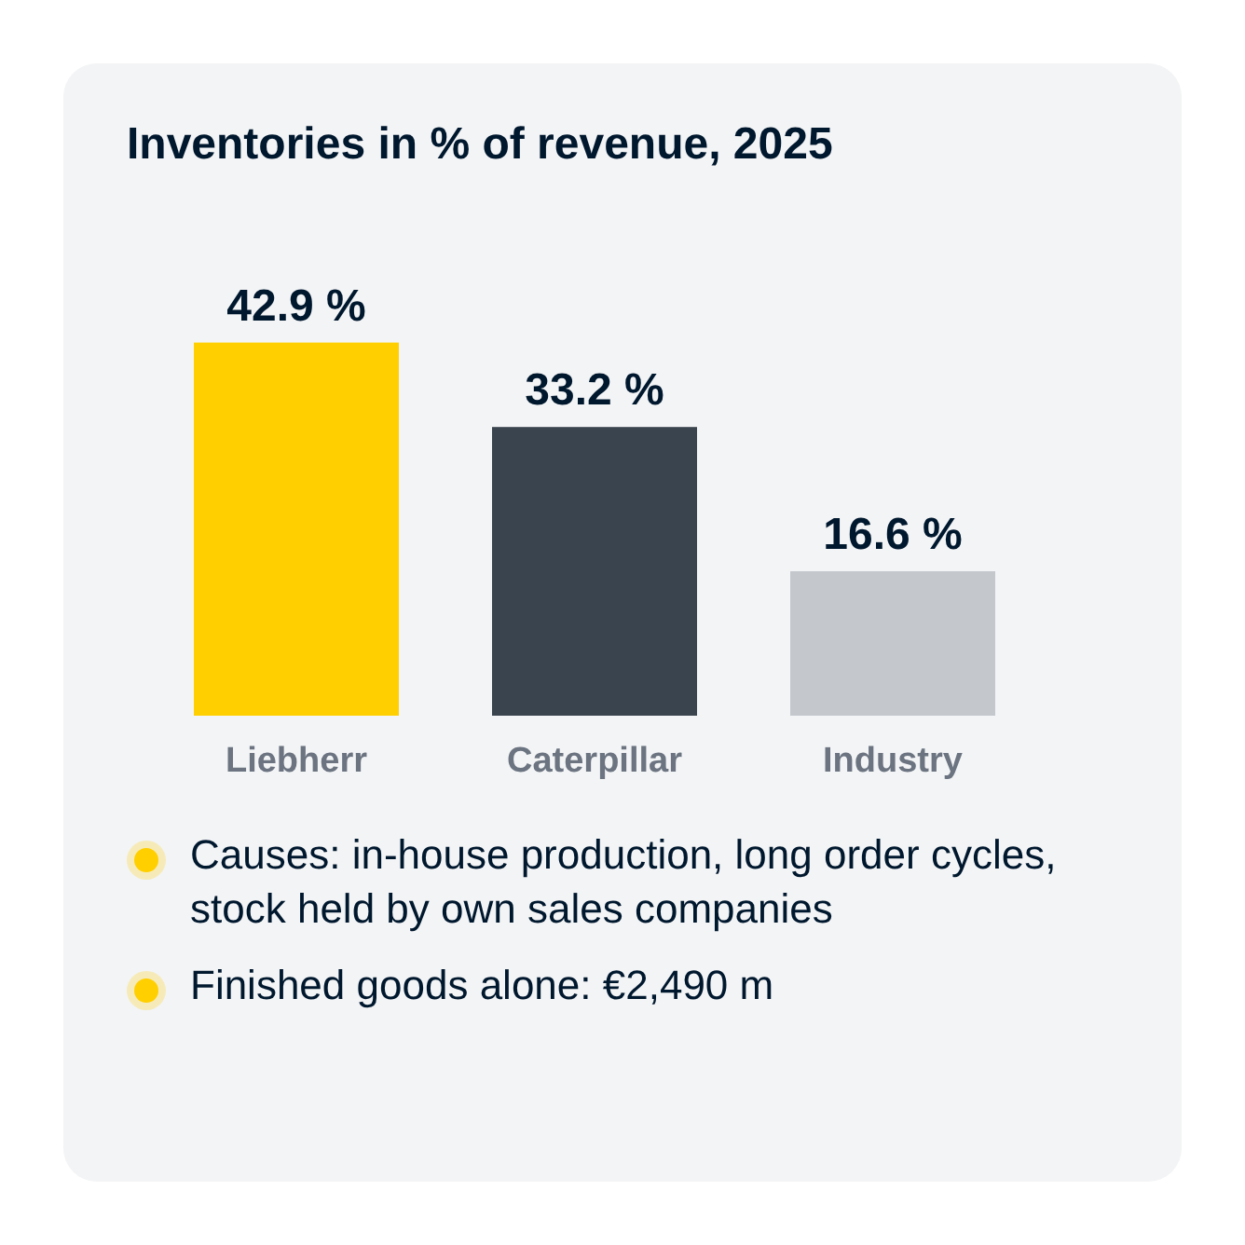
Notes:
Where is the cash tied up? Mainly in inventories: 42.9 per cent of revenue, 2.6 times the industry.
Measured in days of revenue – a proxy, because Liebherr reports no cost of sales – the cash conversion cycle is about 203 days, 77 days longer than Caterpillar. Liebherr holds stock longer and pays suppliers faster.
This is the biggest lever management controls: ten days less would release about 405 million euro. But only once – so it cannot replace a better margin.

Slide 10
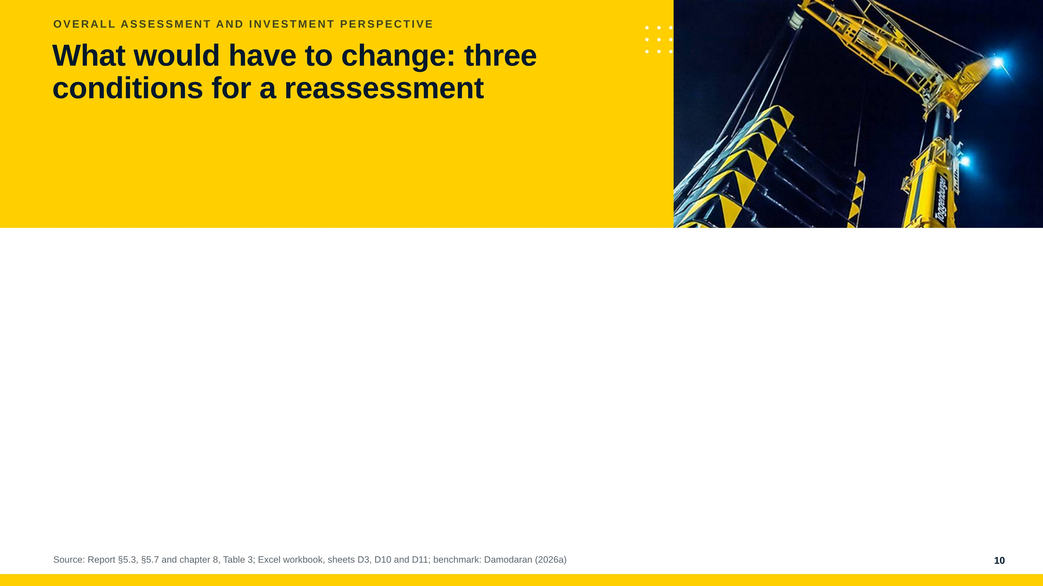
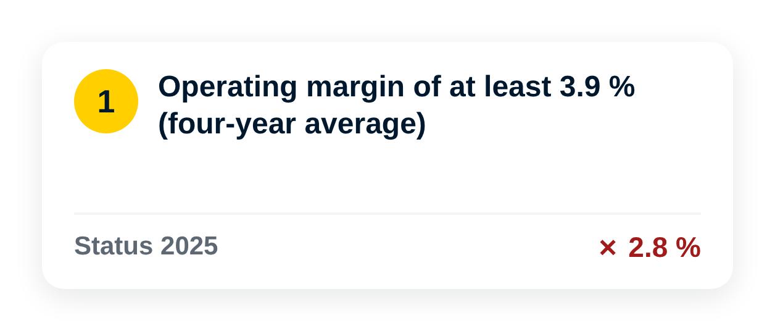
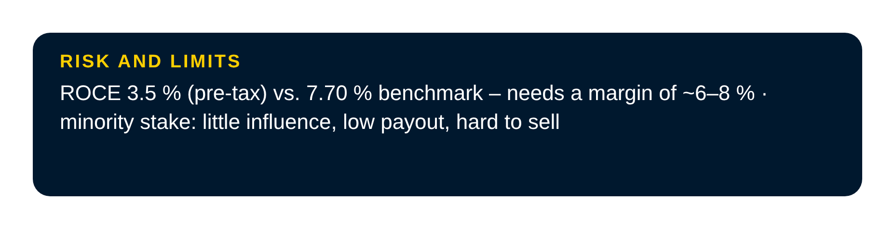
Notes:
So what would have to change before an investment makes sense? We check three conditions on the 2026 statements.
First, the margin should return to at least its four-year average of 3.9 per cent – in 2025 it was 2.8. Second, free cash flow should be positive and cover distributions – it was minus 176 million. Third, the investor needs information rights, for example on the 228 million euro of unexplained other costs.
And 3.9 per cent is only a trigger, not a good return: the return on capital employed was 3.5 per cent before tax, against a 7.7 per cent benchmark.
The reward is real – the average margin alone adds 157 million euro of profit. But a minority shareholder has little influence, a low payout and shares that are hard to sell. So meeting the conditions starts a new analysis, and the price would need a discount.

Slide 11
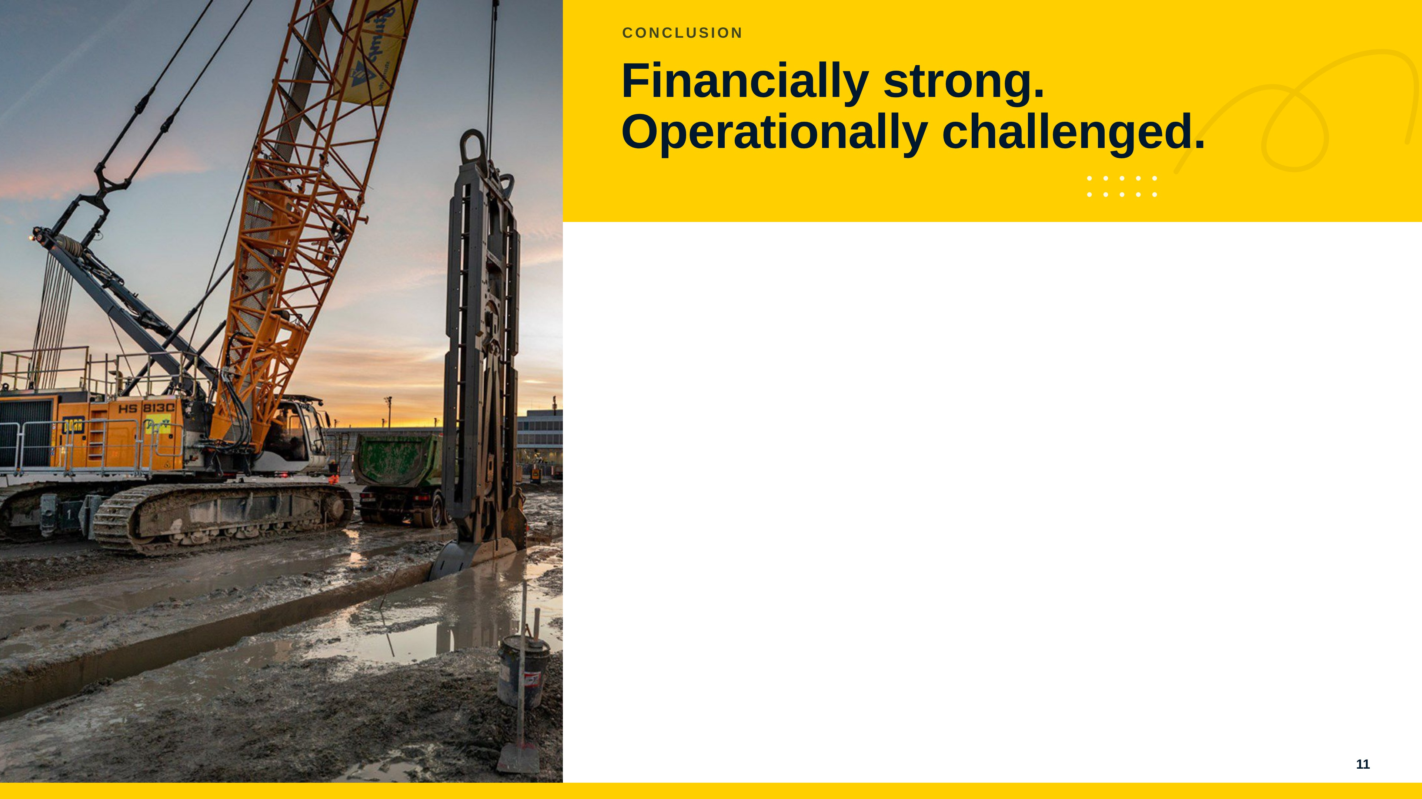
Notes:
So, our answer to the central question: Liebherr is financially strong, but operationally challenged.
Three takeaways. The balance sheet is strong and survives our accounting tests. Returns and cash generation are too weak, and the gap to Caterpillar exists in every year. And the accounting analysis sharpens the verdict rather than softening it.
If the margin stays near 2.8 per cent in 2026 and the net financial position turns negative, the investor should drop the case. In one sentence: see the turn in the figures before committing capital.

Slide 12
Notes:
Thank you for your attention. We are happy to answer your questions.
Back-up figures for Q&A: ROCE 2024 5.9 % before tax at a 4.6 % margin; sustainable growth rate 2.4 %; personnel expenses 28.6 % of revenue (26.4 % in 2023); only €56 m of a €272 m profit distributed in 2025; a deferred tax liability on Caterpillar's LIFO reserve at 21 % would lower its equity ratio only from 24.9 % to 24.2 %.

Slide 13
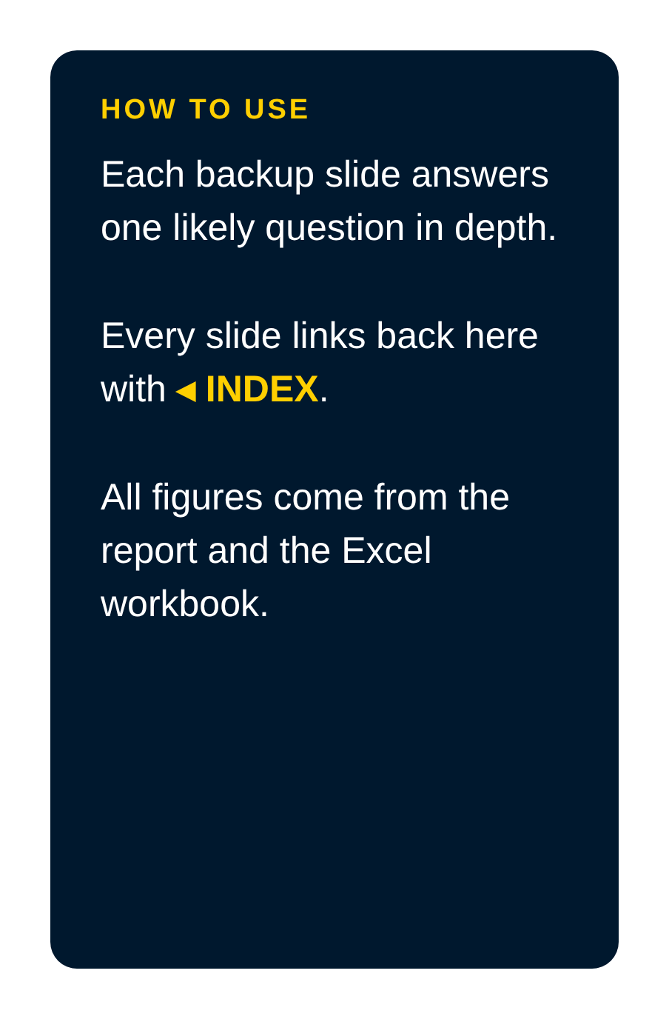


Notes:
Backup slides, not part of the 10-minute talk. Use them to answer questions: A covers the business model, B the accounting analysis, C the financial analysis, D the recommendation and scenarios, E likely questions. Click a section to jump there; every backup slide links back to this index.

Slide 14
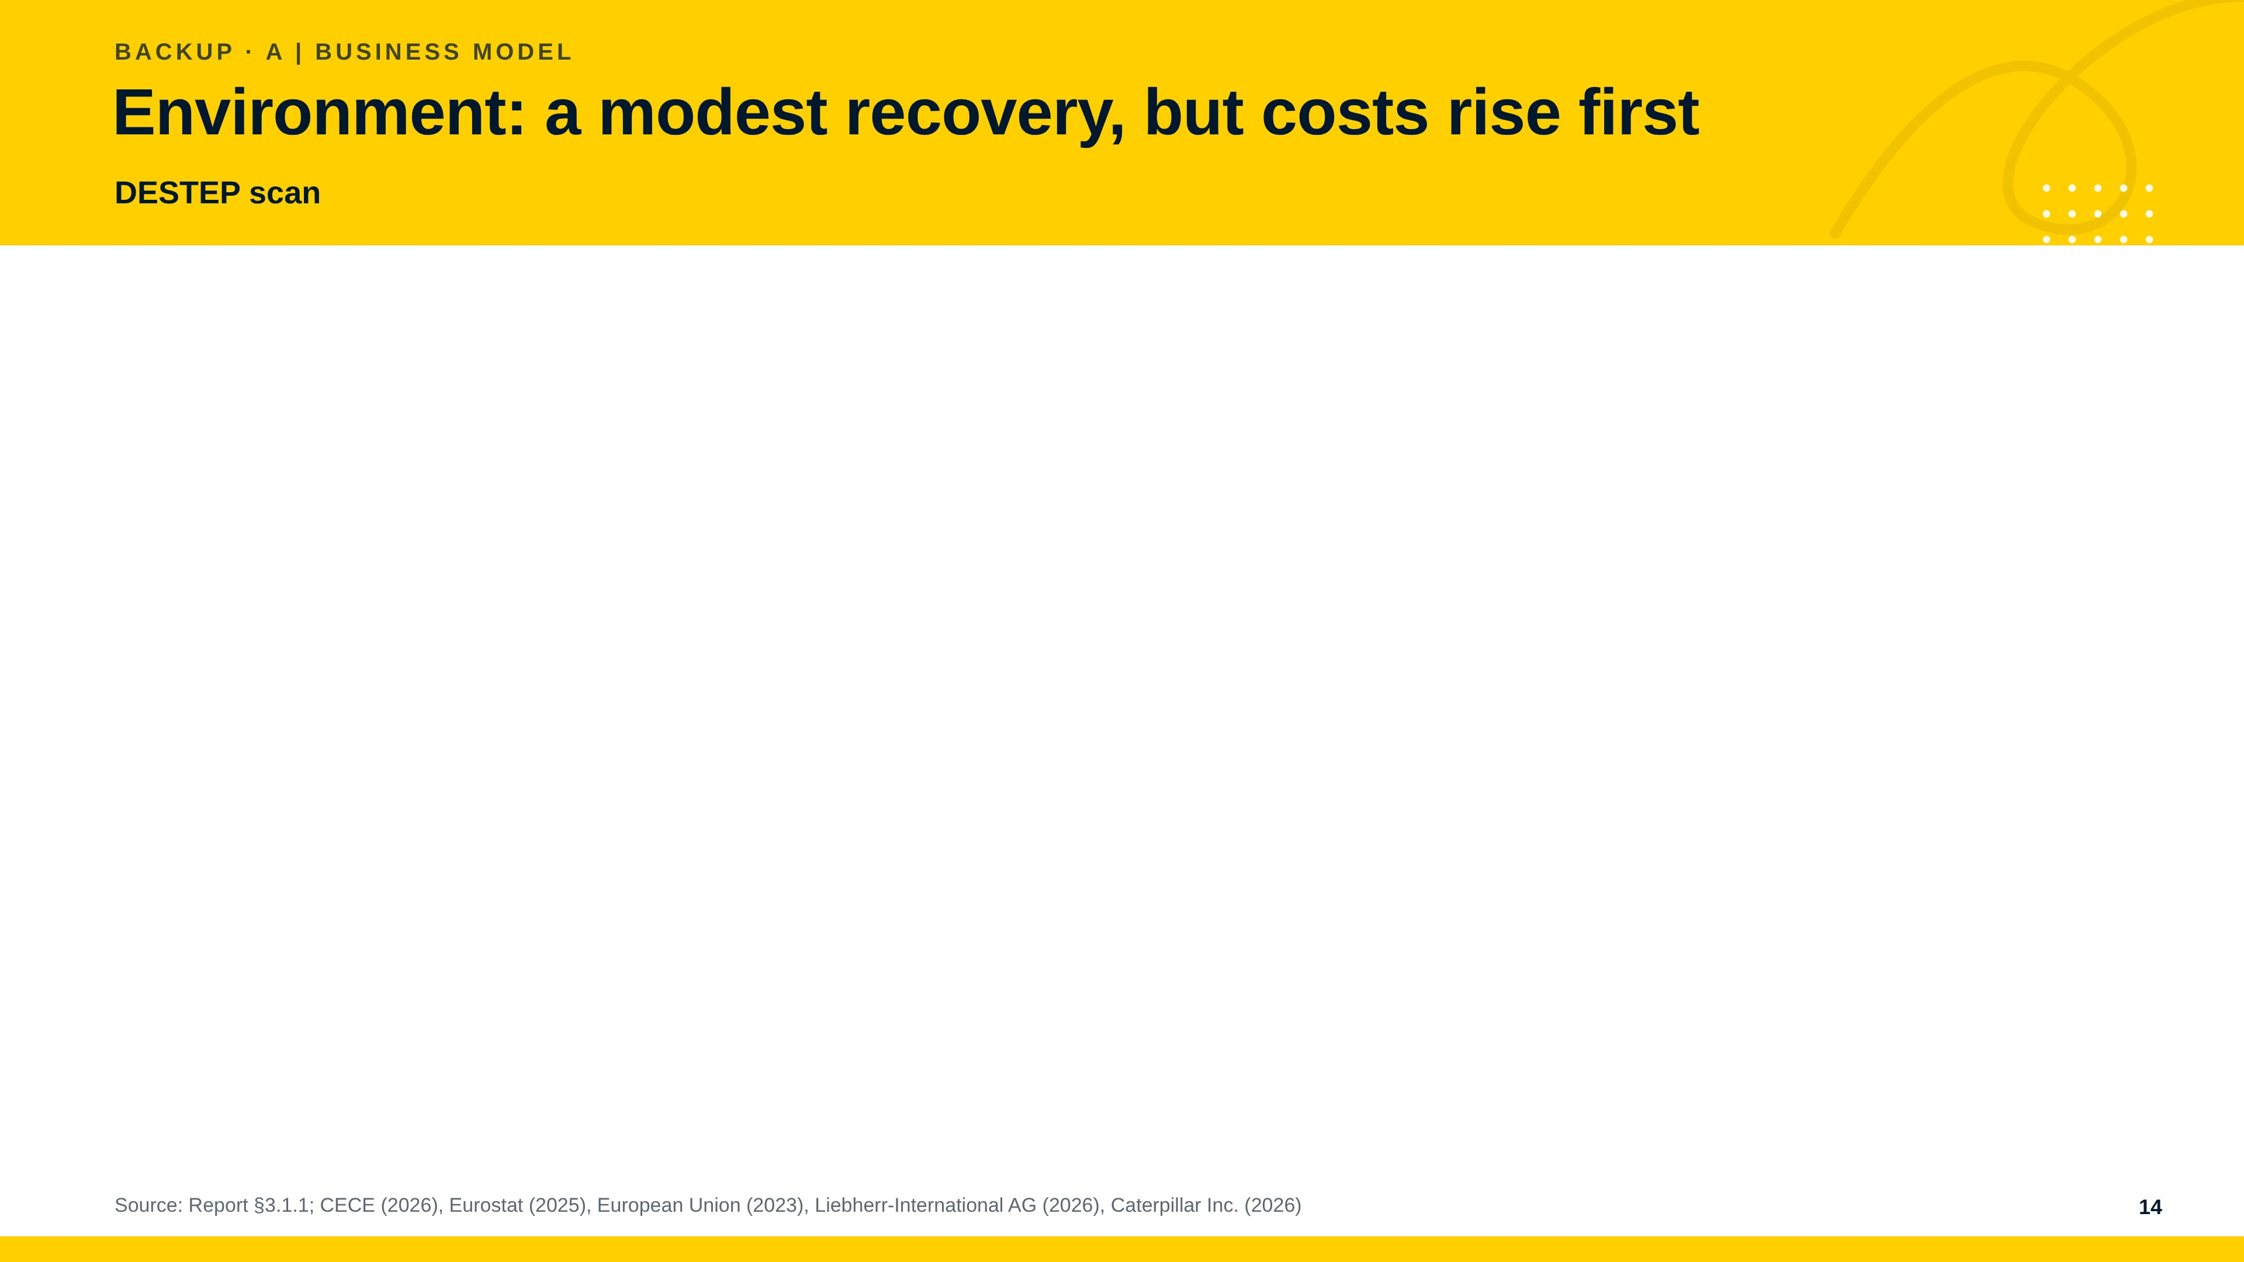

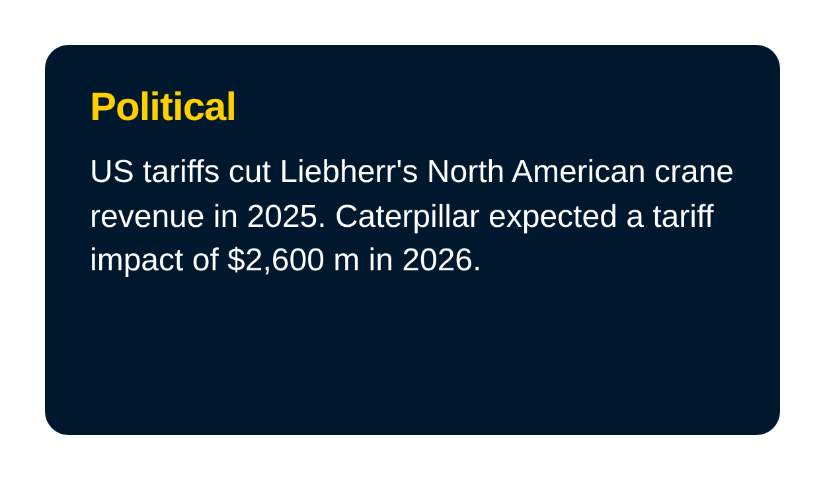
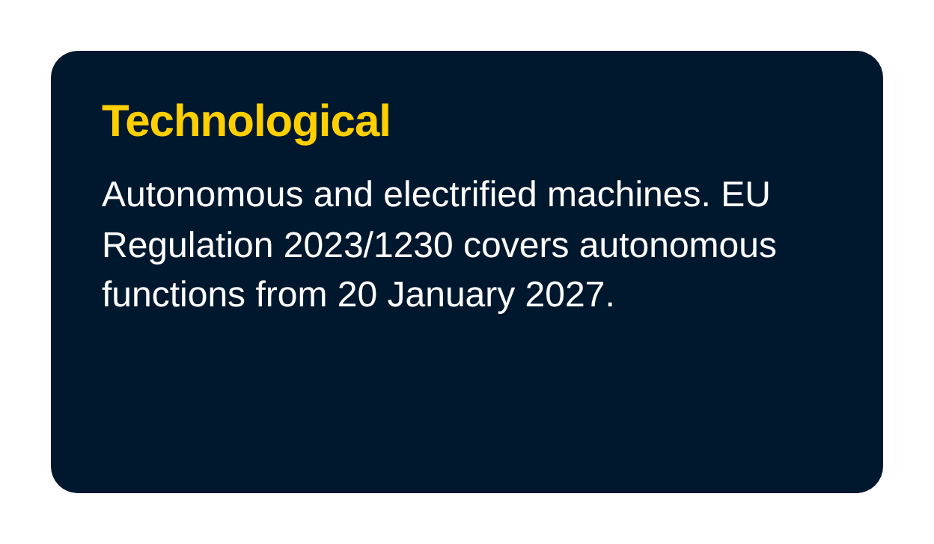
Notes:
The DESTEP scan shows a modest European recovery from 2026, set against higher financing costs, tariff uncertainty and a technology and labour transition that raises costs before it raises prices. Economic and political factors carry the largest near-term risk, technological and ecological factors the largest long-term opportunity. A market recovery alone does not show that the margin recovers.

Slide 15
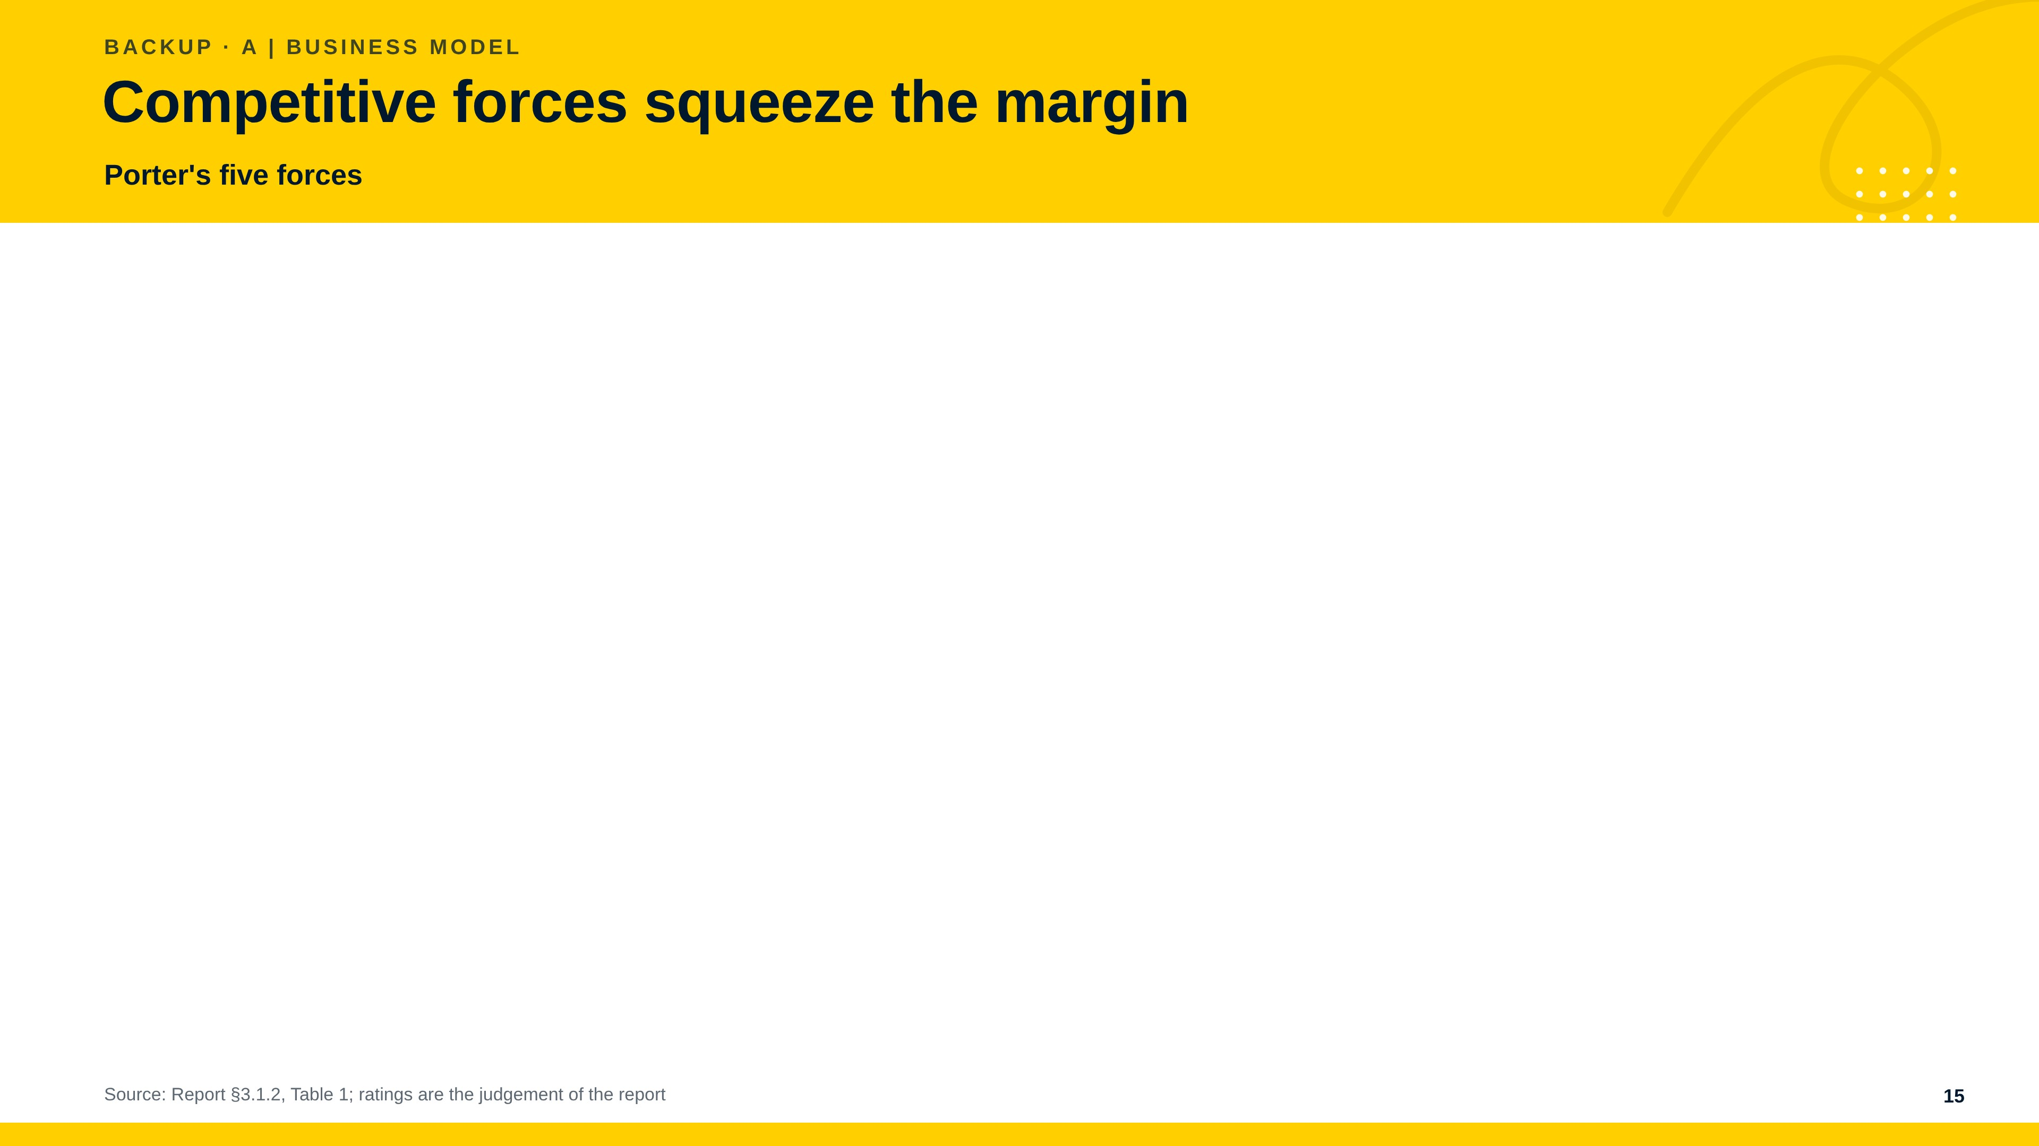
Notes:
Buyer power and rivalry are high, the threat of new entrants and supplier power are moderate and rising, and substitutes are a low to moderate threat. The industry profit potential is therefore limited and squeezed from the customer side and by low-cost entrants. This is consistent with the fall of the operating margin to 2.8 per cent in 2025 against 17.2 per cent at Caterpillar.

Slide 16
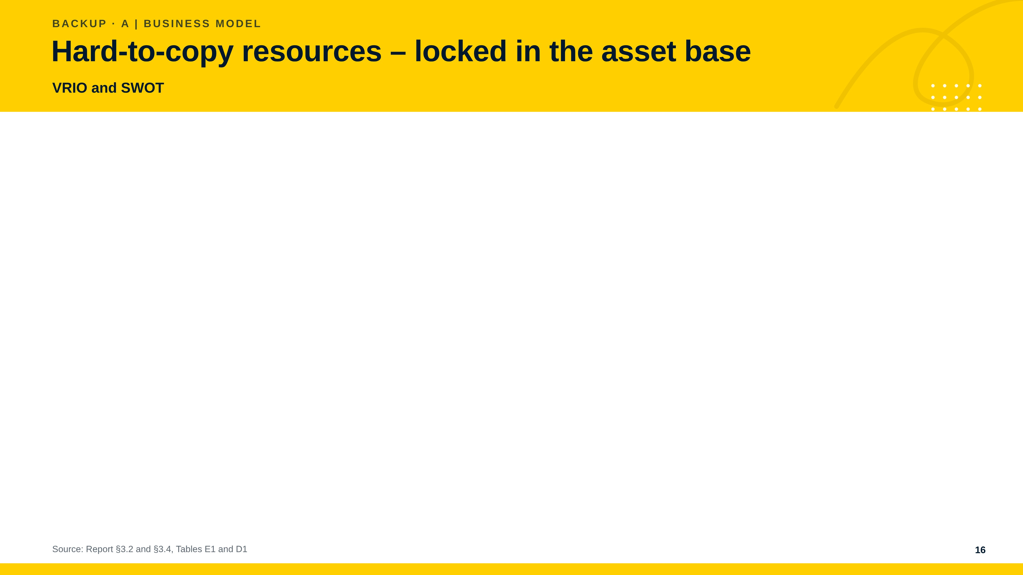
Notes:
The VRIO test shows that in-house technology, application engineering and family capital are sustained advantages, while the sales and service network is only at parity, because Caterpillar's independent dealers provide comparable access. The SWOT sums it up: vertical integration and the equity ratio are the strengths that matter, the weakness is the margin and the weakening internal funding, the opportunity is demand for low-emission and automated machines, and the threats are low-price competitors and tariffs.

Slide 17
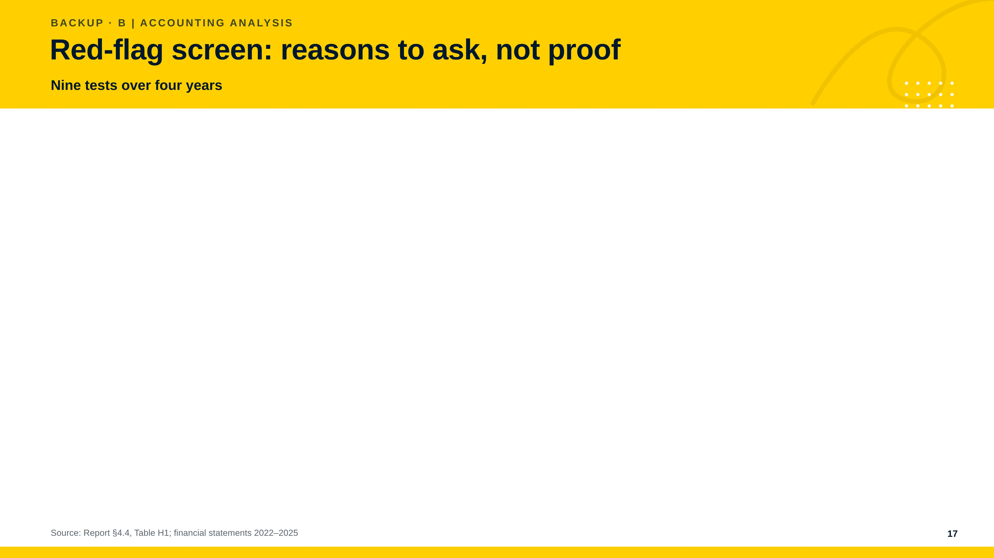
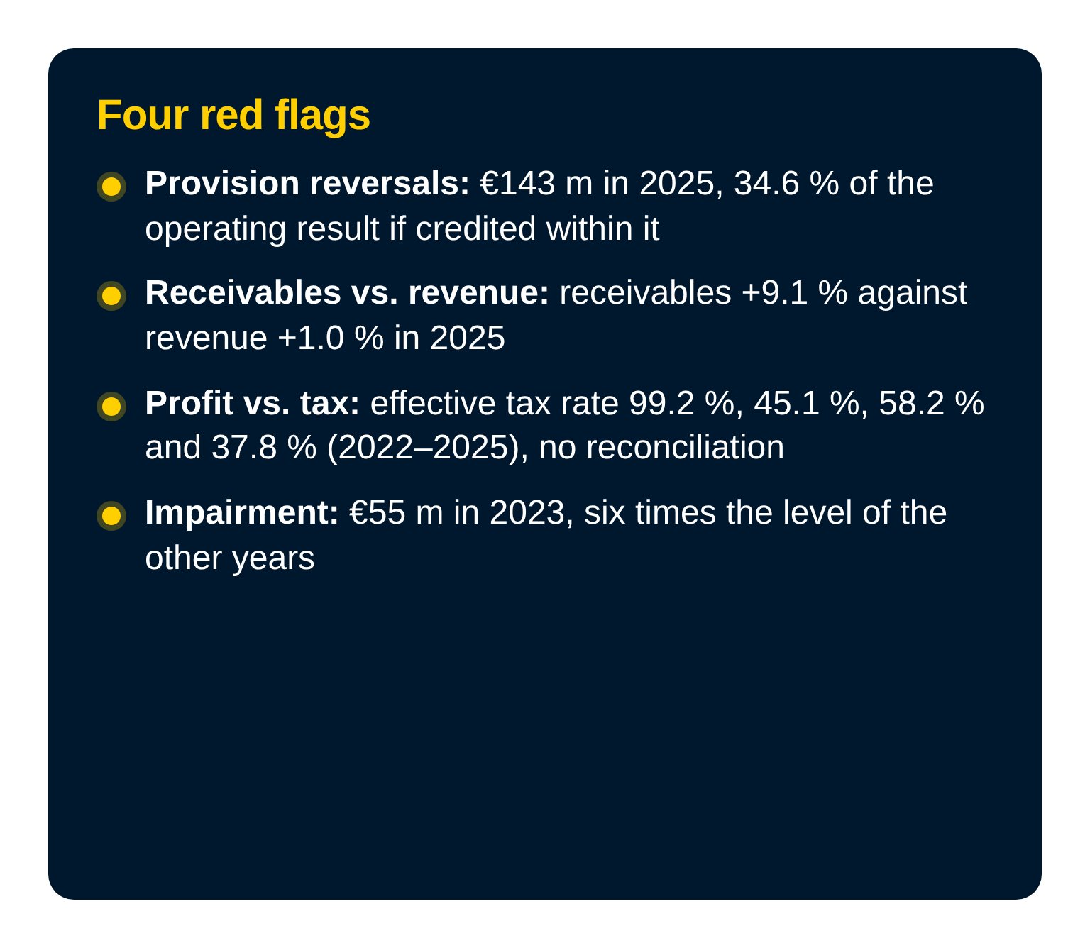
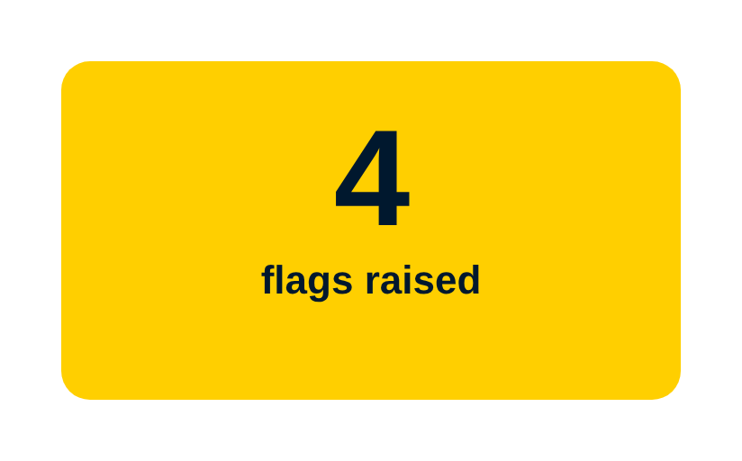
Notes:
We ran nine red-flag tests over four years. Four raised a flag, three came back clean and two cannot be run. The flags are the provision reversals of 143 million euro, receivables growing faster than revenue, an effective tax rate between 37.8 and 99.2 per cent without a reconciliation, and the impairment of 55 million euro in 2023. The tests that cannot be run are related party transactions and year-end adjustments. Red flags are reasons to ask, not proof of manipulation.

Slide 18
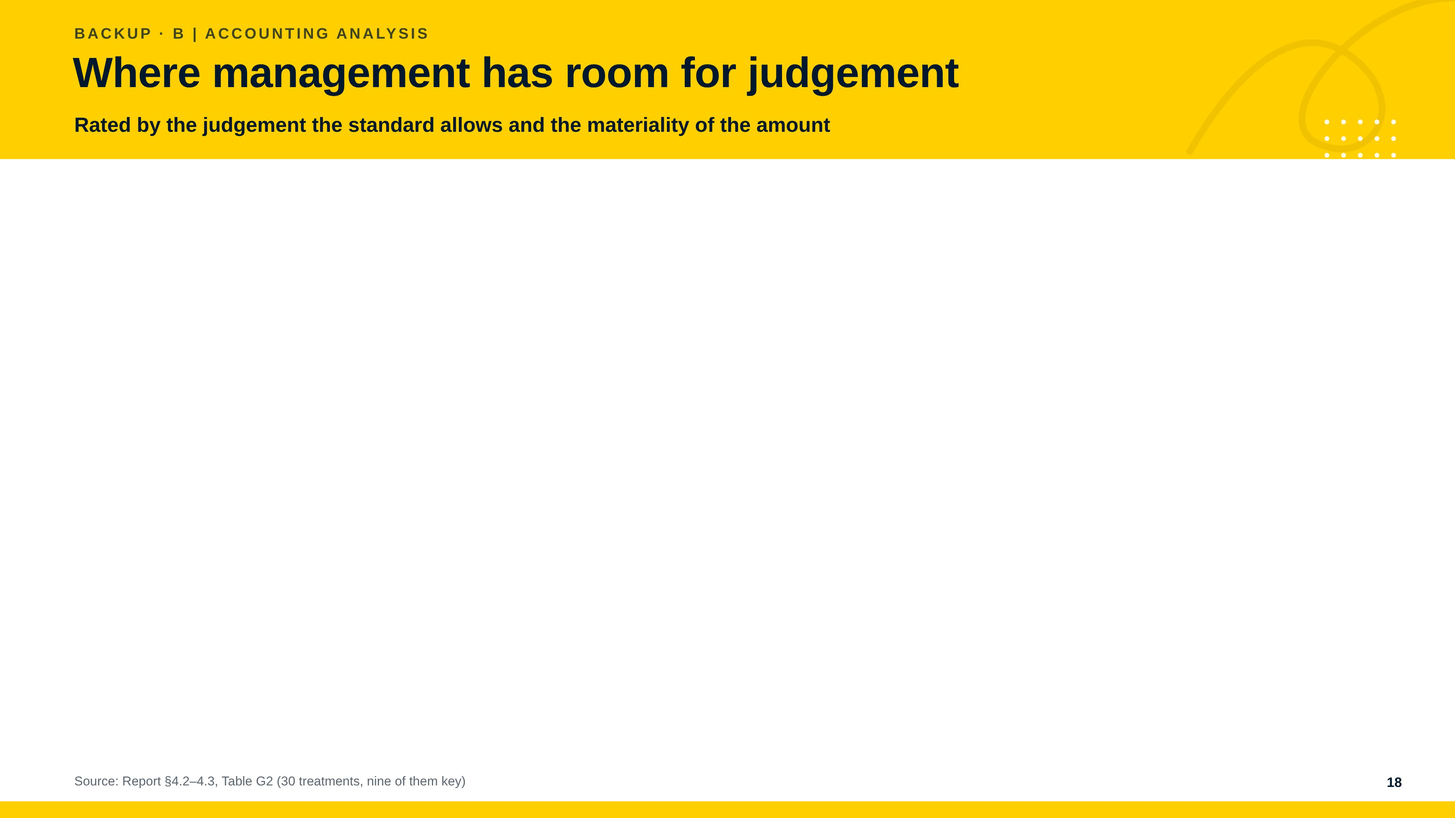
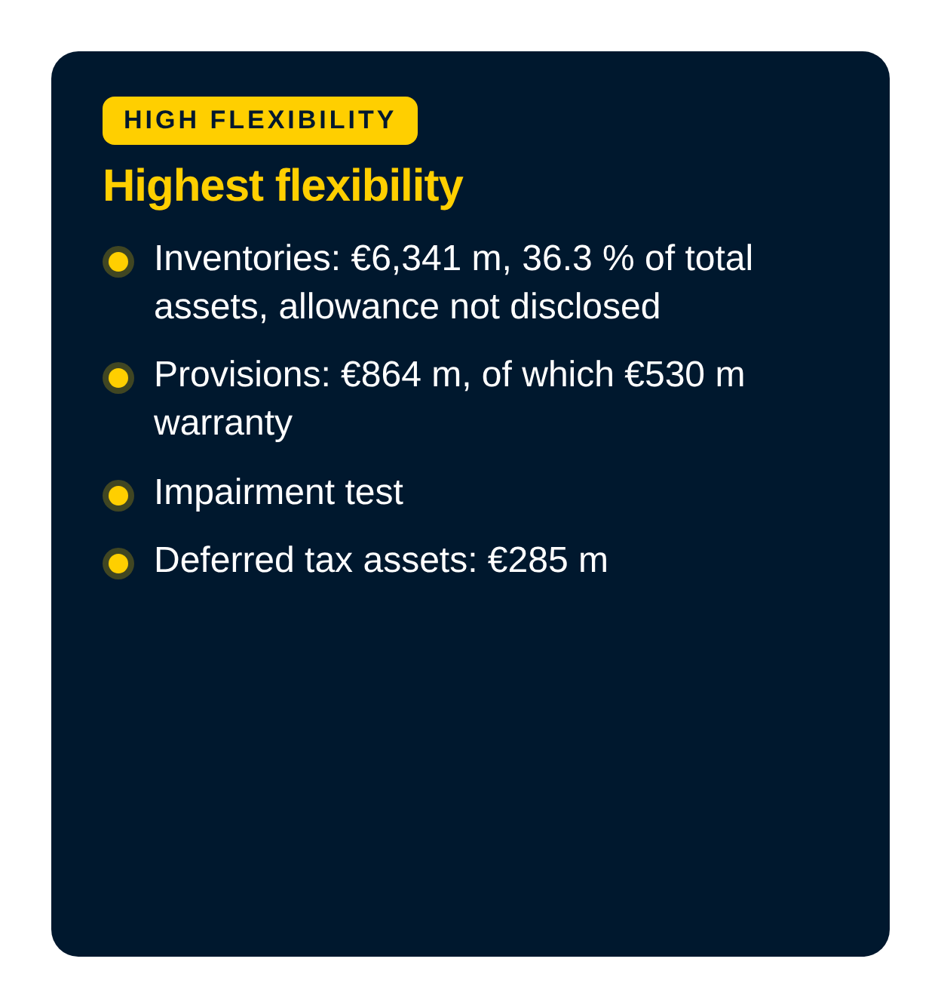
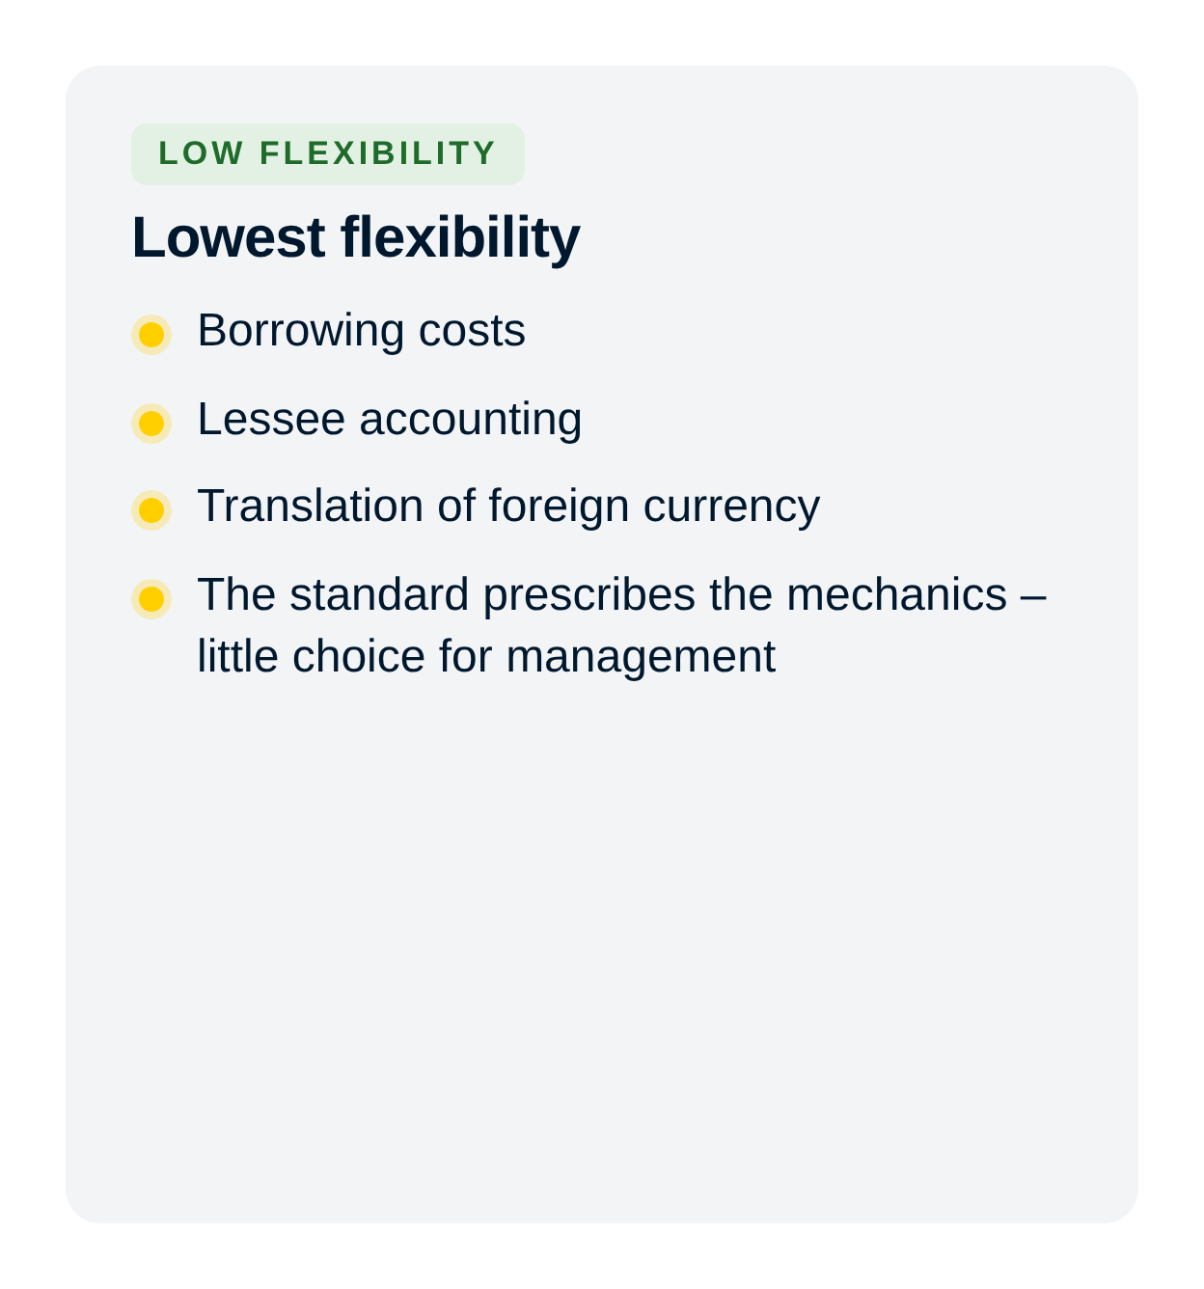
Notes:
Flexibility is rated on two criteria: the degree of judgement the standard permits and the materiality of the amount. It is highest for inventories and their allowance, the impairment test, the provisions and deferred tax assets. Own work capitalised, property, plant and equipment and revenue timing follow. It is lowest where the standard prescribes the mechanics, as with borrowing costs, lessee accounting and currency translation.

Slide 19
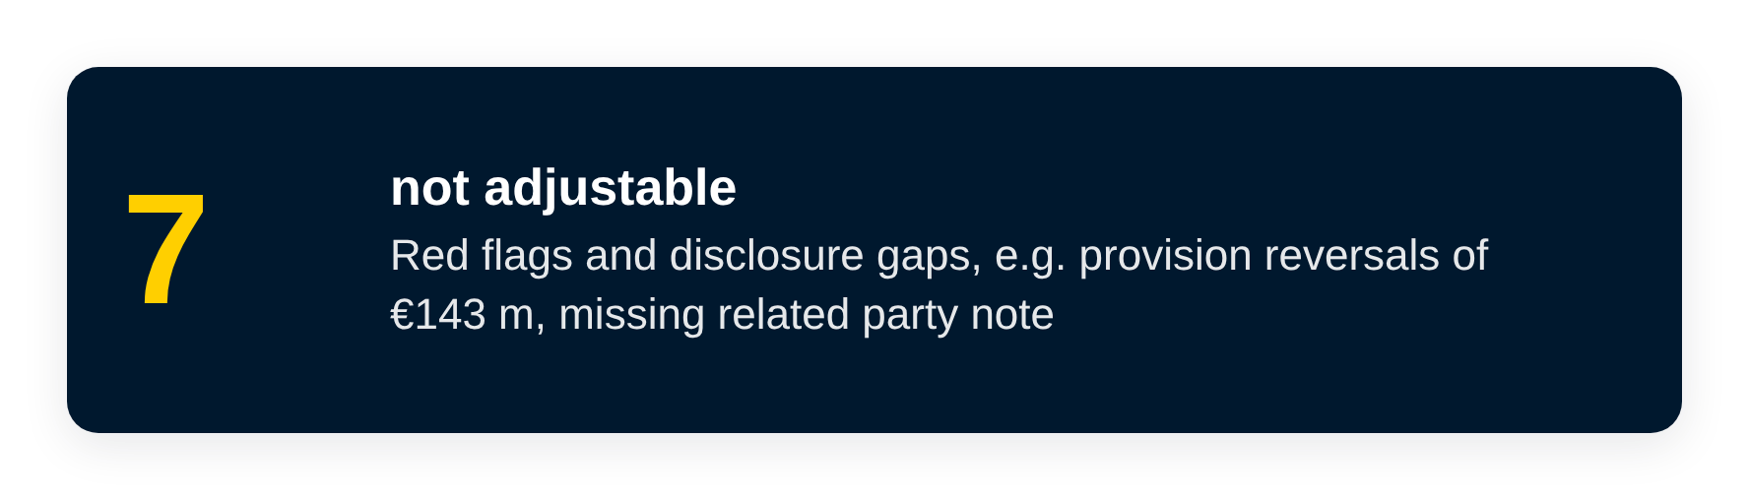
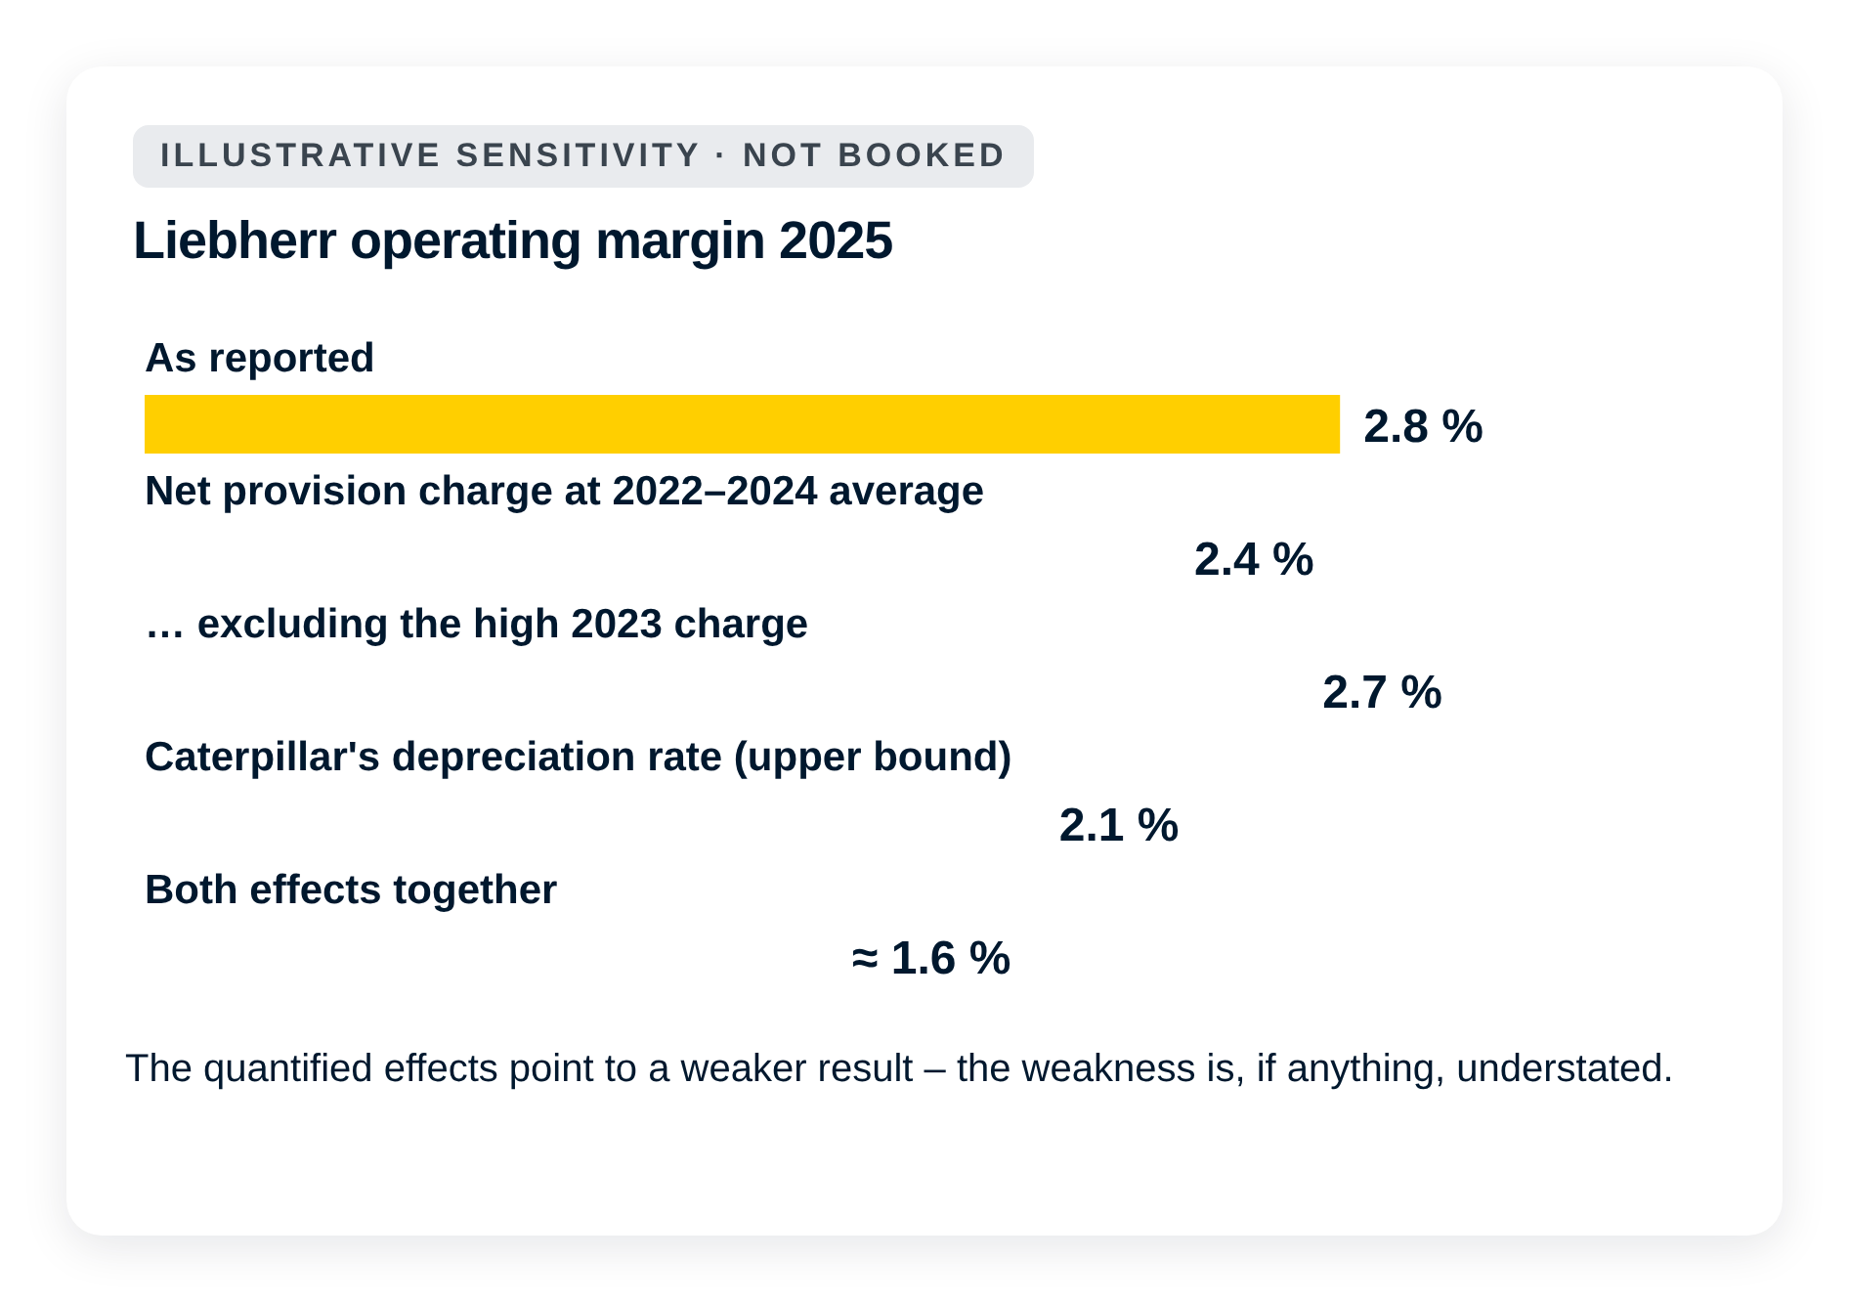
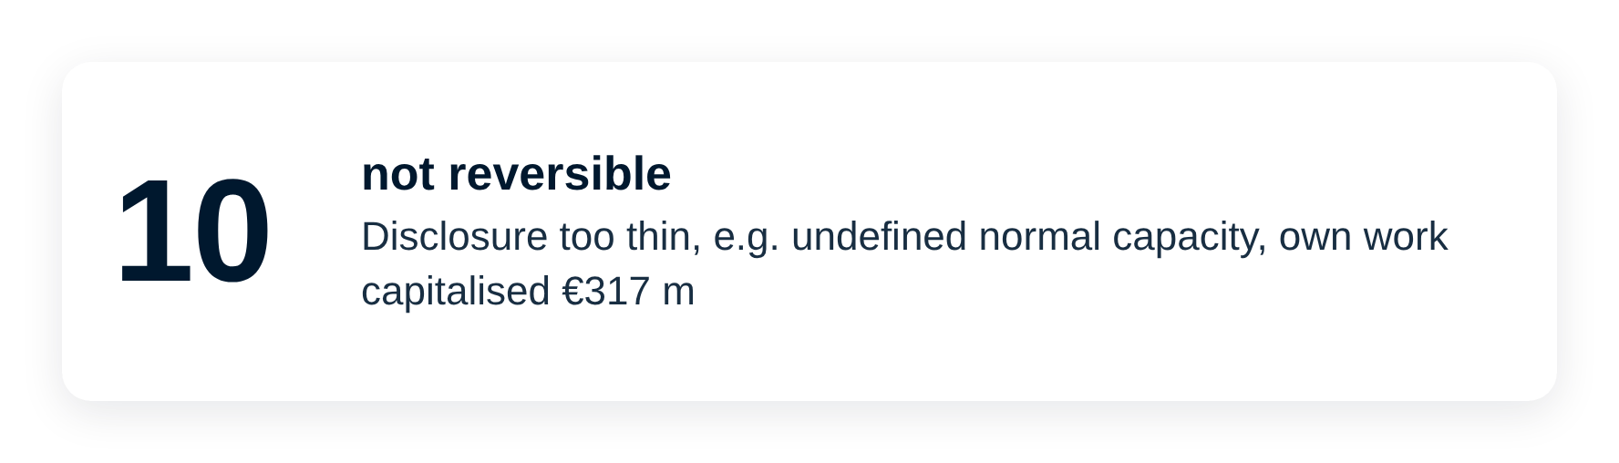
Notes:
The short list holds 22 accounting findings. Seven are red flags or disclosure gaps that no adjustment can remove, five were reversed in the workbook, and ten cannot be reversed because the disclosure is too thin. The quantified effects make the 2025 result look better, not worse: the operating margin of 2.8 per cent falls to between about 1.6 and 2.7 per cent in the measured scenarios, so the weakness is, if anything, understated.

Slide 20
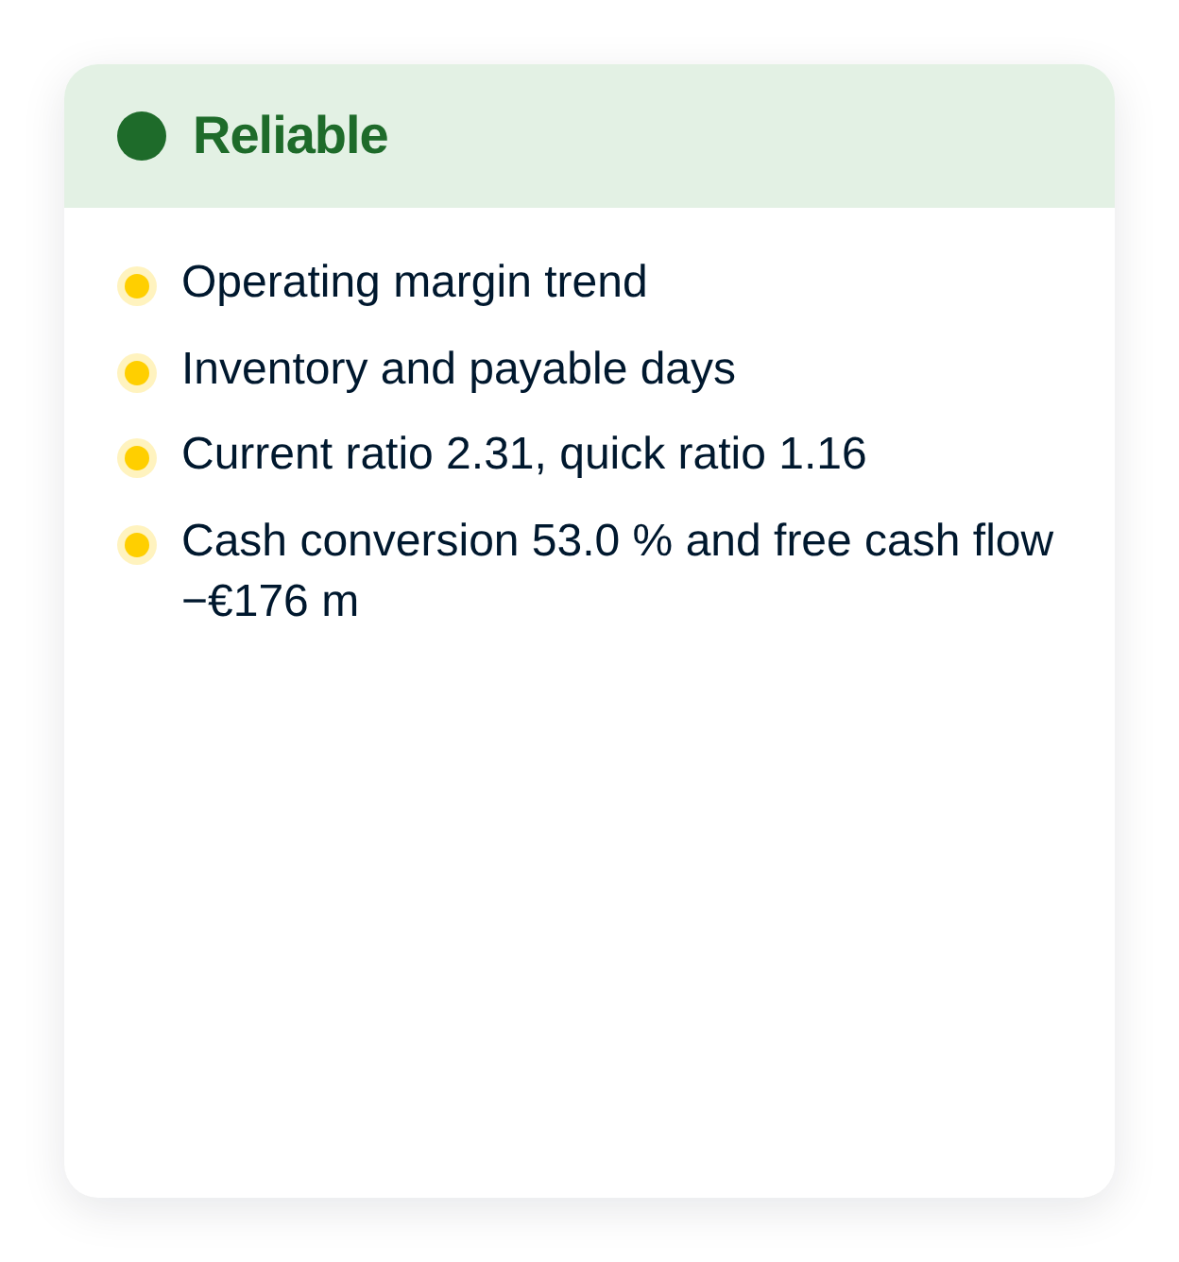
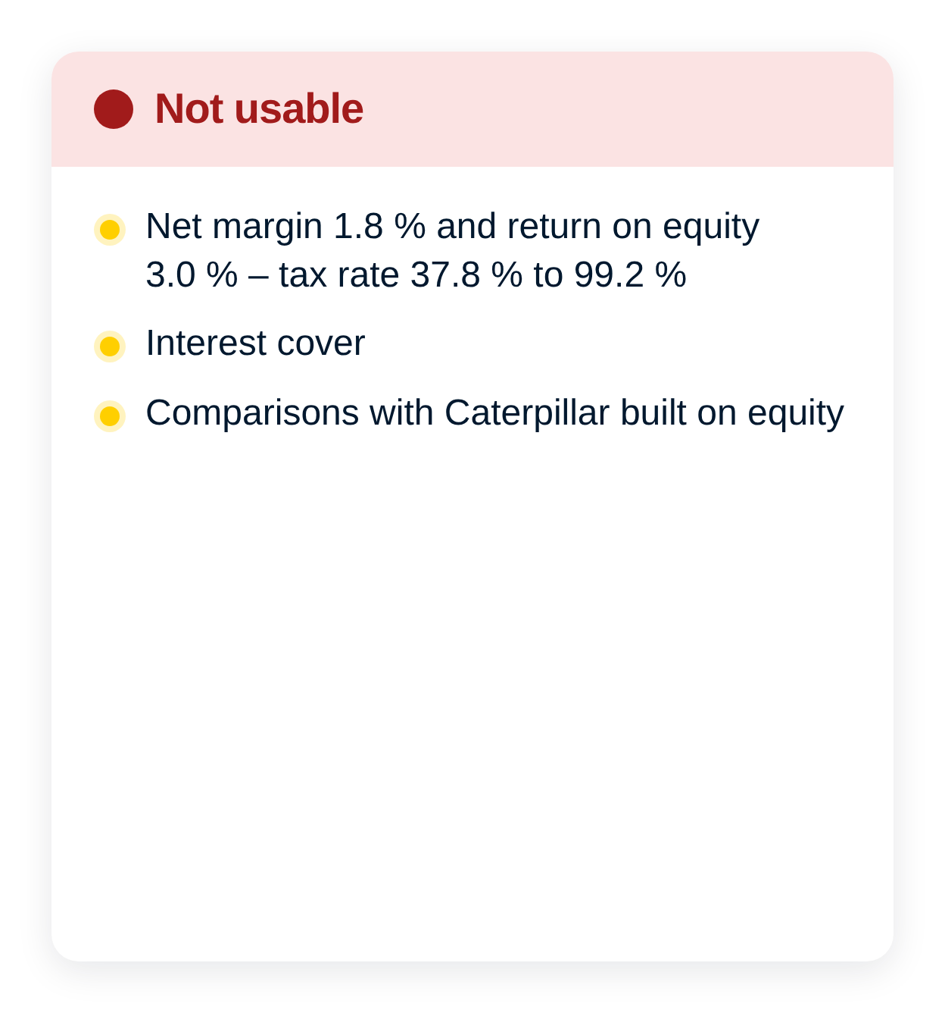
Notes:
After the accounting analysis the ratios fall into three groups. Reliable are the trend of the operating margin, inventory and payable days, liquidity and cash conversion. Usable with a stated bias are the level of the margin, days sales outstanding, fixed asset turnover and the equity ratio. Not usable for a conclusion are the net margin and the return on equity as a trend, interest cover and every comparison with Caterpillar built on equity.

Slide 21
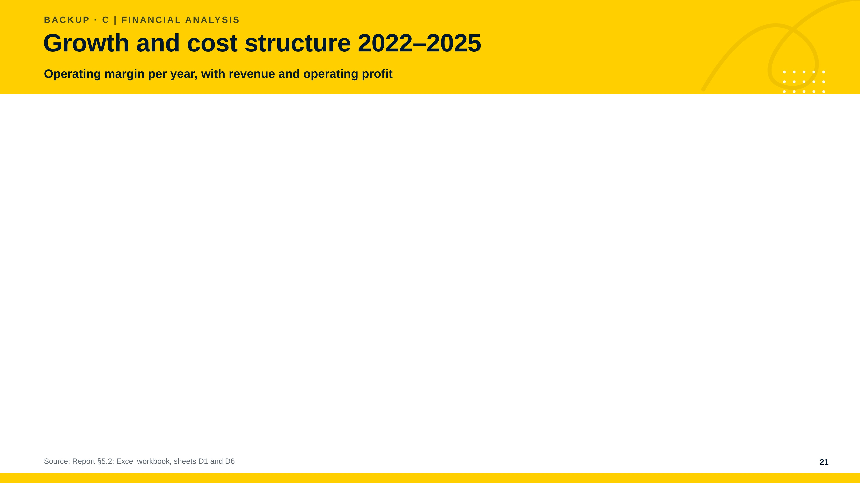
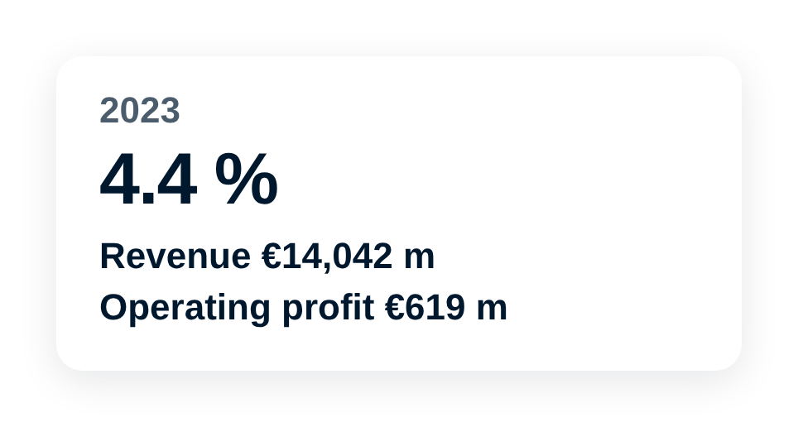
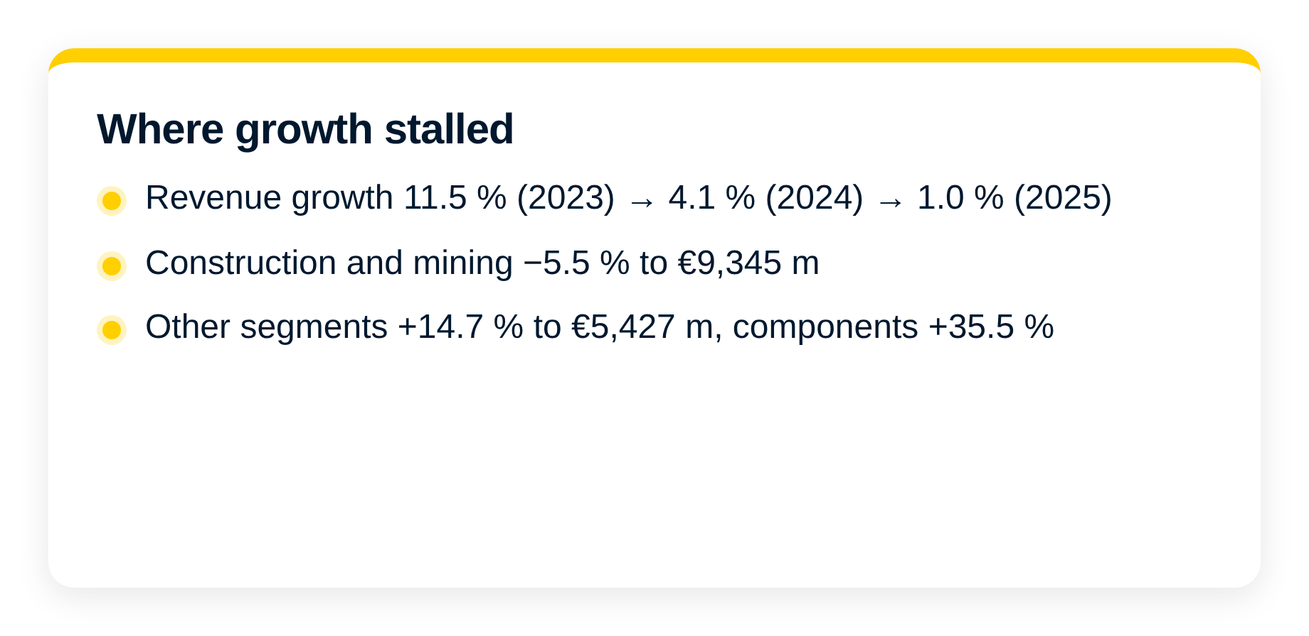
Notes:
Revenue growth slowed from 11.5 per cent in 2023 to 1.0 per cent in 2025. The slowdown came from construction and mining, which fell 5.5 per cent, while the other segments grew 14.7 per cent. The margin fell from 4.6 to 2.8 per cent because personnel expense grew 5.3 per cent against revenue growth of 1.0 per cent, and other operating items added to the burden. Each margin point is worth 148 million euro.

Slide 22
Notes:
We read the return on equity before tax because the tax charge is volatile. The pre-tax return fell from 7.6 per cent in 2023 to 4.8 per cent in 2025. The DuPont decomposition assigns 2.89 percentage points of the fall to the lower pre-tax margin and 0.20 points to lower asset turnover, while higher leverage added 0.28 points. Leverage is therefore not the cause – the margin is.

Slide 23
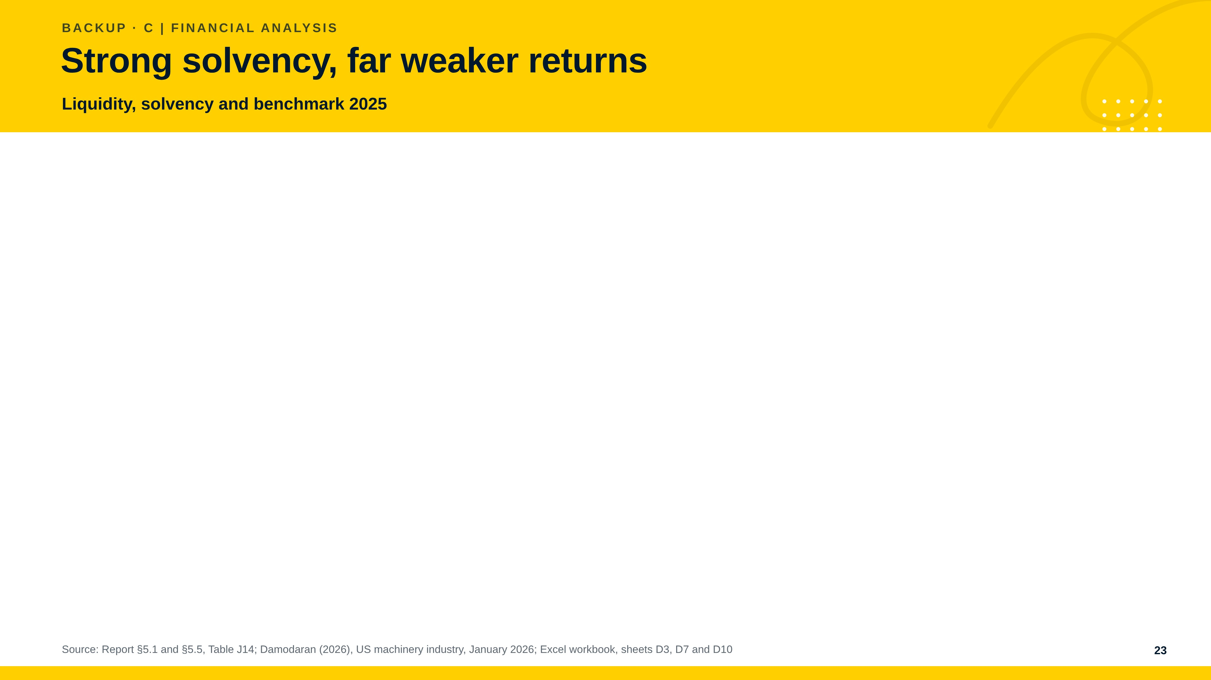
Notes:
Solvency is the clearest strength, with an equity ratio of 53.5 per cent and a current ratio of 2.31. The cushion is shrinking, though: the net financial position fell from 523 million euro in 2022 to a net debt of 85 million in 2023 and stood at 249 million in 2025, and debt to EBITDA rose to 2.90, above the industry's 2.30. Against the industry and Caterpillar, margins and returns are far lower and inventories tie up much more capital. Caterpillar's return on equity is not comparable because of its treasury shares.

Slide 24
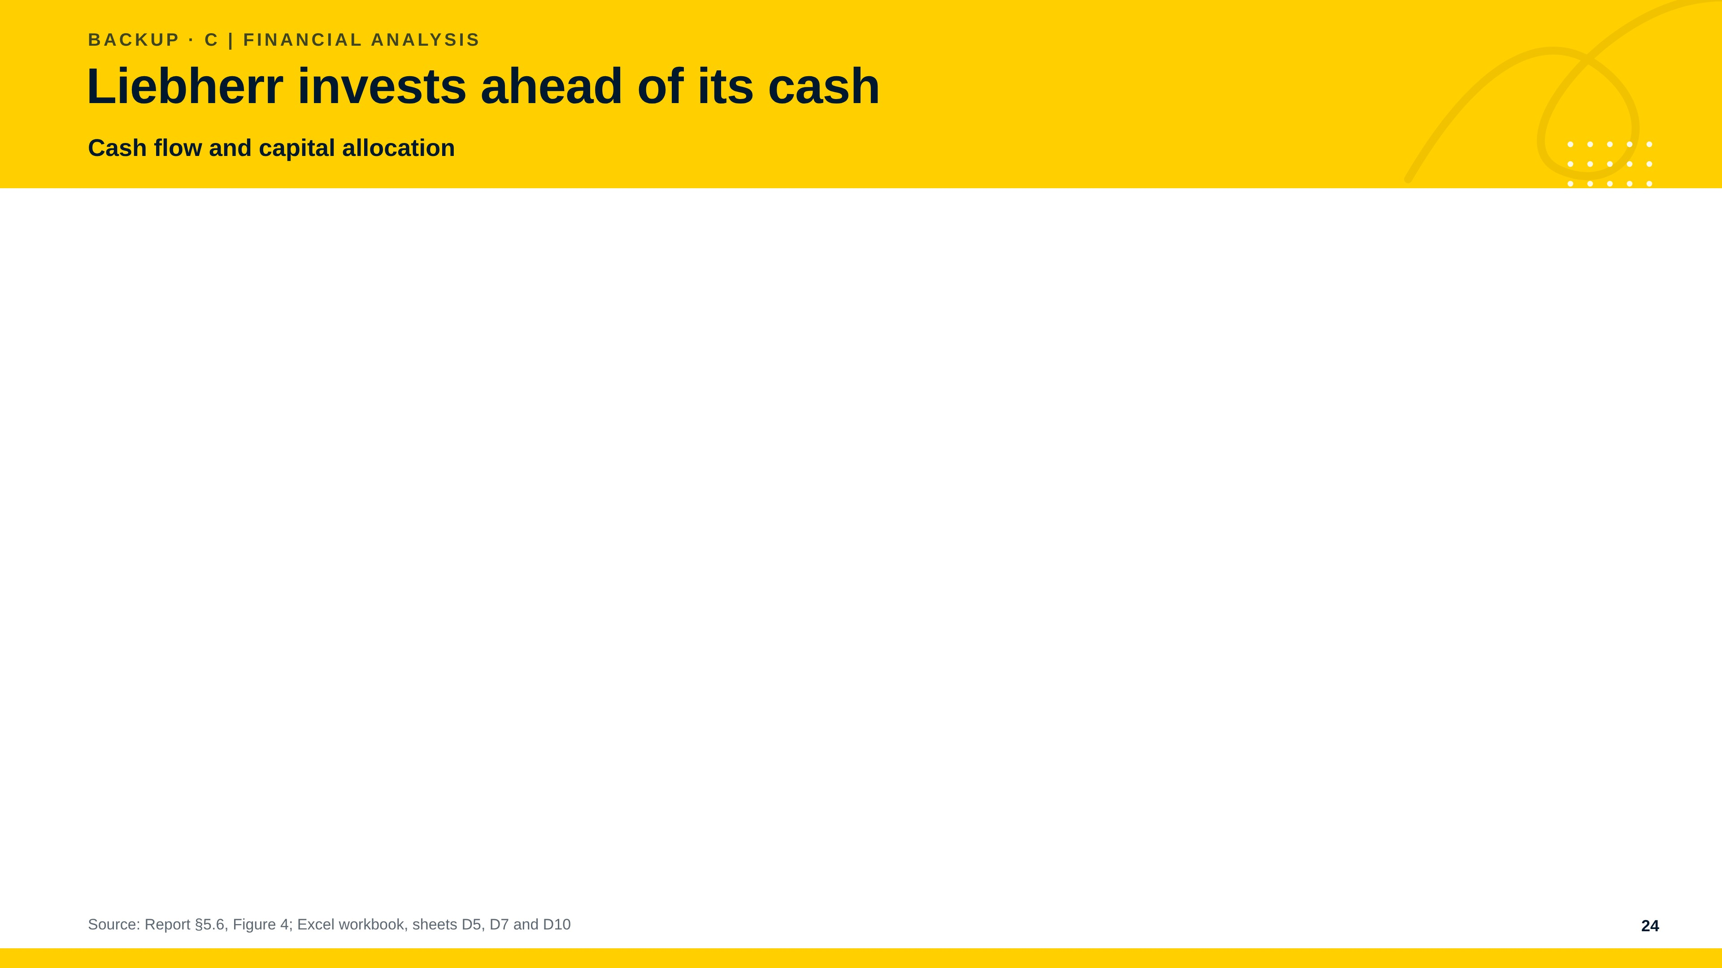
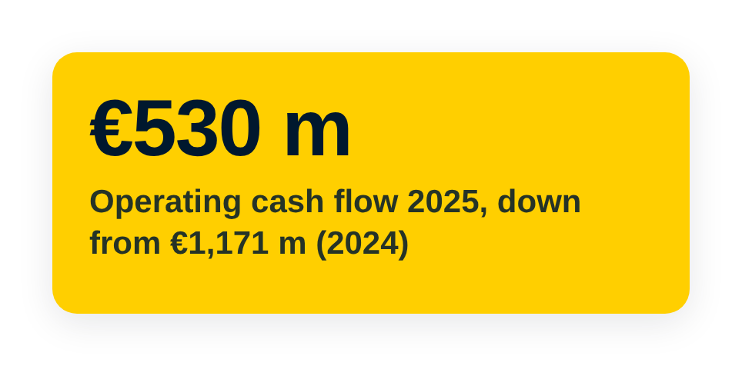
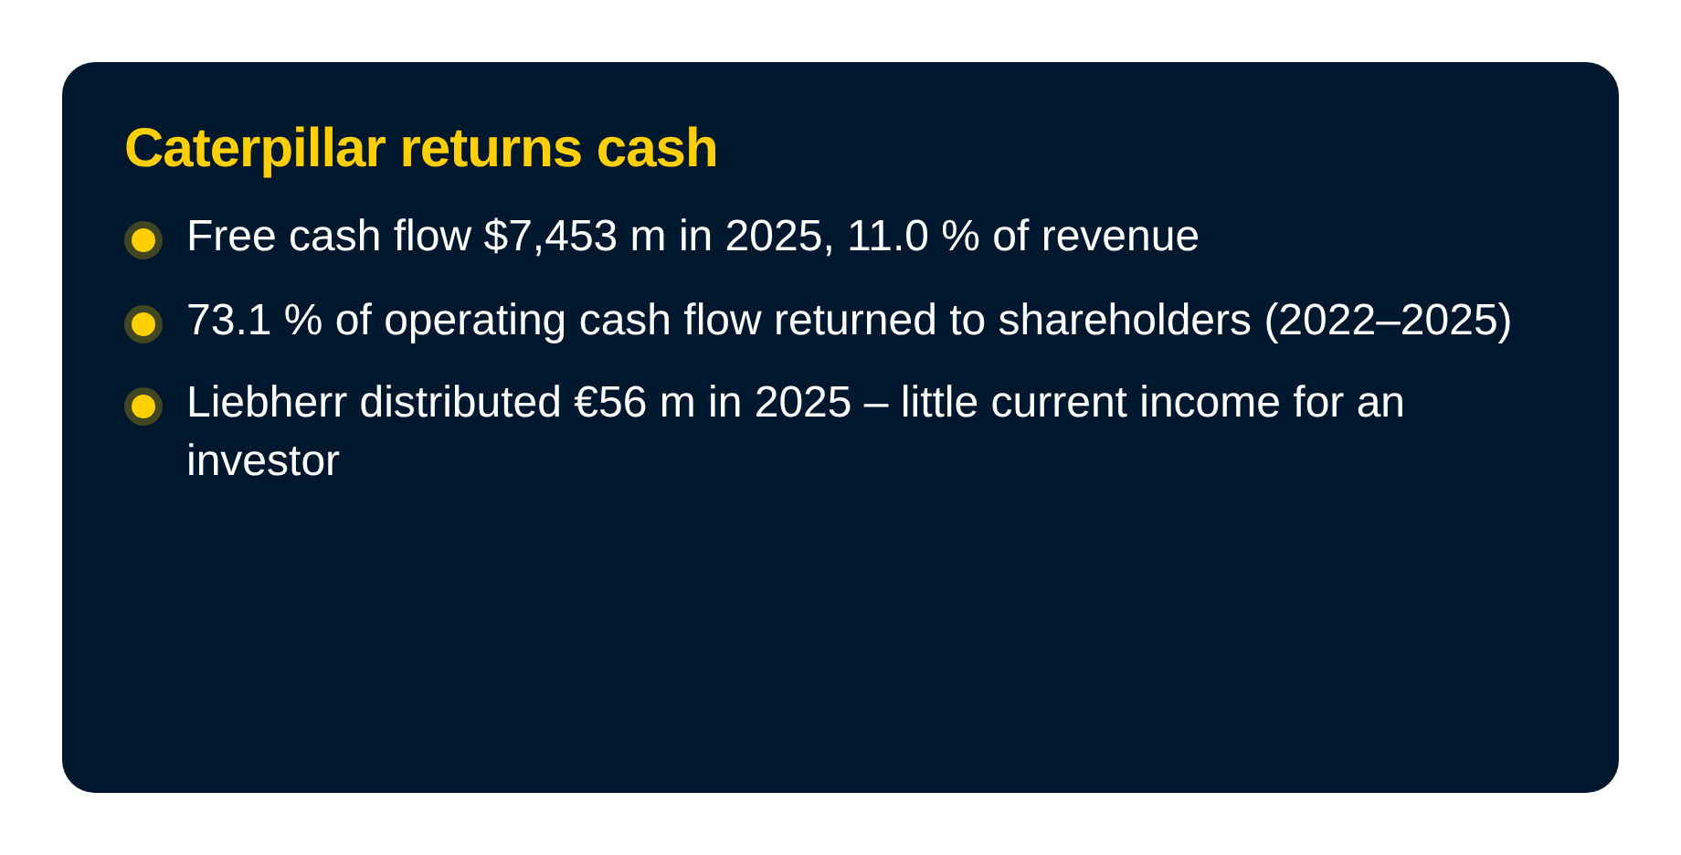
Notes:
Cash flow is the weakest part of the figures. From 2022 to 2025 capital expenditure equalled 190.2 per cent of operating cash flow and free cash flow totalled minus 1,151 million euro. Operating cash flow fell from 1,171 million euro in 2024 to 530 million in 2025. Liebherr spends more than Caterpillar relative to revenue but earns a far lower margin, and borrowing helped fund investment and distributions. Caterpillar generated free cash flow of 7,453 million dollars and returned 73.1 per cent of its operating cash flow to shareholders.

Slide 25
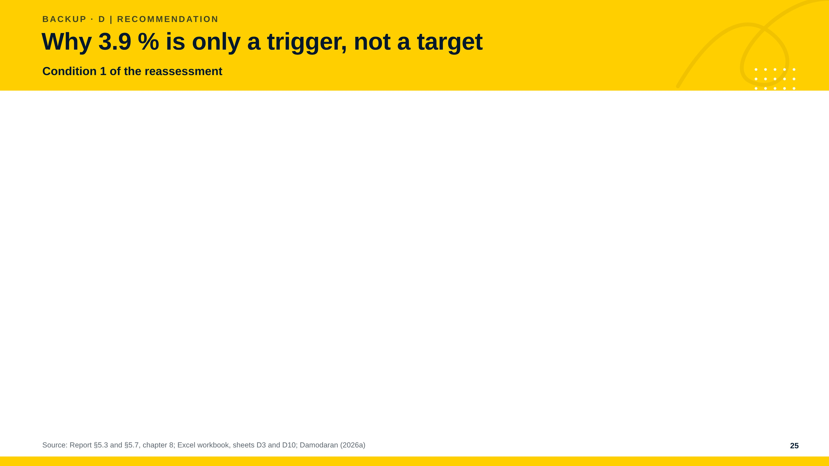
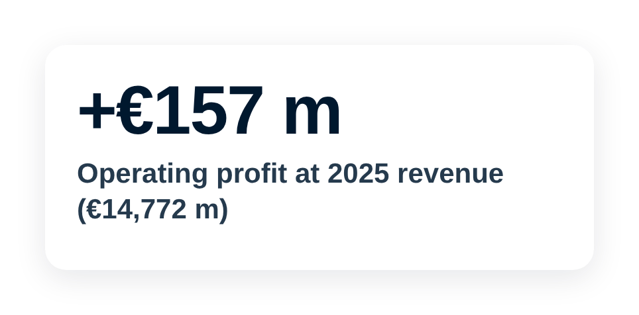



Notes:
The margin of 3.9 per cent is the four-year average and therefore a realistic first test of recovery. At 2025 revenue it would add 157 million euro of operating profit. It is a trigger, not a target return: even in 2024, at a margin of 4.6 per cent, the return on capital employed was 5.9 per cent before tax, below the 7.70 per cent after-tax benchmark. Earning the benchmark would need a margin of about 6 to 8 per cent. The benchmark is that of listed US machinery companies, not Liebherr's own cost of capital.

Slide 26


Notes:
The margin scenarios apply margins Liebherr has already earned to the revenue of 2025 – illustrations on published figures, not forecasts. The industry margin shows the size of the gap and is not a target. On the cash side the net financial position of 249 million euro covers the free cash flow shortfall of 176 million euro for 1.4 years and the shortfall after distributions for 1.1 years. Capital expenditure at the level of depreciation would improve free cash flow by 119 million euro, but it would still be negative at minus 57 million. Ten fewer days in the cash conversion cycle would release about 405 million euro, once.

Slide 27



Notes:
Demand, tariffs and the cost of new technology are the main external risks. Financing is not the immediate constraint, but prolonged underperformance would make it one. The investor needs information rights because the largest cost increase of 2025 cannot be explained. The report does not assess a valuation. For a risk-averse investor an equity stake is unsuitable and a loan might fit better in principle, but its terms are not disclosed. The drop trigger is a margin near 2.8 per cent in 2026 together with a negative net financial position.

Slide 28




Notes:
Answer 1 is the recommendation in short. Answer 2 explains why the four-year average is only a first test. Answer 3 shows that the adjustment of Caterpillar to FIFO is small compared with the gap in margin.

Slide 29


Notes:
The red flags are reasons to ask. ROCE is low because of the low margin and the capital tied up in inventories. The balance sheet protects the investor, but it cannot replace better returns and cash conversion.

