Slide 1
Schematic Drawing Portal
AI-Powered Water Pipe Compliance for Singapore PUB Regulations
React · FastAPI · Docker · OpenAI GPT-4o-mini · RAG

Slide 2
The Problem
Traditional Process
Engineers draw water pipe schematics by hand or in CAD — compliance checking is manual, slow, and error-prone.
Regulatory Complexity
Singapore PUB regulations span the Water Supply Regulations and the 2022 Handbook: hundreds of pages of technical requirements.
The Opportunity
What if a tool could draw the schematic AND instantly evaluate compliance using AI grounded in the actual regulation text?

Slide 3
What was built
Stage 1 Drawing Canvas
Stage 2 AI Compliance Evaluation
• Drag-and-drop schematic editor • 16 built-in water system symbols • Real-world elevation (mRL) Y-axis • Custom symbol uploads (SVG / PNG) • JSON metadata export
• Reg 28 — Backflow Prevention • HB 2.2.1 — Mode of Supply • HB 7.2.1 — Water Efficiency (WELS) • Hydraulic pressure network solver • RAG grounded in PUB documents

Slide 4
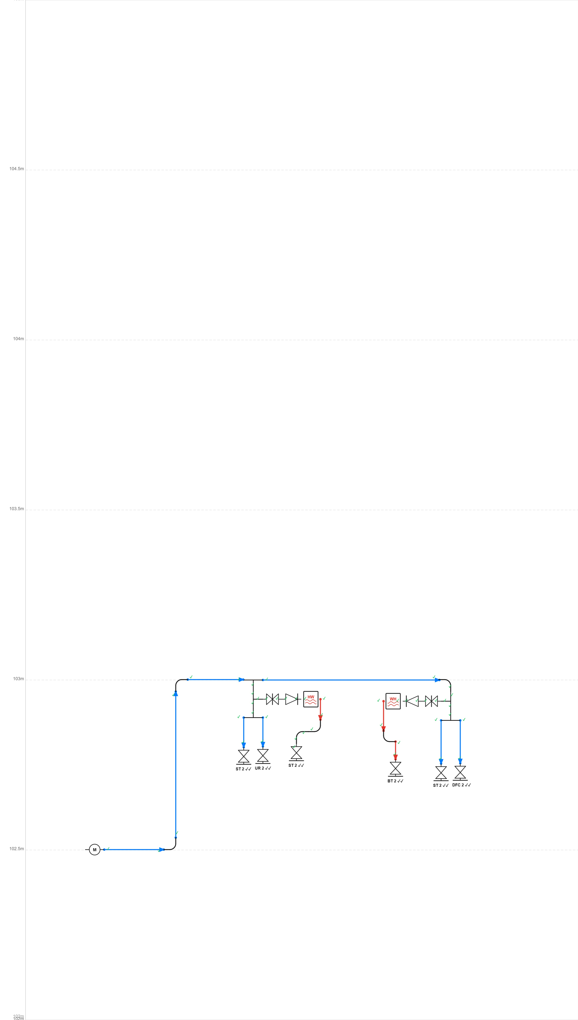
Stage 1 — Schematic Drawing Canvas
Key Features
→ Drag-drop symbol palette → mRL elevation Y-axis → Cold / hot water pipe modes → Valves, heaters, pumps, meters → Tee junctions & elbows → Export JSON metadata → Custom symbol uploads

Slide 5
Stage 2 — AI Compliance Evaluation
PASS Reg 28 — Backflow Prevention
Verifies every water heater has a check valve immediately upstream on its inlet.
Public Utilities (Water Supply) Regulations, Reg 28(1)
PASS HB 2.2.1 — Mode of Supply
Determines whether direct PUB mains supply is appropriate (highest fitting ≤ 125 m MRL).
PUB Handbook on Application for Water Supply 2022, §2.2.1
PASS HB 7.2.1 — Water Efficiency (WELS)
Validates all water fittings carry a MWELS ≥ 2-tick rating and totals design flow demand.
PUB Handbook on Application for Water Supply 2022, §7.2.1
PASS Hydraulic — Pressure Analysis
Network solver computes residual pressure (bar) at every outlet under simultaneous peak demand.
Pass condition: all outlets ≥ 1 bar residual

Slide 6
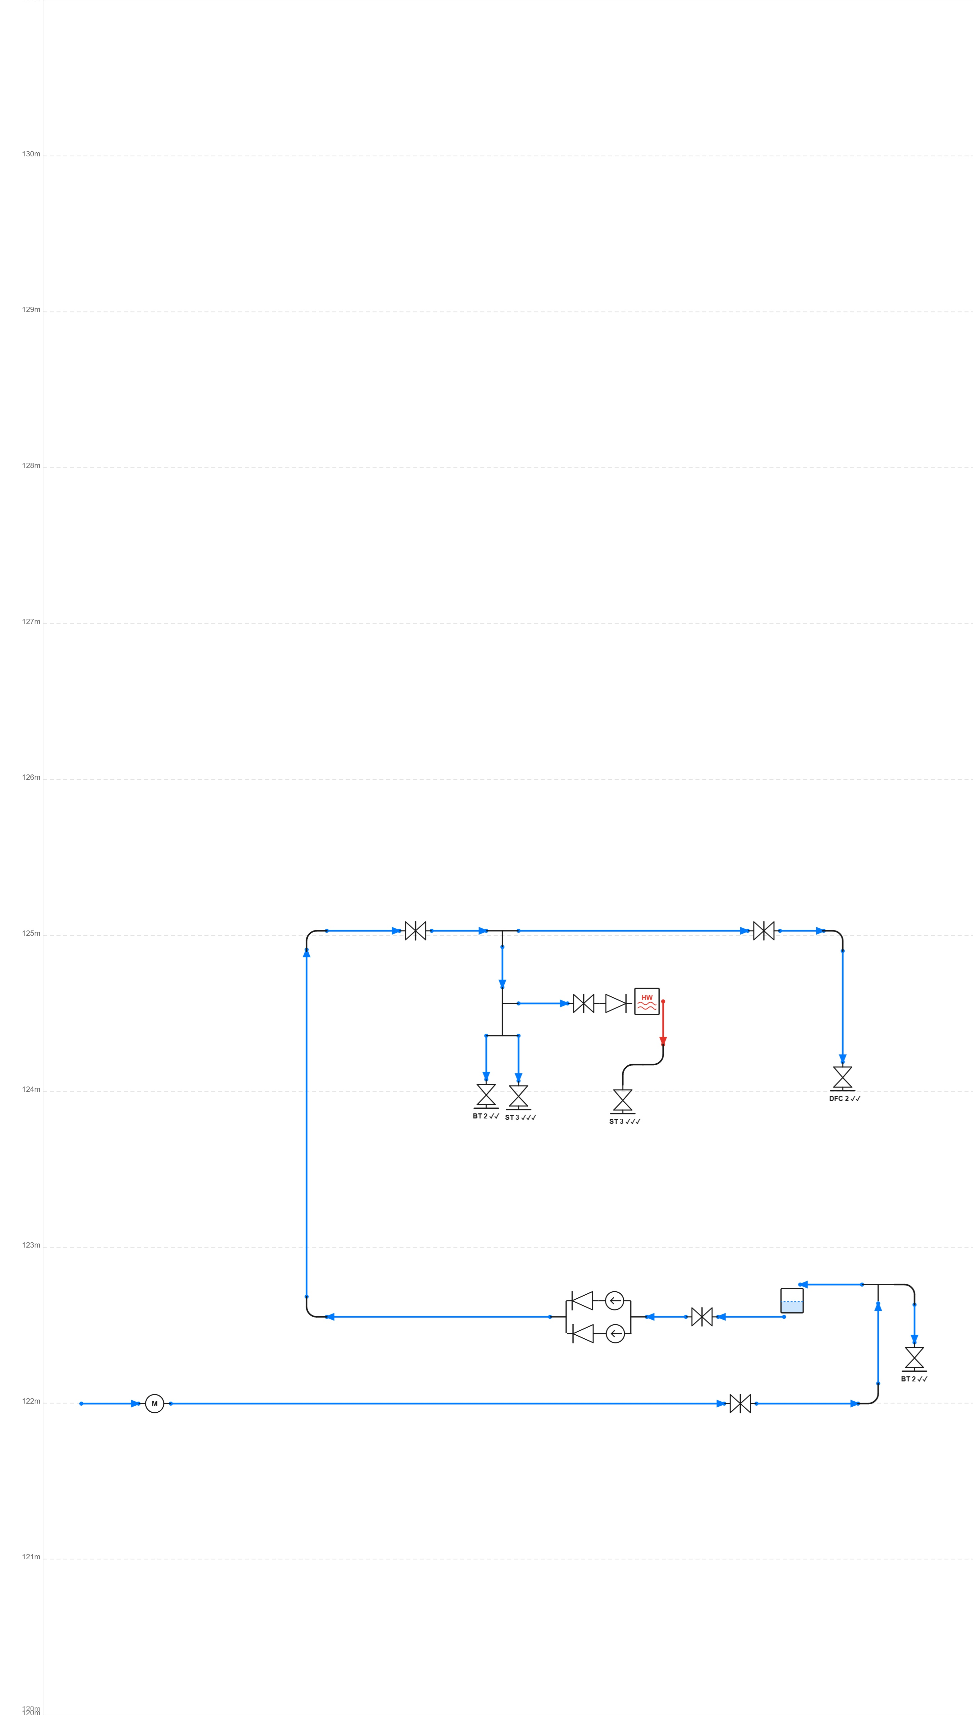
Hydraulic Analysis — Residual Pressure at All Outlets
How it works
→ Parses schematic JSON → Builds pipe network graph → Applies pressure-loss model → Solves residual pressure at each fitting → Flags highest-elevation fitting (worst-case) → Pass: all outlets ≥ 1 bar

Slide 7
Tech Stack
Frontend
React 18 + TypeScript · Konva.js (canvas) · Zustand · Vite · Axios
Backend
Python 3.12 · FastAPI · Uvicorn · Pydantic
AI / LLM
OpenAI GPT-4o-mini · Together AI Qwen2.5-72B · switchable at runtime
RAG
ChromaDB vector store · LangChain document loaders · PDF / DOCX ingestion
Infra
Docker multi-stage builds · Docker Compose · Kubernetes manifests · Nginx
Cost
~$0.0001 per full compliance evaluation (GPT-4o-mini)

Slide 8
Architecture
Browser (React + Konva)
FastAPI Backend (Python)
LLM APIs (OpenAI / Together)
→ HTTP / JSON
→ LLM calls
↑ RAG retrieval
Docker Compose or Kubernetes
ChromaDB Vector Store
PUB Regulations (PDF→Embeddings)
→ deployed by
→ ingested into

Slide 9
Schematic Drawing Portal
Draw. Evaluate. Comply.
Source code available on GitHub
React · FastAPI · Docker · OpenAI · RAG · ChromaDB

