Slide 1
Schematic Drawing Portal on Docker and AWS
EG442S Lab Assignment Part 2 · Build · Containerise · Publish · Deploy
Docker Hub hub.docker.com/r/dockerflocker456/drawing-portal
GitHub github.com/beese54/eg442s-drawing-portal-docker
Notes:
Introduce the app and the goal: package it with Docker, publish to Docker Hub, run it on EC2.

Slide 2
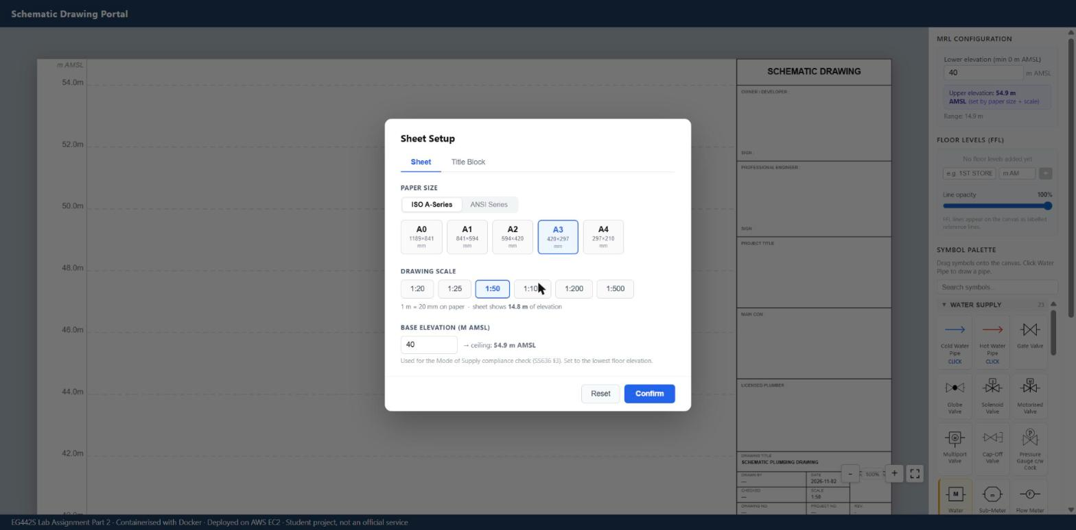
The application
1
Draw
Drag 70 plumbing symbols onto an elevation canvas and connect pipes
2
Evaluate
Run 8 rule-based compliance checks on the drawing
3
Export
Word report, PDF drawing, JSON metadata
Running in the container at http://localhost:8080
React + TypeScript → FastAPI (Python)
Stateless: drawings stay in the browser, so no database or volume
Notes:
Purpose: help designers draw a plumbing schematic and check it against water supply rules before submission.

Slide 3
Deployment architecture
AWS us-east-1 · default VPC
Developer PC
Windows + Docker Desktop
docker build / push
Docker Hub
dockerflocker456/
drawing-portal:1.0
push
Security group: HTTP 80 ← anywhere · SSH 22 ← my IP
EC2 t3.micro
Amazon Linux 2023 + Docker Engine
pull
container: drawing-portal
Uvicorn + FastAPI
/api/* + React files
host :80 → :8000
User's browser
http://<public-IP>
HTTP request on port 80
Notes:
Build on the PC, push to Docker Hub, the EC2 instance pulls the image and runs it. The security group opens port 80, Docker maps host 80 to container 8000.

Slide 4
Inside the image: multi-stage Dockerfile
1
Build the frontend
FROM node:24-alpine
RUN npm ci
RUN npm run build
Output: static HTML/JS/CSS in dist/
2
Runtime image
FROM python:3.12-alpine
pip install -r requirements.txt
COPY --from=frontend-build
USER app · EXPOSE 8000
CMD uvicorn app.main:app
dist/ only
~200 MB
final image (no Node)
1
container, 1 port
non-root
user app
healthy
via /api/health
Notes:
Stage 1 needs Node to compile React. Stage 2 only needs Python; we copy just the compiled files, so Node never ships.

Slide 5
Build, run and manage locally
Command | What it does
docker build -t drawing-portal:1.0 . | Build the image from the Dockerfile
docker images drawing-portal | List the image
docker run -d --name drawing-portal -p 8080:8000 drawing-portal:1.0 | Start a container (host 8080 → 8000)
docker ps | Running containers; STATUS shows healthy
docker logs drawing-portal | View the app's logs
docker exec -it drawing-portal sh | Open a shell inside the container
docker stop / start drawing-portal | Stop or start it again
docker rm -f drawing-portal | Remove the container
Notes:
Open http://localhost:8080 after docker run. curl http://localhost:8080/api/health returns status ok.

Slide 6
Docker Compose and Docker Hub
Command | What it does
docker compose up -d --build | Build + start the web service
docker compose ps / logs -f | Status and live logs
docker compose down | Stop, remove container + network
docker login | Sign in as dockerflocker456
docker tag drawing-portal:1.0 dockerflocker456/drawing-portal:1.0 | Tag with the Docker Hub repo name
docker push dockerflocker456/drawing-portal:1.0 | Publish to Docker Hub
docker pull dockerflocker456/drawing-portal:1.0 | Prove anyone can pull it
Notes:
docker-compose.yml: one service 'web', ports 8080:8000, network portal-net, env vars APP_VERSION and MAX_IMAGE_BYTES, restart unless-stopped, no volume because the app is stateless.

Slide 7
Deploy on AWS EC2
Command | What it does
ssh -i "yourname_ec2.pem" ec2-user@<public-DNS> | Connect to the instance
sudo yum update -y sudo yum install -y docker | Update and install Docker
sudo service docker start sudo systemctl enable docker | Start Docker, and on every boot
sudo docker pull dockerflocker456/drawing-portal:1.0 | Pull the image from Docker Hub
sudo docker run -d --name drawing-portal -p 80:8000 --restart unless-stopped dockerflocker456/drawing-portal:1.0 | Run on port 80, auto-restart
sudo docker ps | Check it is healthy
Then browse to http://<EC2 public IP> · security group must allow HTTP 80
Notes:
t3.micro, Amazon Linux 2023, key pair yourname_ec2, security group with SSH 22 and HTTP 80. Terminate the instance after the assessment.

Slide 8
Challenges and how I solved them
Large original project
Copied only what the image needs: 181 files, 1.5 MB
Node + Python toolchains
Multi-stage build keeps Node out of the final image
Browser port 80, app port 8000
Port mapping -p 80:8000 on EC2
Site timed out at first
Added the HTTP 80 inbound rule to the security group
Lab stops EC2 each session
systemctl enable docker + --restart unless-stopped
Swagger /docs page blank
Strict CSP blocks CDN scripts, so /api/health is used instead
Notes:
Clean-up: terminate the EC2 instance and delete the security group when no longer needed, to save Learner Lab credit.

