Slide 1
Is this thing on?

Slide 2
Mechanics, Dynamics, Aesthetics
A Formal Approach to Game Design
Marc “MAHK” LeBlanc
April 2004

Slide 3
Introduction: The Alien Archeologist
“I have two artifacts from Earth to present to the Academy.”

Slide 4
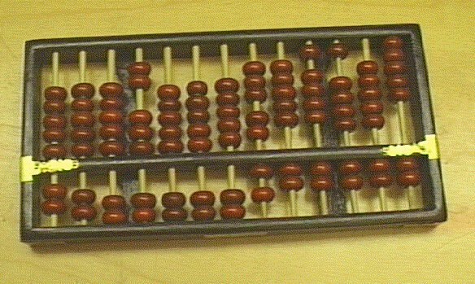
Artifact #1: A Game

Slide 5
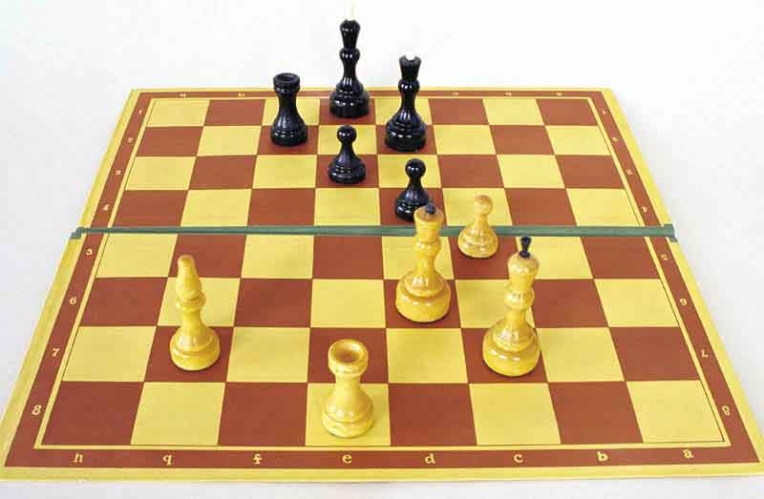
Artifact #2: A Computing Device

Slide 6
Games are State Machines
Input
Output
Rules
(Player)
State
(Graphics/Sound)
All games are computer games.
Game design transcends media.

Slide 7
The Punch Line:
Game design is programming.

Slide 8
Part I: Games as Software

Slide 9
This is Not a Programming Talk
Topics I Won’t Discuss:
Graphics & Sound
Real-Time Simulation
  Physics
  AI
  Network
  Object Database
The Console Environment

Slide 10
Games vs. Other Software
What makes a “program” a “game?”
Fun!
That is, games serve an emotional purpose, not a pragmatic one.
This isn’t a definition.

Slide 11
Games as Software
Code

Slide 12
Games as Software
Code
Process

Slide 13
Games as Software
Code
Process
Requirements

Slide 14
Games as Software
Code
Process
Requirements
Rules

Slide 15
Games as Software
Code
Process
Requirements
Rules
Game
“Session”

Slide 16
Games as Software
Code
Process
Requirements
Rules
Game
“Session”
“Fun”

Slide 17
A Design Vocabulary
Code
Process
Requirements
Rules
Game
“Session”
“Fun”

Slide 18
A Design Vocabulary
Code
Mechanics
Process
Requirements
Rules
Game
“Session”
“Fun”

Slide 19
A Design Vocabulary
Mechanics
Process
Dynamics
Requirements
Game
“Fun”

Slide 20
A Design Vocabulary
Mechanics
Dynamics
Aesthetics

Slide 21
Definitions
Mechanics: The rules and concepts that formally specify the game-as-system.
Dynamics: The run-time behavior of the game-as-system.
Aesthetics: The desirable emotional responses evoked by the game dynamics.

Slide 22
The Designer and The Player


Mechanics
Dynamics
Aesthetics
Designer
Player

Slide 23
The Player’s Perspective
Mechanics
Dynamics
Aesthetics

Slide 24
The Designer’s Perspective
Mechanics
Dynamics
Aesthetics

Slide 25
MDA is a “Taxonomy” of Design Knowledge
Knowledge of Aesthetics
Knowledge of Dynamics
Knowledge of Mechanics
Knowledge of the interactions between them.

Slide 26
Let’s play a game...

Slide 27
Overview
SiSSYFiGHT simulates a schoolyard fight between little girls. Each girls begins with 10 Self-Esteem chips the and goal of the game is to reduce your opponents self-esteem to zero. When there are only one or two players left with any self-esteem, they win the game.
Notes:
This year the rules of the game are described in a way that is noticeably more abstract than last year. That having been said, I may delete this slide or move it later.

Slide 28
Setup
Each player starts with:
  1. Three “Action” cards
  2. Six “Target” cards
  3. Ten chips.
Everyone should pick one of the six colors.
Notes:
This is just a summary. The real rules are on the handout.

Slide 29
Rules
Each Round:
Everyone picks an “Action” and a “Target” in secret.
Reveal cards simultaneously, then resolve actions.
All communication must be public.
When you run out of chips, you’re out.
When one or two people are left, they win.
Notes:
This is just a summary. The real rules are on the handout.
Play for about half an hour.

Slide 30
Actions
Solo: Target discards one chip.
Team: If someone else also played team against this target, target discards two chips.
Defend:
  Target has no meaning, but play it anyway.
  Discard half the number of chips you otherwise would, round down.
  If no one targets you, lose one chip

Slide 31
Observations?
Notes:
5 minutes.

Slide 32
Mechanics
What are the mechanics of Sissyfight?
Specifically, can we identify any “standard” mechanics.

Slide 33
Aesthetics
What are the aesthetics of Sissyfight?
That is, what’s so fun about it?

Slide 34
Dynamics
How did the rules create the fun?
What patterns emerged in the dynamics of the game?

Slide 35
Discussion
What other settings, genres or subjects might fit this game?

Slide 36
Part II: Aesthetics Explored

Slide 37
“Requirements Analysis” for Games
We need to understand the emotional requirements of our software.

Slide 38
Requirements Analysis…
Scenario: The customer wants to cancel an order and get a refund.
Actions:
  Log onto website.
  Navigate to “pending orders” page.
  Click “cancel” button next to order.

Slide 39
…for Games?
Scenario: The player wants to blow stuff up.
Actions:
  Find rocket launcher.
  Find victims.
  Kick major booty.

Slide 40
What’s the Difference?
With productivity software, the user brings his goals to the application.
With games, the application brings goals to the user.
Software eschews emergent behavior.
Games embrace it.

Slide 41
We Need an Aesthetic Lexicon
We need to get past words like “fun” and “gameplay.”
What kinds of “fun” are there?
How will we know a particular kind of “fun” when we see it?

Slide 42
Eight Kinds of "Fun"
1. Sensation
  Game as sense-pleasure
2. Fantasy
  Game as make-believe
3. Narrative
  Game as drama
4. Challenge
  Game as obstacle course

Slide 43
Eight Kinds of "Fun"
1. Sensation
  Game as sense-pleasure
2. Fantasy
  Game as make-believe
3. Narrative
  Game as drama
4. Challenge
  Game as obstacle course
5. Fellowship
  Game as social framework
6. Discovery
  Game as uncharted territory
7. Expression
  Game as self-discovery
8. Submission
  Game as pastime

Slide 44
Clarifying Our Aesthetics
Charades is “fun.”
Quake is “fun.”
Final Fantasy is “fun.”

Slide 45
Clarifying Our Aesthetics
Charades: Fellowship, Expression, Challenge
Quake: Challenge, Sensation, Competition, Fantasy
Final Fantasy: Fantasy, Narrative, Expression, Discovery, Challenge, Masochism
Each game pursues multiple aesthetics.
No Grand Unified Theory.

Slide 46
Clarifying Our Goals
As designers, we can choose certain aesthetics as goals for our game design.
As with other software, our process is driven by requirements, not features.
However, one word is not enough to describe a goal.

Slide 47
Aesthetic Models
Our substitute for “use cases” or “scenarios.”
A rigorous definition of an aesthetic goal.
Serves as an “aesthetic compass.”
States criteria for success as well as possible modes of failure.
Some examples…

Slide 48
Goal: Competition
Model: A game is competitive if:
Players are adversaries.
Players have an ongoing emotional investment in defeating each other.
Some Failure Modes:
A player feels that he can’t win.
A player can’t measure his progress.

Slide 49
Goal: Realistic Flight Simulation
Possible Models: Our flight dynamics are realistic if:
They match a mathematical formula, or,
They pass our “realism checklist,”
Failure Modes:
Counter-intuitive system behavior.

Slide 50
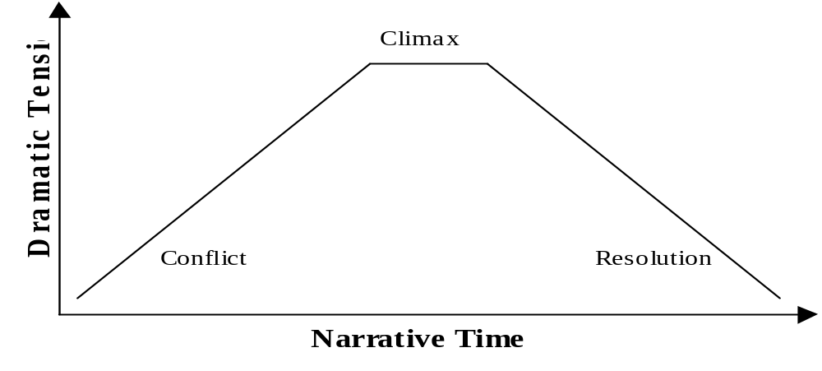
Goal: Drama
Model: A game is dramatic if:
Its central conflict creates dramatic tension.
The dramatic tension builds towards a climax.

Slide 51
Goal: Drama
Failure Modes:
Lack of conflict.
Lack of tension.
  The conflict’s outcome is obvious (no uncertainty).
  No sense of forward progress (no inevitability).
Tension does not increase towards a climax.

Slide 52
Part III: Dynamics in Detail

Slide 53
Understanding Dynamics
What about the game’s behavior can we predict before we go to playtest?
How can we explain the behavior that we observe?

Slide 54
Formalizing Game Dynamics
Input
Output
Rules
(Player)
State
(Graphics/Sound)
The “State Machine” Model
Examples: Chess, Quake

Slide 55
Models of Game Dynamics
Again, no Grand Unified Theory
Instead, a collection of many Dynamic Models.
Dynamics models are analytical in nature.
Some examples…

Slide 56
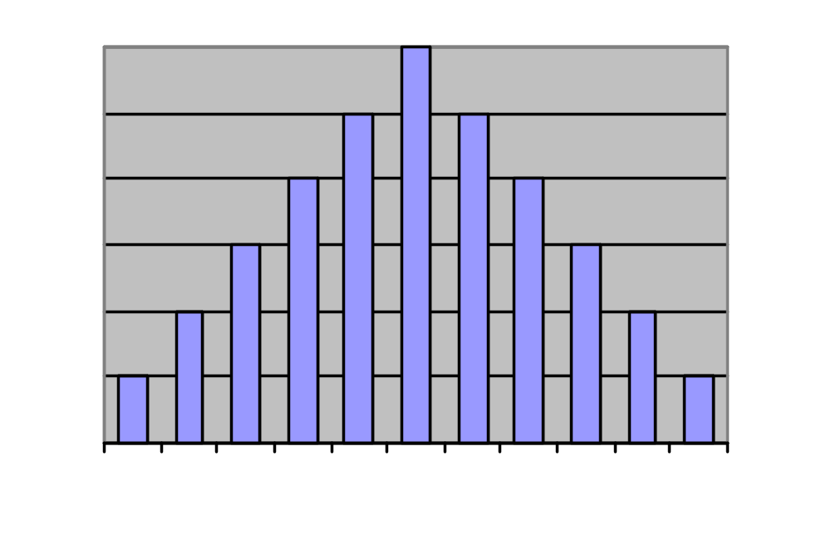
Example: Random Variable
This is a model of 2d6:
Chance in 36
Die roll

Slide 57




Example: Feedback System
A feedback system monitors and regulates its own state.
Room
Thermometer
Heater
Too Cold
Too Hot
Controller
Cooler
An Ideal Thermostat

Slide 58
Example: Operant Conditioning
The player is part of the system, too!
Psychology gives us models to explain and predict the player’s behavior.

Slide 59
Where Models Come From
Analysis of existing games.
Other Fields: Math, Psychology, Engineering…
Our own experience.
On to Mechanics...

Slide 60
Part IV: Mechanics

Slide 61
Understanding Mechanics
There’s a vast library of common game mechanics.

Slide 62
Examples
Cards: Shuffling, Trick-Taking, Bidding
Shooters: Ammunition, Spawn Points
Golf: Sand Traps, Water Hazards

Slide 63
Mechanics vs. Dynamics
There’s a grey area.
  Some behaviors are direct consequences of rules.
  Others are indirect.
  “Dynamics” usually means the latter.

Slide 64
Mechanics vs. Dynamics
There’s a grey area.
  Some behaviors are direct consequences of rules.
  Others are indirect.
  “Dynamics” usually means the latter.
Dynamics and Mechanics are different views of games.

Slide 65
Mechanics vs. Dynamics
There’s a grey area.
  Some behaviors are direct consequences of rules.
  Others are indirect.
  “Dynamics” usually means the latter.
Dynamics and Mechanics are different views of games.
Dynamics emerge from Mechanics.

Slide 66
Part V: MDA Interactions

Slide 67
Interaction Models
How do specific dynamics emerge from specific mechanics?
How do specific dynamics evoke specific aesthetics?

Slide 68
Example: Time Pressure
“Time pressure” is a dynamic.
It can create dramatic tension.
Various mechanics create time pressure:
  Simple time limit
  “Pace” monster
  Depleting resource

Slide 69
Back to sissyfight...

Slide 70
Exercise
Choose a fictional genre and/or setting that might fit this game.
Adapt the game to your chosen subject matter.
Keep in mind the aesthetic qualities we identified in the breakdown.
How can the rules of the game be changed to best support your fiction?
Notes:
Make it clear that the aesthetic qualities from the breakdown are goals. Conveying their subject matter is also a goal. Maybe they should come up with a model?
Obviously the point here is to stress the value of mechanics in conveying fiction. Attendees should also feel free to rename the moves or make other cosmetic changes to convey the fiction, but encourage rules changes. They should think about adding new kinds of actions, etc.
Also encourage people to limit their ambition; don’t just rewrite the rules from scratch. Justify your changes in terms of the goals.

