Slide 1
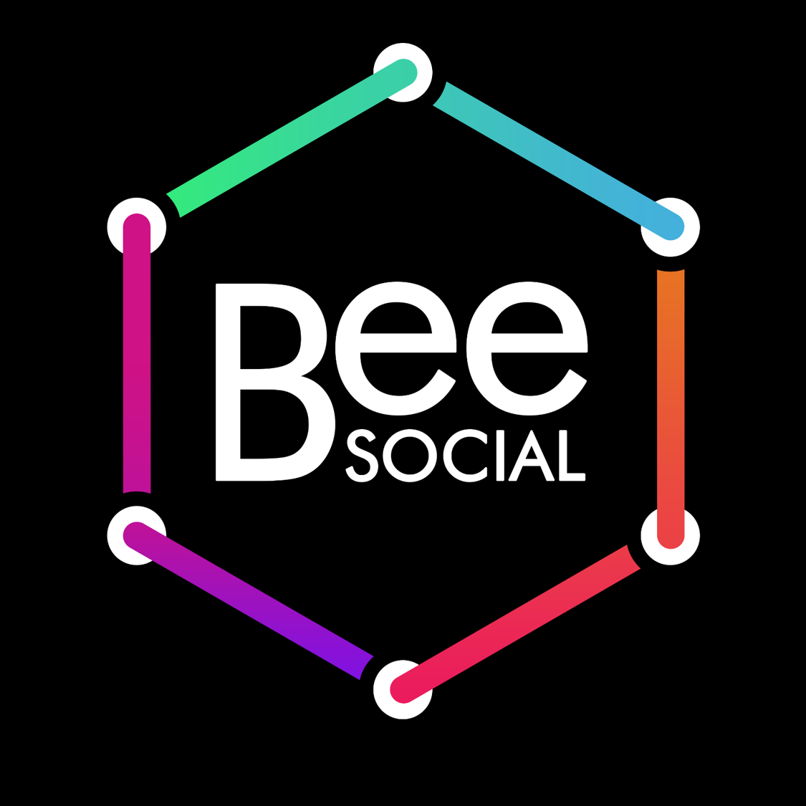
Blockchain platform that connects volunteers, commercial companies and NPOs.

Slide 2

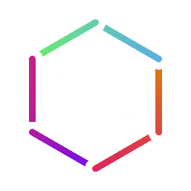
Problem 1
Lack of liquidity of non-monetary resources

Slide 3
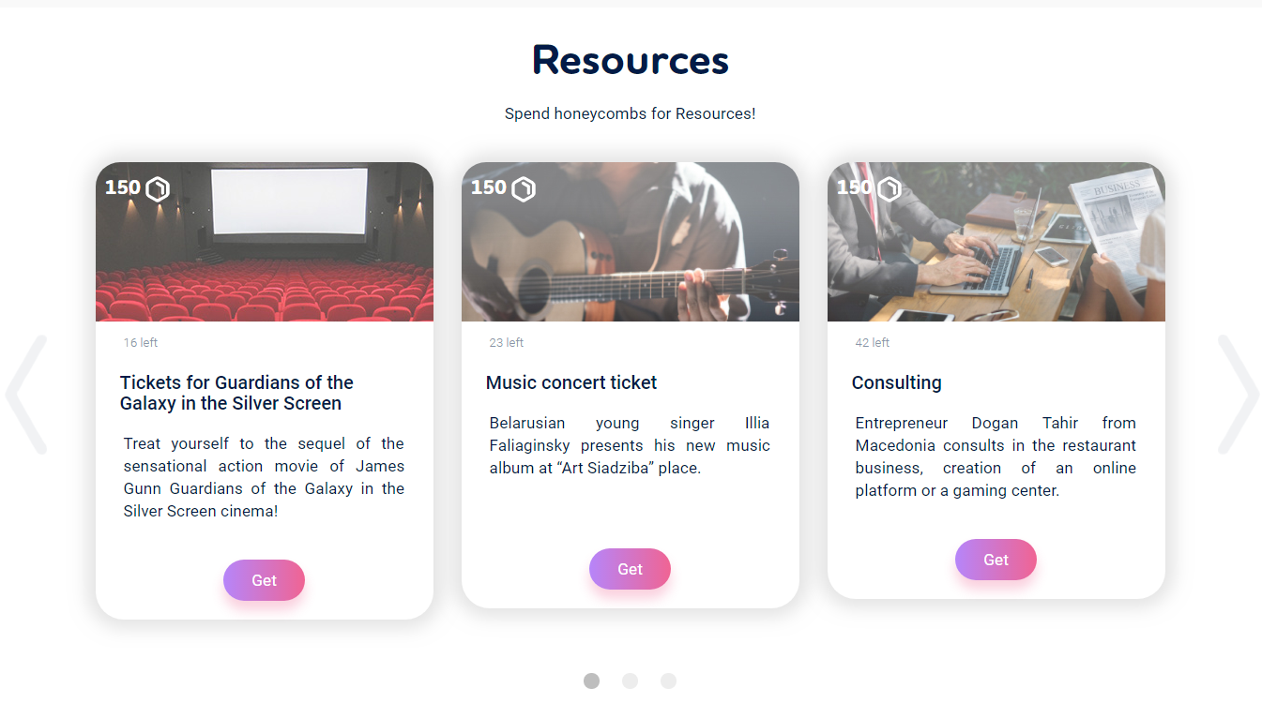
Solution 1 - tokenize resources

Slide 4
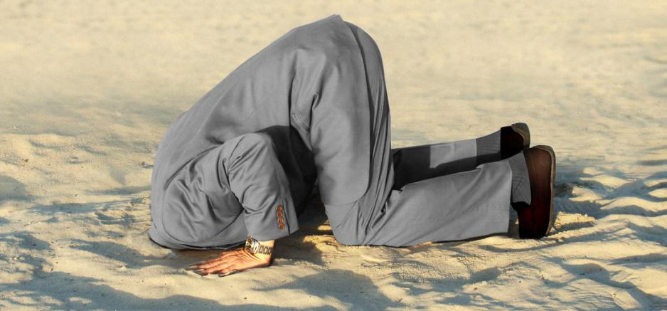
Problem 2
Weak involvement of volunteers in projects

Slide 5
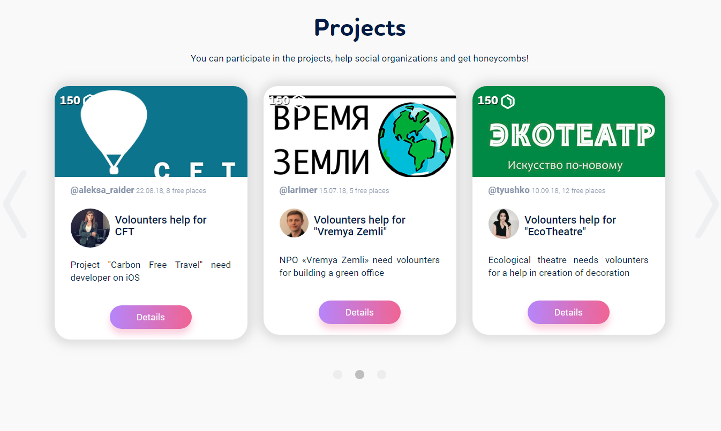
Solution 2 - motivation of volunteers through tokens

Slide 6
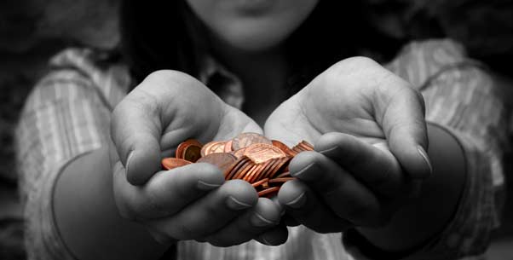
Problem 3
Lack of transparency of charity

Slide 7
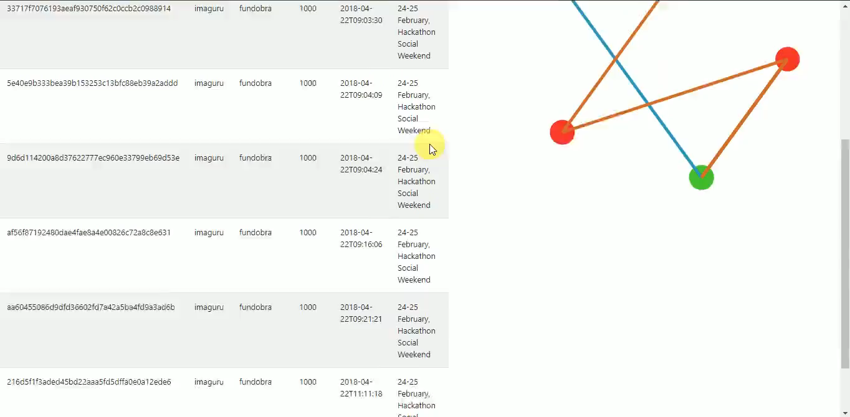
Solution 3 – visualizing transactions

Slide 8
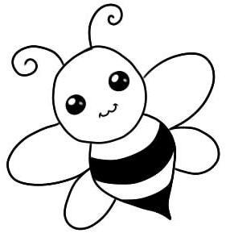
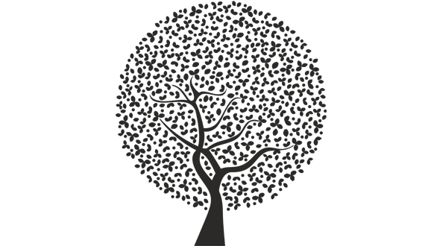
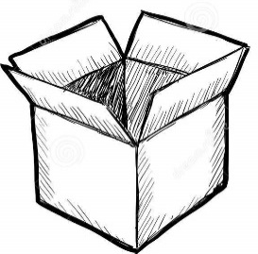

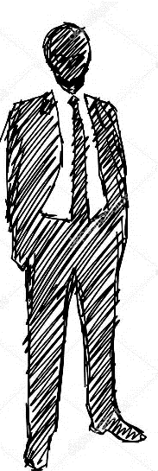
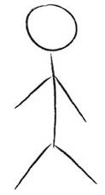
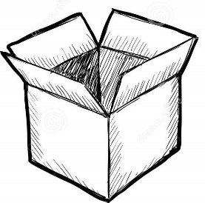
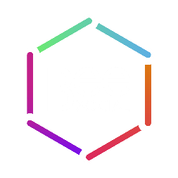
How it works?
NPO
Social project
Resource
Resource
Volunteer
Sponsor

Slide 9
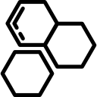

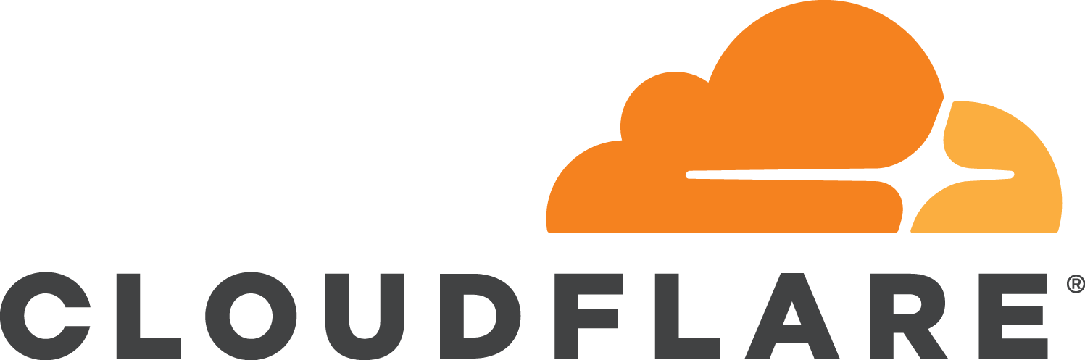


Technology for MVP
Tokens “GOLOS”
=
Tokens “Honeycombs”
Blockchain Golos

Slide 10
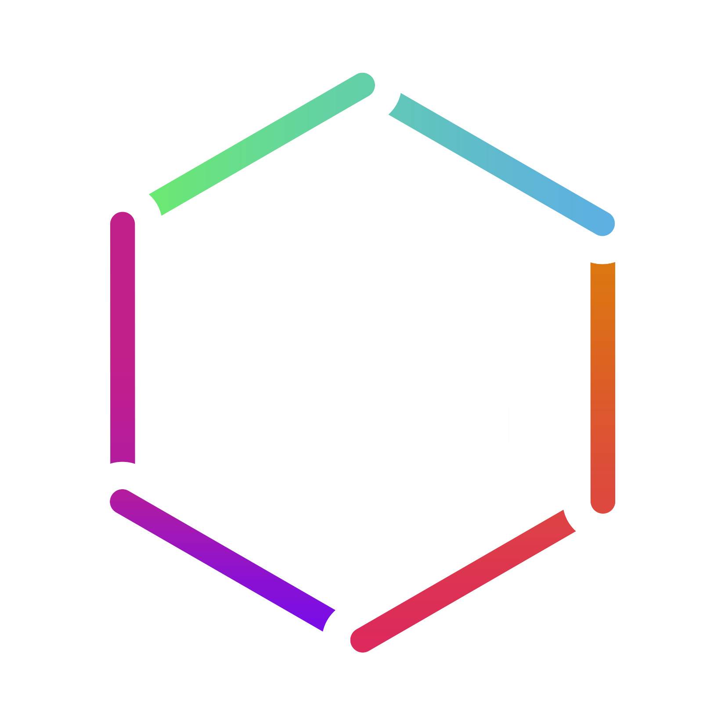
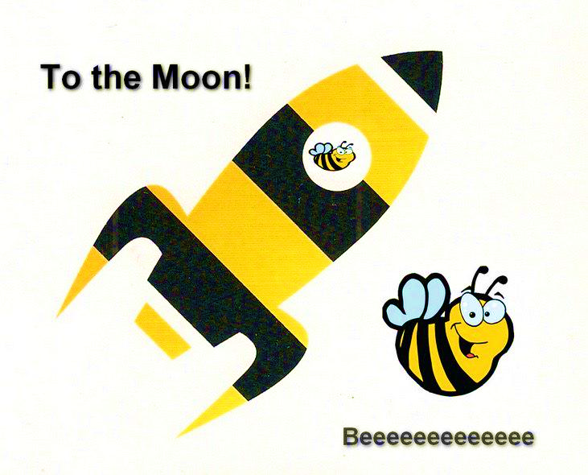
Business Model
Beneficiary = 10%
Growing in capitalization
Supported by the community
Open source

Slide 11
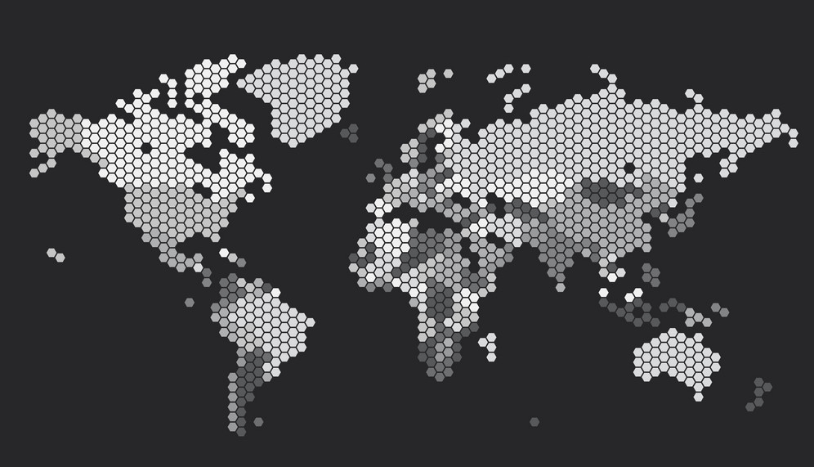
Market size
3 000 NPOs
300 000 Volunteers

Slide 12
Marketing plan
Face to face meeting with NPOs
Meetups for NPO, Sponsors
TV interview
Road show
Organizing a Hackathon

Slide 13

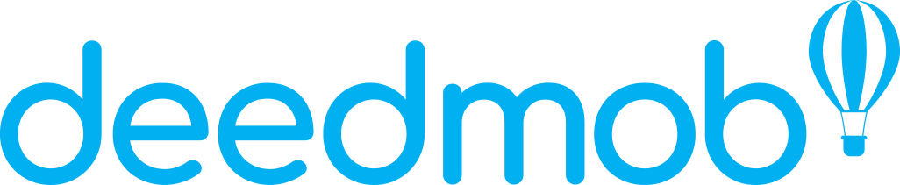
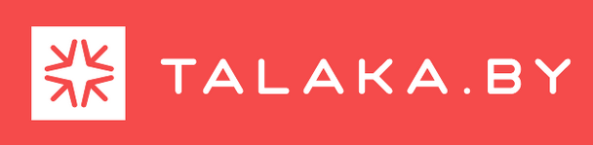

Competitors
Volunteer abroad experience and connect with local communities across the globe
Volunteering movement that solve society's biggest problems
Donating AID in cryptocurrencies for Charity
The platform for collecting the project team to find co-founders, assistants, experts, partners and sponsors for the project
Blockchain solution for charitable donations that aims to put something new in the way charitable

Slide 14
Money
We’ll spend it:
Spend for | Spend $/month | Quantity
Blockchain developers | 8000 | 3
Web-developers | 4000 | 2
Mobile-developers | 5000 | 2
Marketing: - Meetups for NPO, Sponsors - Road show, Hackathons | 600 2000 2000 | 4 1 0.3
SEO, SMM | 1000 | 1
Attract New Customers | 500 | 1
Sum | 21 850
Spend $/per year | 131100
We have received:
20 000 GOLOS – use this currency on the platform.
How much do we need?
131 100 $

Slide 15



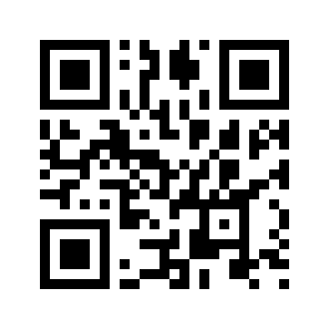


info@beesocial.in
beesocial2
bebeesocial
beesocial.in

