Slide 1
Differences between Flowchart, Pseudocode and Algorithm

Slide 2
FLOWCHARTS
Flowcharts are graphical diagrams that show the steps and logic of an algorithm. They use symbols, arrows, and text to illustrate the inputs, outputs, processes, decisions, and loops of an algorithm. Flowcharts are useful for visualizing the overall structure and flow of an algorithm, and for identifying potential errors or inefficiencies. They are also easy to understand and communicate with others, regardless of their programming background.

Slide 3
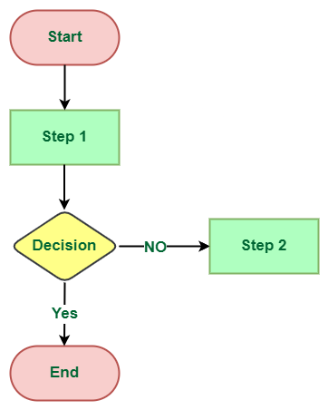

Slide 4
PSEUDOCODE
Pseudocode is a textual representation of an algorithm that uses natural language and some basic programming concepts. It is not meant to be executed by a computer, but rather to describe the logic and steps of an algorithm in a clear and concise way. Pseudocode is useful for planning and testing an algorithm, and for translating it into code later. It can also help you avoid syntax errors and focus on the problem-solving aspect of algorithm development.

Slide 5
ALGORITHM
The word Algorithm means “a process or set of rules to be followed in calculations or other problem-solving operations”. Therefore Algorithm refers to a set of rules/instructions that step-by-step define how a work is to be executed in order to get the expected results.

Slide 6
