Slide 1

CS1028 Programming for
Science and Engineering
Lecture 4: Built In Data Types II
Dr Bob Duncan
Department of Computing Science
Email: robert.duncan@abdn.ac.uk
20th September 2019

Slide 2
Continuing on from Yesterday
How do we define a variable in Python? How do we associate that variable with a data-type value?
We use an assignment statement, which kills two birds with one stone. If we write a = 1234, we are not expressing mathematical equality, rather we are telling Python to:
define the identifier a to be a new variable (if it does not already exist)
associate variable a with integer value 1234
Note the left hand side of an assignment statement must be a single variable!
Note: 1234 = a and a + b = b + a are both invalid statements

Slide 3
Keeping Track of Variables
A Neat Way to Track Variables
We can do this using an Informal Trace. We set up a simple table as follows:
a b c
a = 1234 1234
b = 99 1234 99
c = a + b 1234 99 1333
A more complex way is an Object-level trace
We list the steps on the next page

Slide 4
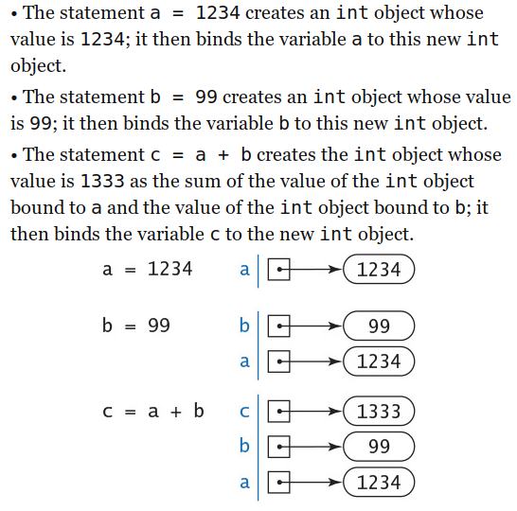
Keeping Track of Variables (Cont.)
Object-level Trace

Slide 5
Incrementing a Variable
Here is some code to do this:
i = 17
i = i + 1
Note the second line is not meant to be a mathematical equivalent. It is a command to Python to carry out:
Create an int object with a value of 17 and bind variable i to that object
Evaluate the expression i + 1 and create a new int whose value is 18
Bind the variable i to this new object

Slide 6
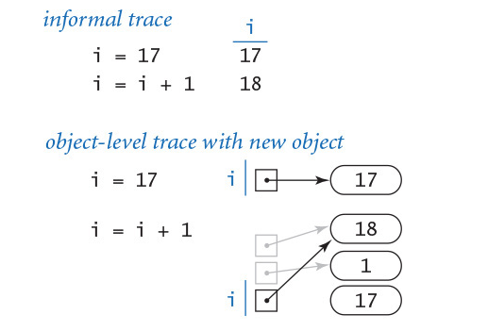
Incrementing a Variable (Cont.)
Traces:

Slide 7
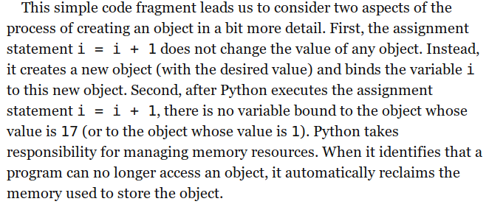
Incrementing a Variable (Cont.)

Slide 8
Exchanging two variables
Check this out:
We will swap variable a value with variable b value here:
t = a
a = b
b = t
Starting values are 1234 and 99 for a and b respectively

Slide 9
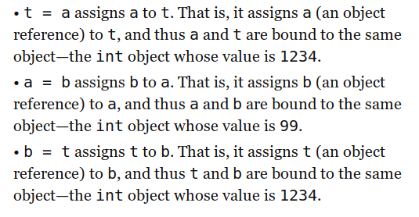
Exchanging two variables (Cont.)

Slide 10
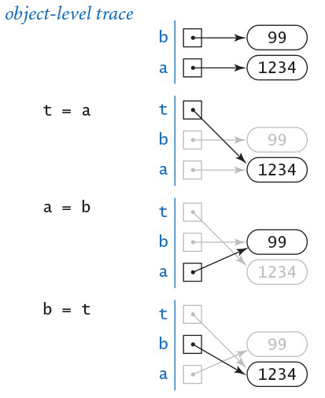
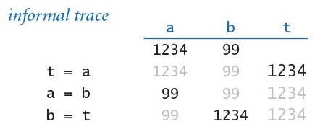
Exchanging two variables (Cont.)

Slide 11
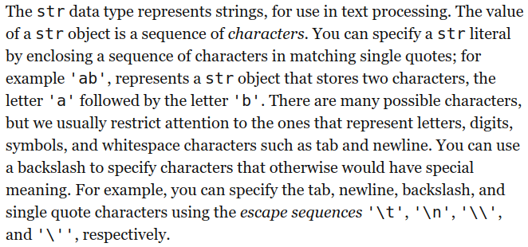
Strings

Slide 12
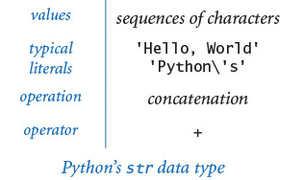
Strings (Cont.)

Slide 13
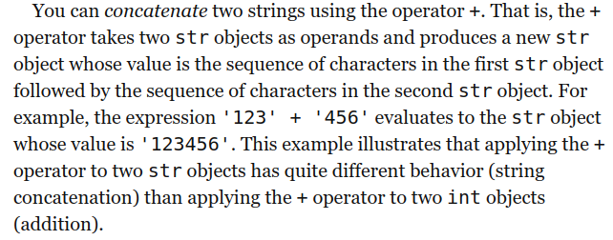
Strings (Cont.)

Slide 14
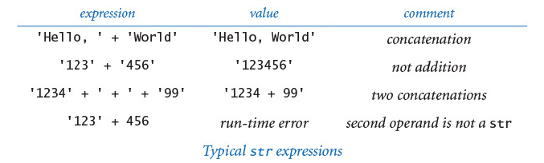
Strings (Cont.)

Slide 15
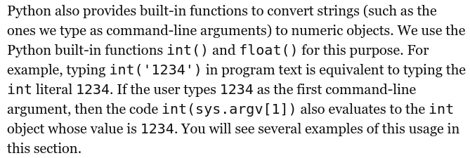
Converting Strings to Numbers for Input

Slide 16
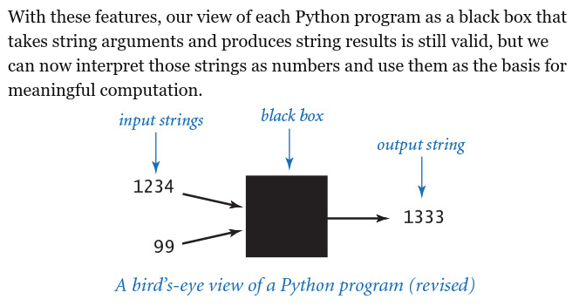
Converting Strings to Numbers for Input (Cont.)

Slide 17
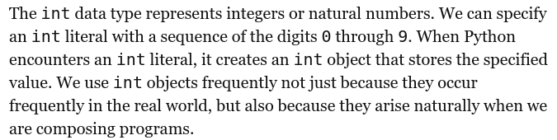
Integers

Slide 18
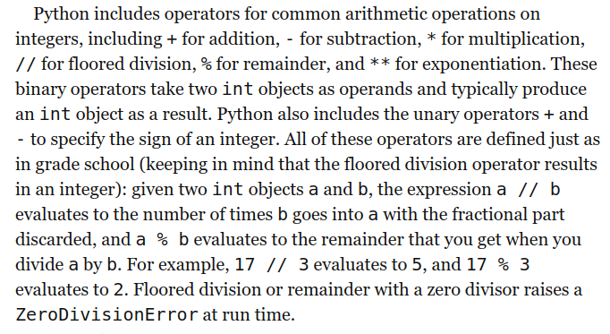
Integer Operators

Slide 19
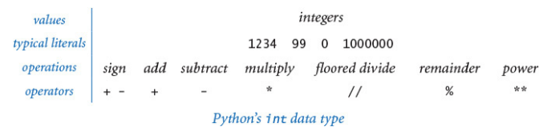
Integer Operators (Cont.)

Slide 20
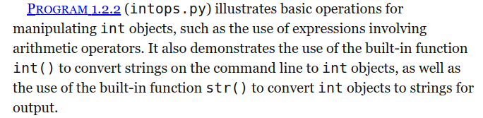
Integer Operators (Cont.)

Slide 21
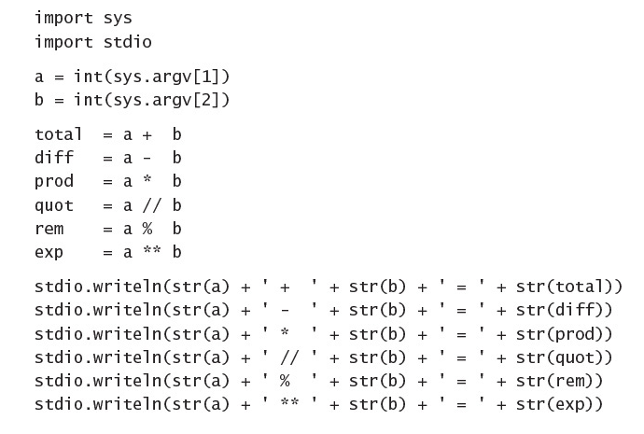
Writing a program with strings converted to numbers

Slide 22
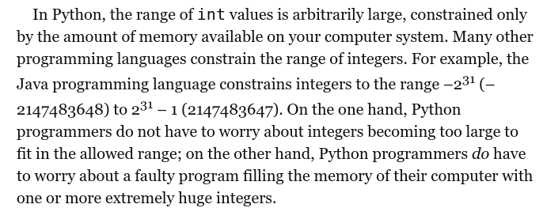
Range of Integers in Python

Slide 23
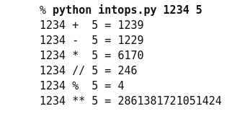
Range of Integers in Python

Slide 24
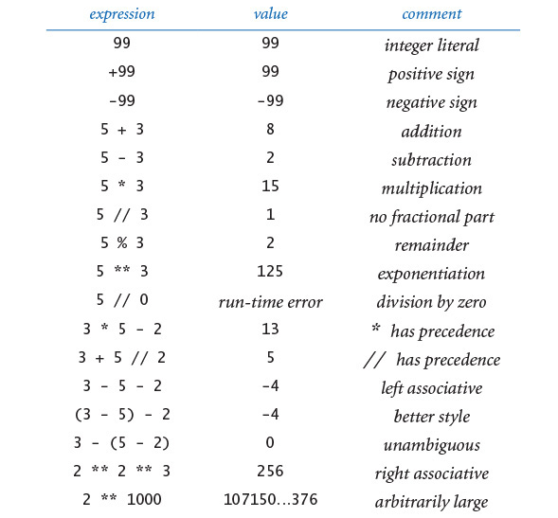
Typical int Expressions

Slide 25
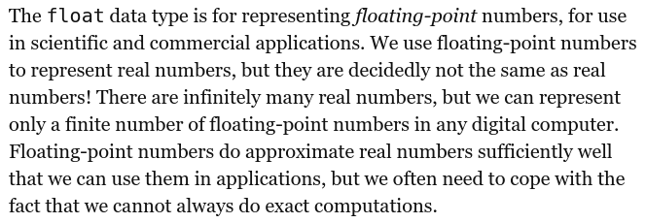
Floating Point Numbers

Slide 26
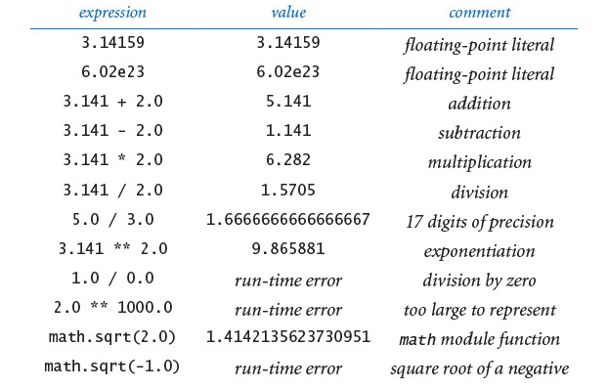
Floating Point Numbers (Cont.)

Slide 27
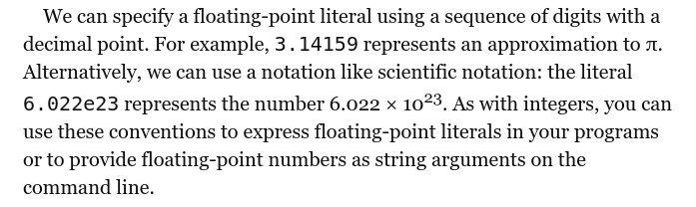
Floating Point Numbers (Cont.)

Slide 28
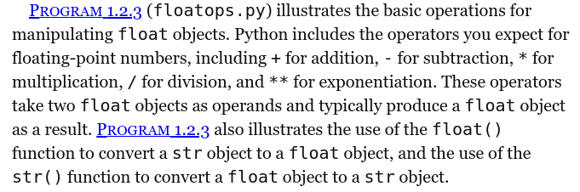
Floating Point Numbers (Cont.)

Slide 29
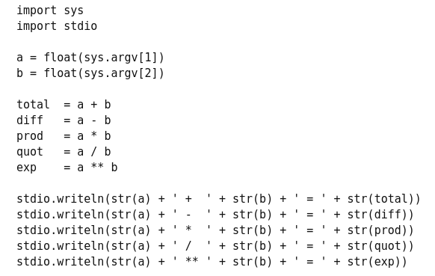
Floating Point Numbers (Cont.)

Slide 30
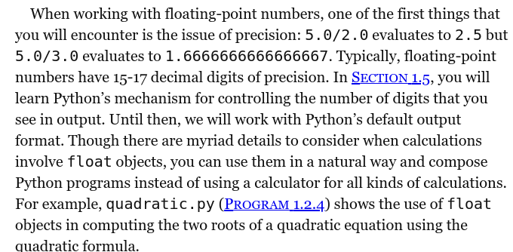
Floating Point Numbers (Cont.)

Slide 31
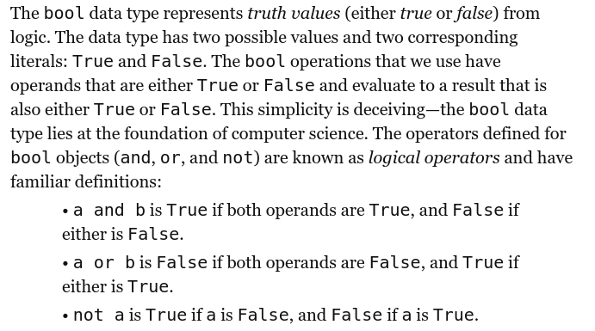
Booleans

Slide 32
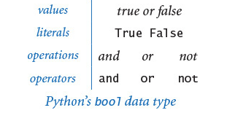
Booleans (Cont.)

Slide 33
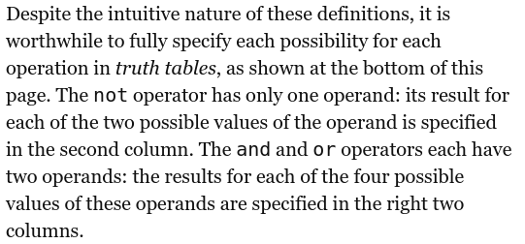
Booleans (Cont.)

Slide 34
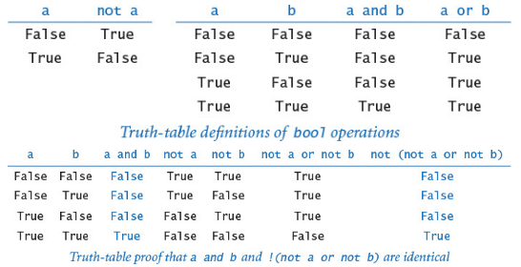
Booleans (Cont.)

Slide 35
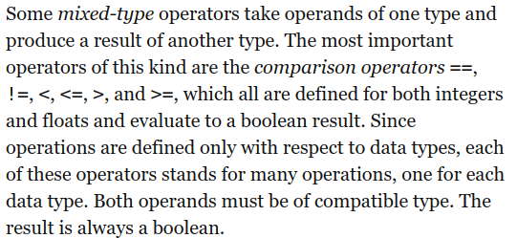
Comparisons

Slide 36
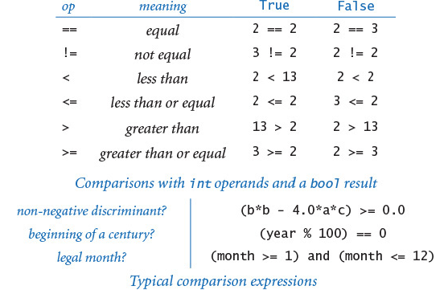
Comparisons (Cont.)

Slide 37
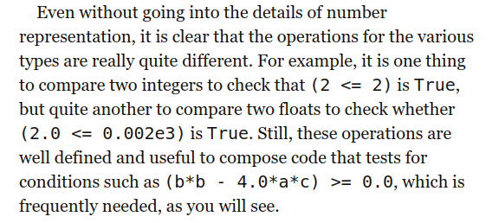
Comparisons (Cont.)

Slide 38
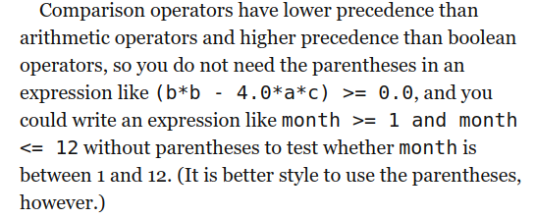
Comparisons (Cont.)

