Slide 2
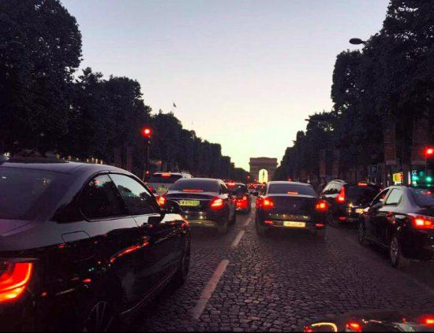


Slide 4
Jeff’s needs and expectations
Each day, Jeff drives about 50 miles and spend an average of 2 hour behind the wheel. Jeff wants to make best use of him time in vehicle.
Jeff wants a life that will make their lives more enjoyable, less stresfull and where they can benefit from the opportunities offered by technology, to make their lives easier.
Jeff wants to be entertained
Peer Influence is important for him
-Jeff
-24 years old
-Likes Technology,
fashion
Do you know what the word ‘fashion’ means ?
In itallian it means “need for change”

Slide 5
What does a “marketplace” mean?
App Store
- Total 3.6 million Apps
- %5.8 of the apps in ’Etertainment’ category.
- $86 billion or 13% of the total (2020).
Google Play Store
- Total 2.4 million Apps
- %5.86 of the apps in ’Etertainment’ category.
$38.8 billion (2020)

Slide 6
What does “in-vehicle purchasing” mean?
By 2023, the global market for in-vehicle transactions is expected to amount to 1 billion U.S. dollars.
Such transactions could include purchasing fuel, food, or parking for example.
These figures serve as a further indication that car manufacturers are beginning to favor cloud-based technologies in their cars.

Slide 7
Evaluation of The Car Entertainment Systems

Slide 8
How to address these needs and expectations
MB Store
Screen Simulation
Marketplace
Product Creation
Basket
Create Order with Payment provider
User authentication via face recognition
in-MVPscope
Next releases

Slide 9

Value Proposition
Value proposition for Mercedes-Benz
New selling point through providing a marketplace including subscribeable features/services.
Value proposition for Consumer
Customizable Atmosphere
Premium Perception and peer influence
Value proposition for App Developer
Income Source
Personal eminence

Slide 10
TECHNOLOGIES

