Slide 1
SEEING
AROUND THE
CORNER
The collision of advancing technology with evolving human behavior and rituals creates moments of opportunity for innovation.
Notes:
OPEN WITH 3 QUESTIONS — HANDS UP. Do not introduce yourself yet.
1. Who here makes an effort to stay on top of new technology and what's coming? (Follow up: how? Newsletters, podcasts, YouTube, reading?)
2. Who notices the little friction points around you? Things that make you think: why do people do it that way? Why is that still so hard? Couldn't that be done better?
Payoff: "Fantastic. You're already halfway there."
3. Who was born after 2006? (Most hands.) "So none of you were alive for any of what I'm about to show you. Good. I'm not here to make you nostalgic. I'm here to show you what a corner looks like BEFORE you turn it."
THEN introduce yourself, briefly: University of Minnesota computer science. IBM. Compaq. Then two decades immersed in product innovation. Here to talk about what it means to see around the corner.
Leave this slide up while you talk. The sentence on screen is the entire talk — do not read it aloud, let them read it.

Slide 2
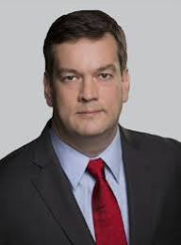
FORREST NORROD
CYRIX
WHERE HE WENT
EVP & GM, Data Center — AMD
Board of Directors — Intuit
Board Member — Intersil
VP & GM, Server Business — Dell
CTO, Client Products — Dell
GM, x86 CPU — National Semi
VLSI Engineer — Hewlett-Packard
11 US patents in system design
MS Electrical Eng — Virginia Tech
30+ years in technology
GM, Integrated x86 CPU Business
Todd's supervisor
DELL
VP & GM, Server Business
Reported to Michael Dell ~10 years
AMD
EVP & GM, Data Center Solutions Business Group
AMD's #2 - runs AI & datacenter

Slide 3
CYRIX: M1 → MEDIAGX
Great technology. Now what?
M1 — PIN-COMPATIBLE x86
MEDIAGX — INTEGRATED x86
North Bridge
MediaGX Processor
Super I/O
x86 Processor
South Bridge
North Bridge + Super I/O
functionality integrated
South Bridge
Pin-compatible with Intel
Could leverage existing PC platforms
Compaq • Gateway • IBM • Dell
OEMs used our compatibility as price leverage on Intel
Struggled to win sockets
Not pin-compatible with Intel
Smaller footprint • lower power • less heat
Significant advantages for portable computing
PC companies wouldn’t invest millions building a unique laptop platform around a small single-source supplier
BUPKIS

Slide 4
1997: THE FIRST CORNER
Watch all the technology advance — not just your own. Watch the rituals change.
THE TECHNOLOGY WAS ADVANCING
THE RITUAL WAS CHANGING
Flat panels just invented
Wireless networking emerging — before 802.11
Touch coming online
Embedded software rendering browsers beyond the PC
Internet use picking up fast
The web becoming a daily habit, not a task
People wanted it in more places than the desk
Computing still tethered to a desktop
BOOM
The internet was ready to leave the desk.
Notes:
THE TEACHING SLIDE. Slow down. This is the longest dwell in the deck besides the props.
Frame it: none of this was secret in 1997. Every item on this slide was sitting in plain sight for anyone who was paying attention.
LEFT — the technology was advancing. Say the line out loud: "Watch all the technology, not just your own." The tech that mattered to me was OUTSIDE my company. That is the difference between an engineer reading a roadmap and an entrepreneur reading a market.
RIGHT — the ritual was changing. Internet use was climbing, the web was becoming a daily habit, and people wanted it in more places than the desk.
BOOM = the collision. Do not explain the WebPad yet. Let the bottom line land: "The internet was ready to leave the desk."
HINDSIGHT GUARD: keep emphasizing what was observable AT THE TIME, before anybody knew the answer. This is the antidote to "well, obviously."
THEN GO TO THE PROPS — off PowerPoint, this slide stays up:
1. Etch A Sketch. The physical origin of the idea in my head. I cannot claim I invented a navigational tablet with a screen — this already existed.
2. WebPad pressboard / development artifact. Idea moving into engineering reality.
3. WebPad Unit 1. "This is what came out of it."
No iPad. Everybody knows what an iPad looks like — showing one dilutes the lesson. The star is the WebPad at the moment the destination was still around the corner.

Slide 5
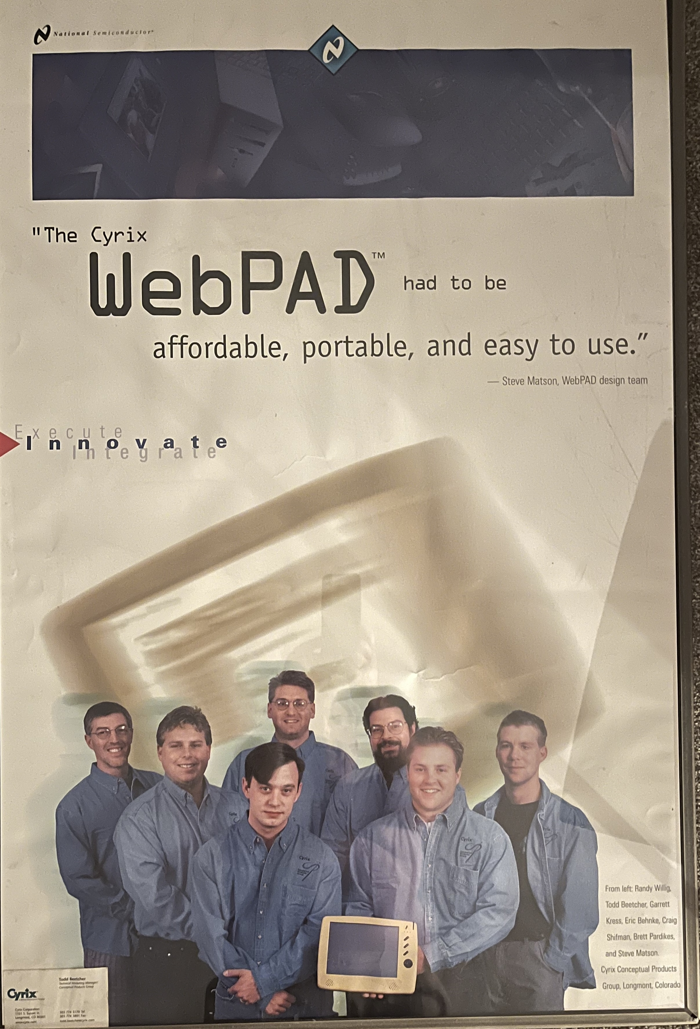
FROM LEFT
Randy Willig
Todd Beetcher
Garrett Kress
Eric Behnke
Craig Shifman
Brett Pardikes
Steve Matson
Cyrix Conceptual Products Group
Longmont, Colorado
Cyrix Conceptual Products Team • 1997–98
Notes:
THE PROPS COME BEFORE THIS SLIDE. Etch A Sketch, then the pressboard artifact, then WebPad Unit 1. Full notes are on the 1997 collision slide.
This slide is the credit beat. Keep it short.
"And I didn't do this myself. These are the people who actually made it happen."
Cyrix Conceptual Products Group, Longmont, Colorado, 1997-98. Mention Longmont — it is local to this room.
Purpose: innovation becomes real through teams, not through one person's insight. This slide is what keeps the WebPad story from sounding self-congratulatory. Do not read all seven names unless a student asks.
Then move to the three follow-on examples — 15 to 30 seconds each, no war stories.

Slide 6

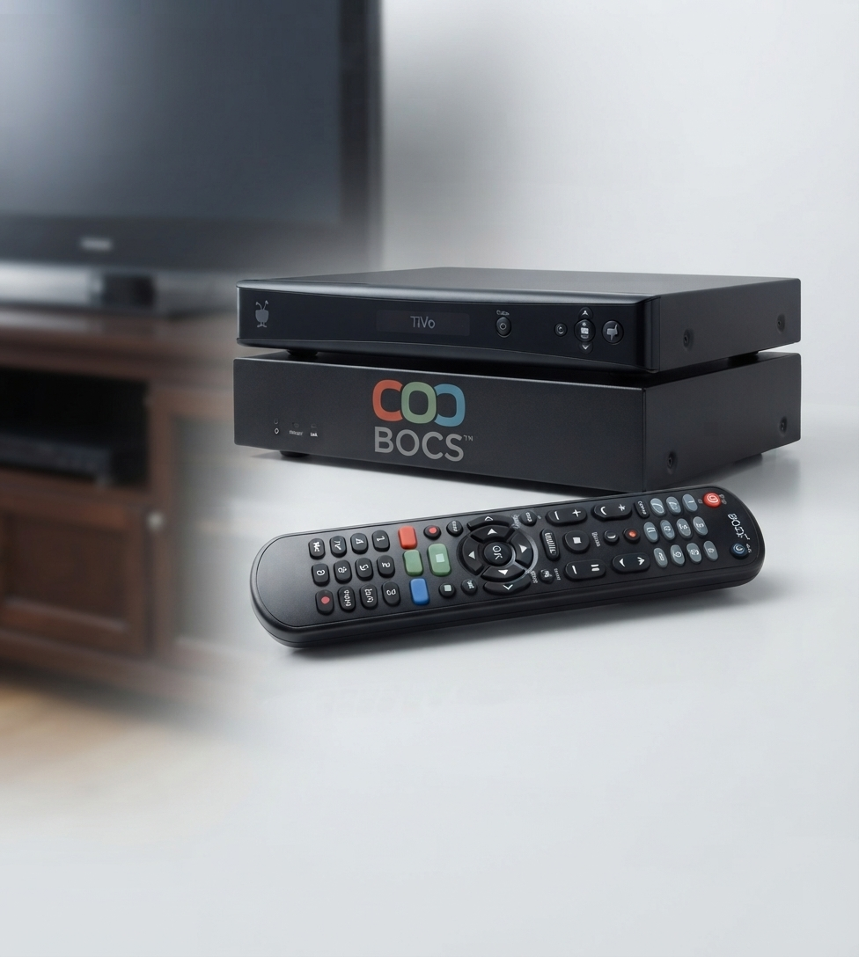
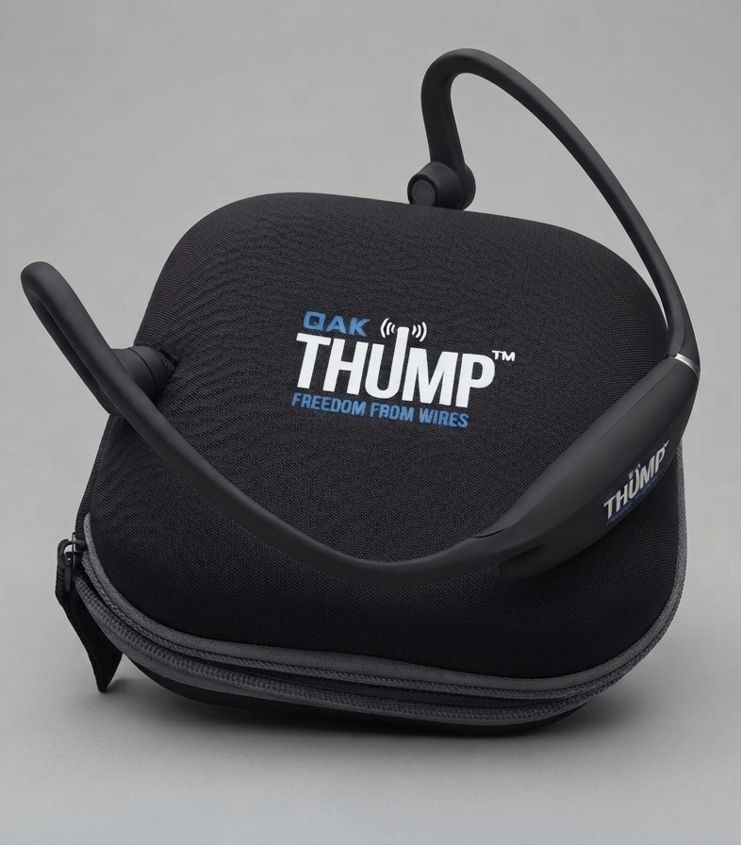
THREE MORE CORNERS
[ ZUM PRODUCT PHOTO ]
[ BOCS PRODUCT PHOTO ]
[ THUMP PRODUCT PHOTO ]
ZUM
BOCS
THUMP
2003
2006
2010
Adult sports nutrition
the rise of youth sports
TiVo
entertainment moving beyond one room
Bluetooth
endurance athletes going digital

Slide 7
AND THEN AI HIT THE GAS
Not one more technology to watch — an accelerant under all of them.
COMBUSTION
ENGINES
VEHICLES
One new capability. Decades of products nobody had imagined yet.
AI
EVERY FIELD ADVANCES FASTER
YOUR CORNER
Materials science • Mining
Energy • Robotics
Same pattern. Faster clock. And it is not only AI that is advancing.
There has never been a better ten years to look around the corner.

Slide 8
SEEING
AROUND THE
CORNER
The collision of advancing technology with evolving human behavior and rituals creates moments of opportunity for innovation.
I hope you see
around the corner.

