Slide 1
SEEING
AROUND THE
CORNER
The collision of advancing technology with evolving human behavior and rituals creates moments of opportunity for innovation.
Notes:
OPEN WITH 3 QUESTIONS — HANDS UP. Do not introduce yourself yet.
1. Who here makes an effort to stay on top of new technology and what's coming? (Follow up: how? Newsletters, podcasts, YouTube, reading?)
2. Who notices the little friction points around you? Things that make you think: why do people do it that way? Why is that still so hard? Couldn't that be done better?
Payoff: "Fantastic. You're already halfway there."
3. Who was born after 2006? (Most hands.) "So none of you were alive for any of what I'm about to show you. Good. I'm not here to make you nostalgic. I'm here to show you what a corner looks like BEFORE you turn it."
THEN introduce yourself, briefly: University of Minnesota computer science. IBM. Compaq. Then two decades immersed in product innovation. Here to talk about what it means to see around the corner.
Leave this slide up while you talk. The sentence on screen is the entire talk — do not read it aloud, let them read it.

Slide 2
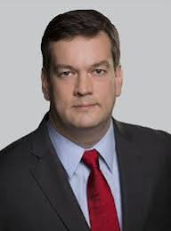
FORREST NORROD
CYRIX
WHERE HE WENT
EVP & GM, Data Center — AMD
Board of Directors — Intuit
Board Member — Intersil
VP & GM, Server Business — Dell
CTO, Client Products — Dell
GM, x86 CPU — National Semi
VLSI Engineer — Hewlett-Packard
11 US patents in system design
MS Electrical Eng — Virginia Tech
30+ years in technology
GM, Integrated x86 CPU Business
Todd's supervisor
DELL
VP & GM, Server Business
Reported to Michael Dell ~10 years
AMD
EVP & GM, Data Center Solutions Business Group
AMD's #2 - runs AI & datacenter
Notes:
THE PROTAGONIST. Forrest Norrod is the person who handed me the problem that led to all of this. Walk the trajectory quickly: Cyrix -> Dell (VP & GM, Server Business, reporting to Michael Dell for about a decade) -> AMD (EVP & GM, Data Center Solutions -- AMD's #2, runs AI and datacenter).
Point: this is where that 1997 story leads. Now go backward -- to the moment when Forrest had a problem and I worked for him.

Slide 3
CYRIX: M1 → MEDIAGX
Great technology. Now what?
M1 — PIN-COMPATIBLE x86
MEDIAGX — INTEGRATED x86
North Bridge
MediaGX Processor
Super I/O
x86 Processor
South Bridge
North Bridge + Super I/O
functionality integrated
South Bridge
Pin-compatible with Intel
Could leverage existing PC platforms
Compaq • Gateway • IBM • Dell
OEMs used our compatibility as price leverage on Intel
Struggled to win sockets
Not pin-compatible with Intel
Smaller footprint • lower power • less heat
Significant advantages for portable computing
PC companies wouldn’t invest millions building a unique laptop platform around a small single-source supplier
BUPKIS
Notes:
THE SETUP. Cyrix built the M1 -- pin-compatible with Intel, so PC makers (Compaq, Gateway, IBM, Dell) could slot it straight in. But OEMs mostly used that compatibility as price leverage against Intel, not real volume. We kept struggling to win sockets.
Forrest's answer: MediaGX -- integrate the North Bridge and Super I/O functionality into the processor itself. Smaller footprint, lower power, less heat. Real advantages for portable computing.
But it broke pin-compatibility. Now we were asking PC companies to invest millions building a unique laptop platform around one small single-source supplier.
Commercial response: BUPKIS. Let that word sit -- it's funny, and it's true. Now there's millions of dollars of processor development and no product. My job: "crap, now what are we going to do?"

Slide 4
1997: THE FIRST CORNER
Watch all the technology advance — not just your own. Watch the rituals change.
THE TECHNOLOGY WAS ADVANCING
THE RITUAL WAS CHANGING
Flat panels just invented
Wireless networking emerging — before 802.11
Touch coming online
Embedded software rendering browsers beyond the PC
Internet use picking up fast
The web becoming a daily habit, not a task
People wanted it in more places than the desk
Computing still tethered to a desktop
BOOM
The internet was ready to leave the desk.
Notes:
THE TEACHING SLIDE. Slow down. This is the longest dwell in the deck besides the props.
Frame it: none of this was secret in 1997. Every item on this slide was sitting in plain sight for anyone who was paying attention.
LEFT — the technology was advancing. Say the line out loud: "Watch all the technology, not just your own." The tech that mattered to me was OUTSIDE my company. That is the difference between an engineer reading a roadmap and an entrepreneur reading a market.
RIGHT — the ritual was changing. Internet use was climbing, the web was becoming a daily habit, and people wanted it in more places than the desk.
BOOM = the collision. Do not explain the WebPad yet. Let the bottom line land: "The internet was ready to leave the desk."
HINDSIGHT GUARD: keep emphasizing what was observable AT THE TIME, before anybody knew the answer. This is the antidote to "well, obviously."
THEN GO TO THE PROPS — off PowerPoint, this slide stays up:
1. Etch A Sketch. The physical origin of the idea in my head. I cannot claim I invented a navigational tablet with a screen — this already existed.
2. WebPad pressboard / development artifact. Idea moving into engineering reality.
3. WebPad Unit 1. "This is what came out of it."
No iPad. Everybody knows what an iPad looks like — showing one dilutes the lesson. The star is the WebPad at the moment the destination was still around the corner.

Slide 5
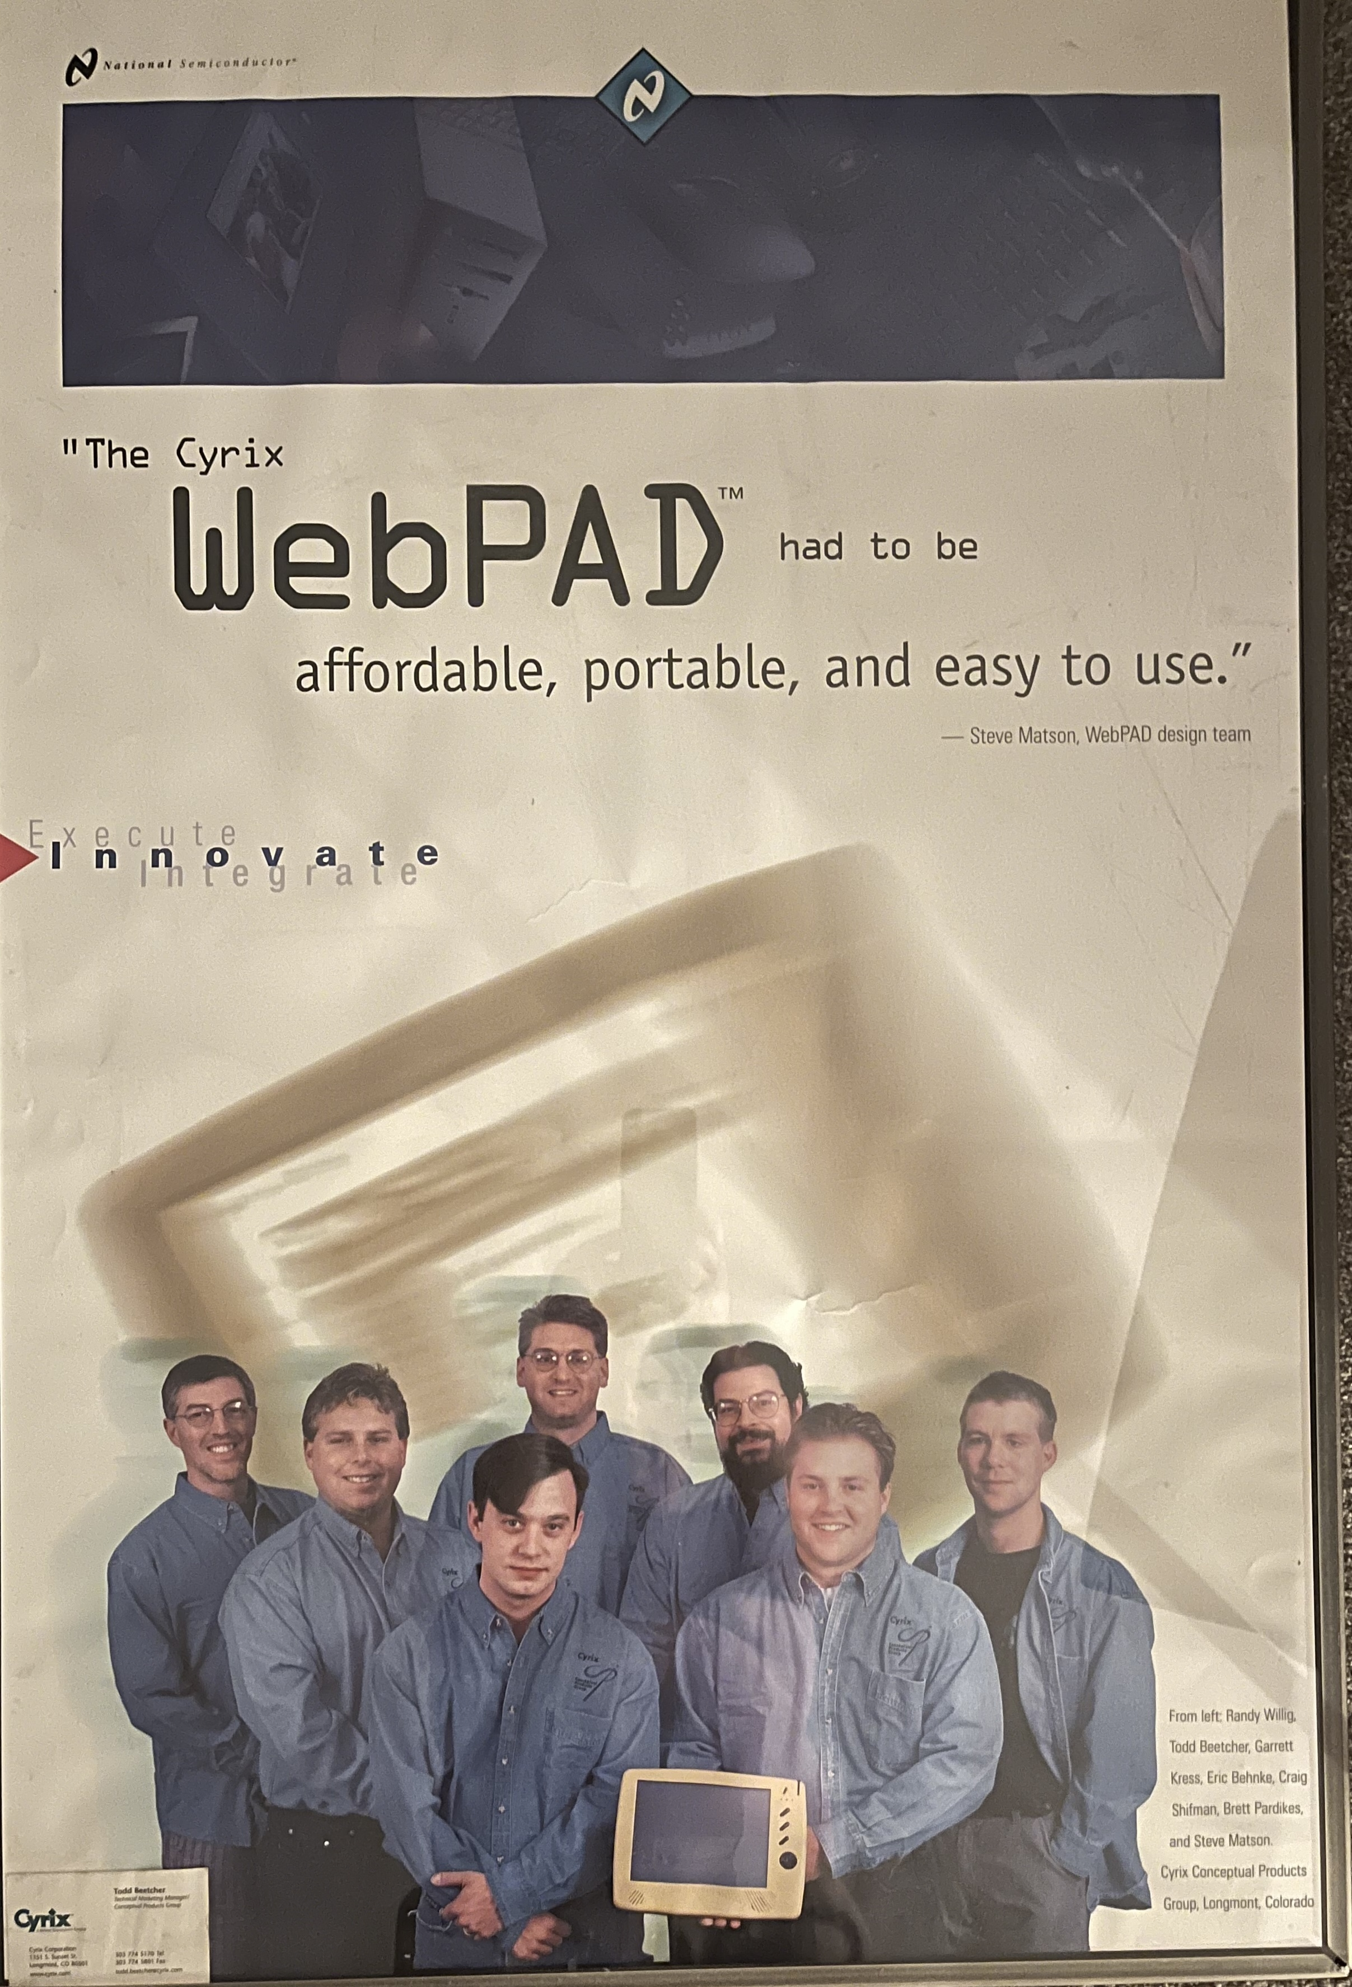
FROM LEFT
Randy Willig
Todd Beetcher
Garrett Kress
Eric Behnke
Craig Shifman
Brett Pardikes
Steve Matson
Cyrix Conceptual Products Group
Longmont, Colorado
Cyrix Conceptual Products Team • 1997–98
Notes:
THE PROPS COME BEFORE THIS SLIDE. Etch A Sketch, then the pressboard artifact, then WebPad Unit 1. Full notes are on the 1997 collision slide.
This slide is the credit beat. Keep it short.
"And I didn't do this myself. These are the people who actually made it happen."
Cyrix Conceptual Products Group, Longmont, Colorado, 1997-98. Mention Longmont — it is local to this room.
Purpose: innovation becomes real through teams, not through one person's insight. This slide is what keeps the WebPad story from sounding self-congratulatory. Do not read all seven names unless a student asks.
Then move to the three follow-on examples — 15 to 30 seconds each, no war stories.

Slide 6

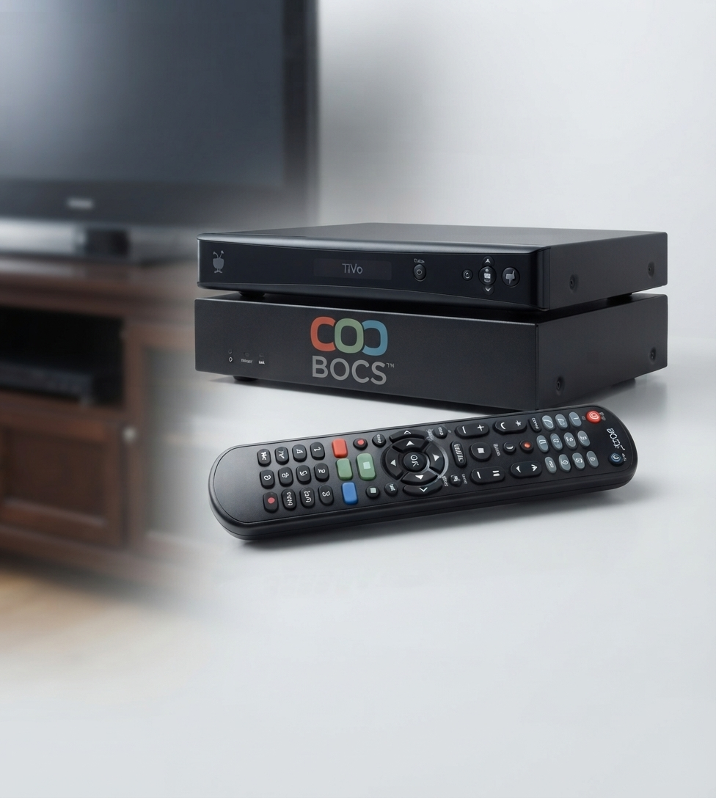
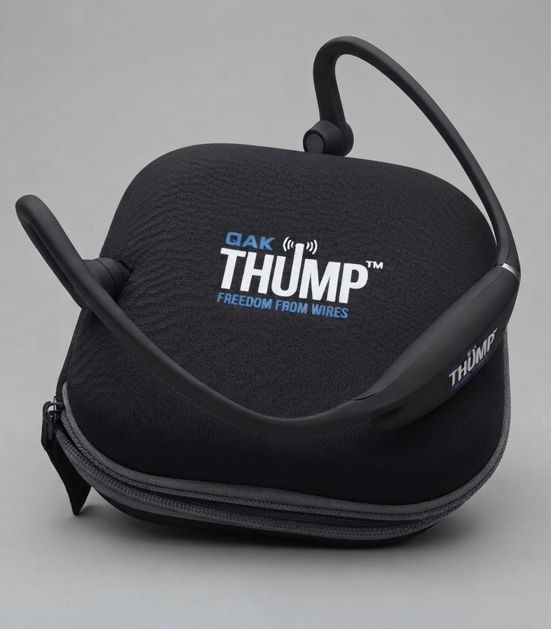
THREE MORE CORNERS
[ ZUM PRODUCT PHOTO ]
[ BOCS PRODUCT PHOTO ]
[ THUMP PRODUCT PHOTO ]
ZUM
BOCS
THUMP
2003
2006
2010
Adult sports nutrition
the rise of youth sports
TiVo
entertainment moving beyond one room
Bluetooth
endurance athletes going digital
Notes:
15-30 SECONDS EACH. Not three more war stories -- proof the pattern repeats.
ZUM (2003) -- adult sports nutrition was advancing, youth sports nutrition hadn't caught up. Watching my own kids and other young athletes. Built a sports-nutrition product for kids.
BOCS (2006) -- TiVo arrives while I'm training for Ironman. I wanted it in one room, Suzanne wanted it in another. Moving the box around was the friction. New entertainment tech collides with ordinary household behavior -> whole-home distribution.
THUMP (2010) -- digital music goes pervasive while I'm deep into endurance sports. Cords are a nuisance; I'm using a business Bluetooth headset just to work out. Bluetooth + digital music + endurance athletics collide -> wireless sports audio.
The pattern: sometimes someone hands you the problem (Forrest). Sometimes you live the friction yourself (BOCS, THUMP). Sometimes you watch it happen to someone you care about (ZUM).

Slide 7
AND THEN AI HIT THE GAS
Not one more technology to watch — an accelerant under all of them.
COMBUSTION
ENGINES
VEHICLES
One new capability. Decades of products nobody had imagined yet.
AI
EVERY FIELD ADVANCES FASTER
YOUR CORNER
Materials science • Mining
Energy • Robotics
Same pattern. Faster clock. And it is not only AI that is advancing.
There has never been a better ten years to look around the corner.
Notes:
AI IS THE ACCELERANT, NOT THE TOPIC. Don't give them another generic "AI changes everything" talk.
AI speeds up every field, not just software -- materials science, mining, energy, robotics are your corners in this room. Same pattern, faster clock.
There has never been a better ten years to look around the corner.

Slide 8
SEEING
AROUND THE
CORNER
The collision of advancing technology with evolving human behavior and rituals creates moments of opportunity for innovation.
I hope you see
around the corner.
Notes:
MIRROR SLIDE 1. Same sentence, now loaded with meaning from the stories.
Hand it back to them:
Immerse yourself in the technology.
Remember to look up.
Watch what people are doing. Watch how rituals are changing.
Notice what frustrates them. Notice what suddenly became possible. Notice what no longer makes sense.
Sometimes someone hands you the problem. Sometimes you experience it yourself. Sometimes you see it affecting someone you care about.
Every once in a while, you will see the collision before everybody else.
"I hope you see around the corner."
Leave this up through Q&A.

